Slide 1
Cell Membrane by Dr.Vani Gupta

Slide 2
Cell Membrane
cell membrane is the boundary
separate cell from its environment
All cells have a cell membrane made of proteins and lipids

Slide 3
DIFFERENT MODEL
Overton(1902) postulated that the plasma membrane is composed of a thin layer of lipid.
Danielli and Davson(1935) proposed the trilamillar model.
Robertson(1959)proposed the Unit membrane concept.
Singer and Nicolson(1972) put farward the fluid mosaic of membrane structure .it is the most widely accepted model.

Slide 4
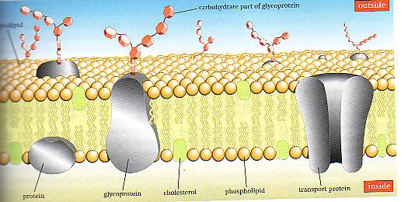
FLUID MOSAIC MODEL
Fluid-because individual phospholipids and protein can move side-to-side with in the layer, like its a liquid.
Mosaic- because of pattern produced by the scattered protein molecules when the membrane veiwed below.

Slide 5
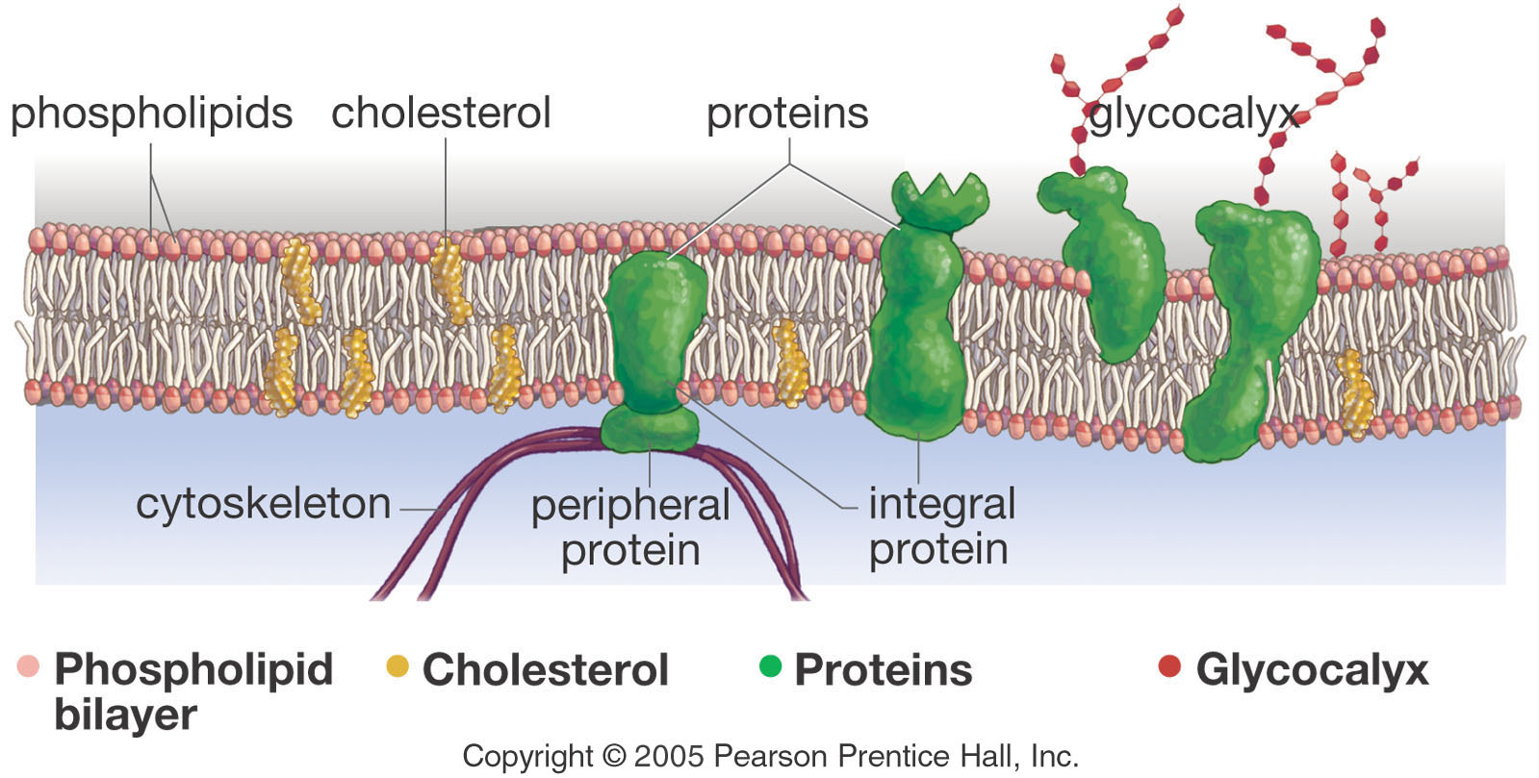
Cell Membrane Component

Slide 6
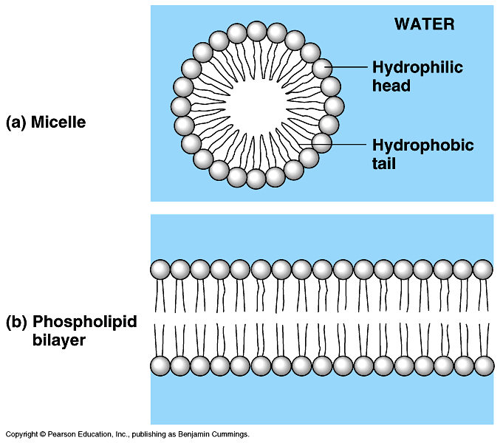
Lipids of cell membrane
Membrane is made of special kind of lipid
  phospholipids
Membrane is a double layer
  phospholipid bilayer
inside cell
outside cell

Slide 7
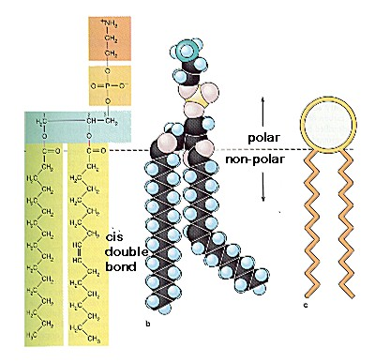
Phospholipids
Phospholipid make up the cell membrane.
Contain two fatty acid chain that are non polar .
Head is a polar and contain phosphate group and glycerol.

Slide 8
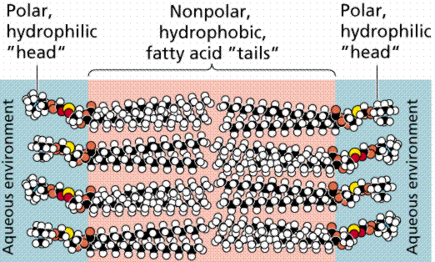
Polar head are hydrophilic “water loving”
Nonpolar tails are hydrophobic “water fearing”

Slide 9
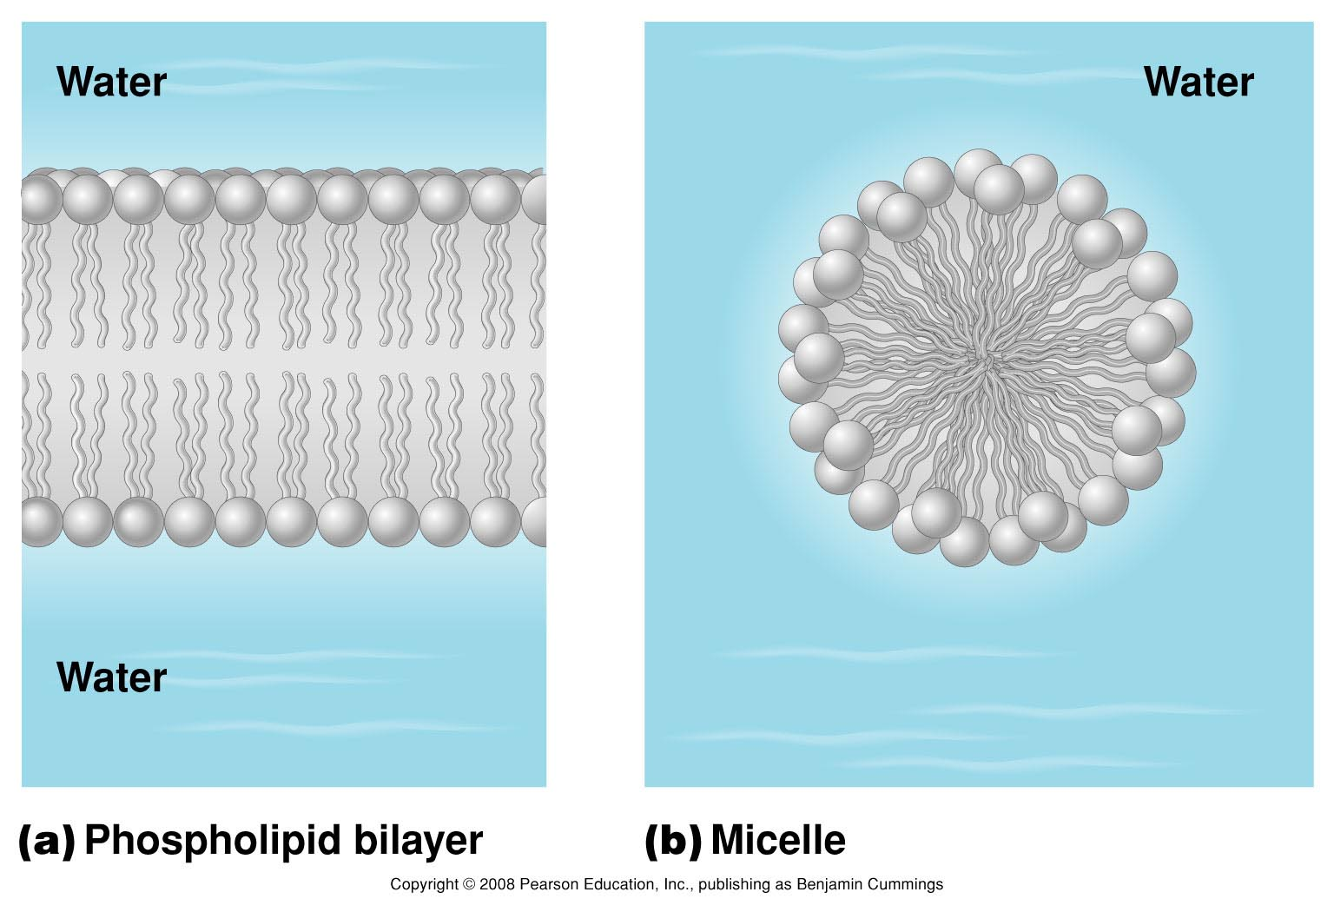
Stable phospholipid organizations

Slide 10
Membrane fluidity
Two factors that are determine fluidity are
1-The length of fatty acid chain.
2-The degree of un-saturation (simply number of double bond)

Slide 11
cell needs materials in & products or waste out
IN
food
- sugars
- proteins
- fats
salts
O₂
H₂O
OUT
waste
- ammonia
- salts
- CO₂
- H₂O
products
- proteins

Slide 12
Semi-permeable membrane
Cell membrane is a semi-permeable membrane.
Cell membrane controls what gets in or out
Need to allow some materials but not all to pass through the membrane
    only some material can get in or out
sugar
lipids
aa
O₂
H₂O
salt
waste

Slide 13
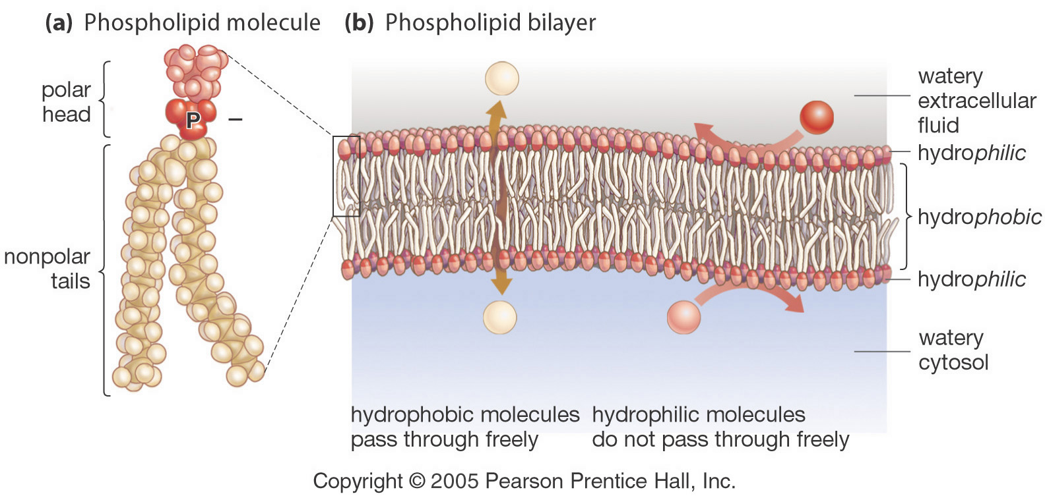
Semipermeable Membrane
Small molecules and larger hydrophobic molecules move through easily.
e.g. O₂, CO₂, H₂O

Slide 14
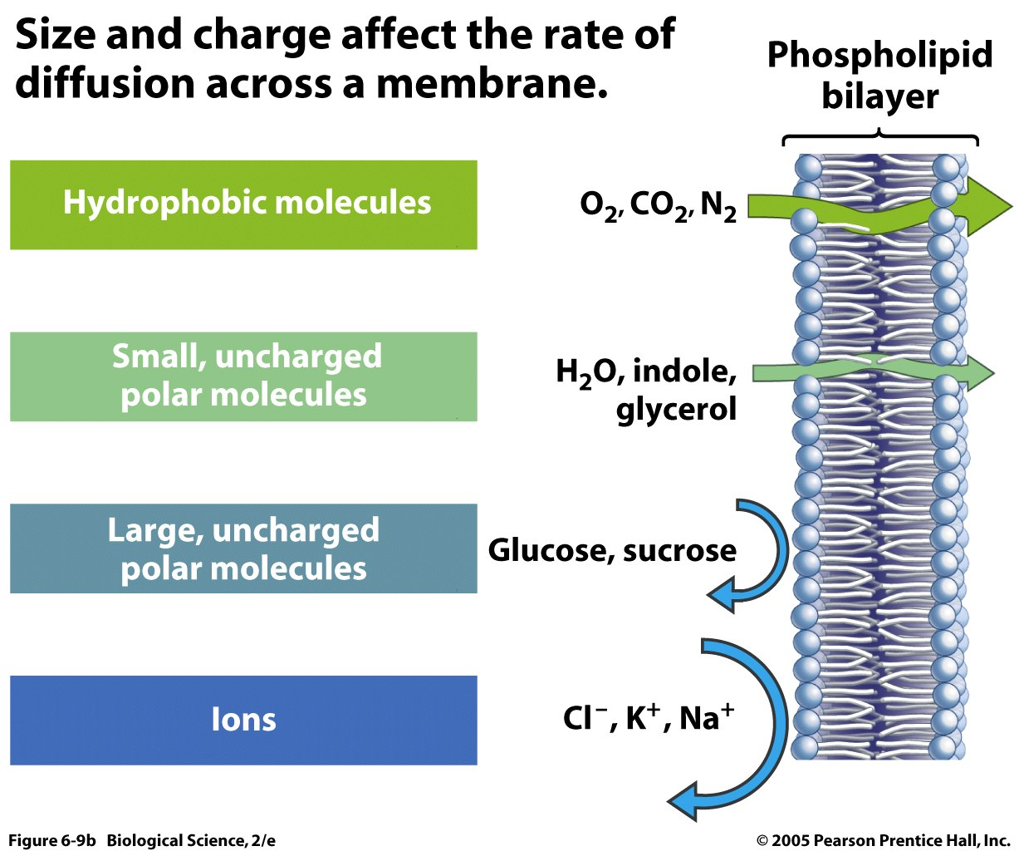

Slide 15
Function of the cell membrane
Protective barrier
Regulate transport in & out of cell (selectively permeable)
Allow cell recognition
Provide anchoring sites for filaments of cytoskeleton
Provide a binding site for enzymes
Interlocking surfaces bind cells together (junctions)
Contains the cytoplasm (fluid in cell)
Cell membrane separates the components of a cell from its environment—surrounds the cell
“Gatekeeper” of the cell—regulates the flow of materials into and out of cell—selectively permeable
Cell membrane helps cells maintain homeostasis—stable internal balance

Slide 16
Q-1 which one of the following is not amembranelipid
a-cholestrol
b-phosphoglyceride
c-cerebroside
d-choline

Slide 17
Q-2in plasma membrane ,carbohydrate present on the
a-both layer
b-only on cytoplasmic side of lipid bilayer
c-only on non cytoplasmic side of lipid bilayer
d-none
Ans-c

Slide 18
Q-3carbohydrate present on the plasma membrane
a-have structural role
b-forms channel
c-act as carrier
d-help in molecular recognization
Ans-d

Slide 19
Q-4Generally accepted features of biological membrane include all of the following except
asymmetric arrangement of lipid
b-rapid diffusion of inorganic ions across lipid bilayer
lateral diffusion of lipid
d-lateral diffusion of integral and peripheral proteins.
Ans-b

Slide 20
Q5-The plasma membrane is impermeable to all molecule except.
a-glucose
b-ATP
c-urea
d-K
Ans-c

Slide 21
Q6-Which of the following statements best describes the fluid mosaic model of the plasma membrane?
a-A single layer of lipids surrounding a layer of proteins.
b- A single layer of proteins surrounding a single layer of lipids.
c- A lipid bilayer with protein molecules dispersed within it.
d-A single layer of proteins with lipid molecules dispersed within.
e- A protein bilayer sandwiching a layer of lipids.
Ans-c

Slide 22
Q7-Which item below is NOT a function performed by proteins found in the plasma membrane?
a-Receptor for chemical messenger molecules
b-Joining of adjacent cells
c-Transport of solutes.
d-Attachment site for cytoskeleton
e-Synthesis of proteins.
Ans-e

Slide 23
Q8-Which of the following molecular components of the lipid bilayer of the plasma membrane possesses a charged polar "head" and an uncharged non-polar "tail"?
a- Integralprotein
b-Glycolipid
c- Cholesterol
d-Phospholipid
e-Glycoprotein
Ans-d

Slide 24
Q9- Selectively permeable membrane means
a-only certain substances can pass through the membrane
b-all substances can pass through the membrane
c- the membrane forms a seal keeping all materials contained at all times
Ans-a

Slide 25
Q10-A substance can cross the cell membrane when it is aided by one of these
a-transport protein
b- isotonic solution
c- lipid bilayer
Ans-a

