Slide 1
Cell Physiology for BDS-2015
by Dr Pradeep Kumar
Professor in Physiology, KGMU, Lucknow India

Slide 2
Lecture -1
Cell-Structure & functions

Slide 3
What is Cell?
The cell is the functional basic unit of life. It was discovered by Robert Hooke and is the functional unit of all known living organisms. It is the smallest unit of life that is classified as a living thing, and is often called the building block of life.

Slide 4
Unicellular and multicellular
Organisms, such as most bacteria, are unicellular (consist of a single cell). Other organisms, such as humans, are multicellular. Humans have about 100 trillion cells

Slide 5
Discovery of cell
The descriptive term for the smallest living biological structure was coined by Robert Hooke in a book he published in 1665 when he compared the cork cells he saw through his microscope to the small rooms monks lived in.

Slide 6
Types of Cell
There are two types of cells: eukaryotic and prokaryotic. Prokaryotic cells are those cells which have nuclear material without nuclear membrane. For ex- bacteria and blue green algae. The cell having well- organized nucleus with a nuclear membrane are called eukaryotic cells.

Slide 7
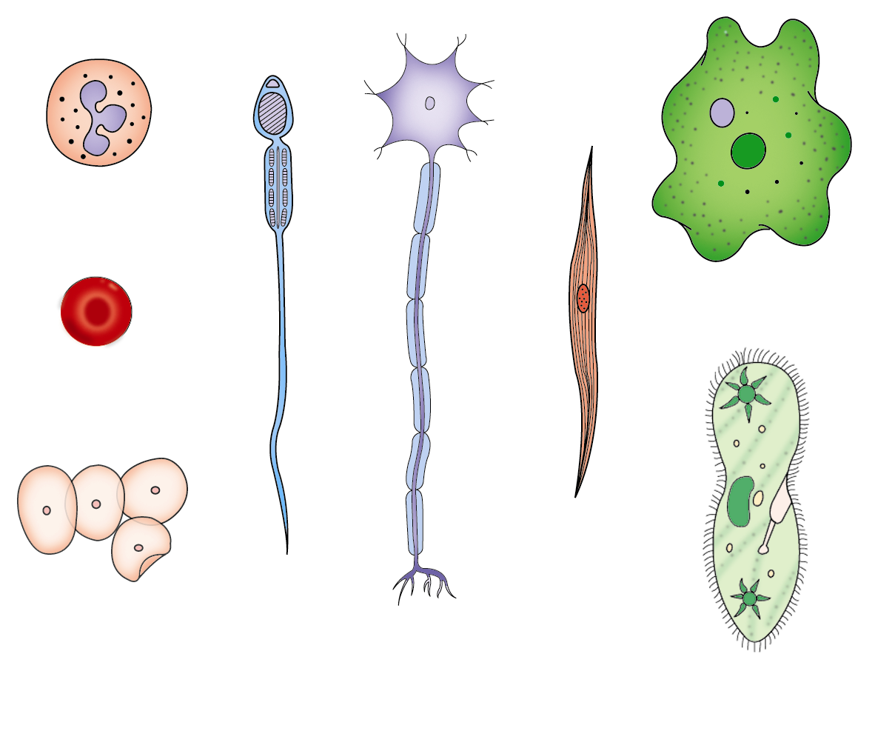
Types of cell
white blood cell
Amoeba
red blood cell
muscle cell
sperm
cheek cells
nerve cell
Paramecium

Slide 8
Shape of cells
Generally, cells are round, spherical or elongated some cells are long and pointed at both ends. They exhibit a spindle shape. Cells sometimes are quite long. Some are branched like nerve cells or a neuron. Some are sphere like RBC.

Slide 9
Organelles of Cell
Very small size
Can only be observed under a microscope
Have specific functions
Found throughout cytoplasm
Endoplasmic reticulum (rough & smooth) ; Golgi Bodies;Nucleolus; Lysosomes; Ribosomes

Slide 10
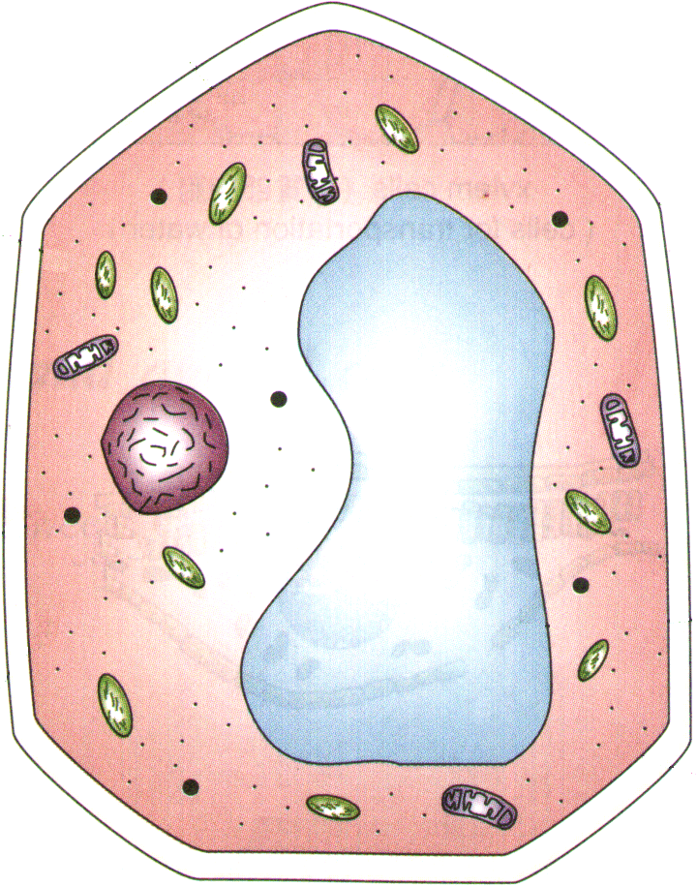
Cytoplasm of a Cell
Jelly-like substance enclosed by cell membrane
Provides a medium for chemical reactions to take place
Cytoplasm

Slide 11
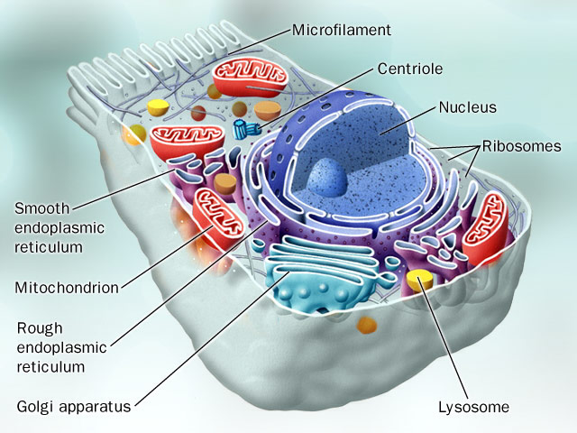

Slide 12
Cell nucleus
The cell nucleus is the most conspicuous organelle found in a eukaryotic cell. It houses the cell's chromosomes, and is the place where almost all DNA replication and RNA synthesis (transcription) occur. The nucleus is spherical and separated from the cytoplasm by a double membrane called the nuclear envelope.

Slide 13
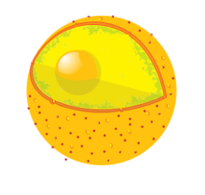

Slide 14
Nucleolus
Cell may have 1 to 3 nucleoli
Inside nucleus
Disappears when cell divides
Makes ribosomes that make proteins

Slide 15
Mitochondria
Mitochondria are present in eukaryotes only. Mitochondria are self-replicating organelles that occur in various numbers, shapes, and sizes in the cytoplasm of all eukaryotic cells. Mitochondria play a critical role in generating energy in the eukaryotic cell.

Slide 16
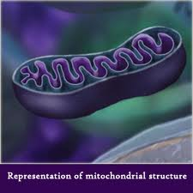

Slide 17
Endoplasmic reticulum
The ER has two forms: the rough ER, which has ribosomes on its surface and secretes proteins into the cytoplasm, and the smooth ER, which lacks them. Smooth ER plays a role in calcium sequestration and release.

Slide 18
Endoplasmic reticulum

Slide 19
The ribosome
The ribosome is a large complex of RNA and protein molecules. They each consist of two subunits, and act as an assembly line where RNA from the nucleus is used to synthesize proteins from amino acids. Ribosomes can be found

Slide 20
Ribosomes

Slide 21
Lysosomes and Peroxisomes
Lysosomes and Peroxisomes are present in eukaryotes only. Lysosomes contain digestive enzymes (acid hydrolases). They digest excess or worn-out organelles, food particles, and engulfed viruses or bacteria. Peroxisomes have enzymes that rid the cell of toxic peroxides.

Slide 22
Lysosomes and Peroxisomes

Slide 23
Golgi Bodies
Stacks of flattened sacs
Have a shipping side & a receiving side
Receive & modify proteins made by ER
Transport vesicles with modified proteins pinch off the ends
Transport vesicle

Slide 24
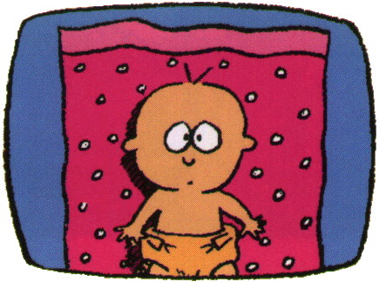
It’s You!
Thank You

