Slide 1
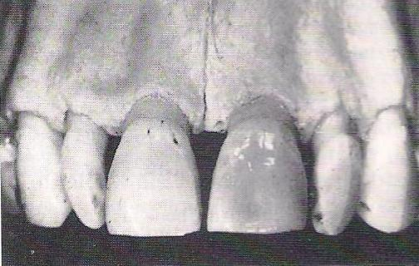
Alveolar bone/ Alveolar process

Slide 2
Is the portion of maxilla and mandible that forms and supports the tooth socket (alveoli).
It forms when tooth erupts to provide the osseous attachment to the forming PDL; It disappears gradually after tooth is lost.

Slide 3
Development
The alveolar bone begins to first form by an intramembranous ossification with in the ectomesenchyme surrounding the developing tooth.
This first formed bone is called as woven bone is less organized and is replaced with more organized lamellar one.

Slide 4
When a deciduous tooth is shed, its alveolar bone is resorbed. The succedaneous permanent tooth moves in to place, developing its own alveolar bone from its own dental follicle.
Mandibular basal bone begins mineralization at the exit of mental nerve from mental foramen.
Maxillary basal bone begins at the exit of infraorbital nerve from infraorbital foramen

Slide 5
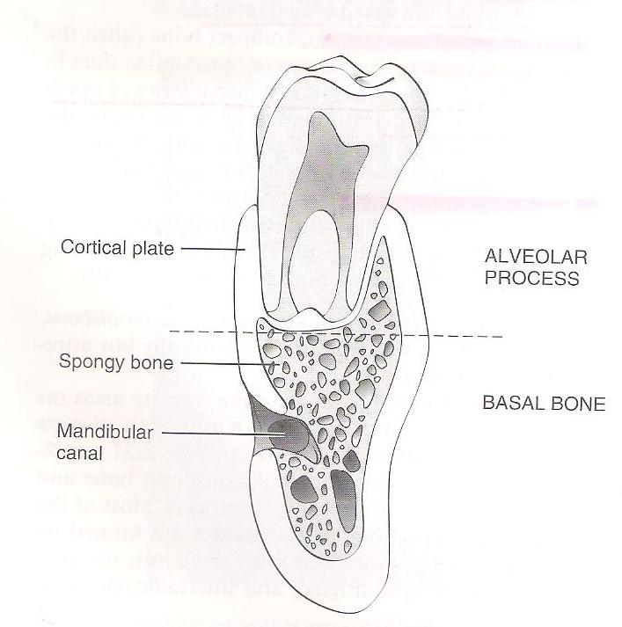
Parts
Alveolar bone proper
Supporting alveolar bone
- Cortical plates
- Spongy bone

Slide 6
Composition
Inorganic Organic
(65%) (35%)
Cellular components-
Osteoblast
Osteocytes
Bone lining cells
Osteoclast
Osteoprogenitor Cells

Slide 7
Periosteum
The tissue covering the outer surface of bone is called periosteum.
Consists of two layers-
- inner layer
- outer layer

Slide 8
Endosteum
Tissue lining the internal bone cavities is called as endosteum.
Made up of single layer of osteoblast and small amount of connective tissue.

Slide 9
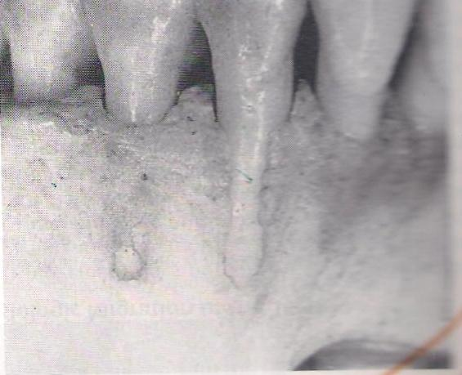
Fenestration
Isolated areas in which the root is denuded of bone and the root surface is covered only by periosteum and overlying gingiva.
In these areas the marginal bone is intact

Slide 10
Dehiscence
When the denuded areas extend through the marginal bone, the defect is called as dehiscence.

Slide 11
1. The inactive osteoblasts are-
Osteocytes
Osteoclasts
Osteoprogenitor cells
Bone lining cells

Slide 12
2. The term lamina dura refers to the radiographic image of
Periodontal ligament space
Cortical plates
Cancellous bone
Alveolar crest

Slide 13
3.Following is true about osteoclast except
Mononucleated cells
having branching processes
Derived from circulating blood cells monocytes
found in Howship’s lacunae

Slide 14
4. Main type of collagen in bone and ligament are respectively
Type I and type II
(b)Type II and type I
(c) Type II in both
(d) Type I in both

Slide 15
5. The enzyme closely associated with the new bone formation is
Acid phosphatase
(b) Alkaline phosphatase
(c) Succinic dehydrogenase
(d) Both A and B

Slide 16
THANK YOU

