Slide 1
Spinal Cord Injury

Slide 2
Partial or complete disruption of spinal cord resulting in paralysis, sensory loss, altered autonomic and reflex activities.

Slide 3
Introduction :
2 General Classifications
Complete Lesion
Incomplete Lesion
A lesion to the spinal cord where there is no preserved motor or sensory function below the level of lesion
A lesion to the spinal cord with incomplete damage to the cord. There may be scattered motor function, sensory function or both below the level of lesion

Slide 4
SCI common terminology

Slide 5
Cauda Equina Injuries: a term used to describe injuries that occur below the L1 level of the spine (LMN)
Dermatome: Designated sensory areas based on spinal segment innervation
Myotome: Designated motor areas based on spinal segment innervation
Neurologic level: the lowest segment of the spinal cord with intact strength and sensation. Muscle groups at this level must receive a grade of 3
Paraplegia: a term used to describe injuries that occur at the level of the thoracic lumber or sacral spine

Slide 6
Epidemiology/etiology

Slide 7
Epidemiology
Vertebral column injuries are reported to occur in 6% of trauma patients
Half of these patients sustain spinal cord or nerve root injury

Slide 8
Spinal Cord Injuries
Most common locations: cervical (1&2), cervical (4-7), and T12 – L2 vertebrae
Cervical and lumbar spine injuries are often associated with incomplete cord injury while thoracic injuries often have complete cord injury.
Notes:
8

Slide 9
Mode of Injury
Accidents (RTA)(45%)
Domestic / Industrial Accidents (34%)
Sport Injury 15%
Assault 6%

Slide 10
PATHOPHYSIOLOGY OF SPINAL CORD INJURY
Neural tissue injuries
  Primary injury – refers to physical tissue disruption caused by mechanical forces
  Secondary injury – refers to additional neural tissue damage resulting from the biological response initiated by the physical tissue disruption e.g. edema

Slide 11
Anatomy of the spinal cord

Slide 12
Gross Anatomy
  Sagittal Diameter: 7-12 mm
  Cervical Enlargement: C3-T2 level
  Lumbar Enlargement: T10-T12 level
  Length: approximately 45cm. From foramen magnum to L1-L2 vertebrae
Vascular Supply
  1 anterior spinal artery which supplies the anterior 2/3 of the cord
  2 posterior spinal arteries which supply the posterior 1/3 of the cord
  Both anterior and posterior arteries receive reinforcement from the Radicular Artery
  Spinal vertebral venous plexus to the azygous vein

Slide 13
Internal Anatomy
  Gray Matter – neuronal cell bodies & synapses
    Anterior Horn – motor neurons
    Posterior Horn – sensory neurons
  White Matter – ascending & descending fiber pathways
    Ascending – relays sensory information to the brain
    Descending – relays motor information down to the cord

Slide 14
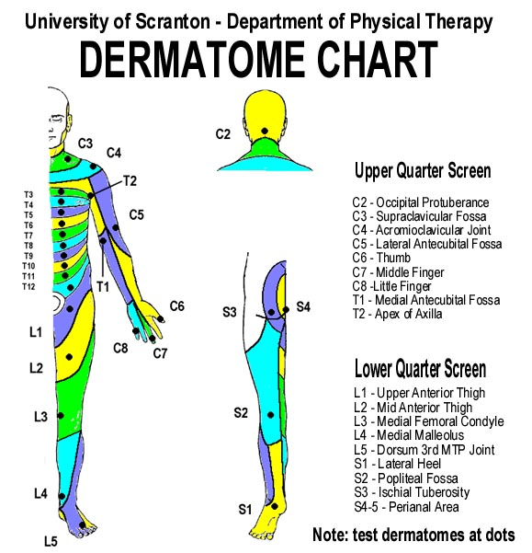
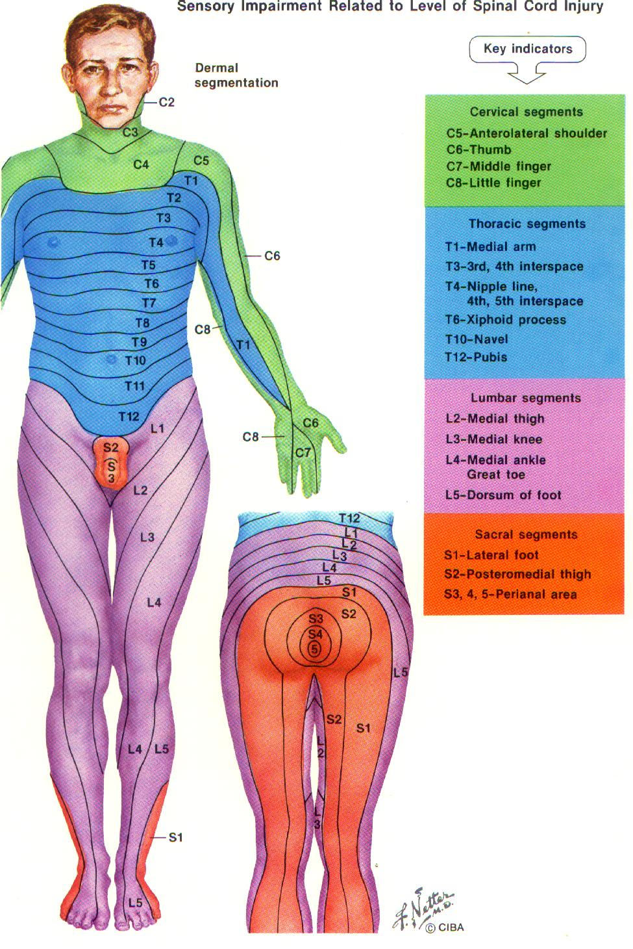

Slide 15
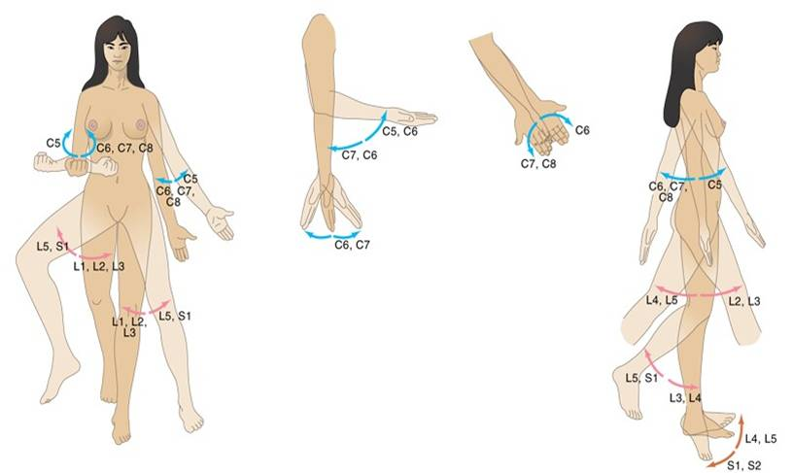
Myotomes

Slide 16
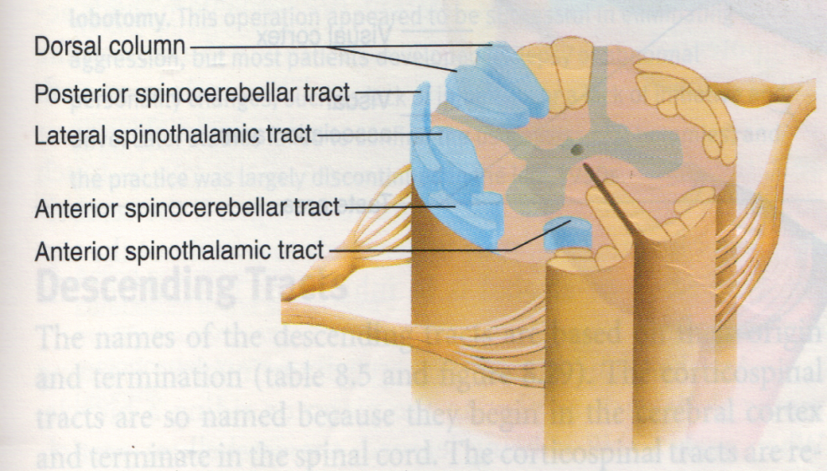
Ascending tracts
Consists of axons that conduct action potentials or impulses towards the brain (afferent)

Slide 17
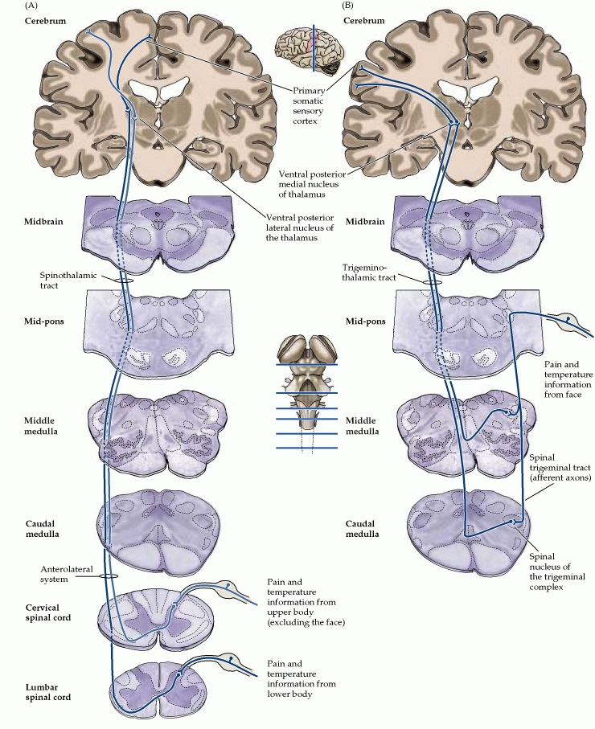
Pain and Temperature
  Lateral Spinothalamic Tract – Main Pathway
  Ventral Spinothalamic Tract
  Both tracts cross to the contralateral side of the cord about 2-3 cord levels above as it travels up the cerebral cortex (Area 3,1,2)
  Lesion of this tract presents with loss of contralateral pain & temperature below the level of injury

Slide 18
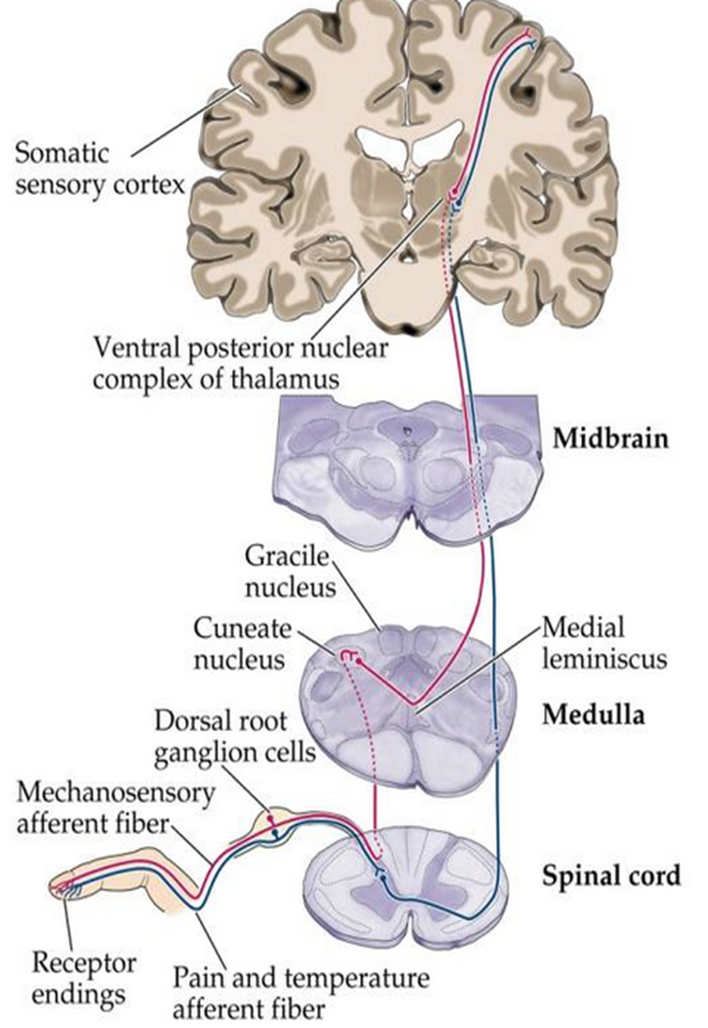
Proprioception and Stereognosis
  Posterior Column – ascends up the spinal cord and crosses to the contralateral side at the level of the medulla to the cerebral cortex (Area 3,1,2)
    Fasciculus Cuneatus – laterally located; UE proprioception
    Fasciculus Gracilis – medially located; LE proprioception
  Lesion of Posterior Column: Loss of ipsilateral proprioception & stereognosis below the level of injury

Slide 19
Summary Ascending Tracts
Lateral & Anterior Spinothalamic Tracts
  Pain & temperature sensation and crude touch
Dorsal Column
  Fine touch, proprioception, two-point discrimination
Dorsal & Ventral Spinocerebellar Tracts
  Proprioceptive and exteroceptive stimuli for movement and position sense
Spinoreticular Tract
  Deep and chronic pain

Slide 20
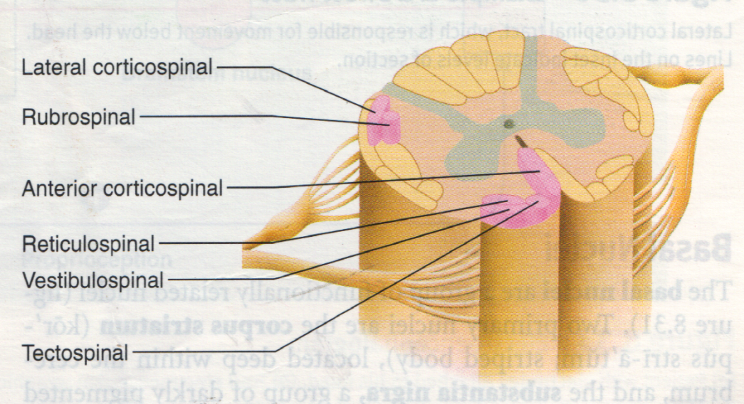
Descending tracts
Consists of axons that conduct action potentials or impulses away from the brain (efferent)

Slide 21
Motor Pathway
Lateral Corticospinal Tract – main pathway
Ventral Corticospinal Tract
  Both tracts decussate from the cerebral cortex (area 4,6) at the level of the medulla as it descends to the cord ipsilaterally
  Lesion of corticospinal tract: loss of ipsilateral motor function below the level of injury

Slide 22
Summary Descending Tracts
Rubrospinal Tract
  Serves as motor junction
  For large muscle movement & fine motor control
  Facilitates flexion & inhibits extension of upper extremities
Reticulospinal Tract
  For modulation of sensory transmission esp. pain; spinal reflexes
Tectospinal Tract
  For reflex head turning
  Mediate reflex postural movements of the head in response to visual & auditory stimuli
Medial Longitudinal Fissure
  For coordination of head and eye movements

Slide 23
Summary Descending Tracts
Anterior Corticospinal (Direct Pyramidal Tract)
  Pathway for control of voluntary motion
  Conduct voluntary motor impulses from the precentral gyrus to the motor centers of the cord.
Lateral Corticospinal (Crossed Pyramidal Tract)
  Pathway for control of voluntary motion
  Provides fine motor control of limbs and digits
Vestibulospinal Tract
  For postural reflexes
  Facilitates extensor muscle tone & equilibrium
Spino-olivary Tract
  Proprioception from muscles & tendons and cutaneous impulses to the olivary nucleus

Slide 24
Classification

Slide 25
UMN Injury
Lesion level indicates most distal uninvolved nerve root segment with normal function; muscles must have a grade of at least 3+/5 or fair + function
Tertraplegia (quadreplegia): injury occurs between C1 and C8, involves all extremities and trunk
Paraplegia: injury occurs between T1 and T12-L1; involves both lower extremities and trunk (varying levels)

Slide 26
Upper Motor Neuron (UMN) vs. Lower Motor Neuron (LMN) Syndrome
UMN syndrome LMN Syndrome
Type of Paralysis Spastic Paresis Flaccid Paralysis
Atrophy No (Disuse) Atrophy Severe Atrophy
Deep Tendon Reflex Increase Absent DTR
Pathological Reflex Positive Babinski Sign Absent
Superficial Reflex Absent Present
Fasciculation and Absent Could be
Fibrillation Present

Slide 27
Functional consequences of spinal cord injury
Complete injury
Incomplete injury
Transient spinal
  cord dysfunction
  Anterior cord syndrome
  Central cord syndrome
  Brown-Sequard syndrome
Pattern of neurological dysfunction observed during clinical evaluation
Grades of severity of neurological injury

Slide 28
Assessment of spinal cord injury
Level of cord injury
Spinal shock is over or not
Injury is complete or incomplete

Slide 29
American Spinal Injury Association
A= complete: no motor or sensory function is preserved in the sacral segments S4-S5
B= incomplete: sensory but not motor function is preserved below the neurological level and includes the sacral segments S4-S5
C= incomplete: motor functional is preserved below the neurological level, and most key muscles below the neurological level have a muscle grade <3
D= incomplete: motor function is preserved below the neurological level, and most key muscles below the neurological level have a muscle grade of ≤3
E= normal: motor and sensory function in normal

Slide 30
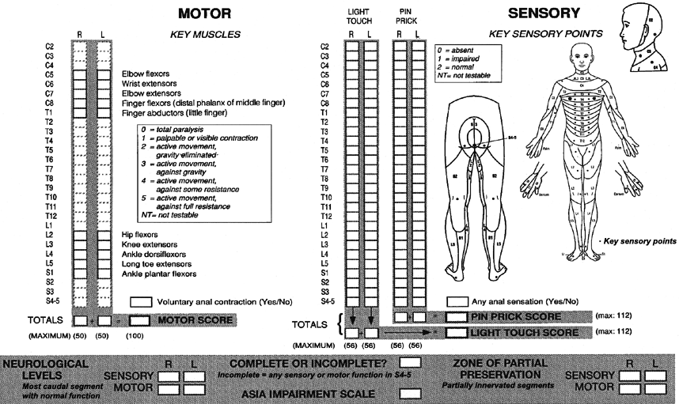

Slide 31
Specific Incomplete lesions

Slide 32
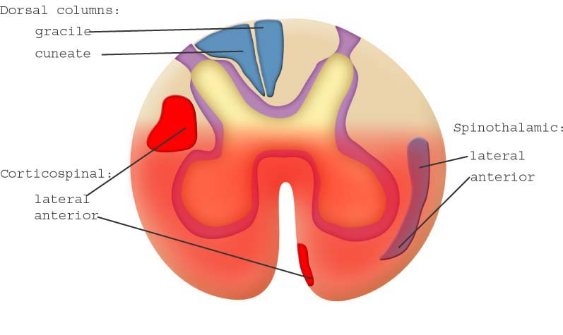
Anterior Cord Syndrome
An incomplete lesion that results from compression and damage to the anterior part of the spinal cord or anterior spinal artery. The mechanism of injury is usually cervical flexion. There is loss of motor function and pain and temperature sense below the lesion due to damage of the corticospinal and spinothalamic tracts

Slide 33
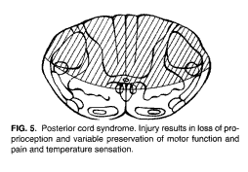
Posterior Cord Syndrome
A relatively rare syndrome that is caused by compression of the posterior spinal artery and is characterized by loss of pain perception, proprioception, two point discrimination, and stereognosis. Motor function is preserved.

Slide 34
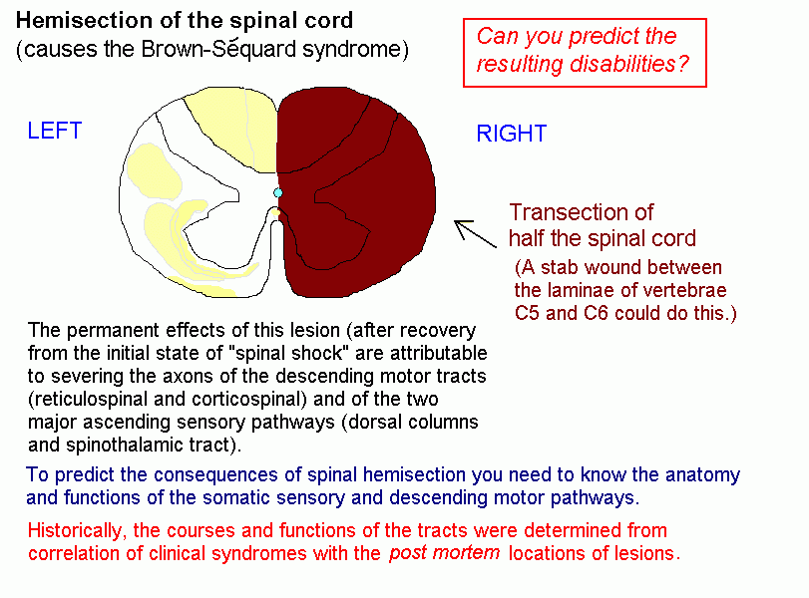
Brown Sequard Syndrome
An incomplete lesion usually caused by a stab wound, which produces hemisection of the spinal cord. There is paralysis and loss of vibratory and position sense on the same side as the lesion due to the damage to the CST and dorsal columns. There is a loss of pain and temp sense on the opposite side of the lesion from damage to the lateral spinothalamic tract.

Slide 35
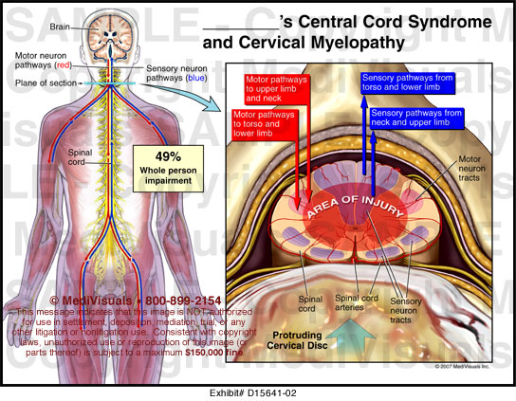
Central Cord Syndrome
An incomplete lesion that results from compression and damage to the central portion of the spinal cord. The mechanism of injury is usually cervical hyperextension that damages the spinothalamic tract, CST and dorsal columns. The upper extremities present with greater involvement than the lower extremities and greater motor deficits exist as compared to sensory deficits.

Slide 36
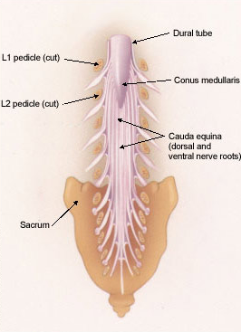
Conus Medullaris Syndrome-
  Most of these injuries occur b/w T11 and L2 vertebrae
Sphincter disturbances
Saddle anesthesia(S3-S5)
Absence of lower extremity reflexes
Usually it is associated With involvement of lumbar roots
Cauda Equina Syndrome
It is bilateral involvement of multiple lumbosacral nerve roots with in the spinal canal, characterized by-
  Absent reflexes in lower limbs
  Bladder and bowel involvement
  Loss of perineal sensation

Slide 37
Sacral Sparing
sparing of tracts to sacral segments with preservation of perianal sensation, rectal sphincter tone or active toe flexion.

Slide 38
Common complications in SCI and their interventions

Slide 39
Spinal Shock
Respiratory complication
Cardiovascular complication
Renal and Bladder complication
Bed sores
Deep vein thrombosis
Musculoskeletal complication

Slide 40
Spinal shock: A physiologic response that occurs between 30 and 60 minutes after trauma to the spinal cord and can last up to several weeks. Spinal shock presents with total flaccid paralysis and loss of all reflexes below the level of injury.

Slide 41
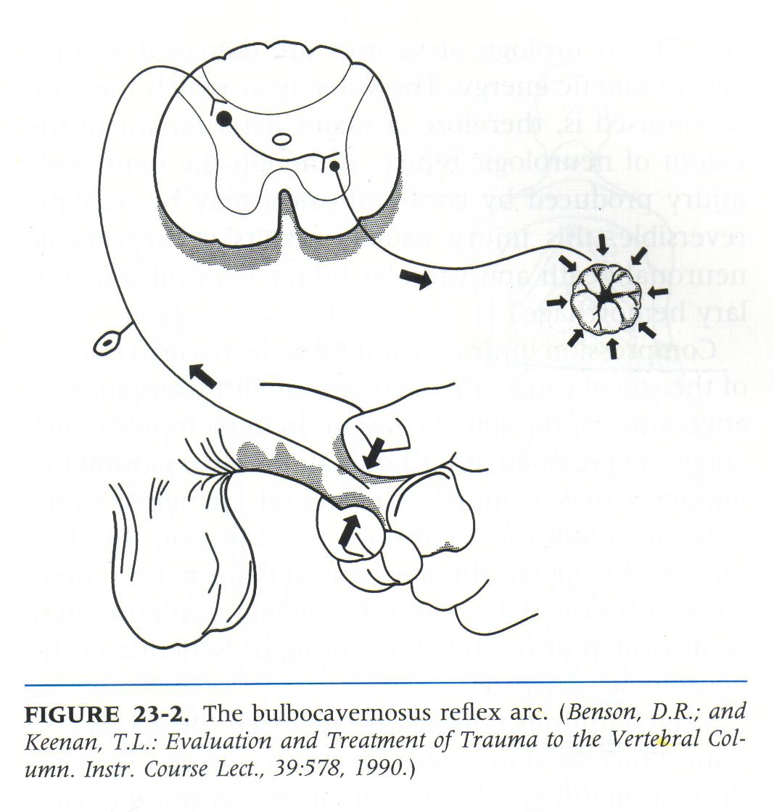
Two reflexes are important in acute spinal cord injury assessment
Anal wink reflex
Bulbocavernous reflex
Return of bulbocavernous reflex marks the end of spinal shock

Slide 42
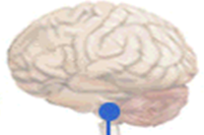
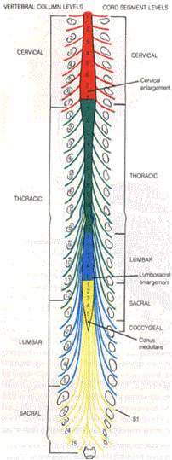
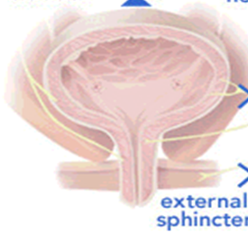
Innervation of the bladder
Parasympethetic, S_{2,3,4}
The afferent fibers carry sensations from the bladder.
parasympathetic nerves stimulate the detrusor to contract
Sympethetic, T₁₁-L₂
Stimulates the internal urinary sphincter to remain tightly closed.
The sympathetic activity also inhibits parasympathetic stimulation.
Somatic S_{2,3,4}
The pudendal nerve originates from the nucleus of Onuf situated in the anteriolateral horns of the sacral segments 2, 3 and 4.
It regulates the voluntary actions of the external urinary sphincter and the pelvic diaphragm.
S_{2,3,4} Preganglionic fibers
Nucleus of Onuf
Primitive voiding centre
Hypogastric nerve
Pelvic Nerve
Pudendal Nerve
Pelvic Plexus
Postganglionic fibers
Detrusor Muscle
Internal urinary sphincter

Slide 43
Neuroanatomy of Voiding
Frontal Lobe, Micturation Centre
Pontine Micturation Centre
  Sends inhibitory signals PMC until a socially acceptable time and place are found.
  Major relay center/ inherent excitatory nature.
  Coordinates urinary sphincters and the Bladder
  Independent until 3-4yrs of age.
Primitive voiding centre

Slide 44
Neuroanatomy of Voiding
Frontal Lobe, Micturation Centre
Pontine Micturation Centre
There is first a voluntary relaxation of the perineum, followed sequentially by an increase tension of abdominal wall, a slow contraction of the detrusor, and an associated opening of internal sphincter; finally there is relaxation of the external sphincter resulting in urinary flow.
Primitive voiding centre
Parasympethetic
Sympethetic
Pudendal Nerve
Detrusor Contraction
Relaxation of IUS
External sphincter opens
Facilitation of voluntary urination

Slide 45
Neurogenic dysfunction of bladder
Frontal Lobe, Micturation Centre
Uninhibited Neurogenic Bladder
Pontine Micturation Centre
If a problem occurs within the nervous system, the entire voiding cycle is affected. Any part of the nervous system may be affected, including the brain, pons, spinal cord, sacral cord, and peripheral nerves.
Reflex Neurogenic Bladder (Automatic bladder, Spastic bladder)
Autonomic Neurogenic Bladder
Primitive voiding centre
Motor paralytic bladder (atonic detrusor)
Pudendal Nerve
Sensory paralytic bladder

Slide 46
The Neurogenic Bladder
Lapides Classification
Five Types –
Two upper motor neuron type (reflex and uninhibited neurogenic bladder) and
Three lower motor neuron type (autonomous, sensory paralytic, and motor paralytic bladder).

Slide 47
Uninhibited Neurogenic Bladder
A hyper-reflexic detrusor with a normal sphincter.
Lesions of the brain above the pons destroy the master control center, causing a complete loss of voiding control.
Urgency, frequency, hesitancy, urge incontinence.
The bladder empties too quickly and too often, with relatively low quantities.
Frontal Lobe, Micturation Centre
Pontine Micturation Centre
Primitive voiding centre
Cerebro-vascular accident
Brain tumors
Parkinson disease
Shy-drager syndtrome
Cerebral palsy
Dementia

Slide 48
Reflex Neurogenic Bladder (Automatic bladder, Spastic bladder)
Frontal Lobe, Micturation Centre
Pontine Micturation Centre
During spinal shock, all sensory and motor innervations are depressed.
When intravesical pressure rises above sphincter pressure some amount of urine dribbles out until again intravesical pressure comes below urethral pressure.
Primitive voiding centre
Motor vehicle and diving accidents leading to spinal cord injury
Myelitis
Cervical Spondylosis
Multiple sclerosis
Arterio-venous malformation
Syrigomyelia
Other spinal cord disorder
Children born with myelomeningocele

Slide 49
Autonomous neurogenic bladder
Frontal Lobe, Micturation Centre
Pontine Micturation Centre
The bladder is paralyzed and there is no awareness of the state of fullness.
voluntary initiation of micturition is impossible
Overflow incontinence, painless retention.
saddle anesthesia with absence of bulbocavernosus and superficial anal reflex.
Typical causes are -
A sacral cord tumor,
Herniated disc(conus medullaris),
Injuries that crush the pelvis, lumbar laminectomy, radical hysterectomy, or abdominoperineal resection.
Tethered cord syndrome.
Primitive voiding centre

Slide 50
Motor paralytic bladder (atonic detrusor)
Frontal Lobe, Micturation Centre
A lesion affecting S2-S4 motor neurons (detrusor motor neurons),
Painful urinary retention with overflow incontinence and inability to initiate the urination.
The saddle and bladder sensations are normal, but anal and bulbocavernosus reflexes are usually absent.
Pontine Micturation Centre
Primitive voiding centre
Develops when the motor supply is interrupted, as in –
Poliomyelitis,
Polyradiculoneuritis,
Trauma,
Some pt may present this in association with Lumber canal stenosis and with lumbosacral meningo-myelocoele,
Pelvic surgery

Slide 51
Sensory paralytic bladder
Frontal Lobe, Micturation Centre
Pontine Micturation Centre
Afferent limb of the micturition spinal reflex is compromised, posterior root ganglion of sacral nerve or the posterior column of spinal cord.
Bladder sensations are absent and there is no desire to void.
Painless retention with overflow incontinence is present, but pt can initiate the urination with difficulty.
Saddle anesthesia is present and anal & bulbocavernosus reflexes may or may not be present.
Primitive voiding centre
Causes --
Multiple sclerosis,
Diabetic autonomic neuropathy,
Tabes dorsalis

Slide 52
Bladder Management for Supra Sacral SCI
Frontal Lobe, Micturation Centre
Uninhibited Neurogenic Bladder
Pontine Micturation Centre
Four Important Goals
Prevent complications of the kidneys
Prevent complications of the bladder
To have a bladder management program that best fits lifestyle of the patient
To keep skin and clothing free of urine
Reflex Neurogenic Bladder (Automatic bladder, Spastic bladder)
Most common methods
Intermittent catheterization
Reflex voiding (for men)
Indwelling catheter
Less frequent methods
Bladder augmentation to surgically increase bladder size
Surgical diversion
Neurostimulation
Primitive voiding centre
Pudendal Nerve

Slide 53
Bladder Management for Supra Sacral SCI
Frontal Lobe, Micturation Centre
Uninhibited Neurogenic Bladder
Pontine Micturation Centre
b-Antispasmodic drugs –
These relax the smooth muscles of the urinary bladder. By exerting a direct spasmolytic action
Oxybutynin chloride
Tolterodine L-tartrate
Trospium
c-Tricyclic antidepressant drugs –
They function to increase norepinephrine and serotonin levels. In addition, they exhibit anticholinergic and direct muscle relaxant effects on the urinary bladder.
Imipramine hydrochloride
Amitriptyline hydrochloride
Anticholinergic drugs
They inhibit involuntary bladder contractions.
Propantheline bromide – 30-60 mg qid.
Dicyclomine hydrochloride –10 mg tds
Darifenacin
Solifenacin succinate
Medication
Urge incontinence
The 3 main categories of drugs used to treat include
Anticholinergic drugs
Antispasmodics,
Tricyclic antidepressant agents.
Reflex Neurogenic Bladder (Automatic bladder, Spastic bladder)
Primitive voiding centre
Pudendal Nerve

Slide 54
Management Techniques for Sacral SCI
Frontal Lobe, Micturation Centre
Intermittent Catheterization
Easier than for those with Supra SCI because the bladder is flaccid and underactive and generally upper body strength and mobility are relatively better
Intra-abdominal Pressure Voiding
Valsalva (bearing down)
Credé (pushing inward on the bladder with fist)
Pontine Micturation Centre
Autonomic Neurogenic Bladder
Primitive voiding centre
Motor paralytic bladder (atonic detrusor)
Sensory paralytic bladder

Slide 55
Intermittent Catheterization
There are two general catheterization techniques.
Sterile technique (catheters put in using sterile gloves and a sterile catheter or a catheter contained in a sterile bag)
“Clean” technique (catheters are washed, dried, stored and reused)
Generally done every 4-6 hours to prevent the bladder from getting too full

Slide 56
Indwelling Catheters: Two Types
Urethral Catheter
Suprapubic Catheter
      Requires minor surgery for insertion
      Does not require fluid restriction, good hand function or transfer/dressing skill.
      Clinically preferable over an indwelling catheter (less likely to get plugged with stones, easier to change)
      Preferable by men because sexual activity is not limited (Women are not limited by either catheter type)
  :Placed in the bladder through the urethra
  Held in place by an inflated balloon
  Does not require fluid restriction, good hand function or transfer/dressing skill.
  30% become coated with stones that prevents drainage and contributes to UTIs

Slide 57
Concern with Credé Voiding
Can have negative side effects such as hemorrhoids, hernias, rectal prolapse, and reflux of urine up the ureters to the kidney
Can increase the risk for infections
Best not to do unless you have a weak sphincter

Slide 58
Spasticity
Can occasionally be useful to a patient with a SCI however more often serves to interfere with functional activities. Spasticity can be enhanced by both internal and external sources such as stress, decubiti, urinary tract infections, bowel or bladder obstruction, temperature changes or touch.
Increased involuntary contraction of muscle groups, increased tonic stretch reflexes, excessive deep tendon reflexes.
Treatment: medications are usually administered in an attempt to reduce the degree of spasticity (Dantrium, Baclofen, Lioresal). Aggressive treatment includes rhizotomies, myelotomies, and other surgical intervention. Physical therapy intervention includes positioning, aquatic therapy, weight bearing, FES, ROM, resting splints and inhibitive casting.

Slide 59
Autonomic Dysreflexia
(hyperreflexia): an emergency situation in which a noxious stimulus precipitates a pathological autonomic reflex with symptoms of paraoxysmal hypertension, bradycardia, headache, diaphoresis, flushing, diplopia, or convulsions; examine for irritating stimuli; treat as a medical emergency, elevate head, check and empty catheter first.
Treatment: the first reaction to this medical crisis is to transfer the patient to a sitting position and then immediately check the catheter for blockage. The bowel should also be checked for impaction. A patient should remain in sitting position. Lying a patient down is contraindicated and will only assist to further elevate blood pressure. The patient should be examined for any other irritating stimuli. If the cause remains unknown the patient should receive immediate medical intervention.

Slide 60
Heterotopic Bone Formation
Abnormal bone growth in soft tissues; examine for early changes-soft tissue swelling, pain, erythema, generally near large joint; late changes- calcification, initial signs of ankylosis
Treatment: Drug intervention usually involves diphosphates that inhibit ectopic bone formation. Physical therapy and surgery are often incorporated into treatment. Physical therapy must focus on maintaining functional range of motion and allowing the patient the most independent functional outcome possible.

Slide 61
Deep Vein Thrombosis
Results from the formation of a blood clot that becomes dislodged and is termed an embolus. This is considered a serious medical condition since the embolus may obstruct a selected artery. A pateint with a spinal cord injury has a greater risk of developing a DVT due to the absence or decrease in the normal pumping action by active contractions of muscles in the lower extremities.
Treatment: once a DVT is suspected there should be no active or passive movement performed to the involved lower extremity. Bed rest and anticoagulant drug therapy are usually indicated. Surgical procedures can be performed if necessary.

Slide 62
Orthostatic Hypotension
Occurs due to a loss of sympathetic control of vasoconstriction in combination with absent or severely reduced muscle tone. Venous pooling is fairly common during the early stages of rehab. A decrease in systolic blood pressure greater than 20mmHG after moving from supine to sitting is typically indicative of this.
Treatment: Monitoring vital signs assists with minimizing the effects of orthostatic hypotension. The use of elastic stockings, ace wraps to the lower extremities, and abdominal binders are common. Gradual progression to a vertical position using a tilt table is often indicated. During intervention may be indicated in order to increase blood pressure

Slide 63
Pressure Ulcers
Caused by sustained pressure, friction, and/or shearing to a surface. The most common areas susceptible to pressure ulcers are the coccyx, sacrum, ischium, trochanters, elbows, buttocks, malleoli, scapulae, and prominent vertebrae. Pressure ulcers require immediate medical intervention and can often significantly delay the rehab process.
Prevention is of greatest importance. A patient should change position frequently, maintain proper skin care, sit on an appropriate cushion, consistently weight shift, and maintain proper nutrition and hydration. Surgical intervention is often necessary with advanced pressure ulcers.

Slide 64
Physical Therapy Goals, Outcomes and Interventions

Slide 65
Improve Respiratory Capacity
Deep breathing exercises, strengthening exercises to respiratory muscles; assisted coughing, respiratory hygiene (postural drainage, percussion, vibration, suctioning) as needed to keep airway clear; abdominal support

Slide 66
Maintain ROM
Prevent contracture: PROM, positioning, splinting, selective stretching to preserve function (tenodesis grasp)

Slide 67
Maintain Skin Integrity
Free of pressure ulcers and other injury positioning program, pressure relieving devices (cushion, ankleboots) patient education: pressure relief activities (pushups) and skin inspection; provide prompt treatment of pressure sores

Slide 68
Improve Strength
Strengthen all remaining innervated muscles use selective strengthening during acute phase to reduce stress on spinal segments; resistive training to hypertrophy muscles

Slide 69
Reorient Patient to Vertical Position
Tilt table, wheelchair, use of abdominal binder, elastic lower extremity wraps to decrease venous pooling; examine for signs and symptoms of orthostatic hypotension (light headedness, syncope, mental or visual blurring, sense of weakness

Slide 70
Promote early return of ADLs
Emphasis on independent rolling and bed mobility assumption of sitting, transfers, sit-to-stand, and ambulation as indicated
Tolerance, postural control, symmetry, and standing balance as indicated

Slide 71
1. Motorcyclist fracture is
a. Ring fracture
b. Comminuted fracture
c. Fracture base of skull
d. Separation of anterior and posterior half of skull

Slide 72
2.Most common cause of SCI in India is
a. RTA
b. Fall from height
c. Fall in well
d. House collapse

Slide 73
3. Dislocation without fracture is seen in
a. Sacral spine
b. Lumbar spine
c. Cervical Spine
d. Thoracic spine

Slide 74
4. Whip-lash injury is caused due to
a. Fall from height
b. Acute hyperextension of spine
c. Blow on top of head
d. Acute hyperflexion of spine

Slide 75
5. Jeffersons fracture is
a. C1
b. C2
c. C2-C1
d. C2-C3

Slide 76
6. Hangmans fracture is fracture of C2
a. Dens
b. Lamina
c. Pars intercularis
d. Spinous process

Slide 77
7. Burst fracture of cervical spine is due to
a. Whiplash injury
b. Fall of weight on neck
c. Car accident
d. Vertebral compression injury

Slide 78
8. Tear drop fracture of lower cervical spine implies
a. Wedge compression fracture
b. Axial compression fracture
c. Flexion compression failure of body
d. Flexion rotation failure of body

Slide 79
9. Dennis stability concept of spine is based on
a. 1 column
b. 2 column
c. 3 column
d. 5 column

Slide 80
10. Spinal shock is associated with
a. Increased spinal reflexes
b. Absent spinal reflexes
c. Loss of autonomic reflexes
d. Bizzare reflexes

Slide 81
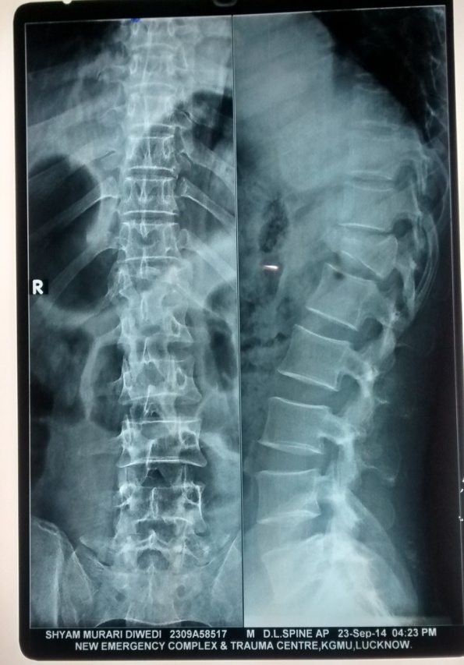
11. A 29 year old man following RTA presented with tenderness present at the thoracolumbar region in the back and there was a suspicion about posterior ligamentous complex disruption on local examination of spine. There was no visceral injury. On neurological examination, AIS was A. There was no prior history of spinal complaints. X- ray AP and lateral demonstrated a flexion compression injury of T12.

Slide 82
1. Most appropriate method for determining stability of the spine
Modified Denis 3 column classification
CT spine
MRI spine
TLICS score

Slide 83
2. What is the TLICS score for the above case
3
5
7
9

Slide 84
. TLICS is summation of points on 3 categories: fracture morphology, neurologic status, and integrity of the posterior ligamentous complex. Fracture morphology: Compression Injuries (1pt), Burst ( 2pts), Translational/Rotational Injuries (3pts), Distraction Injuries (4pts); Neurologic status: Intact (0), Root Injury (2pts), Complete injury (2pts), Incomplete injury (3pts), Cauda Equina injury (3pts);
Integrity of posterior ligamentous complex (PLC) - Supraspinous ligament (SSL), interspinous ligament (ISL), capsular ligaments and ligamentum flavum: Intact (0), Injury suspected (2pts), Injured (3pts)
In this patients it is 1 point for morphology + 2 points for complete neurological injury(AIS score A) + 2 points for suspected PLC injury . Total TLICS= 5.
Management according to summation of point values from each category 3 or less - nonoperative

Slide 85
. Management for this case would be
Surgical stabilization
Spinal bracing
Complete bed rest only
Surgical or conservative

Slide 86
. Which of the following is not a component of TLICS score
Injury morphology
Posterior ligamentous complex integrity
Dynamic X ray of spine
Neurological status

Slide 87

…….THANK YOU

