Slide 1
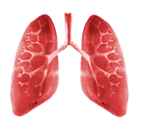
PRACTICAL APPLICATIONS OF PULMONARY FUNCTION TESTS
MODERATOR : DR.G.P SINGH
PRESENTERS : DR.SWATI AGGARWAL
DR.KARTHIK PONNAPPAN
DR.JOKHOORAM

Slide 2
GOALS OF PREOPERATIVE PULMONARY EVALUATION
To predict likelihood of pulmonary complications
Obtain quantitative baseline information which can help in decision making
Identify patients who may benefit from ???bronchodilator therapy
To ascertain predictive benefit in pneumonectomy patients

Slide 3
 |  | INDICATIONS OF PRE-OP SPIROMETRY
Patient
 | Known pulmonary dysfunction
 | Currently smoking, especially if >1 pack per day
 | Chronic productive cough
 | Recent respiratory infection
 | Advanced age
 | Obesity >30% over ideal weight
 | Thoracic cage deformity, such as kyphoscoliosis
 | Neuromuscular disease, such as amyotrophic lateral sclerosis or myasthenia gravis
Procedure
 |  | Thoracic or upper abdominal operation
 |  | Pulmonary resection
 |  | Prolonged anesthesia

Slide 4
Contraindications for Spirometry
Recent myocardial infarction
Unstable angina
Recent thoraco abdominal surgery
Recent ophthalmic surgery
Thoracic / Abdominal / Cerebral aneurysm
Pneumothorax

Slide 5
WHAT TESTS SHOULD BE DONE….???
Preoperative pulmonary evaluation must include:
1. History & physical examination
2. Chest x rays
3. ABG : chronic hypoxemics :- to guide ventilatory management goals
4. Screening spirometry
5. Maximum voluntary ventilation
6. DLCO
7. Quantitative radionuclide scintigraphy
8. Maximum cardiopulmonary exercise studies

Slide 6
EFFECTS OF ANESTHESIA AND SURGERY ON LUNG VOLUMES
TLC : decreases after abdominal surgery
VC: 25 to 50 % decrease within 1-2 days
postop , returns to normal in 1-2 weeks
RV : increses by 13 %
ERV :decreases by 25% after LAS
60% after UAS & thoracic Surg
TV :decreases by 20% within first 24 hours
returns to normal within 2 weeks
Pulmonary Compliance : Decreases by 33%

Slide 7
APPLIED ASPECTS OF SOME LUNG CAPACITIES

Slide 8
VITAL CAPACITY
It reflects the patients ability to take
Deep breath
Cough
Clear excessive secretions
Vital capacity may be reduced by :
a. Alterations in muscle power
b. Pulmonary disease
c. Abdominal tumors (* pregnancy )
d. Abdominal pain
e. Abdominal splinting
f. Alterations in posture

Slide 9
POSITION | LOSS OF VITAL CAPACITY ( in percent )
Tredelenburg | 14.5
Lithotomy | 18
Left lateral | 10
Right lateral Bridge in dorsal | 12 12.5
Prone position , unsupported | 10
During anesthesia vital capacity reductions are of little significance , during controlled ventilation lungs feel stiff .
It evaluates patient condition for weaning from ventilator should be >10-15 ml/kg of body weight
Importance in post op period :
( if VC falls about 3* TV – artificial help may be needed to clear secretions )

Slide 10
RESIDUAL VOLUME
Depends on limits of chest wall expansion and small airways collapse
Any increase in it signifies lung is larger than usual and cannot empty adequately occurs in
- After thoracic operations
- OAD

Slide 11
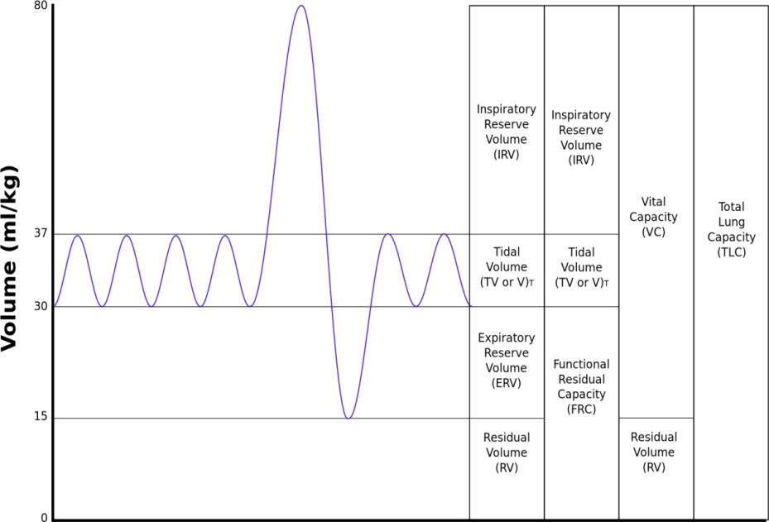
FUNCTIONAL RESIDUAL CAPACITY
Normally FRC is 40-50% of the TLC (30ml/kg IBW )
FRC determines two primary physiologic functions
1. the elastic pressure–volume relationships within the lung. At FRC chest wall and the lung are in equilibrium with each other
2. oxygen reserve when apnea occurs
It greatly influences ventilation–perfusion relationships within the lung (when FRC is reduced , venous admixture increases & results in arterial hypoxemia , mechanism can b understood by its relationship with closing capacity )

Slide 12
FACTORS AFFECTING FRC
INCREASE
Age
OAD
Position
DECREASE
Age
Position
RLD
Anesthetic agents
Post operative period : upper abdominal : 40-50 %
Lower abdominal n thoracic : 30 %
Other : 15 – 20 %

Slide 13
Maximum Voluntary Ventilation (MVV)
The subject is instructed to breathe as hard and fast as possible for 10 to 15 seconds. The result is extrapolated to 60 seconds and reported in liters per minute.
A low MVV can occur in obstructive disease, in restrictive disease, in neuromuscular disease, in heart disease, in a patient who does not try or who does not understand, or in a frail patient.
MVV measures the endurance of the ventilatory muscles and indirectly reflects lung–thorax compliance and airway resistance

Slide 14
Maximum Voluntary Ventilation (MVV)
MVV is the best ventilatory endurance test that can be performed in the laboratory. Values that vary by as much as 30% from predicted values may be normal, so only large reductions in MVV are significant
Healthy, young adults average ~170 L/min. Values are lower in women and decrease with age in both sexes
Because this manoeuvre exaggerates air trapping and exerts the ventilatory muscles, MVV is decreased greatly in patients with moderate-to-severe obstructive disease
MVV is usually normal in patients with restrictive disease

Slide 15
PFT IN THORACIC SURGERIES
Three Goals :
Identify the patient at risk of increased postoperative morbidity and mortality
Identify patients who will need short term or long term post-op ventilatory support
To evaluate beneficial effect and reversibility of airway obstruction with use of bronchodilators
The 3 aspects of respiratory function need to be assessed pre operatively and these form a 3 legged stool :
Lung Mechanics
Lung parenchymal function
Cardiopulmonary Interaction

Slide 16
1. RESPIRATORY MECHANICS
Many tests correlate with post thoracotomy outcome :- FEV1, FVC, MVV, RV/TLC
Most important of these is predicted post operative (PPO) FEV1
PPO FEV1 = preop FEV1 % * (1- no of subsegments removed /42 )
> 40% ~ low risk
30 to 40 % ~ moderate risk
< 30% ~ high risk

Slide 17
2. LUNG PARENCHYMAL FUNCTION
The lungs ability to exchanger O2 and CO2 between pulmonary vascular bed and alveoli is assessed by :
1.ABG : cut offs PaO2 < 60 mmHg, PaCO2 > 45 mmHg , the patients who do not meet these warning criterias are at increased risk
2.DLCO : correlates with total functioning cross sectional area of alveolar capillary interface, corrected DLCO can be used to calculate post transection DLCO
ppoDLCO <40 % - correlates with increased respiratory and cardiac complications
<20 %- unaccepatably high periop mortality rate

Slide 18
3.CARDIOPULMONARY INTERACTION
Laboratory exercise testing – gold standard
Maximal O₂ Consumption (VO_{2max}) – most useful predictor of post-thoracotomy outcome
Stair climbing
1 flight means 20 steps with 6 inches/step
5 flights - VO_{2max} > 20 mL/kg/min
2 flights - VO_{2max} > 12 mL/kg/min

Slide 19
6MWT – 6 Minute Walk Test
Less than 2000 feet (610 m) correlates to VO_{2max} < 15 mL/kg/min
Fall in SpO₂ more than 4 % during exercise
Estimated ppoVO_{2max} < 10 mL/kg/min is an absolute contraindication for pulmonary resection

Slide 20
V/Q SCINTIGRAPHY
Assessment of preoperative contribution of lobe or lung resected
For any patient whose preoperative FEV1 and/or less than 80%

Slide 22
APPROACH TO PFT
Spirometry is an effort dependent test therefore it is important to ensure that subject gives his best while performing this test
Way of doing this is to look at the acceptability and repeatability criteria
ACCEPTABILITY
1. No inadequate inspiratory effort
2. No slow / hesitated start
3. No cough
4. No poor effort
5. No early termination ( i.e FET >/= 6 seconds )
6. No glottic closure / obstruction of mouth piece due to tongue
REPEATABILITY
Difference between two best FEV1 and FVC must show minimum variability. It should be within 200 ml

Slide 23
HOW MANY BLOWS….????
Atleast 3 acceptable / repeatable readings
Upto maximum of 8 blows are needed
CUT OFF VALUES
FVC >80%
FEV1 >70%
FEV1/ FVC >80 %
FEF25 – 75 > 60 %

Slide 24
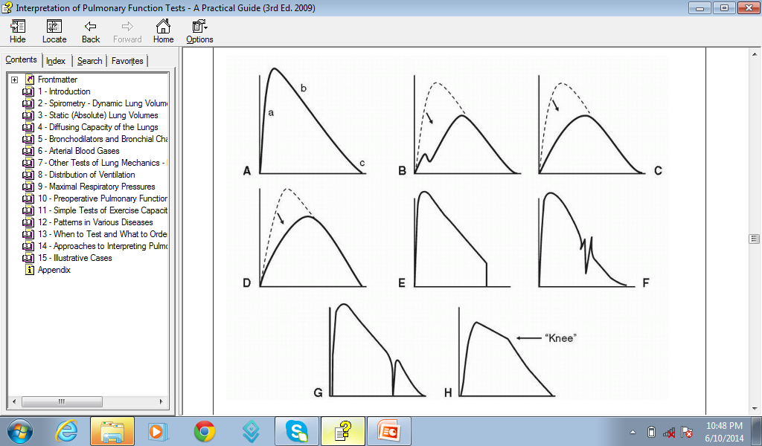
Any suboptimal test must be interpreted with caution because it may suggest the presence of disease when none exists

Slide 25
STEPS FOR PFT INTERPRETATION

Slide 26
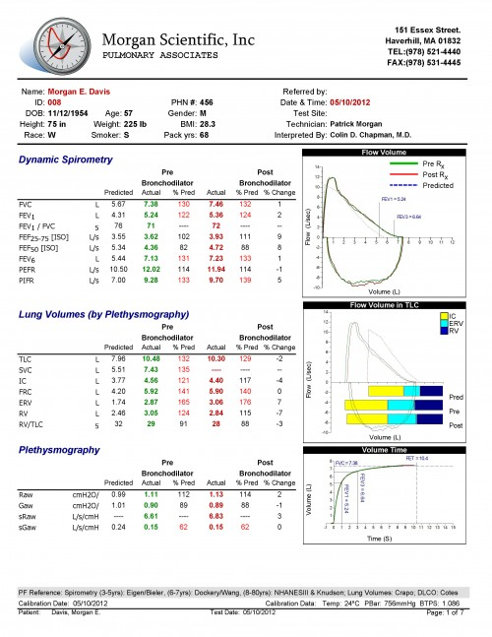
Step 1 SPIROMETRY INTERPRETATION
Look at the flow-volume curve, the FVC, and the FEV₁/FVC ratio:
A.Does the curve suggest obstruction ,restriction
B.Is the FEV₁/FVC ratio reduced < 70 % - Obstruction
C.If the FEV₁/FVC ratio is normal and the TLC is below the lower limit of normal → restriction
D. Examine expiratory flow values FEF 25-75% : indicator of early airway obstruction
E.Bronchodilator response is positive if either the FEV₁ or FVC increases ≥ 12% and ≥ 200 mL.

Slide 27
Step 2FLOW-VOLUME CURVE
Gives clues about the presence of obstruction or restriction.
Gives clues about unusual conditions, such as the following:
central airway obstructive process , Neuromuscular weakness

Slide 28
Step 3 LUNG VOLUMES
Obstructive disorders have a TLC that is high (hyperinflation) or normal
An increased residual volume (RV) (air trapping) and an increased RV/TLC ratio
Restrictive disorders have a reduced TLC

Slide 29
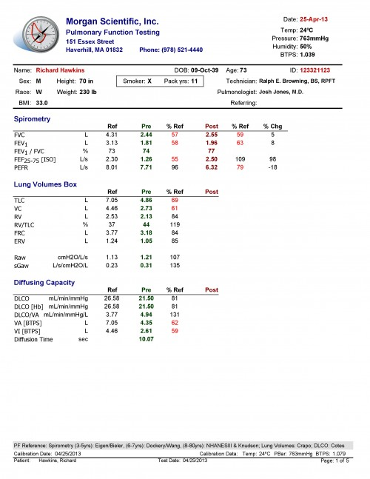
Step 4 DLCO
Normal : in normal lungs , major airways lesion
Decreased : parenchymal , restrictive disorders , copd
Increased : alveolar hemorrhage , very obese , asthma

Slide 30
Pulmonary Function Testing
Ventilation
Forced Expiration
Lung Volumes
Diffusion
Blood Flow
Ventilation-Perfusion Relationships
Topographical Distribution of Ventilation and Perfusion
Inequality of Ventilation
Inequality of Ventilation-Perfusion
Ratios
Blood Gases and pH
Mechanics of Breathing
Lung Compliance
Airway Resistance
Closing Volume
Control of Ventilation
Exercise Testing

Slide 31
Ventilation

Slide 33
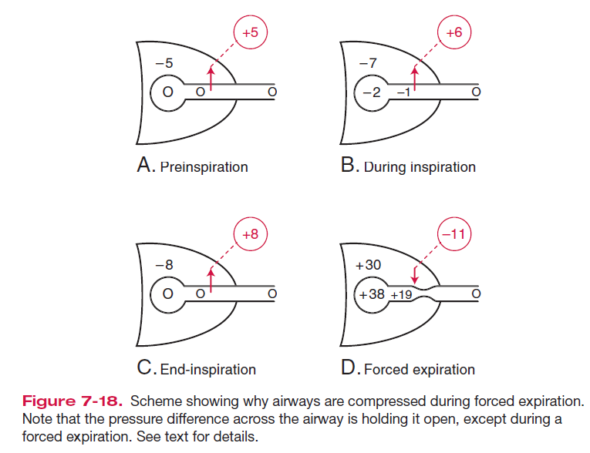
Dynamic Compression of Airways

Slide 35
OBSTRUCTIVE v/s RESTRICTIVE
Obstructive Disorders
Characterized by a limitation of expiratory airflow so that airways cannot empty as rapidly compared to normal (such as through narrowed airways from bronchospasm, inflammation, etc.)
Examples:
Asthma
Emphysema
Restrictive Disorders
Characterized by reduced lung volumes/decreased lung compliance
Examples:
Interstitial Fibrosis
Scoliosis
Obesity
Lung Resection
Neuromuscular diseases
Cystic Fibrosis

Slide 36
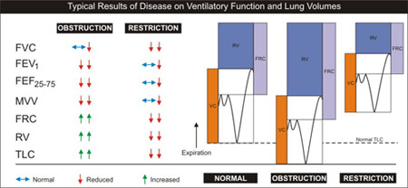
FEV1/FVC

Slide 37
In restrictive diseases, the maximum flow rate is reduced, as is the total volume exhaled.
The flow rate is often abnormally high during the latter part of expiration because of the increased lung recoil.
By contrast, in obstructive diseases, the flow rate is very low in relation to lung volume, and a scooped-out appearance is seen.

Slide 38
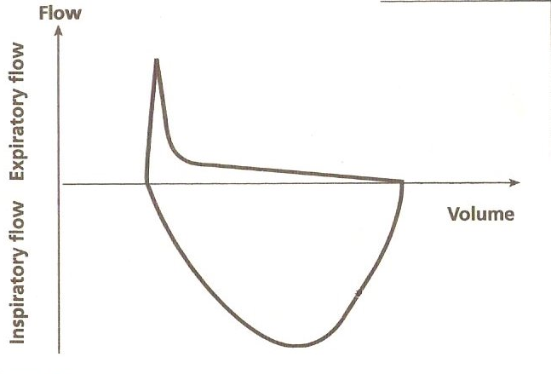
OBSTRUCTIVE DISORDER
Rat tail appearance
Dog tail appearance

Slide 39
RESTRICTIVE DISORDER
Tall and narrow with steep end-expiratory phase.

Slide 40
In obstructive disease, the total lung capacity is typically abnormally large, but expiration ends prematurely.
The early airway closure is due to
increased smooth muscle tone of the bronchi, as in asthma,
loss of radial traction from surrounding parenchyma, as in emphysema.
Other causes include edema of the bronchial walls, or secretions within the airways.
In restrictive diseases, inspiration is limited by the reduced compliance of the lung or chest wall, or weakness of the inspiration muscles.

Slide 41
The FEV1.0 (or FEF25–75%) is reduced by an increase in airway resistance or a reduction in elastic recoil of the lung.
It is independent of expiratory effort due to the dynamic compression of airways.
The increase in airway resistance and the reduction of lung elastic recoil pressure can be important factors in the reduction of the FEV1.0, as, for example, in pulmonary emphysema.

Slide 42
Classification of COPD Severity
by Spirometry
Stage I: Mild FEV₁/FVC < 0.70
FEV₁ > 80% predicted
Stage II: Moderate FEV₁/FVC < 0.70
50% < FEV₁ < 80% predicted
Stage III: Severe FEV₁/FVC < 0.70
30% < FEV₁ < 50% predicted
Stage IV: Very Severe FEV₁/FVC < 0.70
FEV₁ < 30% predicted or
FEV₁ < 50% predicted plus chronic respiratory failure

Slide 43
Bronchial challenge testing -
Often used for asthma diagnosis
How?
Off inhalers
Check spirometry
Inhale a bronchoprovocator (histamine, methacholine, saline) at inc. concentrations
measure spirometry after each inhalation
N.B. exercise as a bronchoprovocator

Slide 44
Bronchial challenge - interpretation
Threshold for positive may vary centre to centre
Indicates ‘Bronchial hyperresponsiveness’
Negative test virtually excludes asthma
False positives post-infection

Slide 46
Variable Extra-thoracic Airway Obstruction
It is characterized by reduction of inspired flows during forced inspiration with preservation of expiratory flows
The causes are unilateral and bilateral vocal cord paralysis, vocal cord adhesions, vocal cord constriction, laryngeal edema and obstructive sleep apnea
Surrounding soft tissue unsupporting
Collapses during inspiration
Expands during expiration

Slide 47
Variable Intra-thoracic Obstruction
It is produced by localized tumors of the lower trachea or main stem bronchus, tracheomalacia , & airway changes associated with polychondritis
In these obstructions, there is reduction of airflow during forced expiration with preservation of a normal inspiratory flow configuration.
Outer surface exposed to pleural pressure
Expands during inspiration
Collapses during expiration

Slide 48
Fixed Upper Airway Obstruction
It is characterized by plateaus of flow during both forced inspiration & expiration
The causes include goitres, endotracheal neoplasms, stenosis of both main bronchi, post intubation stenosis & performance of the test through a tracheostomy tube or other fixed orifice device
In these, there is reduction in airflow both during inspiration & expiration

Slide 51
LUNG VOLUMES
Lung volumes by spirometry, and
functional residual capacity (FRC) by helium dilution and body plethysmography

Slide 52
Lung Volumes

Slide 53
Helium Dilution

Slide 54
Body Plethysmograph

Slide 55
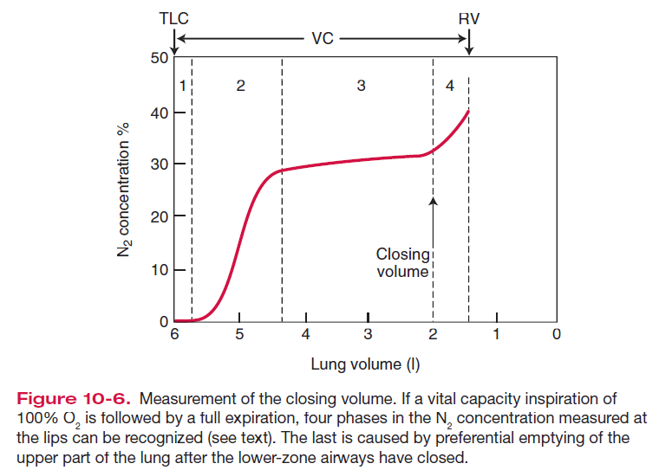
Single Breath Nitrogen Washout

Slide 56
Fowler’s method for VD (Anatomical)
)

Slide 57
Bohr equation VD Physiological

Slide 58
Fick’s Diffusion law

Slide 59
Examples of diffusion- and perfusion-limited gases are carbon monoxide and nitrous oxide, respectively.
Oxygen transfer is normally perfusion limited, but some diffusion limitation may occur under some conditions, including intense exercise, thickening of the blood-gas barrier, and alveolar hypoxia.

Slide 60
DLCO

Slide 61
DL_{CO} - interpretation
DL_{CO} ↓ by:
Pulmonary vascular diseases
Conditions affecting alveoli
Cardiac diseases
Anaemia
Pregnancy
Recent smoking

Slide 62
DL_{CO} - interpretation
DL_{CO} ↑ by
Polycythaemia
Pulmonary haemorrhage
L to R shunt
Exercise

Slide 63
Blood Flow
The volume of blood passing through the lungs each minute (Q) can be calculated using the Fick principle.
This states that the O2 consumption per minute (VO2) measured at the lungs is equal to the product of blood flow and A-V concentration gradient of O2.

Slide 64
Blood Flow
arterial pressure is reduced (severe hemorrhage,)
alveolar pressure is raised (PPV)

Slide 66
Ventilation Perfusion Relationship

Slide 67
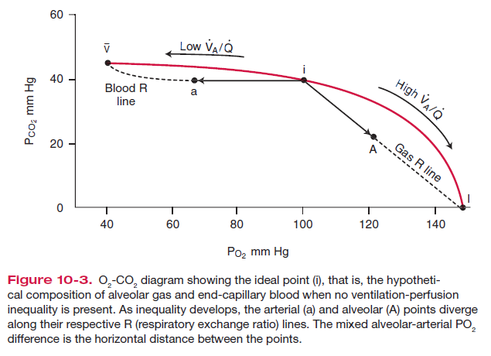
V-P ratio

Slide 69
VP in Normal

Slide 70
V-P in disease

Slide 71
TESTS FOR GAS EXCHANGE FUNCTION
1) ALVEOLAR-ARTERIAL O2 TENSION GRADIENT:
High values at room air is seen in asymptomatic smokers & chronic. Bronchitis (min. symptoms)
PAO2 = PIO2 – PaCo2
R

Slide 72
Blood Gases and pH
causes of low arterial Po2, or hypoxemia:
(1) hypoventilation,
(2) diffusion impairment,
(3) shunt, and
(4) ventilation-perfusion inequality

Slide 73
Oxygen cascade

Slide 75
causes of an increased arterial Pco2:
(1) hypoventilation
(2) ventilation-perfusion inequality

Slide 76
Hypoxemia
Calculate A-a gradient if normal then hypoventilation or altitude
If >20 then V/Q mismatch, shunt or diffusion
Shunt does not respond to O2

Slide 77
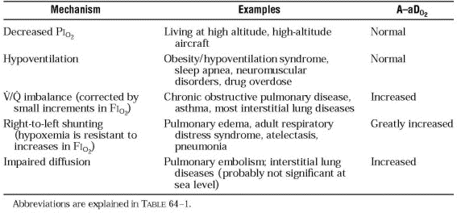

Slide 78
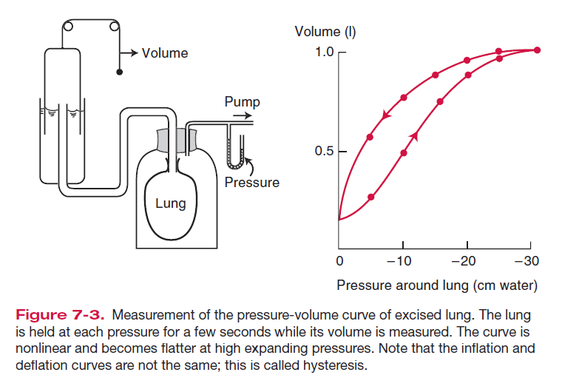
Mechanics of Breathing
Lung Compliance
Compliance is defined as the volume change per unit of pressure change across the lung.
To obtain this, we need to know intrapleural pressure.

Slide 82
Airway Resistance
Airway resistance is the pressure difference between the alveoli and the mouth per unit of airflow.
Airway resistance is the pressure difference between the alveoli and the mouth divided by a flow rate.
Mouth pressure is easily measured with a manometer.
Alveolar pressure can be deduced from measurements made in a body plethysmograph.

Slide 83
Airflow Resistance

Slide 84
Closing Volume
The volume of lungs above the RV at which the small airways close is the closing volume.
In young normal subjects, the closing volume is about 10% of the vital capacity (VC).
It increases steadily with age and is equal to about 40% of the VC, that is, the FRC, at about the age of 65 years.
Relatively small amounts of disease in the small airways apparently increase the closing volume.

Slide 85
pure dead space(1),
a mixture of dead space and alveolar gas (2),
pure alveolar gas (3)
end of expiration, an abrupt increase in N2 (4)

Slide 86
Control of Ventilation
The responsiveness of the chemoreceptors and respiratory center to CO2 can be measured by having the subject rebreathe into a rubber bag.
The ventilatory response to hypoxia can be measured in a similar way if the subject rebreathes from a bag with a low Po2 but constant Pco2.

Slide 87
Exercise Testing
Exercise testing can be valuable in detecting small amounts of lung disease.

Slide 88
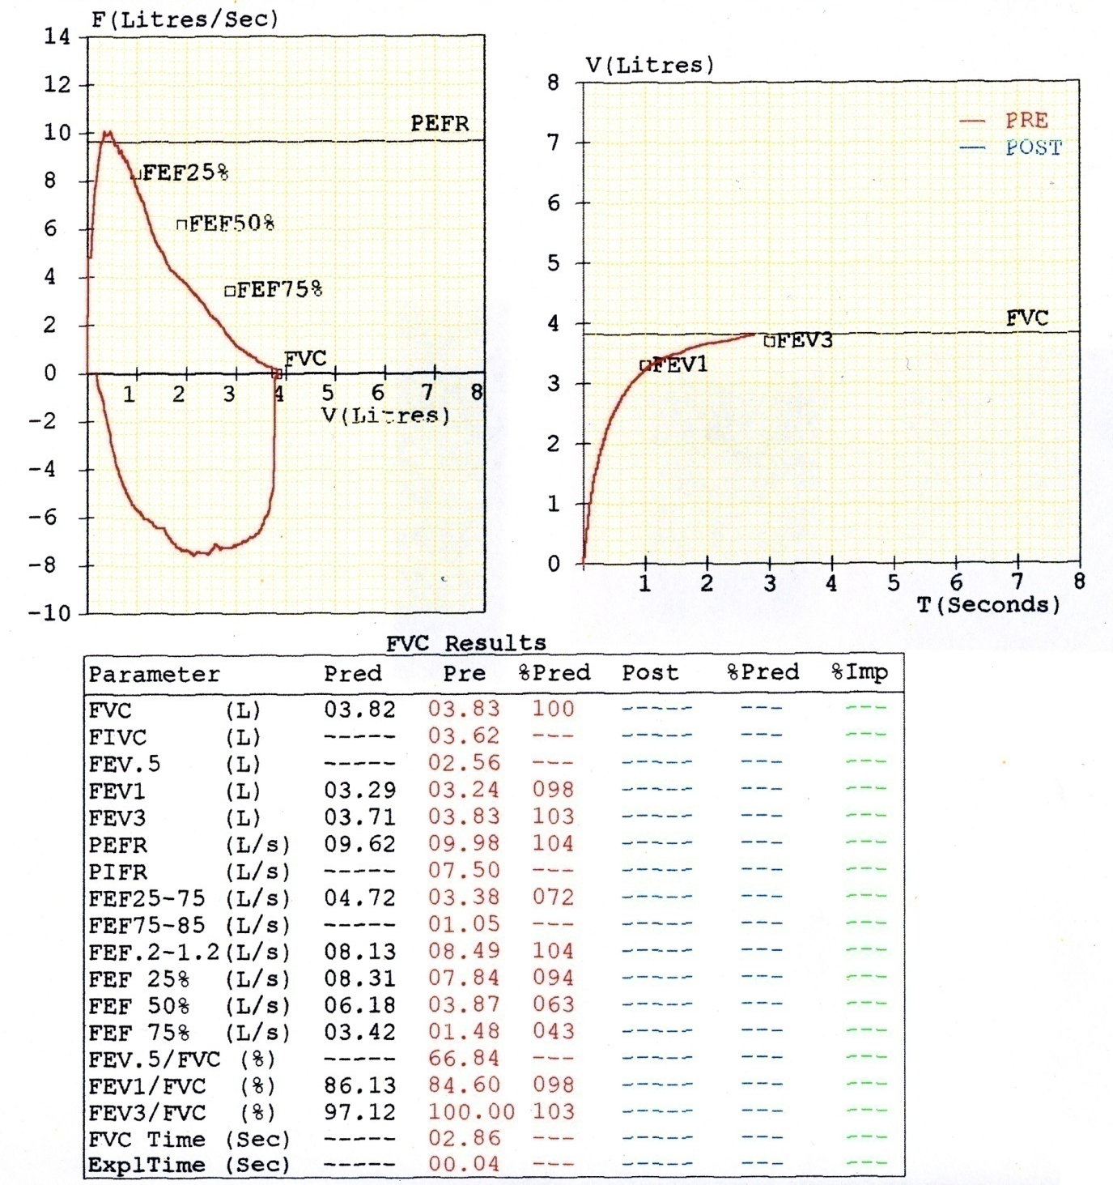
Peak/Descent/Cough /Loop
Expl time/FET/ Reproducibility

Slide 89
Day-1 :
FEV1/FVC :82.51 (108%)
FVC : 2.23 (66%)
FEV1 : 1.84 (71%)
What is the diagnosis ?
: Restrictive Pathology
Day 14 :
FEV1/FVC : 89%
FVC : 3.04 L.(90%)
FEV1 : 2.71 (105%)
: Normal

Slide 90
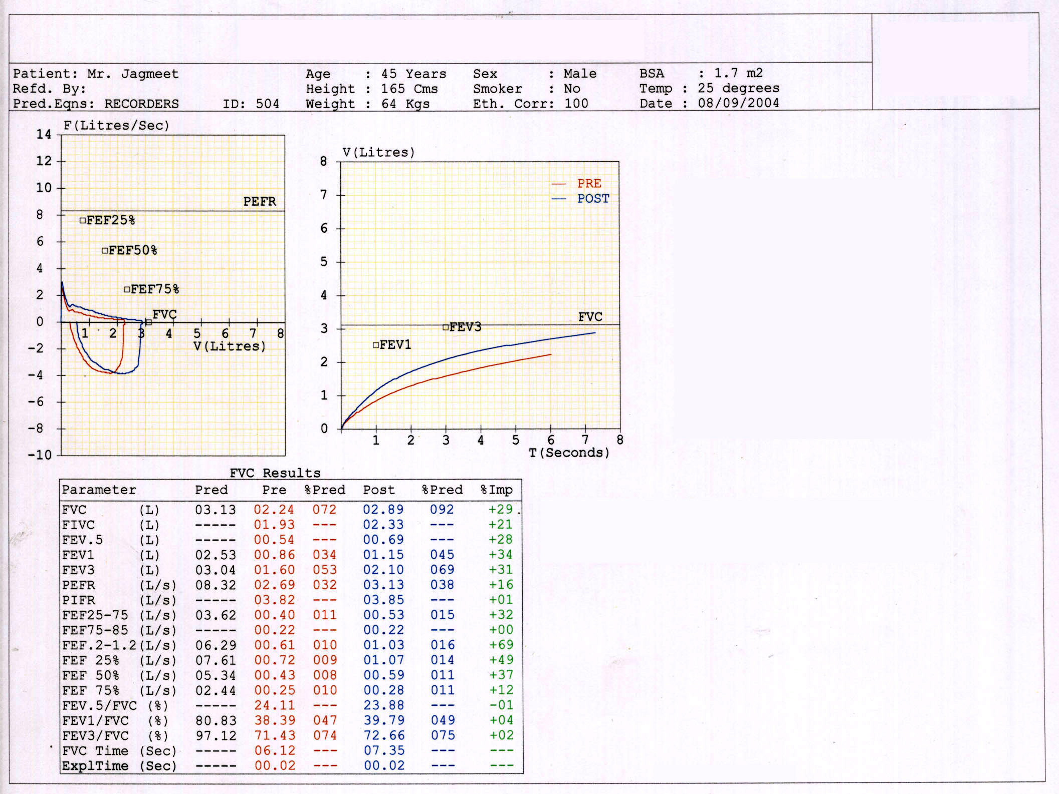
Pre-bronchodilator spirograph
shows :
FEV1/FVC : 38.39%(Very low )
FVC : 2.24 (72 % pred.)
FET : 6.12 sec.
Diagnosis ?
Obstructive airway disease
Post- bronchodilatation spirograph
shows:
Δ FVC : 650 ml (29 %)
Δ FEV1 : 290 ml (34%)
What is your final diagnosis ?
Reversible airway obstruction-Bronchial Asthma

Slide 91
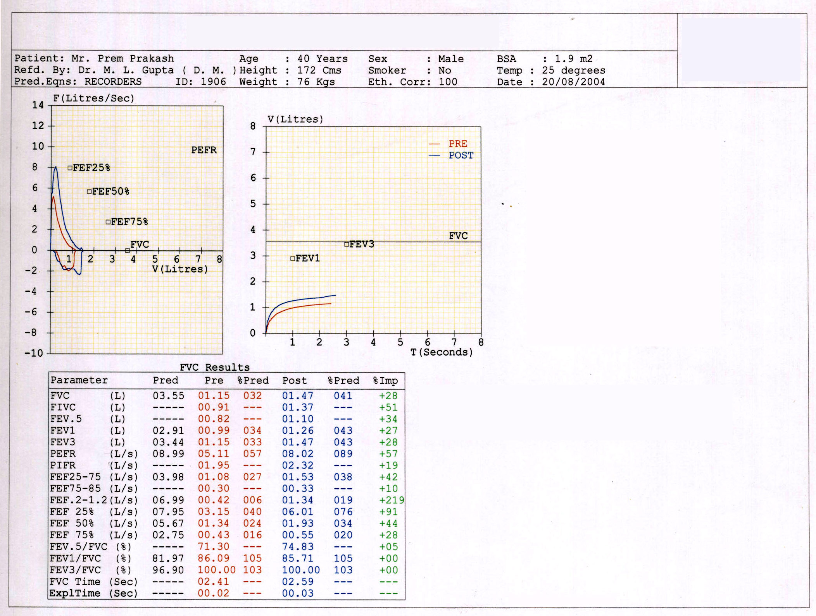
This patient came with history of proxysmal cough ,breathlessness
Pre bronchodilator
spirometry findings are:
FEV1/FVC : 86.09 %(normal)
FVC : 1.15 L.(32% of pred.)
Diagnosis :
Restrictive Pathology
But, Post bronchodilator reading shows:
Δ FVC : 320 ml (28%)
Δ FEV1 : 270 ml (27%)
Now diagnosis is……
How to explain :
Normal FEV1/FVC ratio
Inadequately expiratory time result in false increase in FEV1 ratio.
Pearl : Obst. Disease,FET

Slide 92
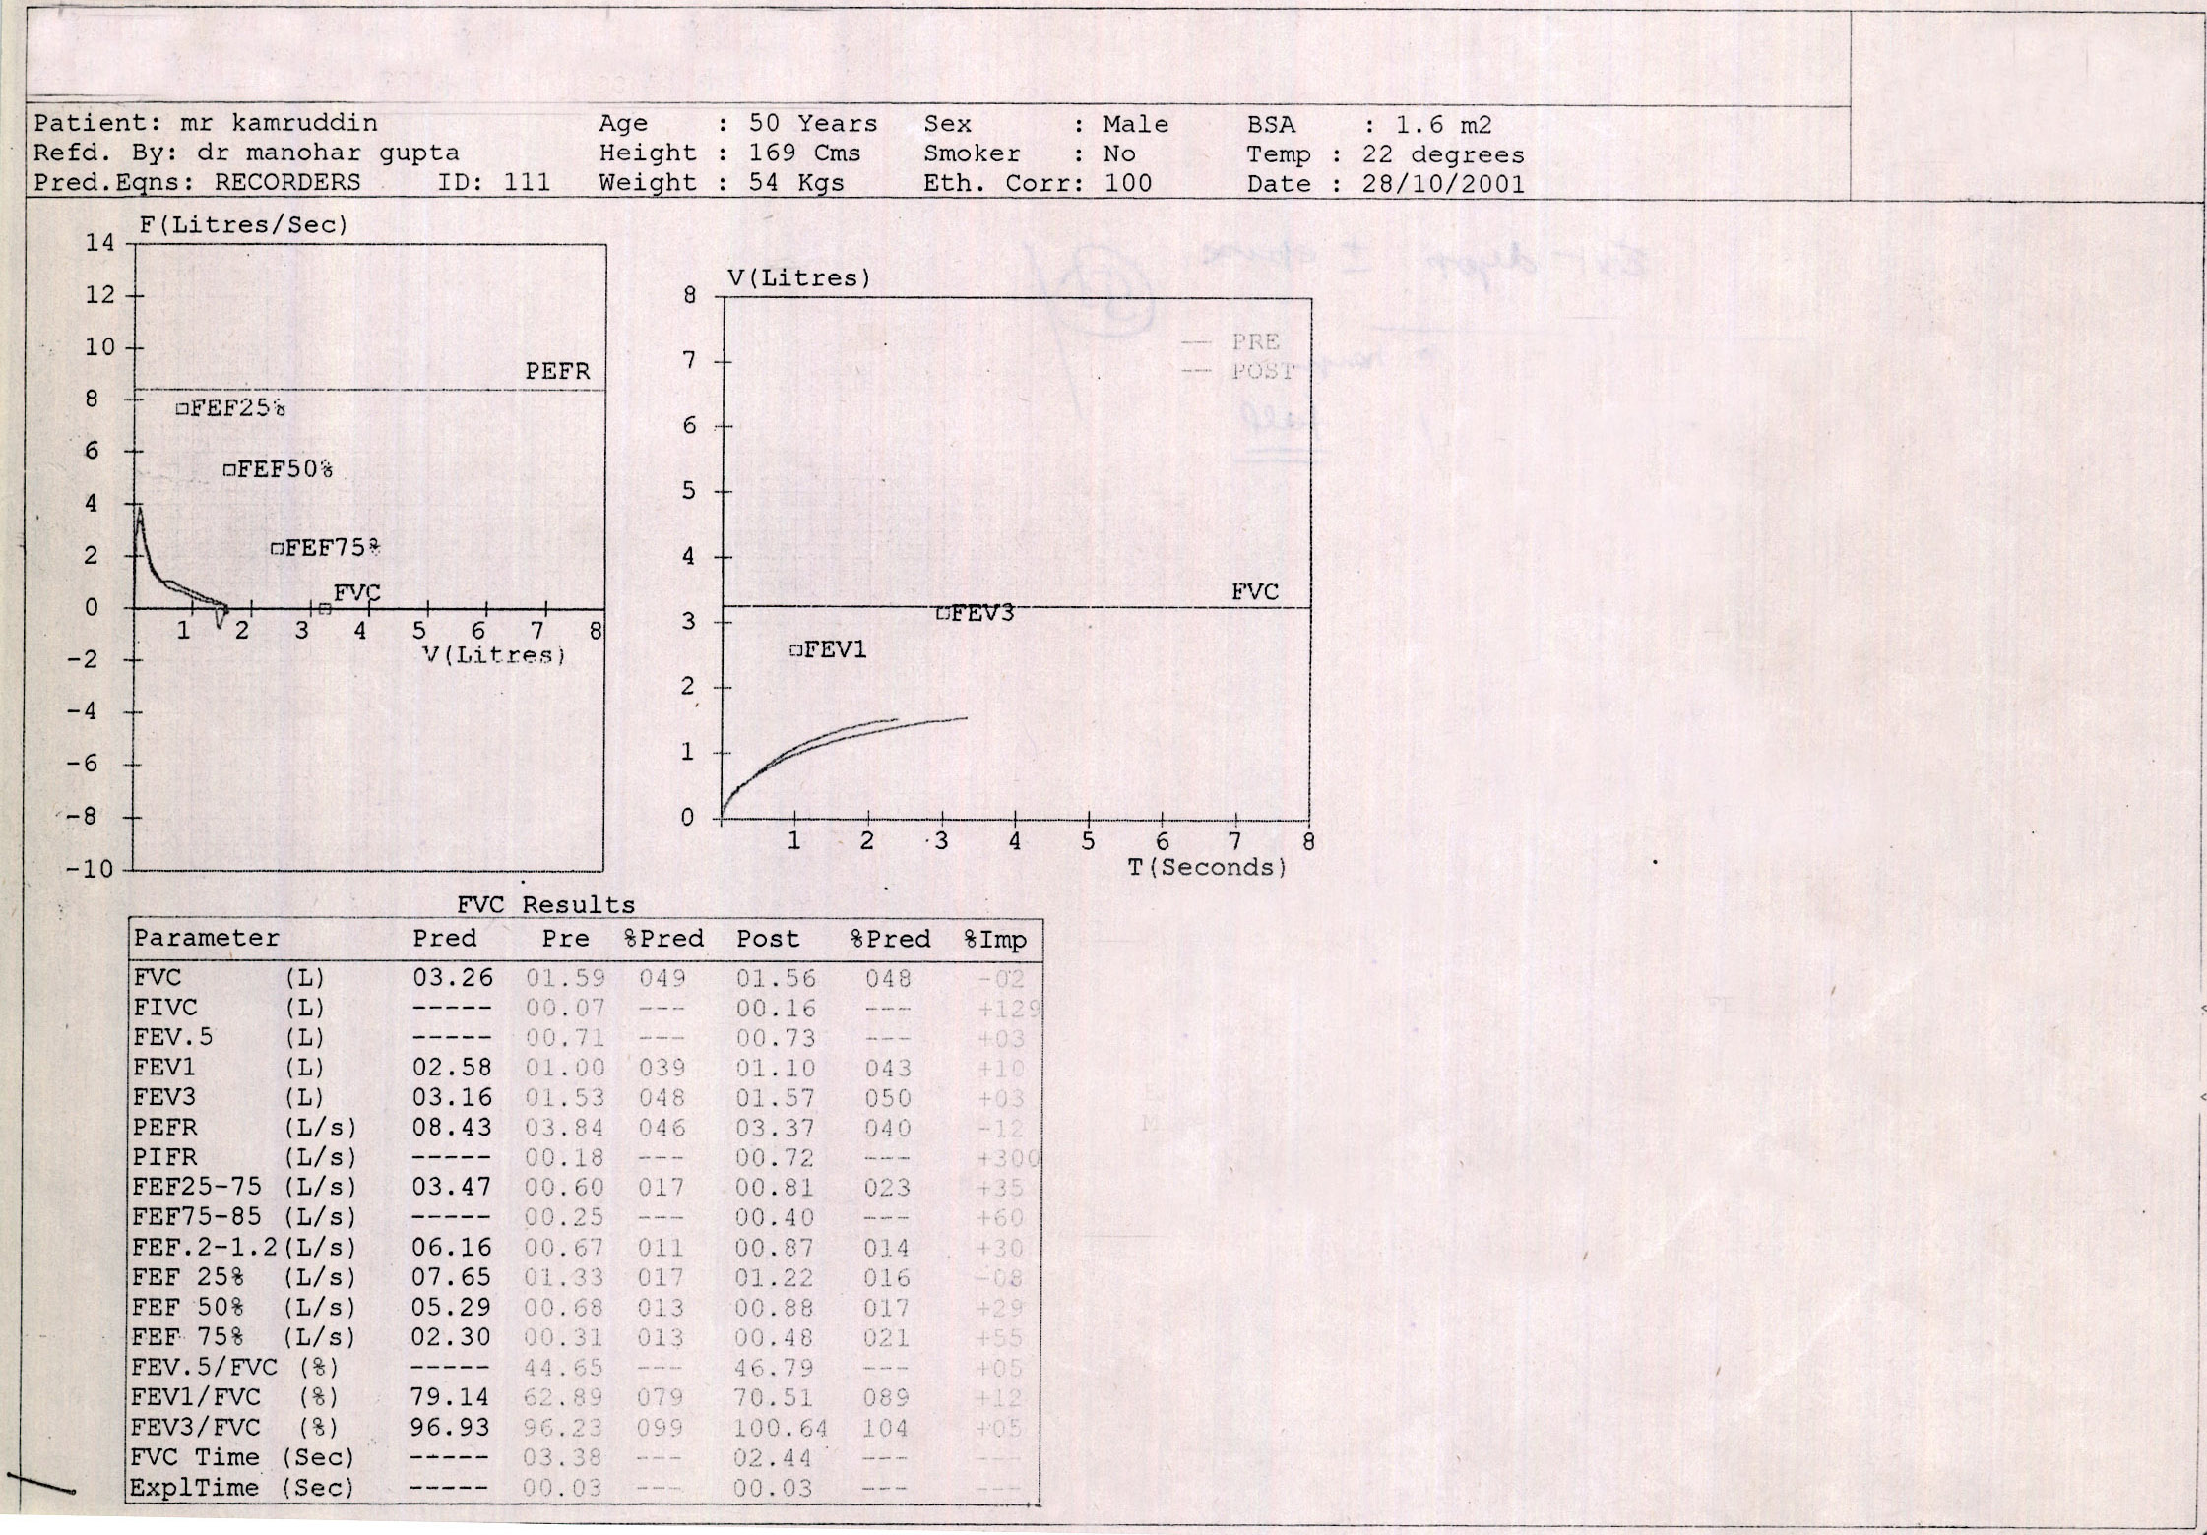
This spirometry has
FVC : ↓(1.59 L.49% pred)
FEV1/FVC : 62%
Post-bronchodilation
FVC - ↓ 2 %
FEV1 -No Change
What is the diagnosis?
-Irreversible airway obstruction
What is the cause of disproportionate decrease in FVC
Inadequate expiratory time
Loss of lung tissue
Bullae/Pneumothorax
Associated restrictive pathology
Repeat PFT with long FET

Slide 93
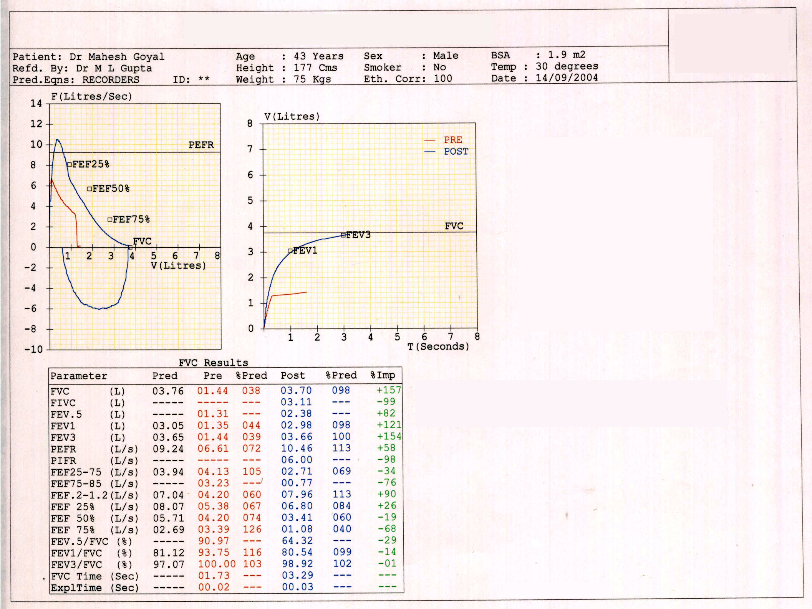
Red spirograph shows-
FEV1/FVC : Normal (93.75)
FVC : low (38%)
Diagnosis ?
Restrictive disorder
NO , because
Patient has stopped expiring suddenly as evident by vertical drop in flow rate
Blue color graph shows :
FEV1/FVC : NORMAL(80%)
FVC : NORMAL (3.70)
FET : NORMAL
NORMAL SPIROMETRY
PEARL :Vertical drop in expiratory flow volume loop is unacceptable.
Inadequately effort will result in false increase in FEV1/FVC ratio.

Slide 94
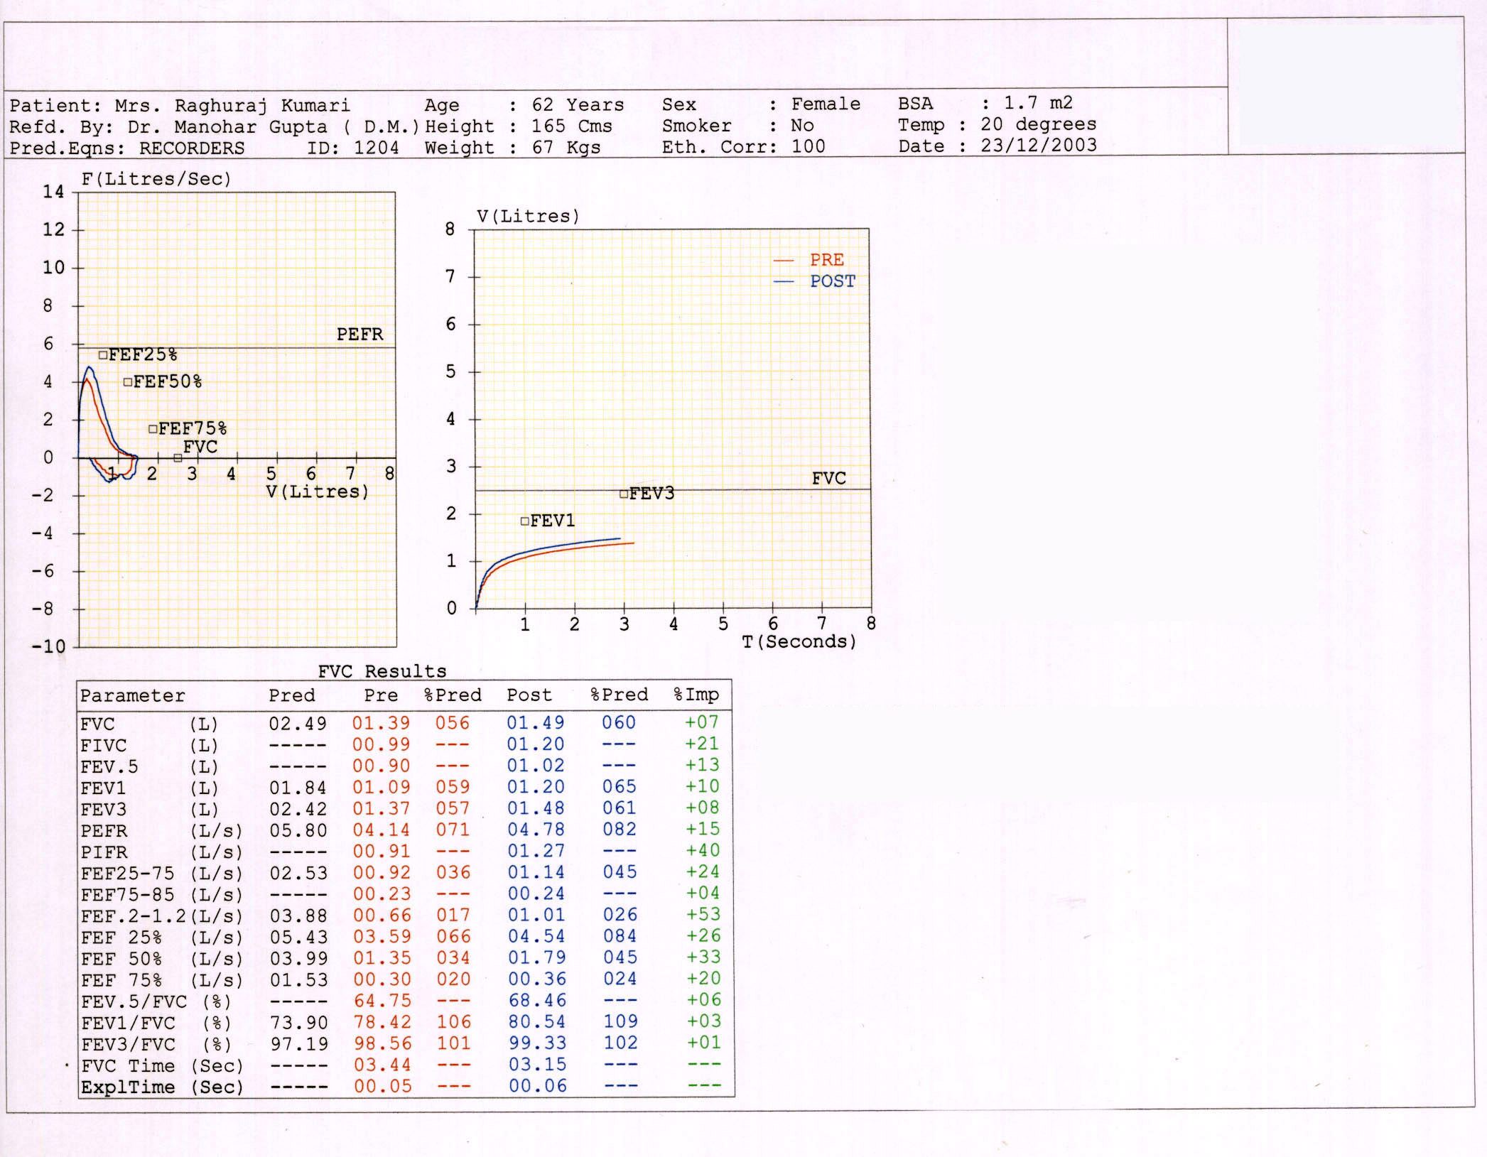
This non smoker female came with symptoms of cough and breathlessness following coryza
Spirometric findings are:
FEV1/FVC : 78.42% (normal)
FVC : 60% of Predicted
FEV1 : 65 % of Predicted
What is the diagnosis ?
Restrictive disorder
But,what about the disproportionate low reading of FEF 25-75 %:
:0.92 L/S.(only 36% of pred.)
Due to small airway disease (Bronchiolitis Obliterans)
Reduced in FEF 25-75 % with normal FEV1/FVC ratio.

Slide 95
SUDDEN CESSATION OF EXPIRATION
Vertical drop in expiratory flow volume loop

Slide 96
LEAK AROUND THE MOUTH
Incomplete flow volume loop

Slide 97
FIXED UPPER AIRWAY OBSTRUCTION
Flattening of both inspiratory & expiratory flow volume loops

Slide 98
VARIABLE EXTRA THORACIC AIRWAY OBSTRUCTION
Flattening of inspiratory loop

Slide 99
VARIABLE INTRA THORACIC AIRWAY OBSTRUCTION
Flattening of expiratory loop of flow volume curve

Slide 100
HESITANT START/ TECHNICALLY UNACCEPTABLE
Increased back extrapolated time (>0.05 sec)

Slide 101
COUGH/ UNACCEPTABLE TRACING
Large undulations during early part of expiration

Slide 102
COUGH / ACCEPTABLE
Small undulations in the later part of expiration

Slide 103
DIAPHRAGMATIC PALSY
2
1
Spirometry in sitting (1) & supine(2) position

Slide 104
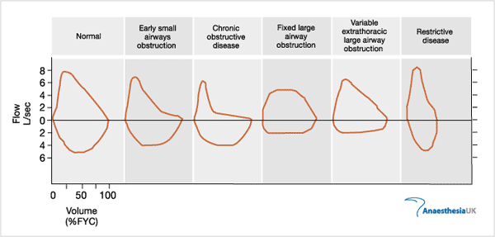

Slide 105
THANK YOU!

