Slide 1
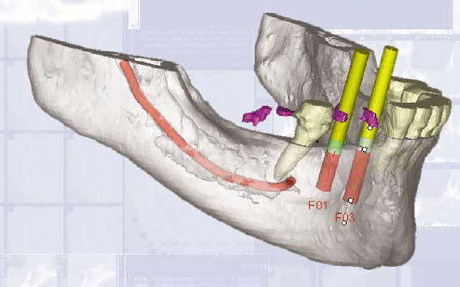
Diagnostic Imaging in implantology
harit talwar
Jr iii

Slide 2
content
introduction
Imaging objectives
Pre prosthetic implant imaging
Imaging modalities
Peri apical radiography
Panoramic radiography
Cephalometric radiography
Tomography
Computed tomography
Magnetic resonance imaging
Interactive computed tomography

Slide 3
Latest advancement
Diagnostic templates
Surgical interventional implant imaging
Post prosthetic implant imaging
conclusion

Slide 4
introduction
In recent years, great interest has been focused on implantology and its role in dentistry.
With the development of various types of endosseous implants, it has become possible to restore function and esthetics in patients with severely compromised dentitions

Slide 5
bone quantity, quality and biological factors are determining factors in the success of implant treatment, and therefore need to be assessed prior to implant placement.
A thorough clinical and radiologic evaluation of patients is required to determine the presence of pathologic conditions (retained roots, cysts, infection, lesions, and so forth) when treatment planning for implants.
Diagnostic images are always needed to assess bone sites for implant placement; the number, angulation, and dimension {length and width) of implants is dependent on the available bone volume.

Slide 6
OBJECTIVES OF IMAGING
it should provide the clinician with cross sectional views of the dental arch for visualization of spatial relationship of internal structures.
minimal image distortion to permit accurate measurement.
the images should allow evaluation of the density of trabecular bone and thickness of the cortical plates(bone quality).

Slide 7
Spatial relationship of the cross sectional views of mandible & maxilla to one another.
A simple means of identifying the exact location of each c/s image to the implant site that can be provided during surgery.
Presence or absence of pathoses
Minimal radiation exposure to patient
should be readily assessable at a reasonable cost to the patient.

Slide 8
PRE-PROSTHETIC IMPLANT IMAGING
objectives of pre-prosthetic imaging
Identify disease - Detection of jaw pathology
Determine bone quantity - – Height and Width
Determine bone Quality - Density
Identify critical structures at the proposed implant regions - Determination of internal anatomy and jaw boundaries
Determine the optimum position of implant placement relative to occlusal loads.

Slide 9
Types of Radiography
Plain film radiography
Digital radiography

Slide 10
Plain film radiography
Intra-oral radiography
Cephalometric radiography
Panoramic radiography
Film tomography

Slide 11
Digital radiography
Intra-oral radiography
Computed tomography
MRI

Slide 12
Plain film radiography

Slide 13
Intra-oral radiography
It is still the most widely used modality for pre and postoperative implant assessment.
Both peri-apical and occlusal radiographs provide the best image details with minimal geometric distortion.
They can resolve more than 20 pairs of lines per millimeter which is twice the resolving power of extraoral radiograph.

Slide 14
Periapical Radiograph
Provide detailed information regarding the dimensions in length and height of available bone in small sections.
They are indicated for single tooth replacement.

Slide 15
Advantages
Approximate vertical height of alveolar ridge can be determined
Best image detail with minimal image distortion
Location of some critical anatomic structures( mental foramen, inferior dental nerve canal & maxillary sinus)
Information about bone quality (density, trabecular pattern) and presence/absence of pathoses is revealed
Films readily available to clinician
Low cost to patient

Slide 16
Disadvantages
Correct positioning of film is difficult in edentulous region.(The film plane can rarely be placed parallel with the alveolar process )
This modality is limited by its 2D-They do not give information regarding the bucco-lingual dimension.

Slide 17
Klinge B et al Found that the mandibular canal could not be identified by periapical radiography in 25% of proposed implantation sites.
They also reported that in those cases in which the canal was seen, only 53% of the measurements made from the crest of the alveolar ridge to the most superior border of the mandibular canal were accurate within 1 mm.
Location of the mandibular canal: comparison of macroscopic findings, conventional radiography, and computed tomography. Int J Oral Maxillofac Implant 1989;4(4):327-32

Slide 18
Occlusal radiograph

Slide 19
Occlusal radiograph
Usually used in conjunction with the peri-apical radiographs.
They are capable of demonstrating almost the entire alveolar process of either the maxilla or the mandible.

Slide 20
Advantages
Good image detail
Indication of buccal-lingual dimension of mandible
Determination of jaw size, jaw curve at proposed implant site
Readily accessible to clinician
Low cost to patient.

Slide 21
Disadvantages
Mandibular occlusal radiograph best describes maximum width of the bone ,which is usually at the base of the jaw & fails to show the medial and lateral extent of cortical bone delineating the alveolar process
This modality is limited by its 2D nature.
A true cross sectional view in the axial plane unobstructed by superimposition is possible only in the mandibular arch.

Slide 22
Cephalometric radiograph
It displays an image of the skull and facial bones in the mid-saggital plane.

Slide 23
Cephalometric radiograph
It provides more accurately the information on inclination, height and width of alveolar bone at the midline, when compared to panoramic radiographs.
It provides information regarding the relationship of the jaws when image is taken with teeth in occlusion.
Position and relationship of mental foramen, nasal fossa and maxillary sinus to the adjacent structures can be assessed.

Slide 25
Advantages
Height/width information is revealed in the anterior mandible/maxilla
Images are cross-sectional images
Low radiation dose; low cost to patient

Slide 26
DISADVANTAGES
A 6-15% image magnification occurs which is undesirable as it leads to measurement errors of implant site.
Image resolution is less when compared to intraoral radiographs.

Slide 27
Panoramic radiography

Slide 28
PANORAMIC RADIOGRAPH
Panoramic radiography is a curved plane tomographic radiographic technique used to depict the body of the mandible, maxilla and the lower one half of the maxillary sinuses in a single image.

Slide 29
They display anatomic structures like nasal cavity, maxillary sinus, inferior alveolar canal and mental foramen.
Indicated when multiple implant placements are planned.

Slide 30
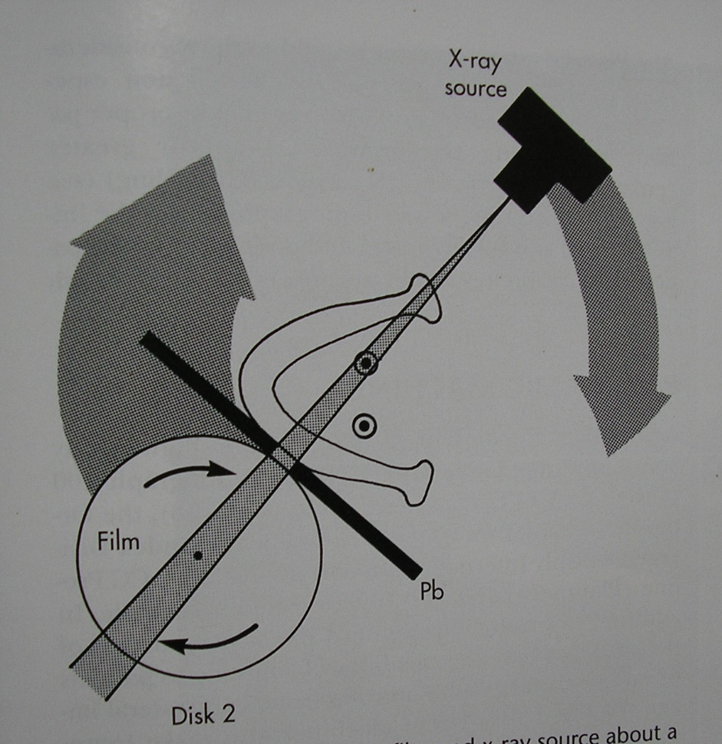

Slide 31
Advantages
Excellent "screening" film for pre-surgical implant planning
Opposing landmarks are easily identified.
The vertical height of bone initially can be assessed
Readily accessible: low cost to patient
Minimal radiation dose
Demonstrates presence/absence of pathoses

Slide 32
Disadvantages
The resolution is lesser when compared to intraoral radiograph.
A 10-20% image magnification occurs, which is non uniform. This magnification is undesirable for both implant selection and implant site assessments.
Geometric distortion and overlapping of images of teeth can occur.
Overlapping of anterior region by vertebral column occurs.
Does not demonstrate bone quality/ mineralization

Slide 33
Film tomography
Tomography is a generic term, formed from the Greek words tomo (slice) and graph (picture).
Conventional film based tomography (body section radiography) is a radiographic technique designed to image more clearly objects lying within a plane of interest.
This is accomplished by blurring the images of structures lying superficial & deep to the plane of interest.

Slide 34
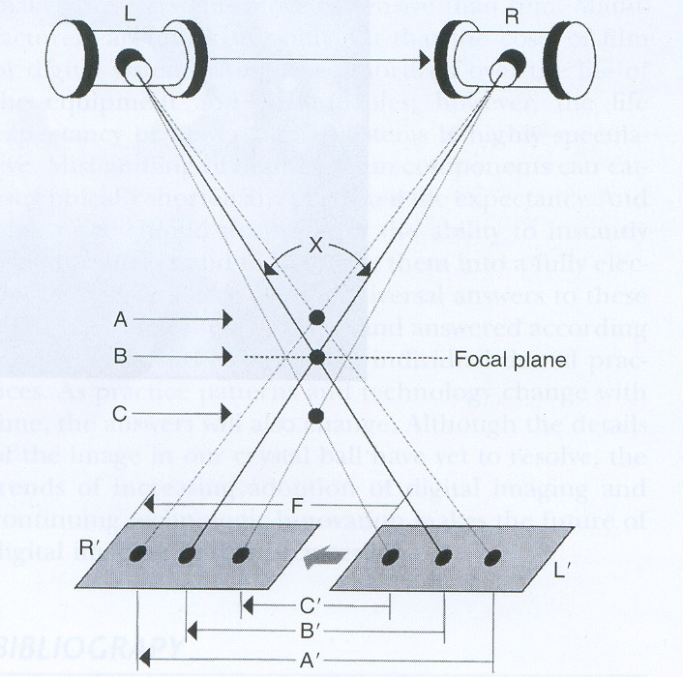
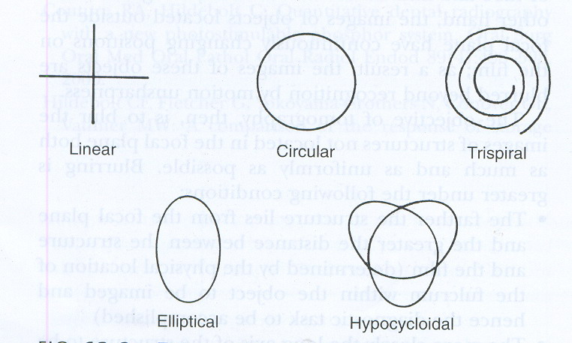
TOMOGRAPHIC UNIT

Slide 36
It has been successfully applied to dental implant diagnostics for accurate assessment of alveolar bone height, width and inclination.
It can assess both the quality and the quantity of bone.
It gives information regarding the spatial relationship of vital structures .

Slide 37
Advantages
Produces cross-sectional images of specific proposed implant sites
Assessment of bone height, width and inclination of ridge
Assessment of bone quality
Determination of anatomic spatial relationship
Exact imaging and detailed view of specific implant site

Slide 38
Little or no superimposition
Selection of varying slice thickness and slice location Relatively low exposure to patient
Development of treatment planning software for certain imaging systems.

Slide 39
Disadvantages
Insufficient contrast when compared to intraoral radiographs.
It is an expensive modality.
An expert radiologist is needed to interpret the image.

Slide 40
Digital radiography
Even though the x-ray film is versatile (serves as the recording, display & storage medium for diagnostic images)
it is relatively inefficient as a detector of radiation, requiring relatively high doses for exposure
it requires chemical processing by solutions that are potentially allergenic & polluting.

Slide 41
The application of computer technology to radiography has allowed image acquisition, manipulation, storage, retrieval, & transmission to remote sites in a digital Format..

Slide 42
Digital imaging requires the following components: Electronic sensor, a computer with an analog-to-digital Converter & a monitor for image display.

Slide 43
The image is captured on a CCD in the patients mouth.
The signal from the CCD is sent to the computer ,where it is digitised.
The image can then be displayed on the monitor,where it can be enhanced by varying the density and contrast.The image may also be stored for future use,printed if a hard copy is required ,or transmitted electronically to a remote site.

Slide 44
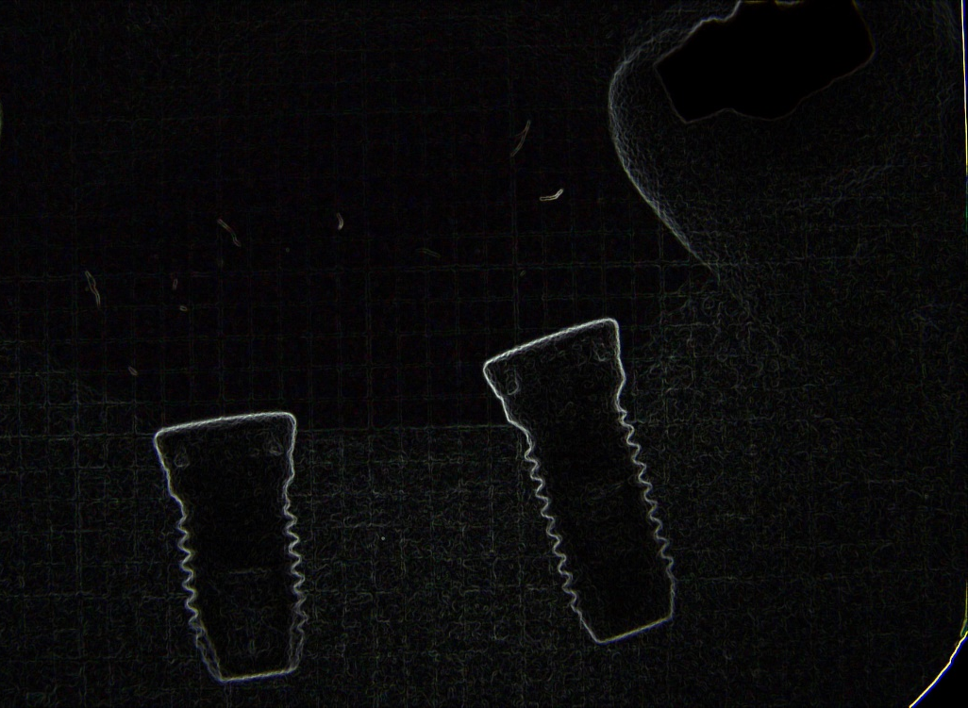
Contrast enhancement
EDGE ENHANCEMENT

Slide 45
VOLTAGE INVERSION

Slide 46
Color enhancement

Slide 47
Disadvantages
Digital radiography lacks the resolution of film radiography.
This technique is used for presurgical site evaluation

Slide 48
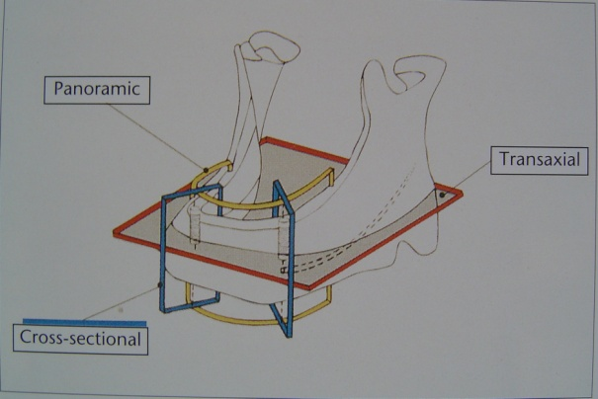
Computed tomography
Considering the new age tool, it blends the concept of thin layer radiography (tomography) with computer synthesis of image.
It was first applied successfully in implantology in the 1980’s. In computed tomography (CT), multiple thin axial slices at small distances are obtained through the jaws and data is reformatted with special software package to produce cross-sectional, panoramic and 3D images.

Slide 50
The CT always images entire arch, and normally is not used for single tooth replacements.
It can determine bone density in any region of the jaw. The 3D image helps in accurately locating the vital structures.
Operator has an access to full range of contrasts.
It automatically calculates bone height and width in a specified region.
Slice thickness ranges from 2-10mm- even smaller slices (1.0mm)-Tomography on the micrometer level-Microtomography.

Slide 51
Disadvantages
It is an expensive modality.
An expert radiologist required to interpret the image.
High radiation dosage when compared to conventional radiographic technique.
Patient's head position must remain constant throughout the entire imaging process of about 15-20 min.

Slide 52
RECENT ADVANCES IN
COMPUTER TOMOGRAPHY

Slide 53
TACT (Tuned aperture computer tomography)
IT'S A NEW AND PROMISING IMAGING MODALITY, WHICH IS BASED ON THE PRINCIPLES OF DIGITAL TOMOSYNTHESIS.
THE TUNED APERTURE COMPUTED TOMOGRAPHY (TACT) CAN SELECTIVELY EXAMINE SMALL SEGMENTS WITHOUT EXPOSING ENTIRE AXIAL PLANE.

Slide 54
In CT –not possible to examine selectively small segments of anatomy.
To improve image quality better sampling & display parameters are needed, but it increases radiation dose & cost.
In TACT based on optical aperture theory, uses information collected by passing a radiograph beam through an object from several different angles.

Slide 55
TACT can map the incrementally collected data into a single 3-D matrix.
Because projection geometry can be calculated after individual exposures, problems of patient movement are of less significance than in other modalities.
There is considerable flexibility adjusting contrast & resolution to answer specific questions.
Radiation dose levels are comparatively low.

Slide 56
Disadvantages
Information available about this modality is limited and restricted to very few studies.
It's application to implantology is still in research phase.

Slide 57
Cone beam CT Scanning
There are many advantages over traditional CT scans.
First, with cone beam CT scanning the patient is subjected to far less radiation, because a focused beam is used with a larger sensor allowing to capture all the axial slices covering the face and the jaws
The entire volume is captured with one scan, there is no redundant overlap of slices, resulting in major reduction of radiation.

Slide 59
A cone beam CT scan,(i-CAT), provides a true reproduction of the patient’s anatomy.
The dimensions represented in the cone beam imaging correspond exactly to the patient.
There is no distortion. The dimensions are accurate.

Slide 60
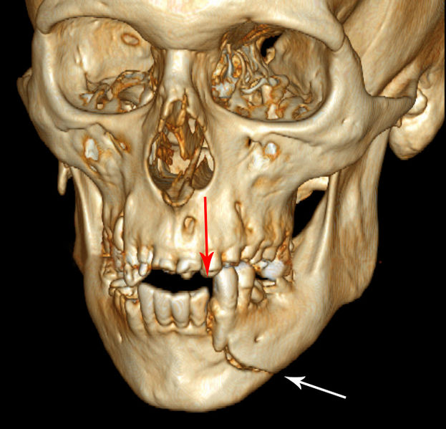
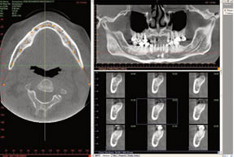
(i-CAT) Cone Beam 3-D Imaging System produces immediate 3-D images of patients‘ critical anatomy, typically in under one minute.

Slide 61
Magnetic resonance imaging
Magnetic resonance imaging (MRI) is based on the phenomenon of nuclear magnetic resonance (NMR). First described in 1946, its application in implantology is however of recent origin.

Slide 62
The MRI can sharply delineate soft and hard tissues.
It can differentiate between cortical and cancellous bones.
The biggest advantage of MRI is 'zero radiation dose.‘
Flexibility of plane acquisition.
Gives good soft tissue details.
Low level of imaging artifacts

Slide 63
Slices are parallel to the jaw at implant site
Slices are planned at right angles to implant site

Slide 64
Disadvantages
It is an expensive tool.
At present no special software is available for specific use in implantology.
An expert radiologist is required to interpret the image.
The MRI application in implantology is still in its experimental phase.

Slide 65
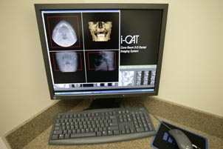
INTERACTIVE COMPUTED TOMOGRAPHY
bridge the gap in information transfer between the radiologist and the practitioner.
The dentist's computer becomes a diagnostic radiologic workstation.
electronic surgery can be performed.

Slide 66
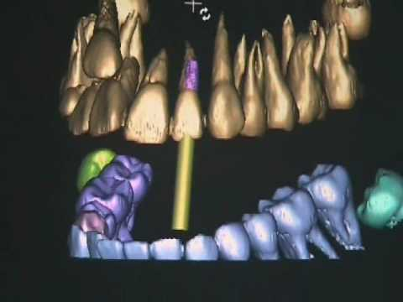
SIMPLANTS
recently developed interactive 3-dimensional CT software program
The objective of the software program is to determine the quantity and quality of bone and relate implant placement to proper prosthetic requirements.
Notes:
has made it possible to visualize the anatomical structures in a 3-dimensional mode on computer monitors for interactive implant placement.

Slide 67
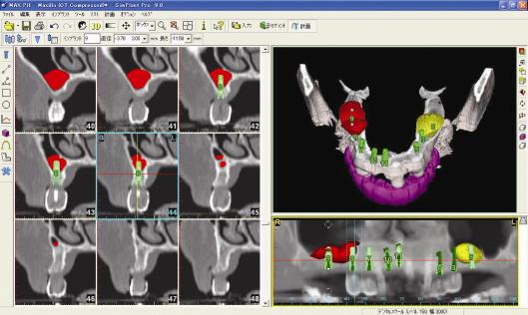
SIMPLANT SOFTWARE
Notes:
The software allows treatment planning for the ideal position of the implants in both 2D and 3D, while taking into account clinical and aesthetical considerations.

Slide 68
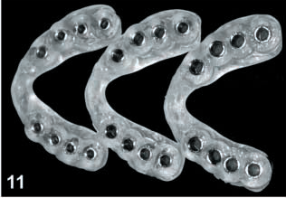
SURGIGUIDE DRILL GUIDES
Notes:
SurgiGuide drill guides are custom-made, patient specific surgical drill guides made from the SimPlant treatment plan. SurgiGuide drill guides guide the drill during surgery to the exact implant location and the exact angulation as planned

Slide 69
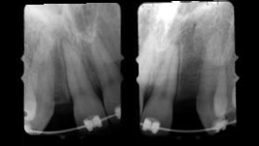
PRE-TREATMENT RADIOGRAPHS

Slide 70
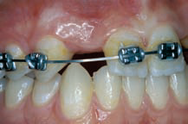
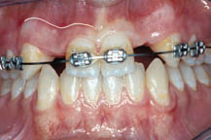
ORAL EXAMINATION

Slide 71
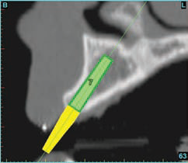
CT DATA WITH TREATMENT PLANNING SOFTWARE

Slide 72
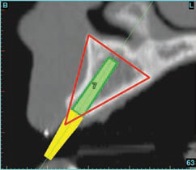
TRIANGLE OF BONE

Slide 73
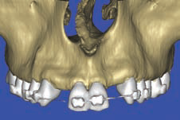
MULTIPLANAR RECONSTRUCTION OF IMAGE

Slide 74
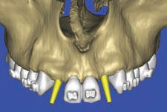
VIRTUAL IMPLANT PLACEMENT

Slide 75
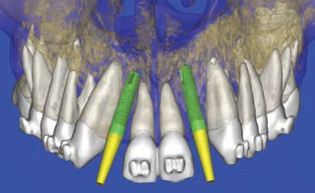
VIRTUAL IMPLANT PLACEMENT

Slide 76
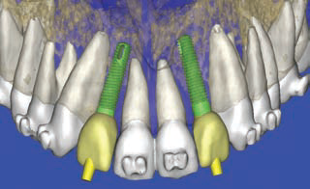
USE OF VIRTUAL TEETH TO CHECK FINAL IMPLANT PLACEMENT

Slide 77
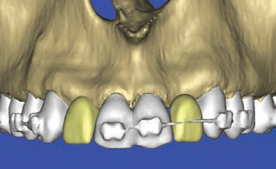
DESIRED VIRTUAL IMAGE FOR ESTHETICS

Slide 78
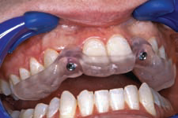
SURGICAL TEMPLATE FABRICATED

Slide 79
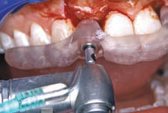
SURGICAL INTERVENTION

Slide 80
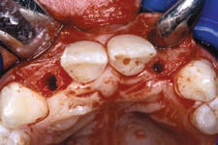
SURGICAL INTERVENTION

Slide 81
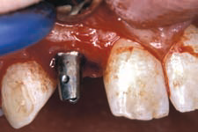
IMPLANT PLACEMENT

Slide 82
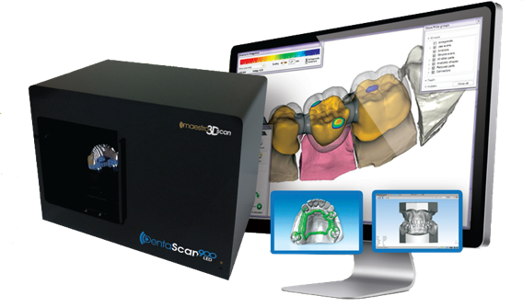
DENTASCAN
Dentascan imaging provides programmed reformation, organization, and display of the imaging study.
Notes:
The radiologist or technologist simply indicates the curvature of the mandibular or maxillary arch and the computer is programmed to generate referenced cross-sectional and tangential/panoramic images of the alveolus along with three-dimensional images of the arch

Slide 83
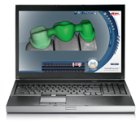
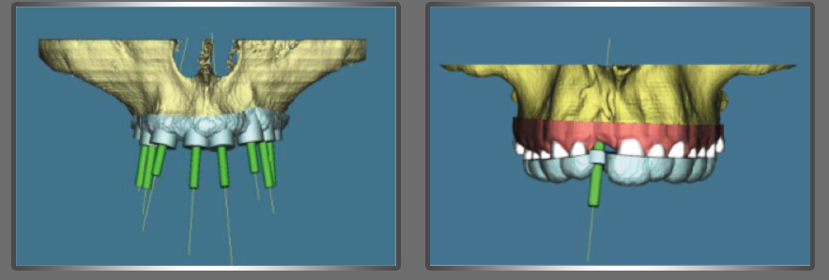
PROCERA SOFTWARE
Allow dentist to place implants by using surgical guide and fixed prosthesis during a single dental visit.

Slide 84
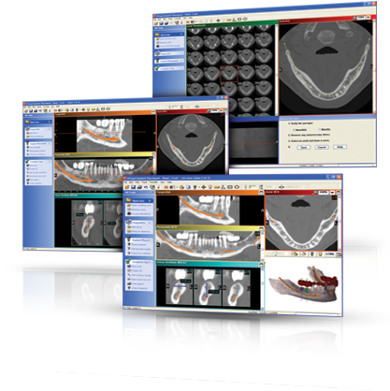
VIRTUAL IMPLANT PLACEMENT SOFTWARE
RECENTLY developed software.
Eliminated the need of radiographic guide .
Notes:
Simplified the process of implant planning and placement by eliminating the requirement for fabrication of a radiographic guide
allows the clinician to scan both the patient’s maxillofacial region of interest and the stone dental casts with CBCT.
all planning and guide fabrication can be completed by means of a virtual patient model

Slide 85
OTHER SOFTWARES
EASY GUIDE
IMPLANT MASTER
Nobel Guide
Implant 3D
Facilitate 11

Slide 86
Diagnostic templates

Slide 87
Radiographic Template
The purpose of diagnostic radiographic templates is to incorporate the patient’s proposed treatment plan into the radiographic examination
The pre-prosthetic imaging procedure enables evaluation of the proposed implant site at the ideal position and orientation identified by radiographic markers incorporated into the template.

Slide 88
Earlier surgeons placed implants where the greatest amount of bone was present, without regard to placement of the final restoration.
This often led to a compromised final prosthesis with a jeopardized occlusal scheme and poor esthetics.
First, implants were placed by use of simple periapical and panoramic radiographs.
With CT scans, patients were scanned with an intra-oral template containing radiopaque markers indicating the relationship of available bone to the final prosthesis.

Slide 89
Intracoronal markers such as ball bearings and gutta percha were incorporated into the template to assist in identifying the implant site and to calculate the percentage of radiographic magnification.

Slide 90
There are two diagnostic templates
produced from the vacuform reproduction
produced from a processed acrylic reproduction of the diagnostic wax-up.
The processed acrylic template is modified by coating the proposed restoration with a thin film of barium sulfate and filling a hole drilled through the occlusal surface of the restoration with gutta percha.
The surfaces of the proposed restoration then become radiopaque in the CT examination and the position and orientation of the proposed implant is identified by the radiopaque plug of gutta percha within the proposed restoration.

Slide 91
The vacuform template has a number of variations.
One design involves coating the proposed restorations with a thin film of barium sulfate.
Another design involves filling the proposed restoration sites in the vacuform of the diagnostic wax up with a blend of 10% barium sulfate and 90% cold cure acrylic. This results in a radiopaque tooth appearance of the proposed restorations in the CT examination.

Slide 92
Lead circumferential strip

Slide 93
Lead strip guide

Slide 94
Gutta percha guide

Slide 95
Metal Sleeve Guide

Slide 96
GUTTA-PERCHA

Slide 97
Amalgam powder &acrylic powder with monomer

Slide 98
Barium sulfate was incorporated into the acrylic resin templates, and intracoronal cylinders (Stent guide tubes) were used to guide the surgeon during placement.
Although intracoronal cylinders and barium sulfate allowed one to evaluate the relationship of the final restoration to available bone, problems still existed.
Because intracoronal markers were removed before or during surgery, the ability to maintain the proper orientation determined from the CT scan was lost.

Slide 99
surgical and interventional implant imaging
to evaluate the surgery sites during and immediately after surgery
To assist in the optimal position and orientation of dental implants
to evaluate the healing and integration phase of implant surgery
to ensure abutment position and prosthesis fabrication are correct.

Slide 100
post-prosthetic implant imaging
To evaluate the long-term maintenance of implant rigid fixation and function
Crestal bone levels around each implant
To evaluate the implant complex
Imaging modalities- digital & conventional IOPAR,
digital subtraction radiography

Slide 102
Conclusion
Today's clinician has a wide array of diagnostic tools at his disposal. The CT gives the best information of the available modalities. More commonly though a combination of intraoral periapical radiograph and panoramic radiograph is used.
To date no modality has been deemed perfect. So, the clinician has to carefully weight the pros and cons of each modality. The future for further development of imaging techniques specific for application in implantology is bright. We can definitely expect much more accurate, faster and safer modalities at lower cost to come into the field soon.

Slide 103
THANK U

