Slide 1
BIOMECHANICAL PRINCIPLES OF REMOVABLE PARTIAL DENTURE DESIGN

Slide 2
REMOVABLE PARTIAL DENTURES
MOVEMENT UNDER FUNCTIONAL LOAD
STRESS ON TEETH
&
TISSUES
STRAIN IN SUPPORTING TISSUES
SHOULD NOT EXCEED THE LEVEL OF PHYSIOLOGICAL TOLERANCE

Slide 3
BIOMECHANICS AND DESIGN
BIOMECHANICS (GPT 7):
1. : the application of mechanical laws to living structures, specifically the locomotor systems of the body
2: the study of biology from the functional viewpoint
3: An application of the principles of engineering design as implemented in living organisms.

Slide 4
Here the main supporting tissue is BONE, whether it is alveolar bone supporting the tooth or residual ridge bone covered by soft tissue.
If forces occurring with prosthesis is minimized within tolerance limit of the tissue, pathological changes do not occur.

Slide 5
MECHANICAL PRINCIPLES APPLICABLE IN REMOVABLE PROSTHODONTICS
Lever principle
Inclined plane
Snowshoe principle
L beam effect

Slide 6
LEVER:
A simple machine consisting of a rigid bar pivoted on a fixed point and used to transmit force, as in raising or moving a weight at one end by pushing down on the other.
Three classes of levers (based on location of fulcrum, resistance and direction of effort (force).
Class I
Class II
Class III

Slide 7
CLASS I LEVER
Fulcrum lies in the centre, Resistance is at one end and force at the other.

Slide 8
CLASS II LEVER
Fulcrum is at one end effort at the opposite end and resistance in the centre.

Slide 9
CLASS III LEVER
Fulcrum is at one end, resistance at opposite end and effort is in the centre.

Slide 10
INCLINED PLANE
Forces against an inclined plane may result in deflection of that which is applying the forces or may result in movement to the inclined plane, neither of these is desirable.

Slide 11
SNOWSHOE PRINCIPLE
This principle is based on distribution of forces to as large an area as possible.
Like in a snowshoe which is designed to distribute forces on the entire base area of the shoe, a partial denture should cover maximum area possible within the physiologic limits so as to distribute the forces over a larger area.

Slide 12
L - BEAM EFFECT
This principle is applicable to the antero-posterior palatal bar or strap major connector.
In this component there are two bars /strap lying perpendicular to each other. The anterior and posterior bars are joined by flat longitudinal elements on each side of the lateral slopes of the palate.

Slide 13
The two bars lying in two different planes produce a structurally strong L-beam effect that gives excellent rigidity to the prosthesis.

Slide 14
Stress consideration in partial denture
The stresses can be divided as:
Vertical
Horizontal
Torsional
Displacing stresses
Dislodging stresses

Slide 15
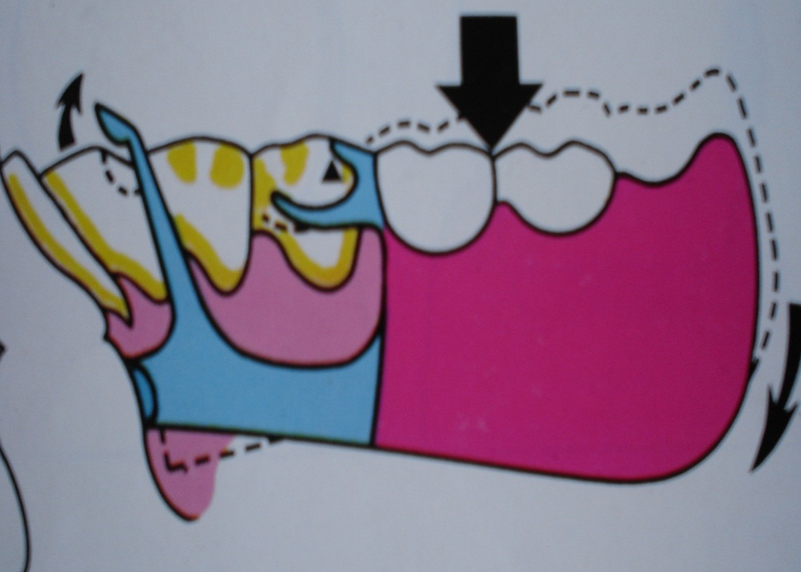
VERTICAL STRESS
Displacing stresses:
result of downward stresses along the long axis of the teeth in a crown to apex direction and the relatively vertical stresses on the ridge mucosa.
These are the least harmful and are born well if within physiologic limits

Slide 16
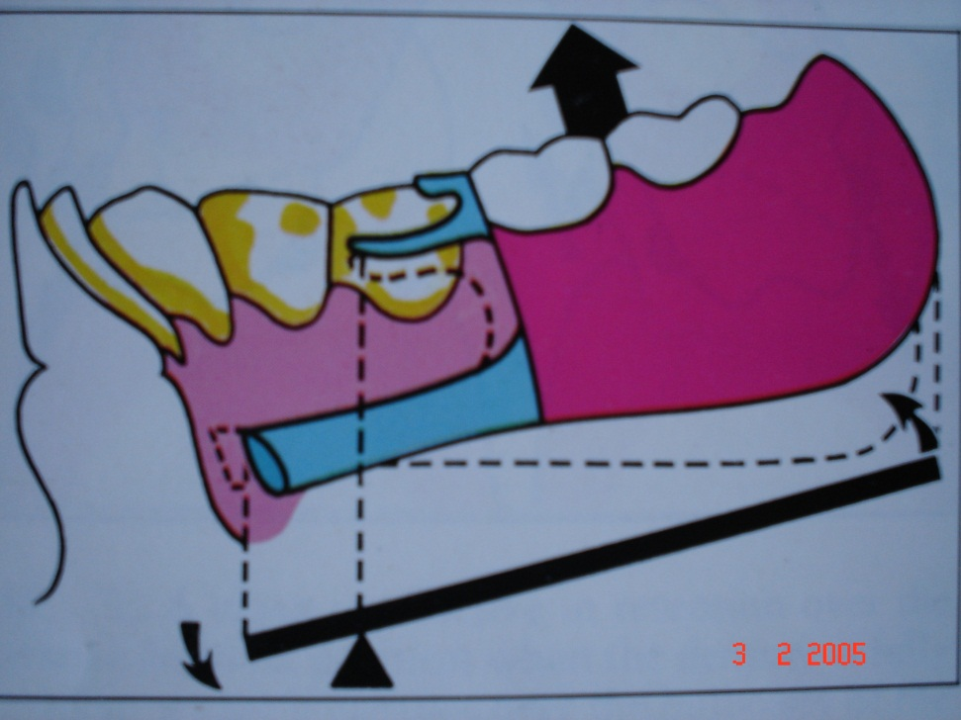
Dislodging stresses :
These are the forces which tend to lift the partial denture from it’s rest position.
Reciprocal dislodging action occurs when wide edentulous spaces are interrupted by few teeth thus inviting an antero-posterior or lateral tilt of prosthesis.

Slide 17
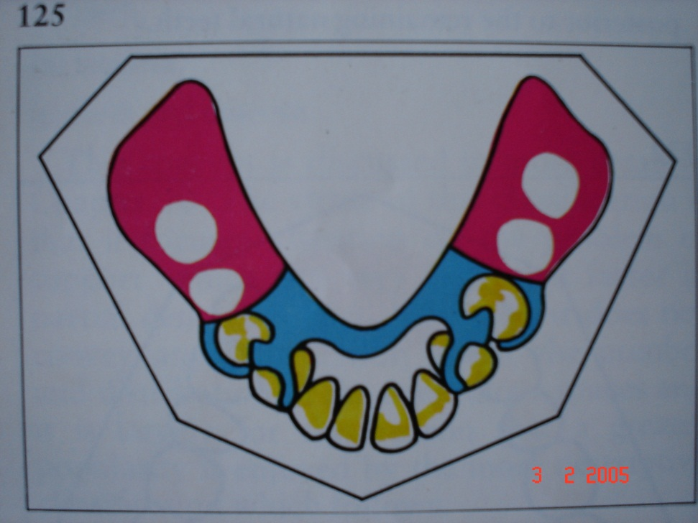
HORIZONTAL STRESS
They originate as a component of rhythmic chewing stroke.
These forces are effective in mesio-distal and buccolingual direction.
These lateral stresses are most damaging.

Slide 18
TORSIONAL STRESS
It is a twisting rotational type of force. It’s a combination of vertical and horizontal force.
Torsion is noted most frequently where a long segment acts upon the first abutment it engages. Where the ridge mucosa has higher resiliency torque is higher. Torque applies rotation about a fixed point.

Slide 19
FORCES ACTING ON PARTIAL DENTURE
Forces on an RPD are the result of a composite of forces arising from three principle fulcrums.

Slide 20
1. FULCRUM ON HORIZONTAL PLANE:
Extends through the principle abutments.
Rotational movement of the denture in the sagittal plane.

Slide 21
Force on abutment→
mesio-apical or disto-apical
(greatest vector in apical direction)

Slide 22
Denture base moves away from supporting tissues:
Counteracted by:
direct retainer and indirect retainer

Slide 23
b) Denture base moves towards the
supporting tissues:
Counteracted by:
Occlusal rest
Tissues of supporting ridge

Slide 24
2. FULCRUM ON THE SAGITTAL PLANE:
Rotation around the longitudinal
axis formed along the crest of residual ridge
Less in magnitude but can be damaging

Slide 25
Counteracted by:
Rigidity of major and minor connector and their ability to resist torque.
Close adaptation of the denture base along the lateral slopes and the buccal slopes of the palate and ridge.
Direct retainer design

Slide 26
3. FULCRUM LOCATED IN MIDLINE JUST LINGUAL TO THE ANTERIOR TEETH (FULCRUM IS VERTICAL)
Rotational movement of denture in horizontal plane
or
flat circular movements of the denture

Slide 27
Counteracted by:
Stabilizing components (reciprocal arm and minor connector)
Rigid major connector
Close adaptation of denture base

Slide 28
FACTORS INFLUENCING MAGNITUDE OF STRESSES TRANSMITTED TO ABUTMENT TEETH

Slide 29
1. Quality of support of ridge
Better support by ridge→ less stress on abutment teeth
(A) Form of residual ridge
Large well formed ridges → less stress on abutment
Broad ridges with parallel sides
longer flanges
stabilize the denture against lateral forces.

Slide 30
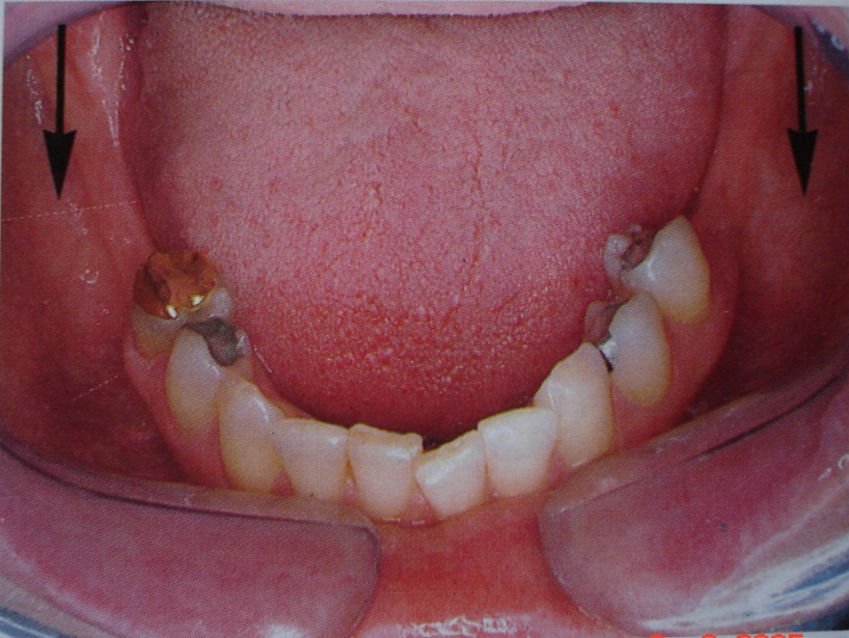
B) Type of mucosa
Influences magnitude of stresses transmitted to abutment teeth.
Healthy mucosa →capable of bearing greater functional loads
Soft, flabby, displaceable mucosa
little vertical support of denture
allows excessive movement of denture

Slide 31
2. Length of span
Longer edentulous span
longer denture base
greater force transmitted to abutment teeth
Every effort be made to retain a posterior abutment to avoid class I and class II situation

Slide 32
3. clasp as a factor in stress
More flexible the retentive arm of clasp → less stress to abutment tooth
But, flexible clasp arm → provides less stability against horizontal forces→ increase stress on residual ridge.

Slide 33
In examination phase decide whether ridge or abutment tooth require more protection
If periodontal support good
less flexible clasp like vertical projection clasp indicated.
If periodontal support weak
use more flexible clasp like combination clasp
(residual ridge share more resistance to horizontal forces).

Slide 34
Clasp design
Clasp be passive once framework seated completely

Slide 35
Length of clasp
Increase in length
Increased flexibility
Flexure directly proportional to (length)

Slide 36
Material
Chrome alloys → higher modulus of elasticity than gold alloys → less flexible.
Therefore, smaller cross sectional form of the clasp and less depth of retentive undercut must be used for chrome alloy.

Slide 37
Wrought wire → because of internal structure i.e. longitudinal structure as compared to grain structure of cast alloy → greater flexibility

Slide 38
Type of abutment tooth surface
Surface of crown offers more frictional resistance to clasp arm movement than does enamel surface of tooth.
Greater stress exerted on tooth restored with crown than with intact enamel.

Slide 39
Amount of clasp surface in contact with tooth
Greater the area of tooth to metal contact between clasp and tooth
more will be stress exerted on the tooth.

Slide 40
4. Occlusion as a factor
A) Harmony of occlusion or lack of it
Disharmonious occlusion
generate horizontal stresses
when magnified by factor of leverage
can transmit destructive forces to both abutment teeth and residual ridge.

Slide 41
B) Type of opposing occlusion
Play important role in determining amount of stress generated by occlusion
Natural teeth → can exert closing force upto 300 pounds/inch square, whereas, complete denture upto 30 pounds/inch square.
Therefore RPD constructed against removable prosthesis is subjected to much less occlusal stress than one opposed by natural dentition.

Slide 42
5. Area of denture base to which load is applied
Less movement of base if load applied adjacent to the abutment tooth than if it is applied to the distal end of the base.
movement may be 4 times greater at distal end of base than next to the clasp.

Slide 43
RPD DESIGNING

Slide 44
Tooth Vs tooth- tissue supported.
They differ in
Manner in which each is supported.
Method of impression registration.
Need for some indirect retention.
Denture base material. Acrylic/metal.
Difference in clasp design.

Slide 45
DIFFERENTIATION BETWEEN TWO MAIN TYPES OF RPD
a.) Support
1. Class I, II & IV
-Residual Alveolar Ridge – Bone & tooth.
(The length & contour of residual ridge)
2. Class III - Tooth

Slide 46
2. Impression Procedure
Distal Extension Partial Denture
Functional form - McLean Method
Or
Supporting Form - Hindels Method
3. Need for indirect retention
Class I, Class II - Mesio occlusal rest
Cingulum Rest
Incisal Rest
Linguoplate
Class III - Does not require Indirect
retainer

Slide 47
4. Denture base material
Class I & II - Acrylic resin
Class III - Metal
5. Difference in clasp design
Distal Extension : Wrought Wire clasp
Combination clasp
Class III : Cast clasp : Cr-Co, gold
alloy

Slide 48
Principles by A.H. Schmidt (1956).
The dentist must have a thorough knowledge of both the mechanical and biologic factors involved in removable partial denture design.
The treatment plan must be based on a complete examination and diagnosis of the individual patient.

Slide 49
The dentist must correlate the pertinent factors and determine a proper plan of treatment.
A removable partial denture should restore form and function without injury to the remaining oral structure.
A removable partial denture is a form of treatment and not a cure.

Slide 50
Philosophy of design
Of the various schools of thought , none are backed by scientific research or statistics.
They are ideas of dentists who by extensive clinical experience have formulated rules by which they produce a design.
The challenge in design lies primarily in class 1 and 2 arches and to some extent in the class 4 arches.

Slide 51
There are 3 basic , underlying approaches to distributing the forces acting on partial denture between the soft tissues and teeth.
Stress equalization
Physiologic basing
Broad stress distribution

Slide 52
Stress equalization
Resiliency of the tooth secured by the periodontal ligament in an apical direction is not comparable to the greater resiliency and displaceability of the mucosa covering the edentulous ridge.

Slide 53
Therefore , it is believed that a type of stress equalizer is needed to replace the rigid connection between denture base and direct retainer.
Most common type is a hinge device which permits vertical movement of the denture base, which can be adjusted to control the amount of vertical movement.

Slide 54
Advantages
Minimal direct retention is required- as denture base acts more independently.
Has the massaging or stimulating effect on the underlying bone and soft tissue, which minimizes tissue change and resulting Rebasing procedures.

Slide 55
Disadvantages.
Construction of stress director is complex and costly.
Constant maintenance required.
Difficult or impossible to repair.
Lateral movements of base can lead to rapid resorption of the ridges.
This school of thought had got fewer advocates.

Slide 56
Physiologic basing
This school of thought too believes that there is relative lack of movement in abutment teeth in an apical direction.
But it believes that stress equalization can be best achieved by either
displacing or depressing the ridge mucosa during the impression making procedure
or by relining the denture base after it has been constructed

Slide 57
The tissue surface is recorded in functional form and not anatomic form.
RPD constructed from tissue displacing impression will be above the plane of occlusion when the denture is not in function.
To permit vertical movement from rest position to functional position the retentive clasps have to have minimum retention and also their number has to be less.

Slide 58
Advantages.
Intermittent base movement has a physiologically stimulating effect on the underlying bone and soft tissue.
Less need for relining and Rebasing.
Simplicity of design and construction because of minimal retention requirements.

Slide 59
Light weight prosthesis with minimal maintenance and repair.
The looseness of the clasp on the abutment tooth reduces the functional forces transmitted to the tooth.

Slide 60
Disadvantages.
Denture is not well stabilized against lateral forces.
There will be always premature contact when mouth is closed .
It may be uncomfortable sensation to the patient.
It is difficult to produce effective indirect retention.

Slide 61
Broad stress distribution
Advocates of this school of thought believe that excessive trauma to the remaining teeth and residual ridge can be prevented by distributing the forces of occlusion over as many teeth and as much of the available soft tissue area as possible.
Achieved by means of additional rests , indirect retainers, clasps and broad coverage denture bases.

Slide 62
Advantages
Teeth can be splinted .
Prosthesis are easier and less expensive to construct.
No flexible or moving parts so less danger of distorting the denture.

Slide 63
Indirect retainers and other rigid components provides excellent horizontal stabilization.
Less relining required.

Slide 64
Disadvantages
Greater bulk may cause prosthesis to be less comfortable.
Increased amount of tooth coverage can lead to dental caries

Slide 65
Strategic clasp positioning as a means of stress control
Leverages can be controlled to a large extent by means of clasps, if there are sufficient abutment teeth and they are strategically distributed in the dental arch.
If number and location of potential abutments is less than ideal→ harmful effects can be decreased by strategic placement of clasps.

Slide 66
a) Quadrilateral configuration
When 4 abutment teeth
available for clasping
and partial denture
confined within 4 clasps
→ all leverages neutralized.
Ideal (for support and leverage control)
Indicated most often in
class III arches
(with modification
space on opposite side)

Slide 67
Class III with no modification space

Slide 68
B) Tripod configuration
Class II situations
Distal abutment on one side of arch missing
leverage controlled to some extent by creating tripod configuration of clasp placement.

Slide 69
Class II with no modification space
Separating two abutments on dentulous side as far as possible
largest possible area of denture will be enclosed in a triangle formed by retentive clasps.

Slide 70
Bilateral configuration
For class I situations
Not considered ideal,
but best option available
Stress must be controlled
by other means.

Slide 71
STRESS BREAKERS/ STRESS DIRECTORS
GPT 7- A device or system that relieves specific dental structures of part or all of the occlusal forces and redirects those forces to other bearing structures or regions.

Slide 72
In distal extension situation
Rigid connection between denture base and retainers
stress on abutment
reduced by using functional basing, broad coverage, harmonious occlusion and correct choice of direct retainers
stress breaking
Allows independent movement of the denture base and the direct retainers.
Separates the action of the retaining elements from the movement of the denture base

Slide 73
The need for stress breakers on free end RPDs has been recognized on the basis that the resiliency or displaceability of the mucosal tissue ranges between 0.4 mm to 2mm, while the vertical resiliency of a normal healthy tooth in its socket
is approx. 0.1mm.
This tissue resiliency
differential of 20 to 40
times the axial
displaceability of a
normal tooth in its
socket dictates the necessity for some form of stress direction in the partial denture design.

Slide 74
2 types of designs:
1) HINGE DESIGN:
Base is permitted to move in a vertical plane only. The hinge type device spares the tooth virtually all of the stress which results from vertical movement of the base, but it is still subjected to all the lateral loads and torsional stress.
Eg: Gerber Hinge, DE Hinge type.
2. ROTATIONAL TYPE:
Works on the ball and socket principle, movements of the base is allowed in all planes, and the tooth is relieved of virtually all stresses.
Eg: CRISMANI, DALBO

Slide 75
INDICATION FOR THE USE OF STRESS BREAKER
Because the stress breaker does, in far relieve the abutment tooth of the forces generated by the masticatory load, the stress is then borne by the residual ridge. Therefore a prime indication for the application of this principle would be the mouth where in an abutment tooth is inherently weak.

Slide 77
1. Biomechanics is A. the application of mechanical laws to non-living structures B. the study of biology from the structural viewpoint C. An application of the principles of engineering design as implemented in living organisms. D. All of Above

Slide 78
2. Class II lever is
Fulcrum lies in the centre, Resistance is at one end and force at the other
Fulcrum is at one end, resistance at opposite end and effort is in the centre
Fulcrum is at one end effort at the opposite end and resistance in the centre.
Both A and B

Slide 79
2. Class II I lever is
Fulcrum lies in the centre, Resistance is at one end and force at the other
Fulcrum is at one end, resistance at opposite end and effort is in the centre
Fulcrum is at one end effort at the opposite end and resistance in the centre.
Both B and C

Slide 80
4. Snow- shoe principle is used to
Distribute the forces to as large an area as possible
transmit force, as in raising or moving a weight at one end by pushing down on the other.
To give excellent rigidity to the prosthesis
All of above

Slide 81
5. Least harmful stresses for patient in RPD is
Horizontal stresses
Torsional stresses
Vertical displacing stresses
Vertical dislodging stresses

Slide 82
6. Most harmful stresses for patient in RPD is
Horizontal stresses
Torsional stresses
Vertical displacing stresses
Vertical dislodging stresses

Slide 83
7. Movement of denture base towards tissue is protected by
Direct and Indirect retainer
Rest and alveolar ridge
Direct retainer and Rest
Alveolar ridge and Indirect retainer

Slide 84
8. Movement of denture base in RPD away from denture base is protected by
Direct and Indirect retainer
Rest and alveolar ridge
Direct retainer and Rest
Alveolar ridge and Indirect retainer

Slide 85
9. which is tooth and tissue supported cast RPD
Class I and II
Class I and III
Class III and IV
Class II and III

Slide 86
10. which is tooth supported cast RPD
Class I and II
Class III
Class III and IV
Class II and III

