Slide 1
PEDIATRIC OPERATIVE DENTISTRY (cont.)

Slide 2
Principles of cavity preparation

Slide 3
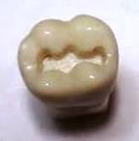
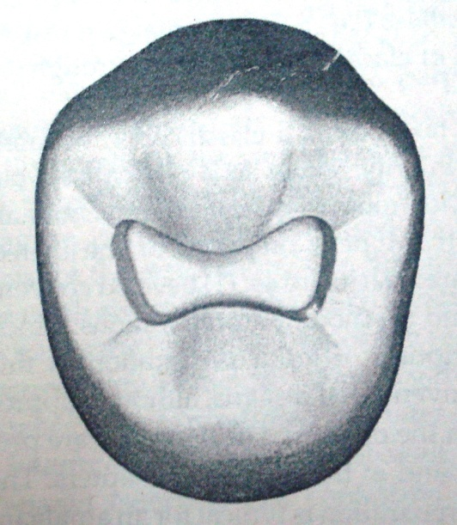
Black’s classification
Class I cavity
All pit and fissure cavities
Occlusal surfaces of posterior teeth
Occlusal 2/3 of buccal and lingual surfaces of premolars & molars
Lingual surfaces of anterior teeth.

Slide 4
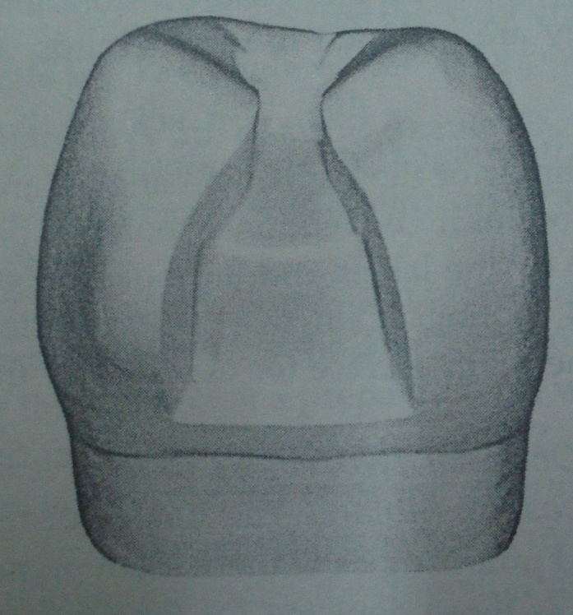
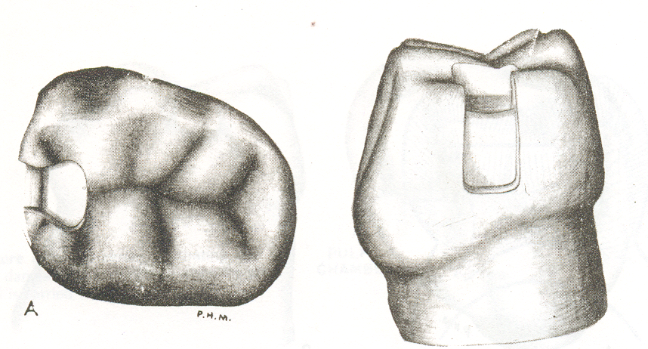
Class ii cavity
All proximal surface cavities on the premolars and molars.

Slide 5
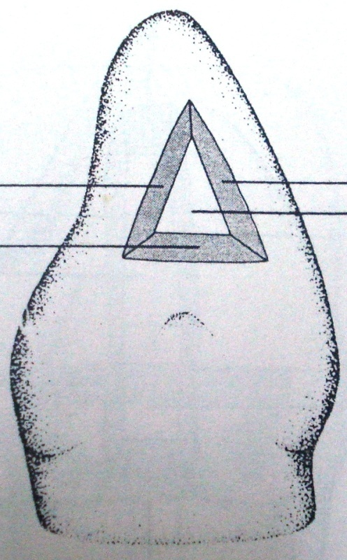
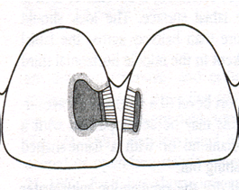
Class iii cavity
All proximal surface cavities on the incisors and canines which do not involve the removal and restoration of the incisal angle.

Slide 6
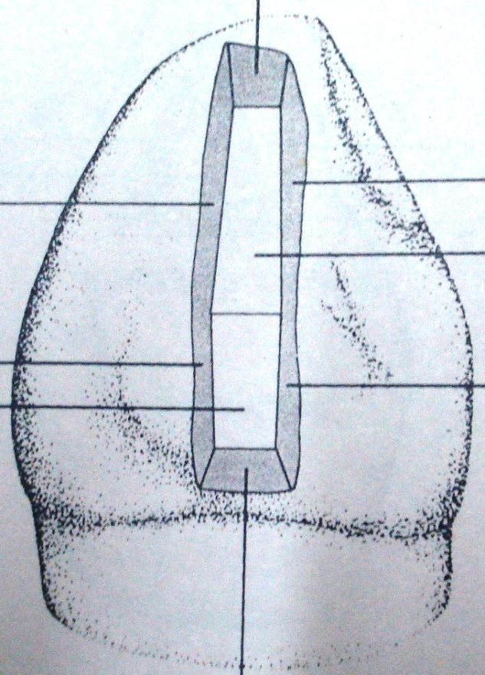
Class iv cavity
All proximal surface cavities on the incisors and canine which involve the removal and restoration of the incisal angle.

Slide 7
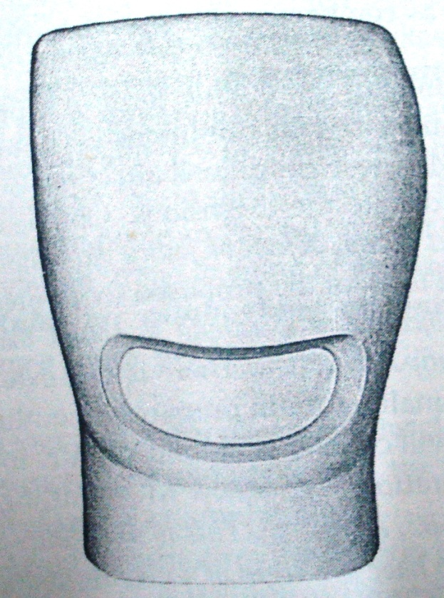
Class v cavity
All gingival cavities located within the gingival one third of the tooth. These may be either on the facial or lingual Gingival one third of the tooth

Slide 8
Class vi cavity
CAVITIES ON THE INCISAL EDGES AND CUSP TIPS OF ALL TEETH.

Slide 9
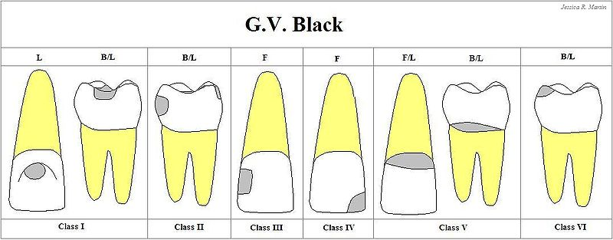

Slide 10
Blacks concept extension for prevention
Obtaining Outline form
Obtaining Resistance form
Obtaining Retention form
Obtaining Convenience form
Removal of infected dentin
Finishing enamel walls
Debridement /toilet of the cavity

Slide 11
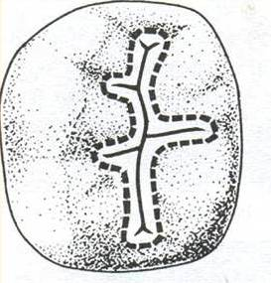
Outline form
Area of tooth surface or enamel margin to be included in the finished cavity
It can be-
External outline form
Internal outline form

Slide 12
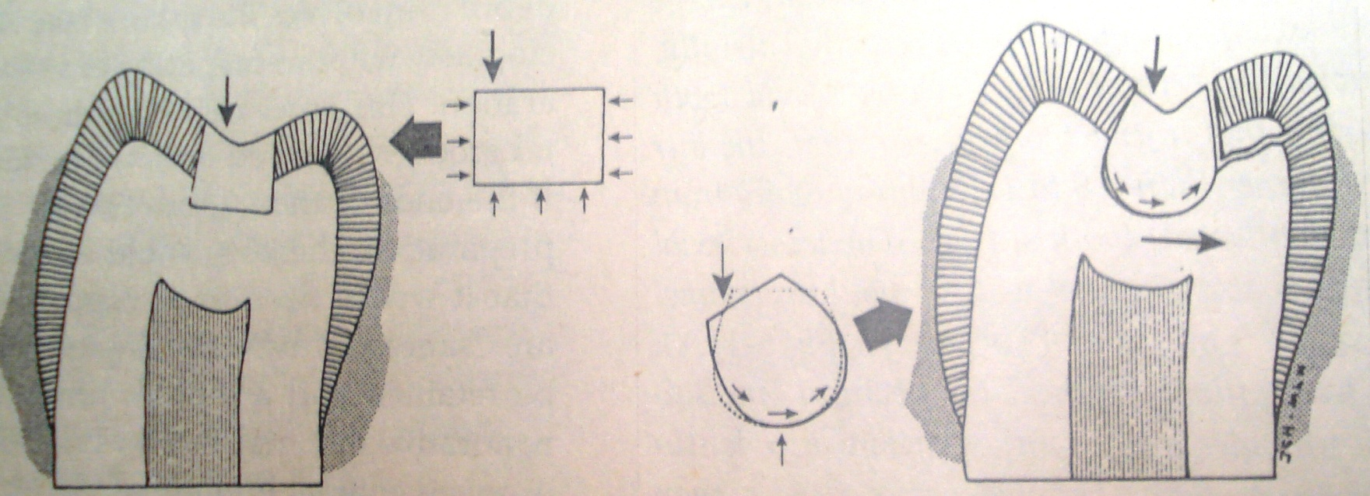
Resistance form
Shape & configuration of the cavity that best enables both the restoration & tooth to withstand occlusal forces without fracture

Slide 13
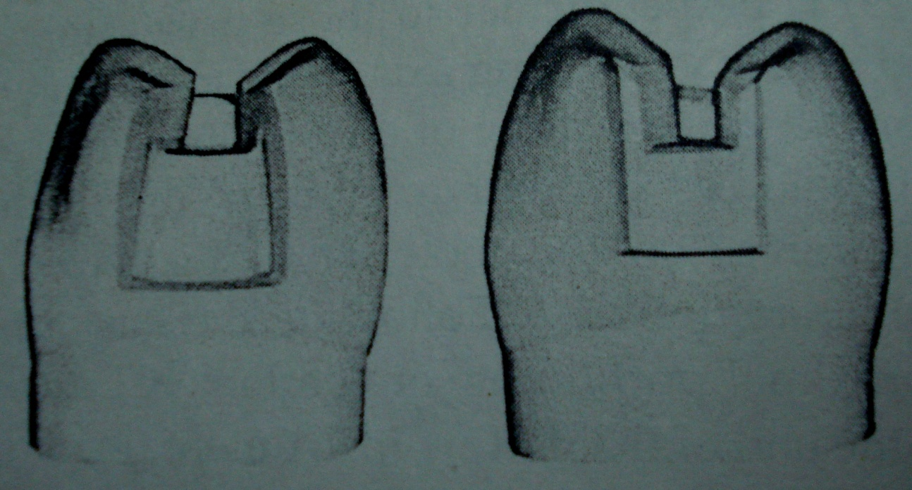
Retention form
Factors of cavity design that prevent the restoration from being displaced.

Slide 14
Convenience form
Shaping the cavity to facilitate access for instrumentation , for condensation, adaptation and finishing

Slide 15
Removal of infected dentin
Elimination of any infected carious tooth structure or faulty restoration left in the cavity preparation

Slide 16
Finishing enamel walls
To place the margins on smooth tooth structure
To have smooth walls and rounded angles
To facilitate placement and finishing of restorative materials

Slide 17
Cleaning of the cavity
Removing all chips or loose debris that have accumulated
Drying the cavity
Making a final complete inspection of the preparation for any remaining infected dentin, unsound enamel margin

Slide 18
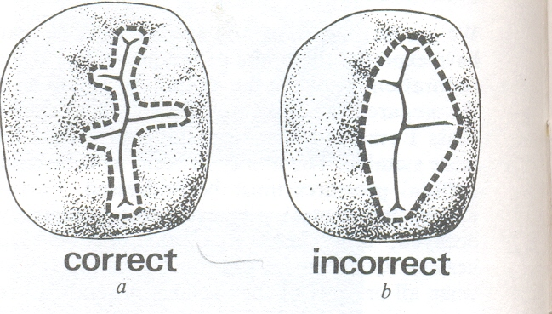
PREPARATION OF CLASS I CAVITY
The extension & depth of the cavity will be determined by the amount & location of caries & preoperative occlusal anatomy. Every effort should be made to retain as much well-supported enamel as possible.

Slide 19
PREPARATION OF CLASS I CAVITY Cont.
The maximum intercuspal cavity width should be one-quarter to one-third of the intercuspal width.
0.5 mm pulpally to the DEJ to provide sufficient bulk of amalgam to withstand occlusal forces.
Pulpal floor should be flat & smooth
Internal line angles should be rounded to reduce any stresses in the set amalgam

Slide 20
PREPARATION OF CLASS I CAVITY Cont.
The extension is made, buccal or lingual cavity walls should be straight & either parallel or converging occlusally
The extension should be cut 0.5 mm into dentine & should extend gingivally to include the developmental pits.
Retention grooves can be place in dentine if considered necessary.

Slide 21
PREPARATION OF CLASS I CAVITY Cont.
The ‘isthmus’ area where the extension meets the occlusal section can be rounded or beveled to increase the bulk of amalgam. as it is subjected to heavy stresses during lateral movements

Slide 22
Class II Cavity
Outline: The outline follows the fissure pattern so as to prevent secondary caries occurring adjacent to the restoration. A smooth flowing outline reduces stress & permits better of the amalgam.
Isthmus: This should be between 1/4 of the intercuspal distance (approximately 1.5 mm)

Slide 23
CLASS II CAVITY Cont.
Depth: This should be 0.5 mm below dentino-enamel junction or 1.5 mm from the cavosurface
Internal angles: All the internal angles should be rounded so as to limit stress & to ensure that amalgam can be easily packed into these regions.
Pulpal floor: Pulpal floor should be slightly concave.

Slide 24
.
CLASS II CAVITY Cont.
Buccal & lingual walls: should be converging so making the cavity retentive. Also, the cavosurface angle needs to be a right angle to ensure maximum strength at the enamel-amalgam junction.
Gingival floor: should be located just below the contact area with the adjacent tooth but supragingivally.

Slide 25
CLASS II CAVITY Cont.
Axial wall: The width of the floor of the box should be approx. 1 mm. follows external contour of tooth
Buccal & lingual walls: These should be convergent, parallel to the appropriate external surface & make a cavosurface angle of 90 degree.
Axio-pulpal line angle: Rounded to give maximum thickness of amalgam with minimum stress in this area

Slide 26
CLASS II CAVITY Cont.
Retention grooves- made to enhance retention.
Occlusal dovetail -It should be made including all carious areas & shapes should be such that it locks the occlusal portion of filling

Slide 27
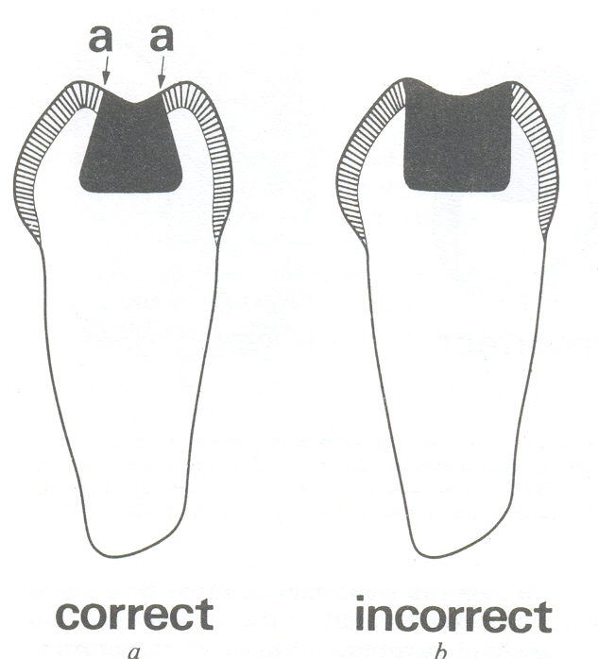
CLASS II CAVITY Cont.

Slide 28
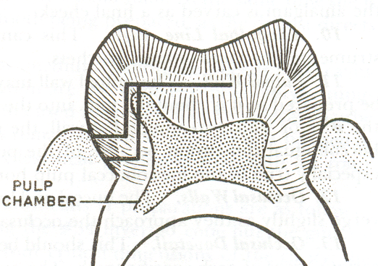
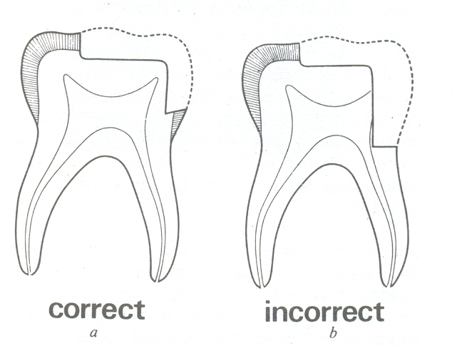
DIAGRAM ILLUSTRATING THE INCREASED DANGER OF PULP EXPOSURE WHEN THE GINGIVAL WALL IS CARRIED TOO DEEPLY

Slide 29
Recent Concept
CONSTRUCTION WITH CONSERVATION
(OLD CONCEPT- EXTENSION FOR PREVENTION)
Cavity design dictated by site & extent of lesion.
No need to extend cavity into the “caries free” area.
Biologically active restorative material which assists remineralization & healing of remaining tooth structure.
ONLY Irretrievable/ degenerated/ broken down tooth surface to be removed.
Completely control plaque accumulation by eliminating surface cavitation as a result of caries.

Slide 30
Modifications required for cavity preparation in primary & young permanent teeth

Slide 31
REASONS FOR PRESERVATION OF PRIMARY TEETH
Necessary till the succedaneous teeth replace them
Mastication of food
Preservation and increase in arch length
Development of speech and phonetics
Prevention of any infection or caries to the permanent teeth
Prevention of malocclusion of permanent teeth
Esthetics

Slide 32
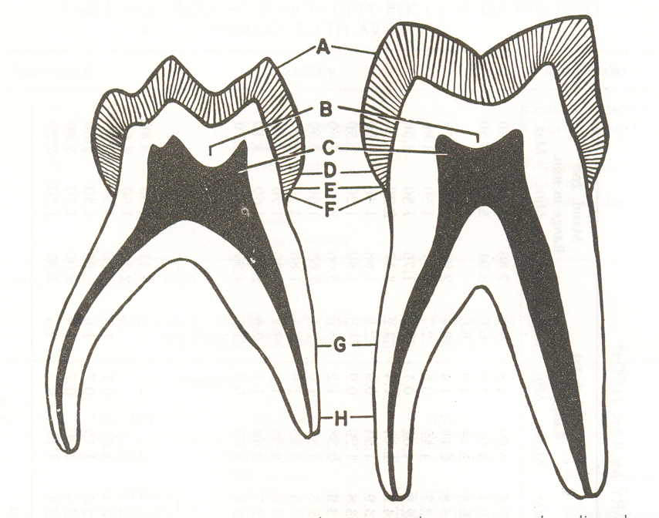
Difference between primary & permanent teeth
Primary teeth have thinner enamel & dentin than permanent teeth.
The pulps of primary teeth are larger in relation to crown size than permanent pulps

Slide 33
The pulp horns of primary teeth are closer to outer surface of the tooth than permanent pulps
In primary teeth, the enamel rods of the gingival third of the crown extend in an occlusal direction from dentin-enamel junction
Primary teeth demonstrates greater constriction of the crown and have a more prominent cervical contour than permanent teeth

Slide 34
Primary teeth have broad, flat proximal contact areas.
Primary teeth are whiter than their permanent successors.
Primary teeth have relatively narrow occlusal surface in comparison with their permanent successors.

Slide 35
Factors to be considered while restoring the primary teeth
Smaller tooth dimension of deciduous teeth
Thin enamel
Broad contact areas
Proximity of pulp chamber to outer tooth surface
Narrow occlusal table

Slide 36
Class I cavities
For small carious lesions, the isthmus should not be more than 1/3 the intercuspal distance.
Pulpal floor should be flat
Use of preventive resin restoration

Slide 37
CLASS II CAVITY Cont.
CLASS II CAVITY
Proximal box of deciduous teeth-
Box converges occlusally
Minimal flare to prevent weakening of
enamel walls
Isthmus 1/4th to 1/5th of intercuspal width
Rounded Axio-pulpal angle grooved to
increase retention
No bevel in gingival seat
Depth minimal to prevent pulp exposure
at cervical constriction
Wide gingival floor

Slide 38
THANK YOU

