Slide 1
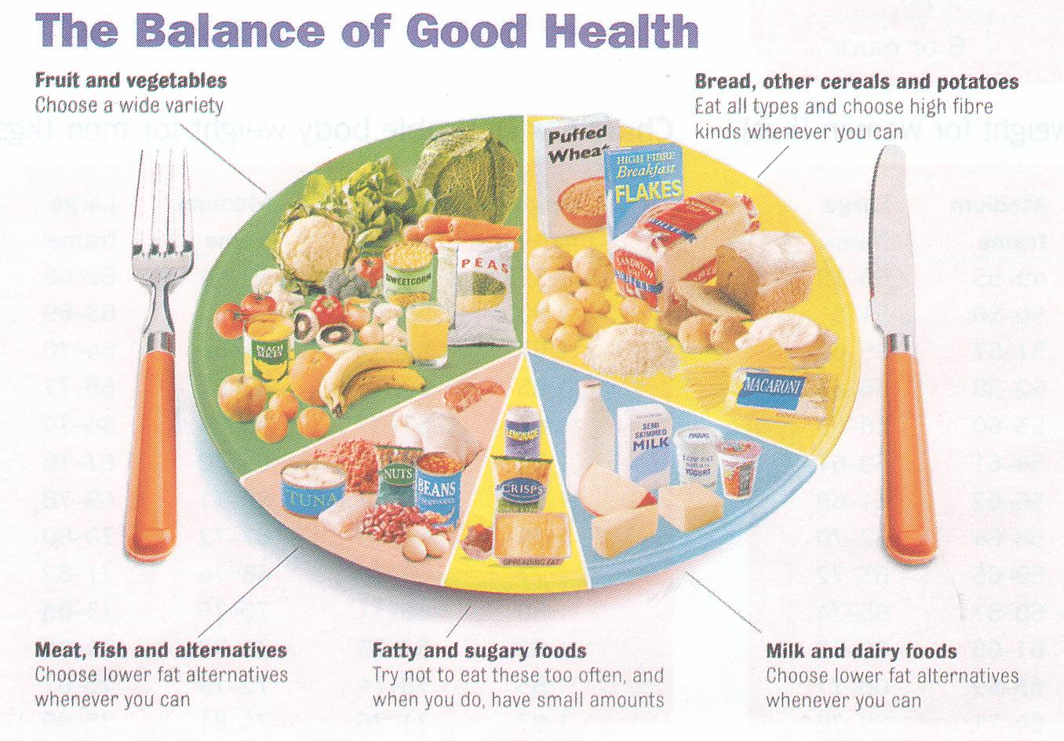
Role of diet and nutrition in dental caries
Presented By:
Dr. Rajeev Kumar Singh

Slide 2

Diet
Balanced diet
Food
Diet is referred to
as "food and drink
regularly consumed.”
Diet refers to the
pattern of food intake
Diet which contains a variety of foods in such quantities and proportions that the need for energy is adequately met for maintaining health ,vitality and general well being
Any substance which
when taken into the organism may be used either to supply energy or to build tissue.

Slide 4
Nutrition
Nutrients
The process of nourishing or being nourished, especially the process by which a living organism assimilates food and uses it for growth and for replacement of tissues.
The science or study that deals with food and nourishment, especially in humans.
Substances in food that are essential for energy ,growth and normal functioning of the body and maintenance of life.
1) Macronutrients :- carbohydrates, fats & proteins
2) Micronutrients :-
minerals and vitamins

Slide 5
Nutritional Status & Dental Caries
Dental caries is an interaction between diet, cariogenic flora and tooth of the host.
Ingestion of food may affect oral-dental health by both systemic and local mechanisms
Nutritional effects are mediated systemically
Dietary effects are mediated locally in the oral cavity

Slide 6
Systemic effects
Absorption & circulation of nutrients to all cells & tissues
Mediated through influences on
Development of teeth
Quality & quantity of saliva
Improved host resistance
Improved function

Slide 7
Local effects
Influencing metabolism of oral flora
Modifying salivary flow rates
Quality of saliva

Slide 8
Carbohydrates
Monosaccharides
eg. Glucose, fructose
Oligosaccharides
eg. Sucrose, lactose
Polysaccharides
eg. Starch, glycogen

Slide 9
Carbohydrates and caries
Sugars are the most important dietary factor in the development of dental caries
A strong correlation exists between both the amount and frequency of sugar consumption and the development of caries

Slide 10
Abilities of natural and refined carbohydrates to cause dental caries
Because of the limited amount of tooth decay usually noted in people ingesting diets containing only natural foods, it is a common belief that unrefined carbohydrates do not contribute significantly to dental caries etiology.
Raw carbohydrates have anti enzymatic substances which are removed in the refining process.
In all probability the only reason they are not ordinarily associated with caries etiology is not that they resist enzymatic degradation but rather that they make up such a limited portion of the carbohydrate fraction of the diet.

Slide 11
Sucrose (cane sugar)
Disaccharide (Glucose+ Fructose)
Constituent of cane sugar, beet sugar & pineapple
Most commonly used table sugar supplying calories

Slide 12
Sucrose “arch-criminal of dental caries”
The simplest method of reducing caries by dietary means would be to eliminate sucrose from the diet.
However, such a step would be difficult. Sucrose is a rich source of energy; it is cheap and generally plentiful; it has attractive cooking characteristics and the majority of people greatly enjoy eating sucrose containing foods

Slide 13
STARCH
COOKED STARCHY FOOD WHEN COMBINED WITH REFINED SUGARS (DOUGH NUT , PASTRY, POTATO CHIPS) RESULTS IN
PLAQUE FORMATION, DENTAL CARIES, PERIODONTAL DISEASE
It has also been shown that the presence of starch increases the acid production from sucrose

Slide 14
Vitamins
Deficiencies of vitamin D and A have been shown to affect the natural development of the teeth, which can make them more susceptible to decay.
Under nutrition, coupled with a high intake of sugars, may increase the risk of caries.
Severe vitamin C deficiency can result in inflammation of the gums,

Slide 15
Fruits
As part of a normal mixed diet there is little evidence that fruit causes caries
Animal studies have shown that when fruit is consumed in very high frequencies (e.g. 17 times a day) it may induce caries.

Slide 16
Breastfeeding
Studies have associated breastfeeding with lower levels of dental caries in early childhood.
This is likely to be due to the fact that breastfed infants consume less sugar than infants fed formula milk to which free sugars are often added.

Slide 17
Minerals
Fluoride is well known for its cariostatic action
Optimum levels of fluoride reduces the incidence of caries
Higher levels of fluoride may cause dental fluorosis.

Slide 18
Foods That Cause the pH to Fall Below 5.5
Apple drink
Apricots, dried
Bananas
Beans, baked
Beans, green canned White bread
Whole wheat bread
Caramels
Chocolate milk
Cola
Crackers, Cream cheese
Doughnuts Gelatin-flavored dessert

Slide 19
Noncariogenic sucrose substitutes
There have been many attempts to identify noncariogenic sucrose substitutes.
These have included sweetening agents such as saccharine and cyclamate,
Sugar alcohols of eg. sorbitol and xylitol are perhaps the best known examples
Natural sugars such as glucose, fructose, lactose and maltose are non cariogenic

Slide 20
For a variety of reasons none of these substitutes has widespread acceptance.
In some the taste is unsatisfactory, others are expensive, non calorific substitutes fail to provide energy needs, and some are thermolabile and hence cannot be used in cooking.

Slide 21
Sugar substitutes
CALORIC / NUTRITIVE
NON-CALORIC / SWEETENERS
Can be metabolized by body to yield energy
Add bulk to food
  Sugar
  alcolhols
  Glycitols
  polyols
  Aspartame
  Cyclamate
  Saccharine
  acesulfame

Slide 22
Important factors in caries determination
Constituents
Physical properties of food
Natural versus Processed food
Acidity of foods

Slide 23
Food constituents
The four carbohydrates starch, sucrose, fructose and glucose comprise the greatest proportion of foods consumed by man.
Starch is not cariogenic in humans.
Glucose & fructose are minor constituents of human foods as they are present only in dried fruits, honey and milk

Slide 24
Physical properties of food
Mechanical properties
Hardness, cohesiveness
Viscosity, adhesiveness
Geometric properties
Particle size
Shape
Others
Moisture
Fat content

Slide 25
Natural versus processed food
Saliva incubated with refined food cause a greater dissolution of enamel than when incubated with unrefined foods.
Mixtures that included bran, wheat germ and unrefined treacle contained protective factors

Slide 26
Acidity of foods
Natural foods such as lemons, apples, fruit juices and carbonated beverages are sufficiently acidic when in prolong contact with tooth.
Habitual use of these foods and beverages may cause etching of enamel with cavitation

Slide 27
DIET COUNSELING

Slide 28
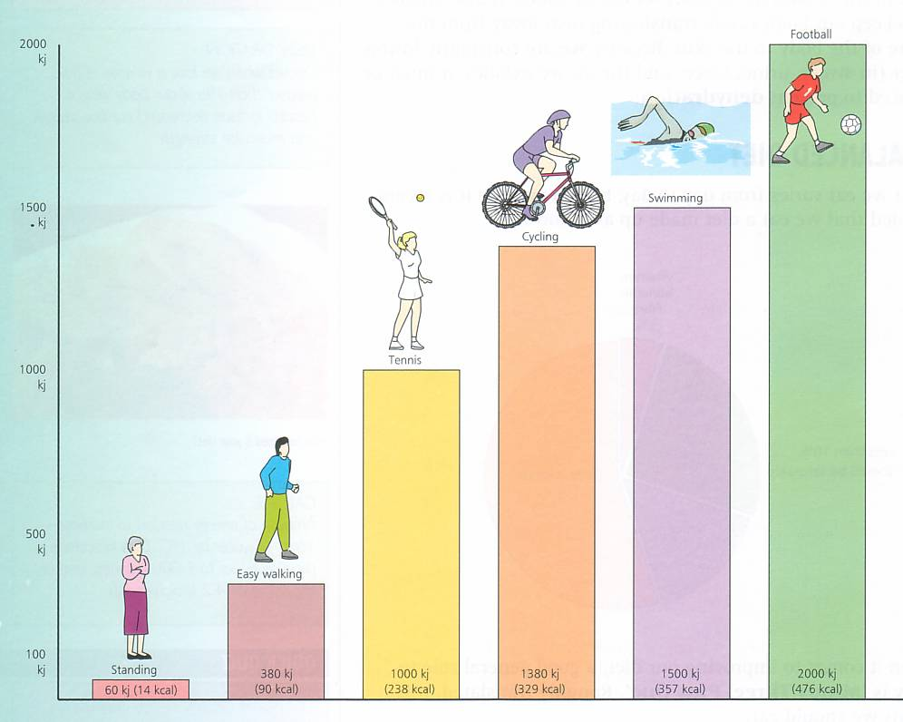
Diet counseling
IT IS THE ACT OF PROVIDING ADVISE AND GUIDANCE TO A PATIENT OR THE PATIENTS FAMILY REGARDING THE TYPE OF FOOD THAT SHOULD BE TAKEN AND ITS RELATION TO BOTH HEALTH AND DISEASE

Slide 29
NEED FOR COUNSELING
To modify dietary habits, particularly ingestion of sucrose containing foods, in forms and amounts that promote caries
To correct dietary imbalances that could interfere with the patient’s general health and well being

Slide 30
AAPD (2005) Recommends
Breast feeding of infants to ensure best possible health , developmental and psychosocial outcomes
Educating people about association between frequent consumption of carbohydrates and caries
Educating people about other health risks associated with excess consumption of carbohydrates , fats and sodium

Slide 31
PATIENT SELECTION
Patient should have a positive attitude and be willing and to make long- term efforts towards improvement of oral status through dietary means.
Should have a demonstrable
need for dietary improvement.

Slide 32
GUIDELINES FOR COUNSELING
GATHERING INFORMATION
Personal data
Likes and dislikes
Cause of problem
Suggest diet diary

Slide 33
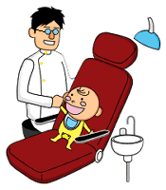
STEPS OF A DIET COUNSELING PROGRAMME
1) First appointment
- Identification of high-risk patients.
- Maintaining the diet diary
2) Second appointment
- Evaluation of the diet diary
- Develop an action plan
- Well balanced diet
- Use of Nutritive sugar
substitutes
3) Third appointment
- Evaluation of the progress

Slide 34
DIET DIARY
Record every food item consumed solid or liquid during 6 consecutive days
Record food consumed during mealtimes, between meals.
Use appropriate household measures to measure the amount of food.
The kind of food and how it was prepared.
Addition to the food in cooking or at table

Slide 35
EVALUATE AND INTERPRET INFORMATION
Nutritional adequacy of diet
Amount of sugary foods
Frequency of sugary foods
Personal and social history
Medical history
Systemic and environmental factors

Slide 36
DEVELOP AND IMPLEMENT A TREATMENT PLAN
Gradual, qualitative changes in diet
Gradually eliminate sugary foods
Avoid patient dislikes
Prescribed diet should vary from normal diet pattern as little as possible
Nutritionally balanced diet
Increase intake of protective and detergent foods – fruits, vegetables, cheese, etc

Slide 37
ACTIVE PARTICIPATION OF PATIENT
Patient encouraged to involve himself in diet monitoring and suggest changes in menu
REGULAR FOLLOW – UP
To monitor progress
Make changes
To clarify doubts
To motivate and encourage

Slide 38
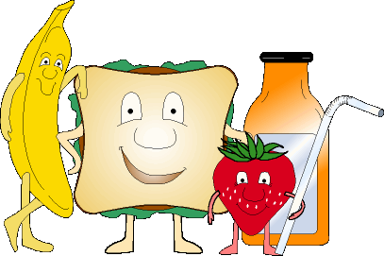
Thank You

