Slide 1
Pelvic Inflammatory Disease
Dr Sabuhi Qureshi

Slide 2
Definition
Pelvic inflammatory disease (PID) refers to acute infection of the upper genital tract structures in women, involving any or all of the uterus, fallopian tubes, and ovaries.

Slide 3
Early diagnosis and treatment are believed to be key elements in the prevention of long-term sequelae, such as infertility and ectopic pregnancy

Slide 4
PID is primarily a disease of sexually active women.
The two most important sexually transmitted organisms associated with acute PID are Chlamydia trachomatis and Neisseria gonorrhoeae.

Slide 5
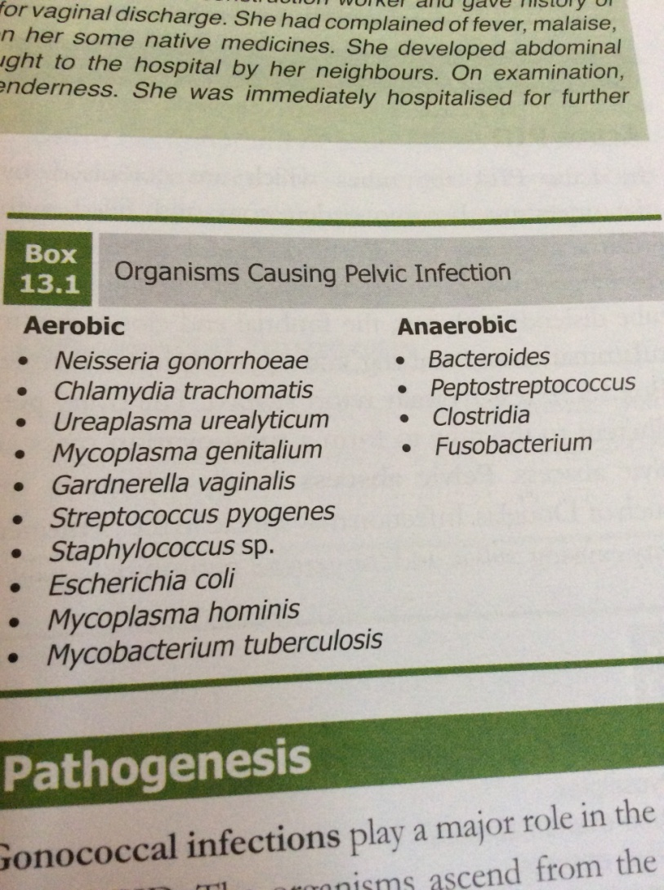
Polymicrobial infection

Slide 6
PID is a polymicrobial infection.
Acute PID is an ascending infection caused by cervical as well as the vaginal microflora, including anaerobic organisms

Slide 7
Cervical microorganisms - Chlamydia trachomatis and Neisseria gonorrhoeae)
Vaginal microflora, including anaerobic organisms, enteric gram-negative rods, streptococci, genital mycoplasmas, and Gardnerella vaginalis, which is associated bacterial vaginosis

Slide 8
Bacterial vaginosis results in complex alterations of the normal vaginal flora, which may alter host defense mechanisms in the cervicovaginal environment

Slide 9
Types
Acute PID
Chronic PID

Slide 10
Pathology of Acute PID
Inflammed, fluid filled tubes
Pyosalpinx
Tubo- Ovarian Abscess
Pelvic abscess
Pelvic/general peritonitis.

Slide 11
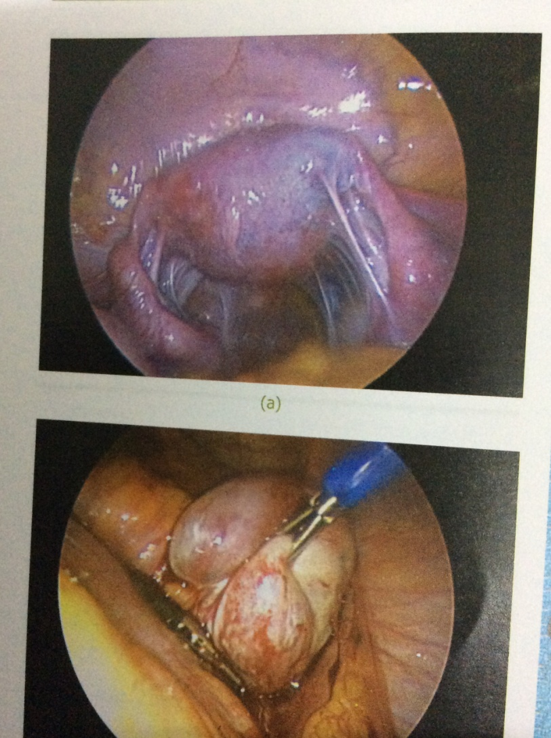
Pelvic adhesions

Slide 12
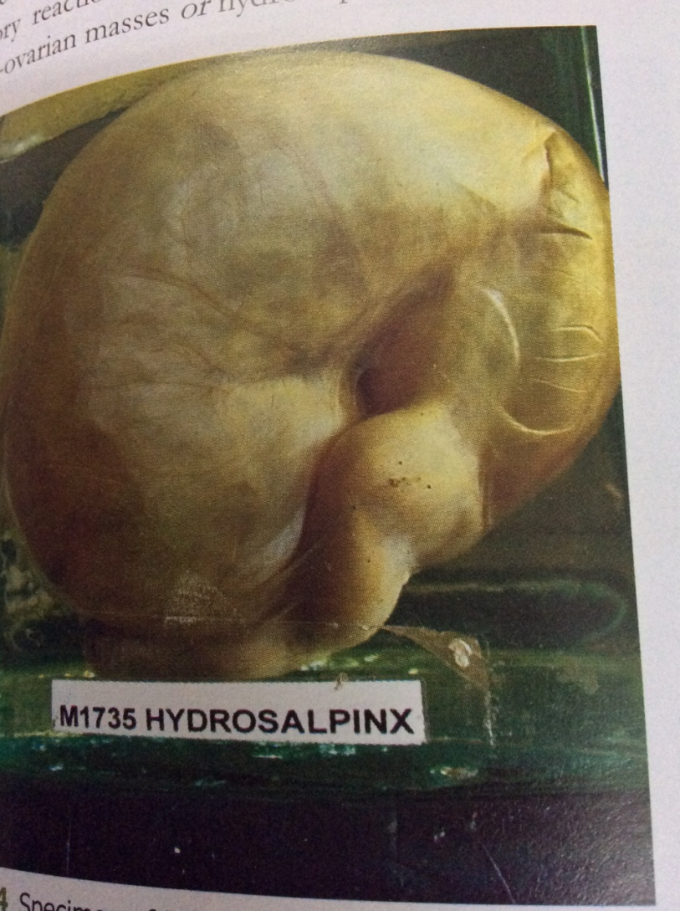
Hydrosalpinx

Slide 13
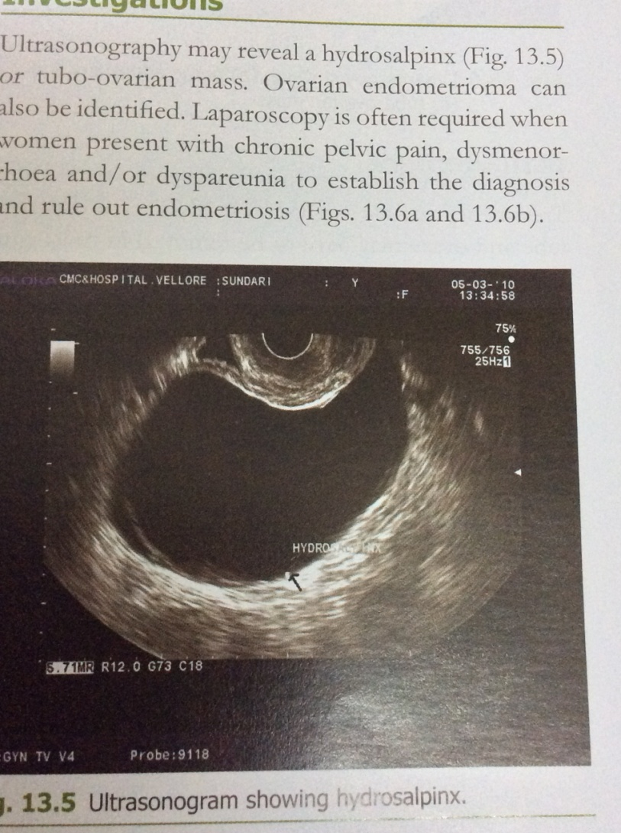
USG showing hydrosalpinx

Slide 14
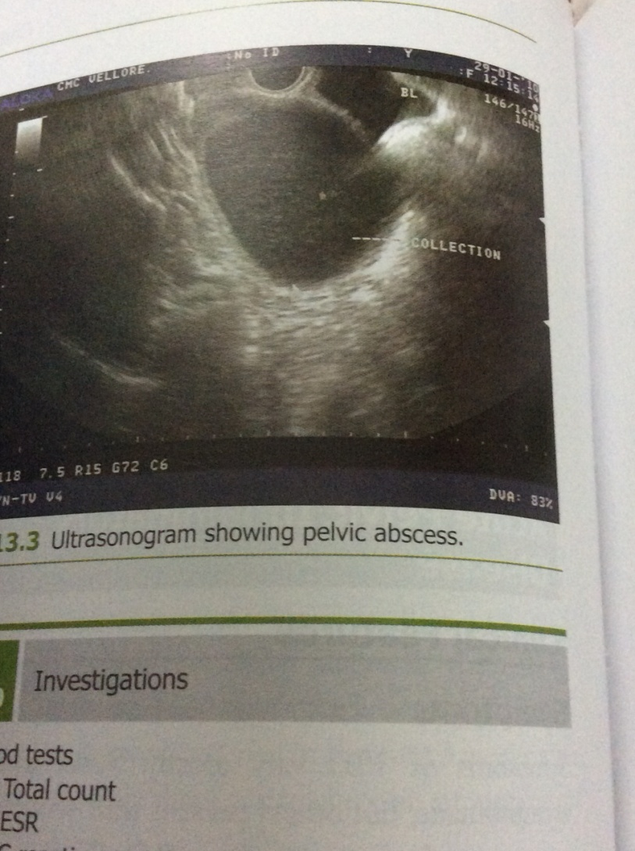
Pelvic abscess- usg TVS

Slide 15
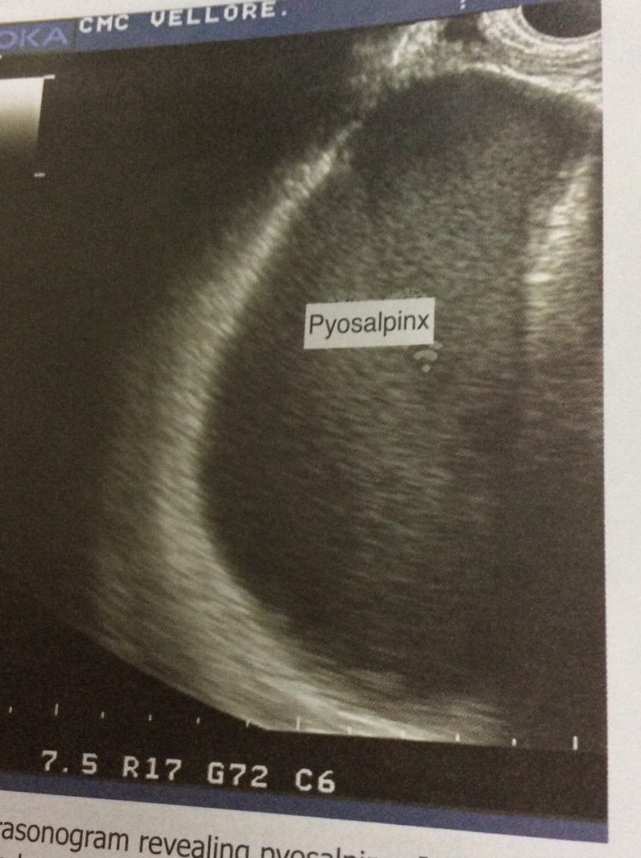
Pyosalpinx seen in USG

Slide 16
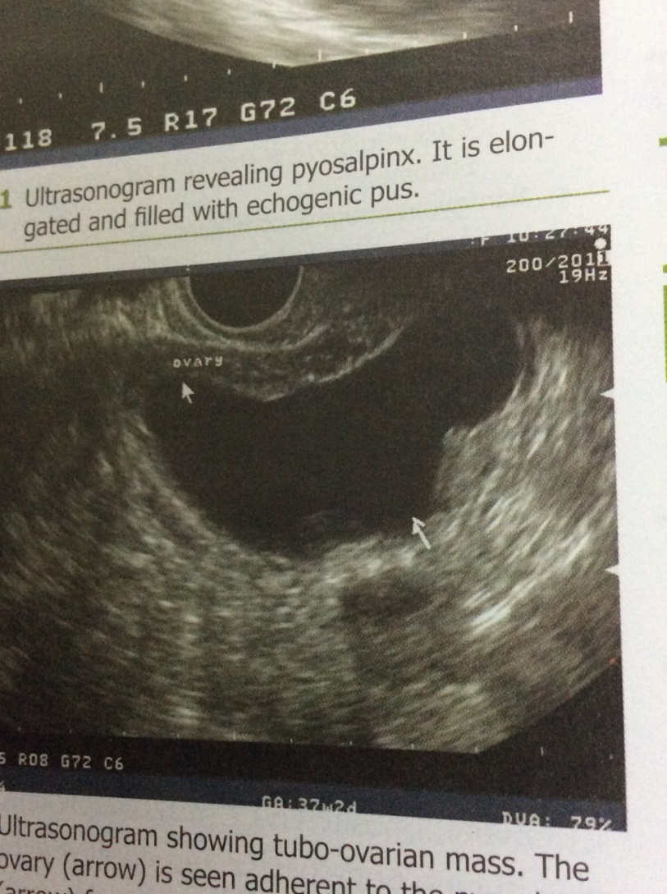
Tubovarian mass in USG

Slide 17
Fitz Hugh Curtis Syndrome – Inflammation of the liver capsule can occur with chlamydia and gonococcal infection.
Patient has right upper quadrant pain & liver tenderness.

Slide 18
Chronic PID
Women who are inadequately treated, untreated or have recurrent infections, chronic PID ensues.

Slide 19
Chronic PID- Pathology
Tubo ovarian mass
Pyosalpinx pus
Hydrosalpinx
Frozen pelvis

Slide 20
Risk Factors for PID
Young age
Low socioeconomic status
Multiple sex partners
Unmarried/ widowed women
Past h/o STI
Vaginal douching
IUCD for 3 weeks after insertion
Smoking/ substance abuse.

Slide 21
Complications/ Sequelae
Pelvic peritonitis
General peritonitis
Rupture of tubo- ovarian abscess
Sub diagphragmatic/ perinephric abscess
Septic thrombophlebitis
Septiceamia

Slide 22
Sequelae
Ectopic pregnancy
Infertility
Chronic pelvic pain

Slide 23
Acute PID - Symptoms
Lower abdominal pain
Abnormal vaginal discharge
Fever
AUB
Dyspareunia- deep
Nausea, vomiting,diarrhea, tenesmus
Right upper quadrant pain

Slide 24
Acute PID - signs
Lower abdominal tenderness
Liver tenderness
Signs of peritonitis
Abnormal vaginal discharge
Mucopus exuding from os
Cervical motion tenderness
Adenexal tenderness/ mass
Fullness in POD- pelvic abscess

Slide 25
Investigation – acute PID
Hgm including TLC & DLC, ESR, CRP
Endocervical d/s for pus cells & NAAT for chlamydia & gonorrhoea
Vaginal d/s for wet saline & KOH test
Urine c&s
TVS- TOmass, Pyo or hydrosalpinx,Pelvic abscess, free peritoneal fluid & to exclude ectopic preg

Slide 26
D/D of acute PID
Ectopic pregnancy
Torsion/ rupture of ovarian cyst
Endometriosis
Acute appendicitis
UTI
Diverticulitis
IBS
IBD

Slide 27
Laparoscopy is considered the gold standard for diagnosis.
But not performed as routine
Indicated in patients who do not respond to initial therapy or diagnosis is doubtful.

Slide 28
Management of acute PID
Assess the need for hospitalization
Antimicrobial therapy
Treatment of partners
Counselling
Assessment of response to therapy
Decision regarding surgical intervention
Follow-up for sequelae.

Slide 29
Indications for hospitalization
Diagnosis is in doubt
Lack of response or tolerance to oral medications
Nonadherence to therapy
Inability to take oral medications due to nausea and vomiting

Slide 30
Severe clinical illness (high fever, nausea, vomiting, severe abdominal pain)
Complicated PID with pelvic abscess (including tuboovarian abscess)
Possible need for surgical intervention or diagnostic exploration for alternative etiology (eg, appendicitis)

Slide 31
CDC guideline for acute PID –inpatient therapy
Cefoxitin (2 g intravenously every 6 hours) or cefotetan (2 g IV every 12 hours)
plus
Doxycycline (100 mg orally every 12 hours).
I/V therapy is discontinued 24 hrs after patient is fever free..
Continue oral doxy for 14 days.

Slide 32
Regimen B
Clindamycin (900 mg intravenously every 8 hours) plus gentamicin loading dose (2 mg/kg of body weight) followed by a maintenance dose (1.5 mg/kg) every 8 hours. Single daily intravenous dosing of gentamicin may be substituted for three times daily dosing

Slide 33
Indications for surgical intervention
USG guided pus aspiration- Pelvic abscess, subhepatic abscess
Posterior colpotomy- Pelvic abscess
Laparoscopic aspiration of pus or drainage or adhesiolysis
Laparotmy for to abscess/ or rupture of same or multiple collection in abdomen
Salpingoopherectomy.

Slide 34
Management of Sexual partners
Contact partners within 6 months of onset of disease.
Screen for gonococcal/chlamydial infection
If screening not possible, start empirical therapy.
Avoid intercourse till the partner completes treatment.

Slide 35
Counseling
Early treatment reduces the risk of sequelae but does not eliminate it.
Barrier contraception reduces risk
Recurrence of infection increases the risk of infertility.
Sexual partner must be treated.

Slide 36
Chronic PID- symptoms
History of previous infection.
Lower abdominal pain
Deep dyspareunia
Congestive dysmenorrhoea
Menorrhagia, polymenorrhoea, polymenorrhagia
Chronic pelvic pain
Infertility

Slide 37
Signs of Chronic PID
Abdominal examination- Tenderness, mass arising from pelvis
Per speculum examination- Vaginal/ Cervical discharge
Pelvic examination- Fixed r/v tender uterus, adenexal tenderness, pelvic mass, hydrosalpinx, tubo- ovarian mass.
Frozen pelvis

Slide 38
Diffrential diagnosis
Endometriosis
Chronic ectopic pregnancy

Slide 39
Investigation
USG may reveal hydro/ pyosalpinx, TO mass, Ovarian endometrioma
Laparoscopy may be required for diagnosis & therapy.

Slide 40
Management of Chronic PID
Laparoscopy- adhesiolysis, salpingo-opherectomy
Laparotomy- Adhesiolysis, Salpingo-opherectomy.
Hysterctomy with bilateral salpingo-opherectomy

Slide 41
Cervicitis
Ectocervix is susceptible to HSV, HPV, Mycoplasma.
Endocervix- is infected by Chlamydia & Gonorrhoea.
Infection is sexually transmitted.
Asymptomatic infection in many.
Symptomatic infection gives rise to muco- pus

Slide 42
Diagnostic criteria
Ectopy of glandular epithelium
Friable epithelium
Bleeds on touch
Mucopus seen frm os
10 or more neutrophils on gram stained smear

Slide 43
Rule out Syphilis & HIV

Slide 44
Diagnosis
Gram staining intracellular diplococci, culture, NAAT, Culture & sensitivity
Chlamydia- Gram staining- pus cells>10 /HPF, Culture, NAAT, Direct fluorescent antigen.

Slide 45
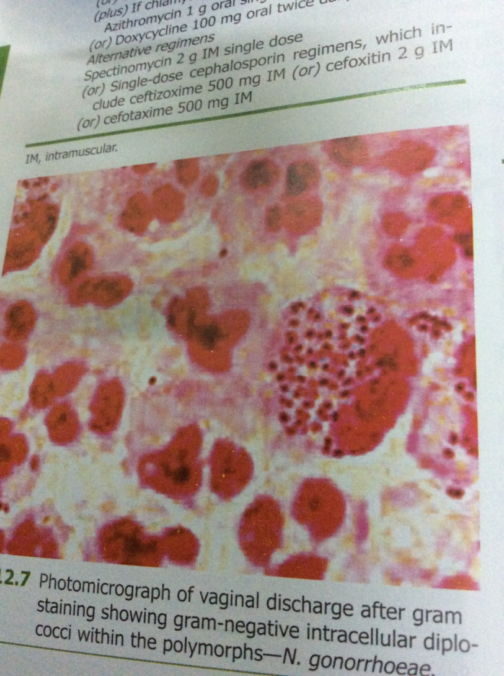
Gram positive intracellular gonococci

Slide 46
Treatment- Gonorrhea
Ceftraixone 125mg IM single dose
Or
Cefixime 400 mgm stat oral dose
Or
Spectinomycin 2gm IM single dose

Slide 47
Treatment- Chlamydia
Azithromycin 1gm stat oral dose
Or
Doxy 100mgm BD for 7 days orally.
Or
Ofloxacin 300 mgm BD orally bfor 7 days.

Slide 48
Syndromic Management
Government of India programme for control of STI & RTI.
Treatment of vaginitis, cervicitis or PID on the basis of history( symptoms) & examination ( signs).
Done where investigation facilities are not available.
Immediate starting of treatment without lab results

Slide 49
Syndrome of vaginal discharge
Syndrome of lower abdominal pain
Treatment- fix dose drugs to be taken by patient in the clinic.
Suraksha clinics have been satrted for RTI/STI control.

Slide 50
Kit 1- Azithromycin 1gm stat plus Cefixime 400 mgm stat.- cervicitis
Kit 2- Fluconazole 150 mgm stat plus Secnidazole 2gms stat- vaginitis.
Kit 6- Doxy 100 mgm BD for 14 days plus Metrogyl 400 mgm BD for 14 days plus Cefixime 400 mgm stat.
Kit 1 is also used for partner management.

Slide 51
Question
A 27 year old nulliparous woman presents with fever, lower abdominal pain, vomiting & discharge p/v. Her LMP was one month back, not on any contraception

Slide 52
What will you look for in clinical examination to make a diagnosis?

Slide 53
Temp, pulse respiration B.P to look for septicaemia.
Abdominal exam, p/s exam & p/v exam

Slide 54
What is the differential diagnosis?

Slide 55
What findings in examination will help you to make a diagnosis of PID

Slide 56
Abdominal tenderness, rigidity,
P/S exam- Mucopus from cervix
P/V exam- Uterine tenderness, adenexal tenderness, cervical tenderness, adenexal mass, fullness in POD

Slide 57
What investigations you will do?

Slide 58
Haemogram- TLC & DLC
Gram staining for gonorrohea & pus cells
NAAT for chalmydia & gonorrhea
Vaginal discharge for BV
UPT, S Beta HCG estimation
TVS

Slide 59
What is the criteria for admission to hospital for acute PID?

Slide 60
Diagnosis is in doubt
Lack of response or tolerance to oral medications
Nonadherence to therapy
Inability to take oral medications due to nausea and vomiting

Slide 61
Severe clinical illness (high fever, nausea, vomiting, severe abdominal pain)
Complicated PID with pelvic abscess (including tuboovarian abscess)
Possible need for surgical intervention or diagnostic exploration for alternative etiology (eg, appendicitis)

Slide 62
Will you treat the sexual partner?

Slide 63
What will you counsel her for?

Slide 64
Complete treatment
Treatment of sexual partner
Use of Barrier contraception
Abstinence during treatment

Slide 65
A 34 year old, para 2, live 2, presnts with lower abdominal pain of 15 days duration, off & on, vaginal discharge, dyspareunia. H/O similar symptoms in past one year.
What is the differential diagnosis?

Slide 66
What are the examination findings in chronic PID?

Slide 67
What is the treatment for chronic PID?

Slide 68
Doxy 100 mgm BD for 14 days
Metrogyl 400 mgm BD for 14 days
Anti inflammatory, analgesics
Ranitidine
Sexual partner to be treated.
Review after 2 weeks for relief.
Counsel for Barrier contraception

