Slide 1
Torture

Slide 2
As per WMA declaration1975 –
Deliberate or intentional systemic or wanton infliction of physical or mental suffering by one or more persons acting alone or on the instruction of any authority to force another person to collect information or to make confession or for any other reason

Slide 3
Motives
Aims or motives
To gather information
To get confession
To obtain testimony
To destroy personality
To take revenge
To spread terror in community

Slide 4
Place generally used:
An isolated or remote or confined place ,usually after sunset with formidable display of power.
Methods:
1. Physical
2. Sexual
3.Psychological

Slide 5
Physical:
A. By inflicting excruciating pain:
a) Beating
b) Falanga ( Falaka Bastinado)
c) Finger torture
d )Dental torture
e) Heat torture
f )Cold torture
g) Quirofano (abdomen torture)
h) Head torture
i) Pulling or twisting of nail, hair ,tongue breast ,nipple ,ear
j) Roller torture

Slide 6
B . Causing extreme exhaustion:
a). Elplanton
b). Forced cabour
C).Asphyxial torture:
wet submarine , dry submarine
made to suck foreign material
d). Suspending from horizontal bar
e). Made stand, sit or lie in abnormal position for a long time
f). Dehydration
g). Rope bondage torture
h). Pharmacological torture
i). Suspension torture: by hand wrist- bandera
by ankle- murcielage
by neck -

Slide 7
C. by causing disfiguration :
Permanent disability
a). Mutilation torture
b). Chemical or irritant
c). Telephono
d). Pushing hot metal rod in to anus (black slave)
e). Piercing torture –pushing nails or needle underneath nails

Slide 8
D. Causing apprehension of immediate death:
a). Electrical torture (cattle prod)
b). Sham torture

Slide 9
II. Sexual:
14% to 61%
By using instrument
Physical sexual torture
Mental sexual torture

Slide 10
III. Psychological(mental torture) :
33% to 77%
A .Deprivation technique
a). Social deprivation
b). Nutritional deprivation
c). Sleep deprivation
d). Hygienic deprivation
e). Medical care
f). Sensory deprivation
g). Perceptional deprivation

Slide 11
B. Coercion technique :
a). To witness torture on others
b). To compell to torture to others
c). To compel to blind obedience to rule
d). Threats and humiliation
e). To compel to sign on false statement

Slide 12
Consequences
1. Physical:
Immediate:
Injuries ,discomfort ,swelling ,tenderness ,haematoma ,burn ,scald ,electrolyte imbalance etc
Delayed :
Infection ,scar , deformity ,disfiguration , impairment of hearing ,or vision , malunion of bone ,pregnancy ,STD etc

Slide 13
2.Psychological:
Anxiety ,depression ,stress disorder ,lack of self confidence ,disturbed sleep, drug abuse
3. Social:
Social stigmas , negative attitude towards social activities

Slide 14
Medicolegal reporting in case of death by autopsy surgeon
Whether victim was tortured or not ?
What were the type of injuries present ?
What was time passed since infliction of injuries?
Mode of causation of injuries?
What was the nature of such injuries?
What types of weapon used?
Whether the injuries were sufficient to cause death in ordinary course of nature?
What was the cause of death ?
Whether any contributory factors aggravated the cause of death?

Slide 15
Medicolegal and Ethical aspect
1.As per the declaration of Geneva 1948:
RMP are prohibited from using their professional knowledge for the purpose of torture.

Slide 16
2.As per the declaration of Tokyo 1975:
Physician are prohibited to :
1.participate or condone in practice of torture, cruelty in human and disregarding procedures
2. provide any promises ,instrument ,substances or knowledge ,to facilitate such practice.
3. be present during any procedure involving cruelty in human activity

Slide 17
3.As per HR Act 1993 :
Freedom from torture in the right to be protected under all circumstances including in times of internal or international disturbances or war

Slide 18
4.As per medical Ethics :
Physician are to protect the prisoners and detainers against the torture or inhuman treatment

Slide 19
5.As duty towards state:
Physician are to examine and treat the victim of torture carefully and thoroughly and to report the police or other investigating agencies.
IPC 330 and IPC 331 deals with the issue of voluntarily causing hurt or grievous hurt for the purpose of extorting confession or any other information

Slide 20
Photographs

Slide 21
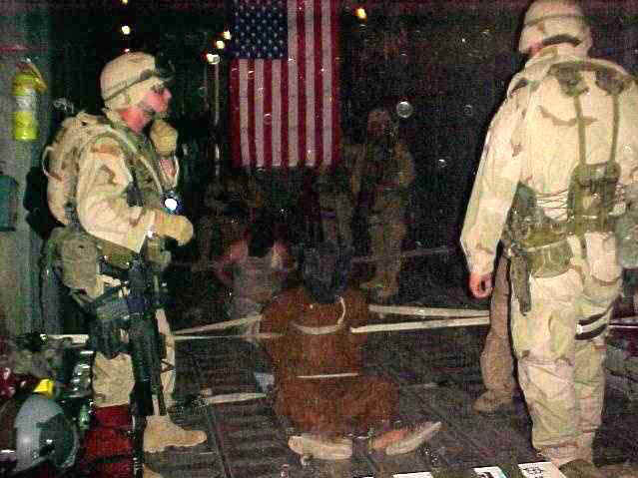

Slide 22
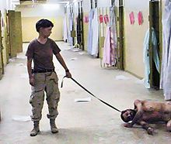

Slide 31
