Slide 1
Essay Type Questions and Their Improvement
Prof.(Dr.) S. Riaz Mehdi
Department of Pathology

Slide 2
Assessment :
Assessment is a process of determining whether predetermined educational objective has been achieved.
Assessment is directly related to the course learning objective.
Assessment of student learning is the measurement of how a student’s knowledge, attitudes or values and skills have changed as a result of academic experience a teacher provides him or her.
The Assessment can be “Summative” or “Formative” for
the purpose of feedback

Slide 3
All methods of assessment have strengths and intrinsic flaws
Van der Vleuten describes five criteria for determining the usefulness of a method of assessment.
Reliability : The degree to which the measurement is accurate and reproducible
Validity : Whether the assessment measures what it claims to measure
Impact on Future Learning and Practice:
Acceptability to students and faculty:
Costs: To the individual trainee and the institution

Slide 4
Assessment can have both intended and unintended consequences.
- Students study more thoughtfully when they anticipate certain
examination formats
The unintended effects of assessment include the tendency for
students to cram for examinations and to substitute superficial
knowledge for reflective learning

Slide 5
Characteristics:
Relevance : Is it appropriate in the context of needs ?
Validity : Does it test what is intended to test ?
Reliability : Does it consistently test what is intended to test ?
Objectivity : Will scores obtained by candidate be same if
examined by two independent expert examiners?

Slide 6
Learning Objective
What is an essay / structured essay / modified essay type question?
When should these question be used?
How should these question be constructed?
Advantages and limitations of these questions.
Construct Essay Question as per the guidelines.
To assess students higher cognitive skills and measure it on Modified Bloom’s Taxonomy

Slide 7
What is an essay / structured essay / modified essay type question?
An Essay question is a type of evaluation system which permits the examinee to write in his own words, a free and extended response to the problem presented and thus reveals information regarding the student’s mental process

Slide 8
Modified Bloom’s Taxonomy
Named after Benjamin Bloom, who formulated this taxonomy
It refers to the classification of different objectives that educators set for student learning, in Cognitive, Affective and Psychomotor domain.
Here the purpose is to move from the level of comprehension to the level of evaluation

Slide 9
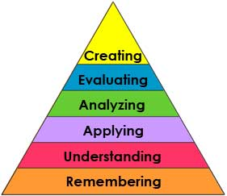
Six Levels of Thinking Skills

Slide 10
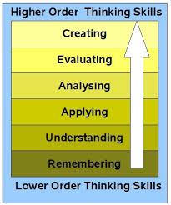

Slide 11
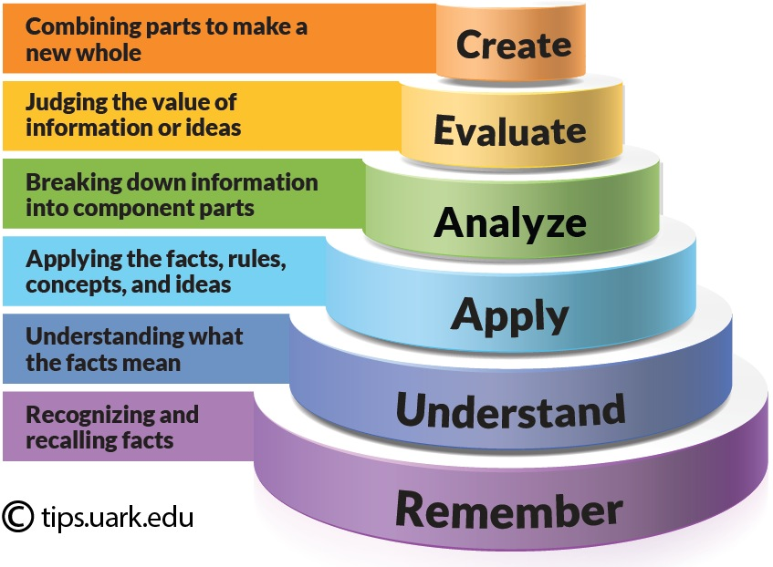

Slide 13
When to use Essay type Questions ?
To assess students’ understanding of subject-matter content.
To assess students’ abilities to reason with their knowledge of a subject.

Slide 14
How should these Questions be constructed
Questions should be clear & specific & exact limit should be set
2. Avoid: - - What do you think?
- What is in your opinion?
- Discuss?
Instead use: - Enlist, Enumerate or Define,
- Compare & Contrast,
- State your reasons,
- Describe ( acceptable)
3. Match the question to specific learning objective. Communicate
clearly to the students what is expected.

Slide 15
How should these Question be constructed
4. Use simple, clear and straight forward language
No options- and better comparison, if options they should be from same topic and should match the difficulty level.
In "Write briefly..." type of questions qualify how briefly into number of words or lines of standard paragraphs.
7. Scoring system: Split the total marks allotted to each part of the question topic. May be indicated in the paper (e.g.1+1+3+5).

Slide 16
Traditional (unstructured)Essay type Question
Discuss Pathology of Thalassemias.

Slide 17
Structured Essay type Questions
Differ from unstructured essay questions in the freedom regarding scope and nature of answer.
Framed in such a way that the student is provided considerable guidance regarding points to be included in the answer.

Slide 18
Traditional Unstructured Essay type Question
Discuss Pathology of Thalassemias. (10 marks)
Structured Essay type Questions
Write an essay on Thalassemias , focusing on its classification, molecular basis, clinical manifestations and laboratory diagnosis. (10)
Write an essay on Thalassemias , focusing on its classification, molecular basis, clinical manifestations and laboratory diagnosis.. (2+3+2+3 )

Slide 19
Advantages of Essay type Questions
1. Free and effective expression
2. Tests their knowledge
3. Test reasoning
4. Test ability to recognize ideas
5. No guess work
6. Easy to frame

Slide 20
Disadvantages of Essay type Questions
Students may interpret it differently from the examiner.
Lack objectivity.
Limited curriculum is tested.
Grading is inconsistent, difficult & time consuming.
Scoring pattern shows a “Halo effect”. - Good or bad student’s previous level of performance.
Advantage-those with better expression power.
Evaluation by different examiners may vary with difference of objectivity

Slide 21
Modified Essay Question (MEQ)
Problem solving type of essay question.
A short history is given to the student, based on which questions are asked.
Requires the student to apply what he has learnt, in the context of a given situation.
The format has questions closely resembling a series of short answer questions than an essay question.

Slide 22
Modified Essay Question (MEQ)
A 4 year old child presents with H/o lethargy, lack of play for 2 months , bouts of fever for last 15 days. On physical examination , his axillary and inguinal lymph nodes were found enlarged. He had mild hepatosplenomegaly.
Q1. What are possible causes of this type of presentation?
Q2. Which investigation would you advise first and why?
Q3. What investigations will you order to arrive at the diagnosis ?
Q4. If the diagnosis is confirmed what shall be the management options ?
(2+2+2+2)

Slide 23
Checklist for Writing Effective Essay Questions
I prepared essay questions that elicited the type of learning outcome I wanted to measure ( Application, Analysis, Evaluation or Creativity)
I phrased each essay question so that the student’s task was clearly and specifically indicated
I indicated for each essay question a point value
I asked questions that elicited responses for which experts could agree that one answer is better than another.
I administered several short answer essay questions rather than one or two extended response essay questions.

Slide 24
RUBRIC for grading Essay Questions
The Rubric is your ideal answer for what an Essay or paper should be like;
The Rubric makes your expectations clear to the students
Helps students evaluate the quality of their own work.
Improves the consistency and speed of grading
The Rubric can be of three types;
- A checklist with Yes or No
- Rating Scales : When simple yes and no is not adequate eg; Low,
Intermediate and High for each performance
- Holistic Scoring: One overall score

Slide 25
RUBRIC Examples
Points Description
0 The response is inaccurate , confused or irrelevant, or the student
has failed to respond to the task.
1 The response indicates that the student has a partial understanding of
the reading concept embodied in the task. The student has provided a response that includes information that is essentially correct and text based , however, the information is too general. Some of the examples and requirements of the task may be incomplete.
2 The response indicates that the student has a complete understanding of the reading concept embodied in the task. The student has provided a response that is accurate, complete, and fills all the requirements of the task. The examples are included and the information is text based

Slide 26
Summary
Use to assess students’ understanding of subject-matter content and abilities to reason.
Types: Traditional, Structured & Modified Essay Questions.(MEQ)
Recommended Action Words: Write, List, Define, Explain, Describe, Compare and Contrast, Enumerate, Classify.
Criteria: Relevance, Validity, Reliability, Objectivity.

Slide 27
Competence is not an achievement but rather a habit of lifelong learning

Slide 29
ELMC Auditorium
Thank You

Slide 30
Task for Workshops
Describe Revised Bloom’s Taxonomy
Using the levels of Bloom’s Taxonomy, create corresponding Essay questions for each level that represents the type of learning embodied in each. Select any course you are teaching .
Select one class that you teach and write five “Modified Essay Questions” utilizing the tips and guidelines given to you.
Prepare a structured question allotting marks for each segment of question, which could be assessed on point rating scale of Rubric

