Slide 1
CONTACT DERMATITIS: JOURNAL CLUB

Slide 2
Outline
Introduction
Classification
Pathophysiology of CD
Allergic contact dermatitis
Irritant contact dermatitis
Investigations
Management

Slide 3
Introduction
Many adverse events can occur when the skin comes in contact with external agents
These reactions are varied
Hyperpigmentation
Hypopigmentation
Acne
Urticaria
Phototoxic reactions
Eczema
Bolognia 3rd ed. Pg 233

Slide 4
Classification
Allergic contact dermatitis (ACD) (20%)
Inflammation caused by allergen-specific T lymphocytes.
Rapid development of dermatitis occurs following re-exposure to low concentrations of allergen, not cause lesions in non-sensitized individuals
Irritant contact dermatitis (ICD) (80%)
Develop following prolonged and repeated exposure to irritants
Inflammatory cells have role in development of dermatitis
Allergen-specific lymphocytes not involved in pathogenesis
Prior sensitization is not necessary
www.worldallergy.org

Slide 5
Pathophysiology of CD
The cutaneous responses of ACD and ICD are dependent on the
Particular chemical
Duration
Nature of the contact
Individual host susceptibility
ACD
Prototype of type IV cell-mediated hypersensitivity reaction
ICD
Nonimmunologic, multifactorial, direct tissue reaction
T cells activated by nonimmune, irritant, or innate mechanisms release proinflammatory cytokines
Dose-dependent inflammation
ACD and ICD frequently overlap because many allergens at high enough concentrations can also act as irritants
Patch test is gold standard for diagnosis for ACD
J Allergy Clin Immunol 2010;125:S138-49.

Slide 6
Skin barrier function
Humectant activity
Anti-bacterial activity
Photoprotector
Calcium signaling
Filaggrin and skin barrier
Filaggrin (De D,Handa, filaggrin mutation & skin,IJDVL, june 2012)

Slide 7
Allergic contact dermatitis

Slide 8
Epidemiology of ACD
Affects the old and young, individuals of all races, and both sexes
Differences in genders usually based on exposure patterns, such as nickel allergy being seen more frequently in women, presumably due to greater exposure to jewelry
Consort dermatitis
Occupations and avocations play an important role
Allergens differ from region to region, e.g. preservatives used in personal care products can vary based on government legislation

Slide 9
Pathophysiology of ACD
In1935 studies of 2,4-dinitrochlorpbenzene DNCB sensitization guinea –pigs
Electrophilic component of hapten and nucleophilic side chain of target protein in skin
Chemical that are not normally electrophilic can converted to properties of hapten by air oxidation or cutaneous metabolism
Electrophilic component | nucleophilic
Aldehydes, ketone,amide metal ion | Lysine,cyctein ,histidine
Contact dermatitis 2005;53:189-200

Slide 10
Induction of contact hypersensitivity. Application of contact allergens (Ag) induces the release of cytokines by keratinocytes, Langerhans cells and other cells within the skin. These cytokines in turn activate Langerhans cells which uptake the antigen and emigrate into the regional lymph nodes. During this process, the Langerhans cells mature into dendritic cells. In addition, the antigen is processed, re-expressed on the surface and finally presented to naïve T cells in the regional lymph node. Upon appropriate antigen presentation, T cells bearing the appropriate T cell receptor clonally expand and become effector T cells. These alter their migratory behavior due to the expression of specific surface molecules like CLA. Effector T cells recirculate into the periphery where they may later meet the antigen again. Ag, antigen; KC, keratinocyte.

Slide 11
Elicitation of contact hypersensitivity. Application of contact allergens (Ag) into a sensitized individual causes the release of cytokines by keratinocytes and Langerhans cells. These cytokines induce the expression of adhesion molecules and activation of endothelial cells which ultimately attracts leukocytes to the site of antigen application. Among these cells, T effector cells are present which are now activated upon antigen presentation either by resident cells or by infiltrating Langerhans cells. Antigen-specific T cell activation again induces the release of cytokines by T cells. This causes the attraction of other inflammatory cells including granulocytes and macrophages which ultimately cause the clinical manifestation of contact dermatitis. Ag, antigen; DDC, dermal dendritic cell; KC, keratinocyte; CLA, cutaneous lymphocyte antigen.

Slide 12
Clinical feature of ACD
Acute
Bright red edematous skin
May have clear fluid-filled vesicles or bullae
As lesions break, skin becomes exudative and weeps clear fluid
Subacute
Characterized by the formation of papules instead of vesicles
Additionally, less edema is seen in subacute phase
Dry scales are sometimes seen in subacute contact dermatitis
Chronic
Scaling, skin fissuring, and lichenification but only minimal edema
Excoriations can also be observed in chronic contact dermatitis

Slide 13
Other common presentations of allergic contact dermatitis
Based primarily upon type of
primary lesion
Based primarily upon distribution
and/or pathogenesis
1. Pigmented (e.g. fragrances,
bactericides; often facial)
2. Lichenoid (e.g. color film developers)
3. Erythema multiforme (e.g. tropical woods, poison ivy)
4. Purpuric (e.g. rubber diving suits)
5. Granulomatous (e.g. zirconium)
5. Pseudolymphomatous (e.g.compositae)
1. Photoinduced (photoallergic contact dermatitis)
2. Airborne contact dermatitis
3. Systemic contact dermatitis
4. Baboon syndrome – symmetric erythema of the gluteal and inguinal area in addition to other flexural sites
Symmetrical drug related intertriginous and flexural exanthema
(SDRIFE)

Slide 14
Baboon syndrome
It is also called symmetrical drug related intertriginous and flexural exanthema (SDRIFE)
In classical baboon syndrome, the initial sensitization is by skin contact with the causative agent then a rash with the particular appearance of the baboon syndrome is brought out by taking the agent by mouth systemic contact dermatitis
It is not fully understood why the rash should occur in these particular areas
Classical baboon syndrome was observed with mercury, nickel, iodinated radiocontrast dyes and ampicillin
Pathomechanism of SDRIFE is likely a cell-mediated type IV allergy
Dermatology. 2007;214(1):89-93.

Slide 15
ACD: Causes
M/C agents are plants of Toxicodendron genus
eg : poison ivy, poison oak, poison sumac
Other common agents
Nickel sulfate (various metal alloys)
Sunscreens
Potassium dichromate (cements, household cleaners),
Chromate (leather products - car seat dermatitis)
Lanolin (emollients)
Formaldehyde ( Textile dermatitis )
Ethylenediamine (dyes, medications)
Mercaptobenzothiazole (rubbers)
Thiram (fungicides)
Paraphenylenediamine (Hair dyes, Henna, photographic chemicals)
Balsam of peru (fragrance)
CAPB (COCOAMIDOPROPYL BETAINE) (shampoos, bath products, and eye and facial cleaners)
Corticosteroids

Slide 16
ACD group 2009,20;149-60

Slide 17
Allergic contact dermatitis in the modern era
Product | Allergen | Clinical presentation
Mobile (cellular) phones | Nickel | Facial dermatitis
Sanitary (baby or wet) wipes | Methylchloroisothiazolinone | Direct contact – anogenital dermatitis (all ages) Indirect contact – posterior thighs (commode seat)
Anti-mold sachets inside leather products to prevent mold formation during shipping (e.g. couches, chairs, shoes | Dimethylfumarate | When heated, fumes are created which penetrate through leather and clothing, leading to dermatitis of the back, buttocks and posterolateral thighs if in furniture
“Natural” botanical products resurgence plus grooming practices, e.g. beeswax-containing lip balm | Propolis | Cheilitis of both the upper and lower lip
Increase in temporary tattoos | Paraphenylenediamine | Allergic reaction at site of temporary tattoo

Slide 18
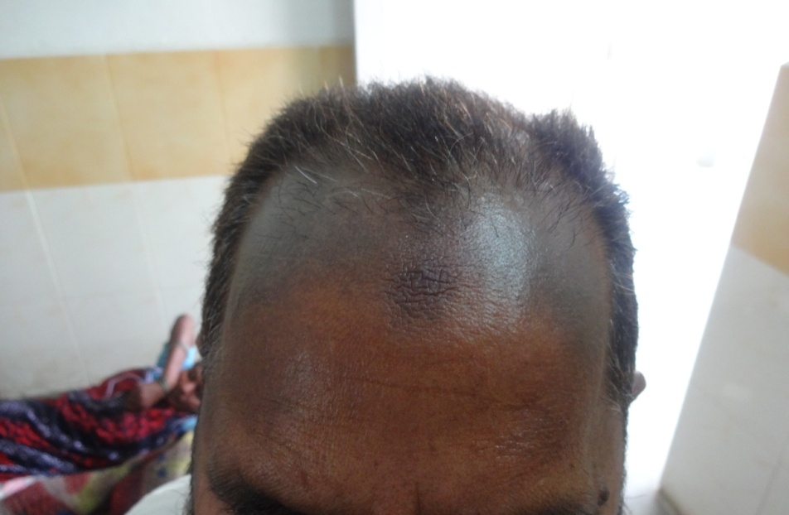
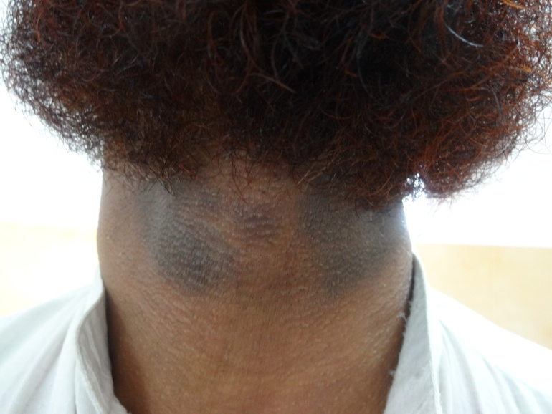
Contact dermatitis to hair dye
Classification of hair dyes | Source | Active principle
1. Vegetable hair dyes | Natural Henna is obtained from the dried leaves and stem of Lawsonia intermis Black henna | Lawsone (2-hydroxy-1,4- Naphthoquinone) PPD is added in order to decrease application time and intensify the color
2. Metallic hair dyes | lead acetate, salts of bismuth, silver, copper, nickel, and cobalt
3. Synthetic hair dyes
A. Direct hair dyes |  | anthraquinone colors, azo dyes, eosin YS dyes
B. Oxidation hair dyes |  | nitrophenylenediamines, nitroaminophenol, and anthraquinones
Indian Journal of Dermatology, Venereology, and Leprology | September-October 2012 | Vol 78 | Issue 5

Slide 19
Contact dermatitis due to minoxidil
A 25-year old girl having androgenetic alopecia developed itching and erythema on the scalp one month after she started applying a commercial preparation containing 2% minoxidil
The dermatitis disappeared on discontinuing minoxidil but recurred when she applied minoxidil again after a gap of 1 month
Patch tests revealed a papulo-vesicular reaction with the commercial minoxidil lotion and also with a minoxidil tablet powdered and made into a paste with distilled water
Patch tests with ethyl alcohol were negative
Pasricha J S, Nanda A, Bajaj N. Contact dermatitis due to minoxidil. Indian J Dermatol Venereol Leprol 1991;57:235-6

Slide 20
Contact dermatitis due to hydroquinone
Hydroquinone is an unstable compound, and thus any preparation containing hydroquinone must contain some stabiliser (5% para­aminobenzoic acid)
Dermatitis due to such a preparation might be due to the agents other than hydroquinone
Positive patch test results with hydro­quinone in an aqueous solution confirmed that the dermatitis was due to hydroquinone
Pasricha J S, Parmar K A. Contact dermatitis due to hydroquinone. Indian J Dermatol Venereol Leprol 1991;57:194

Slide 21
Contact allergy to topical corticosteroids
Clinical settings, signs and symptoms suggesting contact dermatitis to topical corticosteroids
Chronic relapsing or persistent dermatitides of lower legs, hands or face
Older age
Lack of expected improvement in a corticosteroid-responsive dermatosis in spite of adequate treatment
Aggravation of a dermatosis after topical corticosteroid treatment
Patients showing other adverse effects of long-term topical corticosteroid use
Occupational exposure to topical corticosteorids, e.g. pharmacists, nurses, and pharmaceutical industry workers
Tixocortol-21-pivalate 0.1% and budesonide 0.01% are adequate screening agents for this problem
Anti-inflammatory nature of corticosteroids complicating patch test interpretation
Indian Journal of Dermatology, Venereology, and Leprology | September-October 2012 | Vol 78 | Issue 5

Slide 22
Contact allergy to topical corticosteroids
Peculiar reactions seen in patch testing with corticosteroids
Reaction | Description | Interpretation
Edge effect | No reaction under the chamber; erythema or papules seen at and outside the edge of the chamber usually at 48 h reading | A frankly positive reaction usually develops at later readings. Occurs due to too-high anti-inflammatory effect under the chamber
Non-palpable erythema | Faint macular erythema seen at 48 or 96 h readings | Usually seen with milder potency molecules. Often turns into a clear positive reaction at day 7 reading
Blanching | Localized pallor at the test site seen at 48 h reading | Usually seen with potent / superpotent molecules dissolved in alcohol due to vasoconstriction. May turn out to be positive or negative at later readings
Indian Journal of Dermatology, Venereology, and Leprology | September-October 2012 | Vol 78 | Issue 5

Slide 24
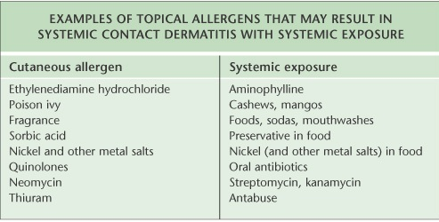
Systemic contact dermatitis
Localized or generalized inflammatory skin disease in contact-sensitized individuals exposed to hapten orally, transcutaneously, intravenously, or by means of inhalation
J Allergy Clin Immunol 2010;125:S138-49.
Indian J Dermatol Venereol Leprol|March-April 2006|Vol 72|Issue 2

Slide 25
Airborne-contact dermatitis
Airborne-contact dermatitis (ABCD) represents a unique type of contact dermatitis originating from dust, sprays, pollens or volatile chemicals by airborne fumes or particles without directly touching the allergen
ABCD in Indian patients has been attributed exclusively by pollens of the plants like Parthenium hysterophorus, etc., but in recent years the above scenario has been changing rapidly in urban and semiurban perspective especially in developing countries
ABCD has been reported worldwide due to various type of nonplant allergens and their clinical feature are sometimes distinctive
Preventive aspect has been attempted by introduction of different chemicals of less allergic potential
Indian Journal of Dermatology 2011; 56(6)

Slide 26
Airborne-contact dermatitis
Plants source | Nonplant etiology
Parthenium hysterophorus | Cement (potassium dichromate) and wood dust, paints (Chloromethyl- and Methylisothiazolinone)
Xanthium strumarium | Fibrous materials like grain dust, glass fiber and rock wool
Chrysanthemum coronarium | Aerosols of mineral oils inducing irritant reaction (Fragrance allergy leading to ABCD)
Helianthus annus (sunflower) | Pollens or dust containing particles from plants such as Parthenium hysterophorus, ragweed or certain types of woods or medicaments by the process of delayed hypersensitivity
Dahlia pimrata | Benzoyl peroxide has been used to bleach candles white. Intense exposure to burning candles in a church has caused facial dermatitis
Psyllium, primarily used as a stool softener, comes from the seed of the genus Plantago | Rubber gloves made with natural latex (usually derived from Hevea brasiliensis Muell.Arg., family Euphorbiaceae)
 | Airborne transmission of latex allergens is enhanced by their adsorption onto the cornstarch (derived from Zea mays L., family Gramineae) used as glove powder
Indian Journal of Dermatology 2011; 56(6)

Slide 27
Irritant contact dermatitis

Slide 28
Pathogenesis of ICD
Denaturation of epidermal keratins
Disruption of the permeability barrier
Damage to cell membranes
Direct cytotoxic effects

Slide 29
Cont…
Clinical manifestations of ICD are determined by:
Properties of the irritating substance
Host factors
Environmental factors including concentration, mechanical pressure, temperature, humidity, pH, and duration of contact
Cold alone may also reduce the plasticity , with consequent cracking of the stratum corneum
Occlusion, excessive humidity, and maceration increase percutaneous absorption of water-soluble substances

Slide 30
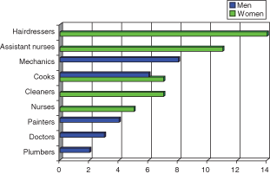
Contact irritants and allergens in the work environment
Ulrik F. Friis1, Torkil Menné1,2, Jakob F. Schwensen1, Mari-Ann Flyvholm3, Jens P. E. Bonde4
and Jeanne D. Johansen1© 2014 John Wiley & Sons A/S. Published by John Wiley & Sons Ltd
Contact Dermatitis, 71, 364–370
Important predisposing characteristics of the individual include:
Age, race, sex, pre-existing skin disease, anatomic region exposed, and sebaceous activity
Both infants and elderly are affected more by ICD because of their less robust epidermal layer
Patients with darkly pigmented skin seem to be more resistant to irritant reactions
Other skin disease such as active atopic dermatitis may predispose an individual to develop ICD
The most commonly affected sites are exposed areas such as the hands and the face, with hand involvement in approximately 80% of patients and face involvement in 10%

Slide 31
Exogenous causes of ICD in Occupational Dermatology Clinic, Skin and Cancer Foundation, Australia (total 621 patients over the period 1993–2002)
Australasian Journal of Dermatology (2008) 49, 1–11

Slide 32
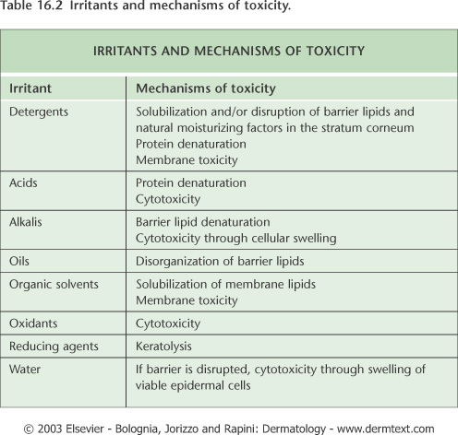

Slide 33
Type of irritation | Onset and type of exposure | Clinical characteristics
Acute ICD | Acute; often single exposure to strong irritant | Erythema, edema, weeping, vesicles, bullae, necrosis, burning, pain
Acute-delayed ICD | Delayed onset of clinical lesions: 8–24 h or longer after exposure; induced by special irritants | Erythema, papules, vesicles, bullae
Irritant reaction | Develops in weeks; often seen in individuals involved in wet work and appears after multiple exposures | Erythema, papules, dryness, scaling; it may resolve or, with continued exposure, may progress to a full-blown ICD
Cumulative ICD | Develops in months to years; multiple exposures to different agents; often weak irritants, capable of inducing a reaction only after repetitive exposure | Erythema, papules, dryness, scaling, fissuring, lichenification. Burning, itching, soreness
Asteatotic ICD | Develops in months to years; multiple exposure to a single agent | Erythema, papules, dryness, scaling, fissuring, lichenification
Traumatic ICD | Develops in weeks to months after skin trauma | Erythema, papules, dryness, scaling, fissuring, lichenification, callus
Friction ICD | Develops in weeks to months by repetitive microtrauma | Erythema, papules, dryness, scaling, lichenification
Pustular and acneiform CD | Develops in weeks to months; exposure to special agents (comedogenic-pustulogens), frequently occurs with occlusion to mineral oils, metals etc | Papules, pustules, comedones
Contact urticaria | Develops sec to parabens, latex, henna | Dryness, scaling, fissuring, itching, soreness

Slide 34
Cumulative Irritant Contact Dermatitis
Consequence of multiple sub-threshold skin insults, without sufficient time between them for complete barrier function repair
Lesions are less sharply demarcated
Itching and pain due to fissures of hyperkeratotic skin
Skin findings include lichenification, hyperkeratosis, xerosis, erythema, and vesicles

Slide 35
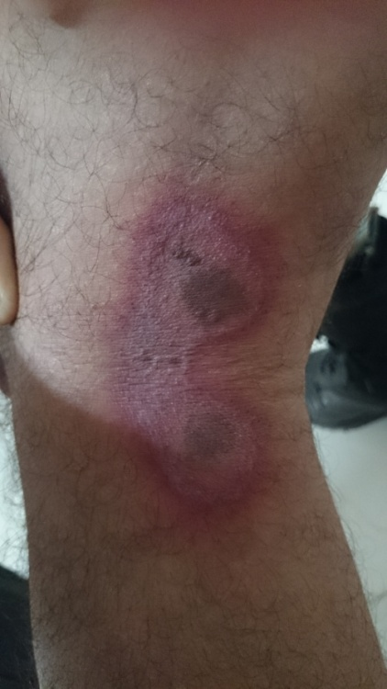
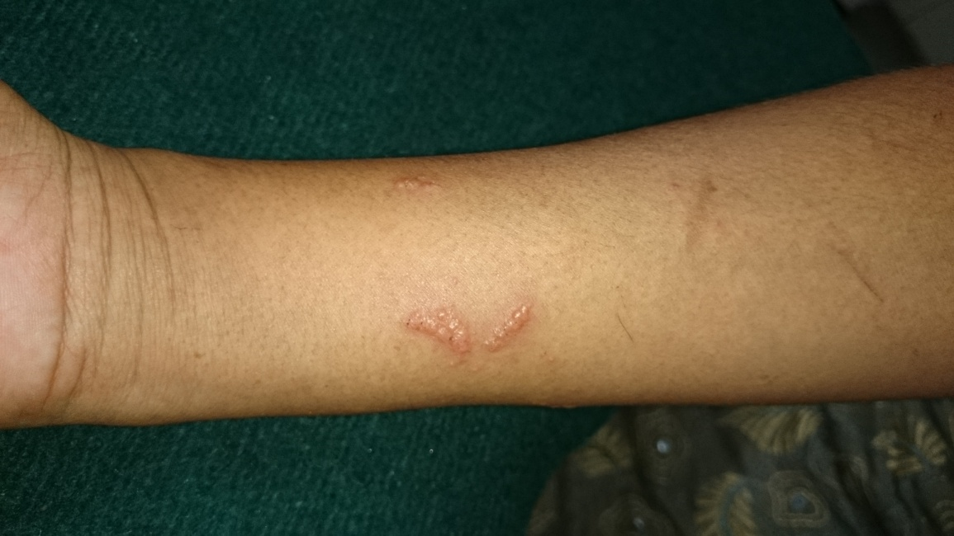
Irritant Contact Dermatitis
Acute Irritant Contact Dermatitis
Burning, stinging, painful sensations can occur immediately within seconds after exposure or may be delayed up to 24 hour
Lesion
Erythema with a dull, nonglistening surface → vesiculation (blister formation) → erosion → crusting → shedding of crusts and scaling or erythema → necrosis → shedding of necrotic tissue → ulceration → healing

Slide 36
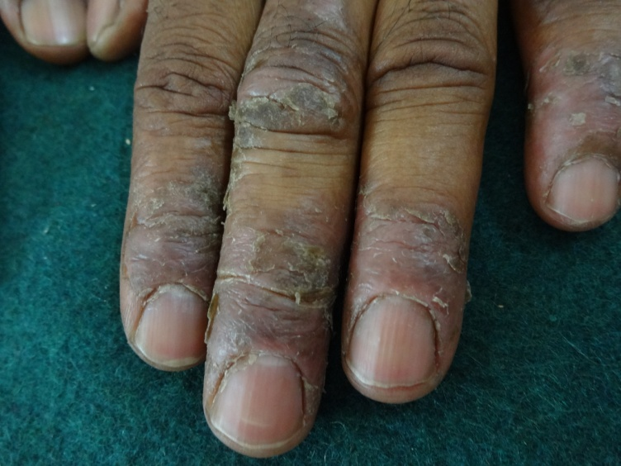
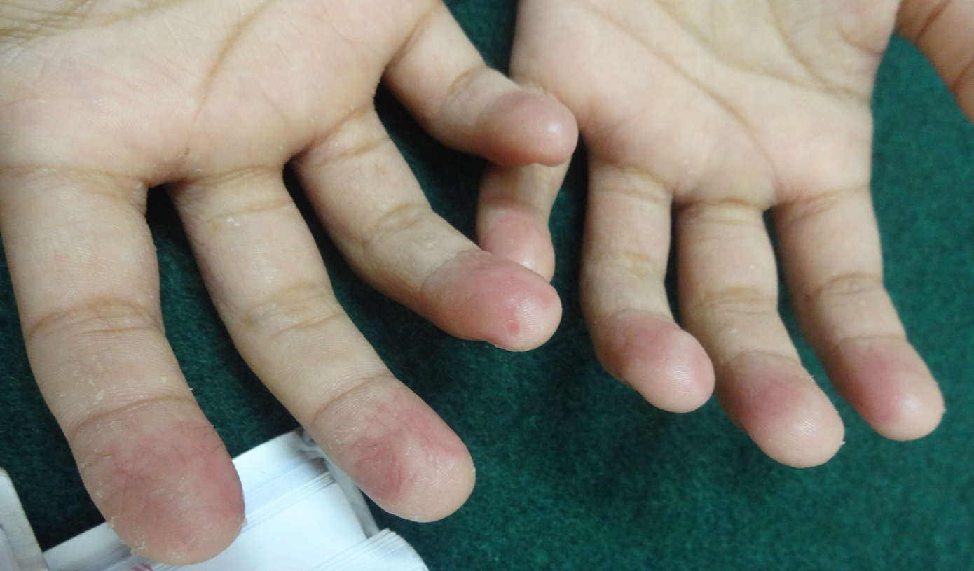
Irritant Contact Dermatitis
Chronic Irritant Contact Dermatitis
Prolonged and repeated exposures of the skin to irritants results to a chronic disturbance of the barrier function, subsequently, elicit a chronic inflammatory response.
Stinging and itching, pain as fissures develop
Lesion
Dryness → chapping → erythema → hyperkeratosis and scaling → fissures and crusting
Lichenification, vesicles, pustules, and erosions

Slide 38
ICD & ACD
Differentiation is often difficult in clinical setting,
Deciding whether dermatitis primarily depends on irritancy or allergy is not always straightforward.
No pathognomic clinical signs and symptoms can unambiguously discriminate between ACD and ICD.
Diagnosis of CD depends on:
Patient history,
Clinical examination,
Exposure assessment (including hazard identification, estimation of dermal exposure and risk characterization),
Analysis of all predisposing and contributory factors,
Comprehensive diagnostic testing.

Slide 39
Workup Laboratory Studies:
Patch tests (epicutaneous)
Open-tests or repeated open tests – ROAT
Thin-layer Rapid Use Epicutaneous Test (T.R.U.E. Test)
Photopatch Test
Provocative Use Test
Differentiation between irritation and allergy can therefore be established clinically by:
– The systematic use of a positive control for irritation during the tests;
– When a reaction is difficult to interpret or there are positive irritation tests:
1) re-test with patch tests for only 24 hours (or 12 hours if the first reaction is strong);
2) carry out a ROAT test.

Slide 40
Cont…
Immunological tests
Shows the existence of allergen-specific T cells in the skin or blood of patients;
Presence of allergen-specific T cells in the skin found in a punch biopsy of ACD lesions or in skin tests
Presence of allergen-specific T cells in patients’ blood

Slide 41
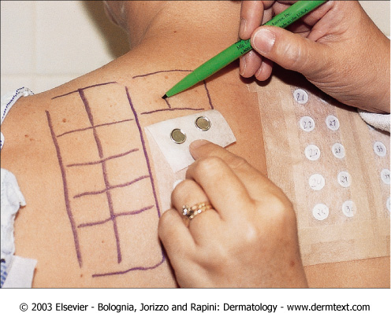
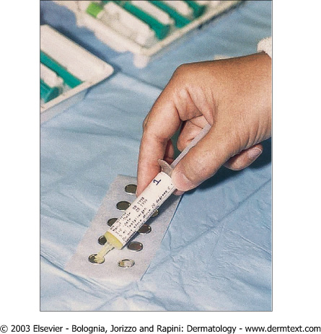
Patch Testing: T.R.U.E Test
Application of TRUE test. www.truetest.com
FDA approved test
Preimpregnated test that screens for 23 allergens
Extending testing beyond these 23 allergens has shown to be more beneficial
In three studies, extended testing detected 37-76% more positive reactions, and 47.3% of patients had positive reactions only to non-screening allergens
Additional allergens come in multiuse syringes
Allergens contained within syringes being placed by nurse into Finn chambers

Slide 42
Patch Testing
Most common site is the upper back
Patients should not have a sunburn in test area, and should not apply topical corticosteroids to the patch test sites for 7 days prior to test
Systemic corticosteroids should be avoided for 1 month prior to testing
Patches are applied to back and reinforced with Scanpor tape, patient instructed to keep back dry and patches secured until second visit at 48 hours
Fixing allergens to patient's back using Scanpor® tape.

Slide 43
Patch Testing
When the patient returns in 48 hours the patches need to be inspected to ensure that the testing technique is adequate
As patches are removed their sites of application should be marked in order to identify the locations of particular allergens

Slide 44
Patch Test Scoring
A positive patch test reaction to nickel. This is an example of a 3+ reaction

Slide 45
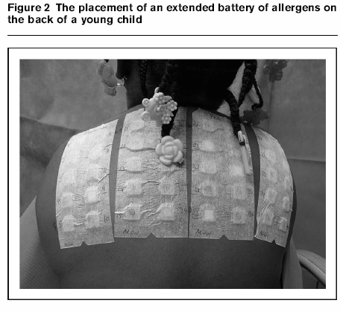
Patch Testing
Patient again asked to keep back dry until second reading, done from 72 hours to 1 week after the initial application of the patches
This delayed reading is necessary due to patch test responses to some allergens such as gold having a delayed reaction

Slide 46
Investigation
Repeat open application test (ROAT)
Improving reliability of interpreting tests for leave-on products
suspected allergens are applied to antecubital fossa twice daily for 7 days and observed for dermatitis
absence of reaction makes CD unlikely
If eyelid dermatitis is considered, ROAT can be performed on back of ear
Dimethyl-glyoxime test for nickel
identification of allergens
Skin biopsy
Distinguishing CD from morphologically similar diseases
J Allergy Clin Immunol 2010;125:S138-49.

Slide 47
Sunsrceens
First sunscreen – 1930s in Europe
Para aminobenzoic acid
Isopropyl dibenzoyl methane
Benzophenones
Octocrylene
Excipients
Surfactants, preservatives, fragrances, moisturizers

Slide 48
Photopatch Test
Duplicate set of allergens
5 joules of UV A
48 hrs of occlusion
Interpretation

Slide 49
Reaction on non-irradiated side | Reaction on irradiated side | Interpretation
Negative | Negative | No allergy, no photoallergy
Negative | Positive | Pure photoallergy
Positive | Negative | Allergy, no photoallergy
Positive | Positive | Allergy with photo-exacerbation

Slide 50
Augmented telomerase activity & reduced telomere length in parthenium-induced contact dermatitis, N.Akhtar, JEADV, 01/08/12
Objectives : To measure telomerase activity & telomere length in Peripheral blood mononuclear cell (PBMC), CD4⁺ and CD8⁺ T lymphocytes

Slide 51
Methods : 50 patients & 50 healthy controls.
Telomerase activity was measured using
PCR–ELISA kit.
Results : Significantly Telomerase activity
Conclusion : The augmented telomerase
activity
Potential diagnostic/prognostic marker for
parthenium dermatitis in future

Slide 53
Azathioprine
It is an effective steroid-sparing agent and can also be used alone in hand eczema (2 mg/kg/day).
Hand eczema seen with parthenium dermatitis responds well to azathioprine.
Atopic hand eczema also shows good response.
Due to genetic polymorphisms, 11% of the population have intermediate TPMT activity and are predisposed to toxic effects.
Dosage should be advised after checking the TPMT levels.

Slide 54
In a study of 91 patients with chronic hand eczema at 24 weeks mean percentage improvement in itching score was 74.15 and 95.55% for Group A (Topical clobetasol alone) and Group B (Topical clobetasol + Azathioprine) respectively (P = 0.003).
At 24 weeks mean percentage improvement in HECSI score was 64.66 and 91.29% (P = 0.001) in Group A and Group B respectively.
* Agarwal US, Besarwal RK. Topical clobetasol propionate 0.05% cream alone and in combination with azathioprine in patients with chronic hand eczema: An observer blinded randomized comparative trial. Indian J Dermatol Venereol Leprol 2013;79:101-3.

Slide 55
IRON THERAPY IN HAND ECZEMA: A NEW APPROACH FOR MANAGEMENT Ashimav Deb Sharma Indian Journal of Dermatology 2011; 56(3)
Abstract
It is observed that adequate iron intake and status can limit nickel absorption from the diet in the human body. Chronic vesicular hand eczema (CVHE) due to nickel sensitivity is a common dermatological condition where the dietary nickel acts as a provocating factor. Such patients are usually treated with low nickel diet (LND). The present study was conducted to observe the result of addition of oral iron with LND in the treatment of CVHE in patients due to nickel sensitivity. 23 patients with CVHE due to nickel sensitivity were taken for this study. Study group (12 patients) were advised LND with oral iron for a period of 12 weeks. Control group (11 patients) were advised LND alone for a period of 12 weeks. Fast improvement noted in the skin lesions of the study group patients; 10 (83.33%) patients had complete clearance of their hand eczemas at the end of 12 weeks. There were significant reductions in the blood level of nickel in those patients. Moderate improvement noted in the skin lesions of the control group patients; 5 (45.45%) patients showed complete clearance of hand eczema at the end of 12 weeks. This study showed that oral iron helped to reduce nickel absorption from the diet. The study also showed that combination of LND and oral iron can bring a faster reduction in the severity of clinical symptoms of CVHE in a nickel sensitive individual.
Notes:
Whole wheat bread, multi grain breads, cauliflower, spinach, canned vegetables, cabbage, corn, mushrooms, onions, carrots, pears, bananas, canned fruits, tomatoes, Tea, chocolate milk, beer, red wine, Chocolate and cocoa powder (especially dark chocolate)

Slide 56
BACH (Benefit of Alitretinoin in Chronic Hand Eczema)
Largest study
249 subjects were taken
30 mg for 24 wks
50% achieved ‘clear’ or ‘almost clear’ hands

Slide 57
Differentiation between ICD and ACD
ICD
ACD
J Allergy Clin Immunol 2010;125:S138-49.

Slide 58
Thank you

