Slide 1
Nursing Care of Patient on Dialysis
Dr. M.L.Patel
Additional Professor
Department of Medicine
KGMU Lucknow

Slide 2
Nursing Care of Patient on Dialysis
Protocols – In each unit in regard to machines,Procedure & patient care
Sanitizing machines
• PD cath care/dressing /treatment
• Flushing new PD catheter
• PET
• Peritonitis care
• Investigation protocol
• Vaccination
Records /Treatment flow sheets

Slide 3
Hemodialysis requires 5 things
Access to patient ’s circulation (usually via fistula)
2. Access to a dialysis machine and dialyzer with a semipermeable membrane
3. The appropriate solution (dialysate bath)
4. Time: 12 hours each week, divided in 3 equal segments
5. Place: home (if feasible) or a dialysis centre

Slide 4
Hemodialysis- Procedure
1. Patient ’s circulation is accessed
2. Unless contraindicated, heparin is administered
3. Dialysis solution surrounds the membranes andflows in the opposite direction.
4. Dialysis solution is:
Highly purified water
Na,K, Ca, Mg, Cl, & Dextrose
c. Either bicarbonate or acetate, to maintain proper Ph.
6. Via the process of diffusion, wastes are removed in the form of solutes (metabolic wastes, acid-base components and electrolytes)

Slide 5
7. Solute wastes can be discarded
8. Ultrafiltration removes excess water from the blood
9. After cleansing, the blood returns to the client via the access

Slide 6
Complications related to vascular
Access during Hemodialysis
Infection
Catheter clotting
3. Central venous thrombosis
4. Stenosis or thrombosis
5. Ischemia of the affected limb
6. Development of an aneurysm

Slide 7
Pre-dialysis care
Assess for-
Weight: Determines amount of fluid to be removed during dialysis
Vital Sign: BP for hypo and hypertension; temperature for sepsis; respiration for fluid Overload
Potassium level: Determines potassium level in dialysate (in the chronic setting, this is done monthly unless the patient is symptomatic
Hold drugs that pass through the dialysis membrane, such as piperacillin, folic acid, and other water-soluble vitamins.
• Hold antihypertensive drugs, especially if systolic pressure is below 100, per physician order

Slide 8
Check access site
Assess fistula or graft for infection
• Assess circulation in distal portion of
extremity
• Auscultate for bruit
• Palpate for thrill
• No IV or blood draws in that arm
• No BP in arm

Slide 9
During Dialysis
Watch for
• Hypotension
• Muscle cramps
• Nausea and vomiting
• Headache
Itching
Less commonly: disequilibrium syndrome, hypersensitivity reaction, arrhythmia, cardiac
tamponade, seizures, air embolism

Slide 10
POST DIALYSIS CARE
Monitor BP; report hypotension or hypertension
• Watch for bleeding
• Check weight and compare (weight loss should
be close to fluid removal goal set during
treatment)
• Document unusual findings
• Assess access site for bruit, thrill, exudate, signsof infection, bleeding
• Give missed meds, if indicated

Slide 11
NURSHING INTERVENTION IN DIALYSIS
Explain procedure to client
2. Cannulating & connecting to HD machine
3. Monitor hemodynamic status continuously
4. Monitor acid-base balance
5. Monitor electrolytes
6. Insure sterility of system
7. Maintain a closed system
8. Diet Restriction- Protein intake, Sodium intake, Potassium intake, Fluid intake
9. Reinforce adjustment to prescribed medications that may be affected by the process of hemodialysis

Slide 12
NURSHING INTERVENTION IN DIALYSIS
10. Monitor for complications of dialysis related to:
Arteriosclerotic cardiovascular disease
Congestive heart failure,
Stroke,
Infection,
Gastric ulcers,
Hypertension,
Calcium deficiencies,
Anemia and fatigue,
Depression,
sexual dysfunction,
suicide risk

Slide 13
DIET –DIALYSIS
PD get calories from Dextrose in the fluid –PD patients may eat fewer CHO than hemodialysis patients
Protein- HD loses 10-12 gms of Aminoacids and PD 5-15gms of protein per treatment
Also compensate infection inflammation anemia -->so consume HBV protein (1gm/Kg/day)
Na – Salt 2gm/day—salt induce thirst – High B P, and HF
K- 2mg/day K is more efficiently removed in PD(daily treatment)

Slide 14
Phosphorous cause severe bone and heart problems , itching and tissue calcifications (800-1000mg/Day)
• Ta ke phosphate binders
• Ca should be more than 2000mg /day. Ca is pulled out by dialysis lead to serious health problems
Fluid- if they consume more fluid—use concentrated dialysate if no urine out put –consume <than 1000ml /day .
Consume 20-25 g fiber

Slide 15
1.2 g of protein/kg body weight/day for hemodialysis patients
• 1.3 g of protein/kg body weight/day for peritoneal dialysis patients
• 35 kcal/kg body weight for patient less than 60 years of age
• 30 to 35 kcal/kg body weight For patients 60 years or older

Slide 16
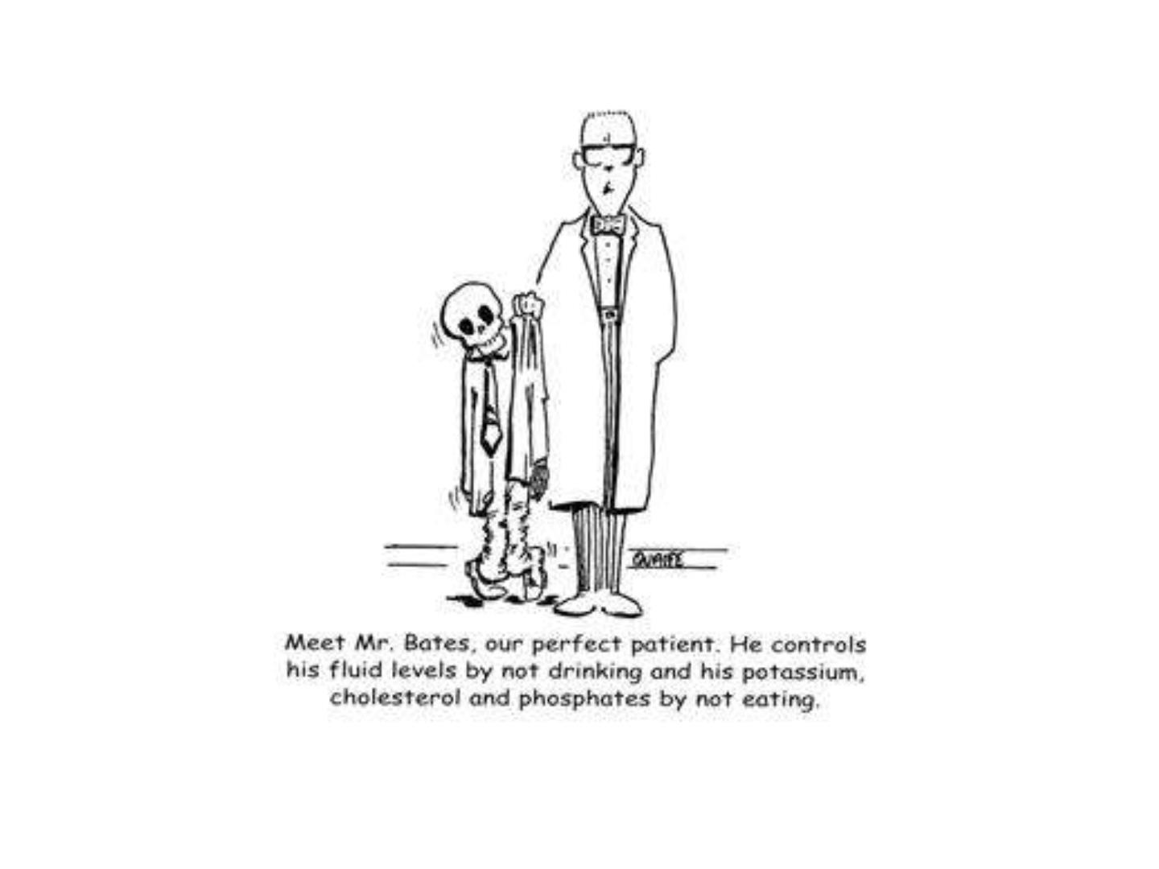

Slide 17
Thank yo u

