Slide 1
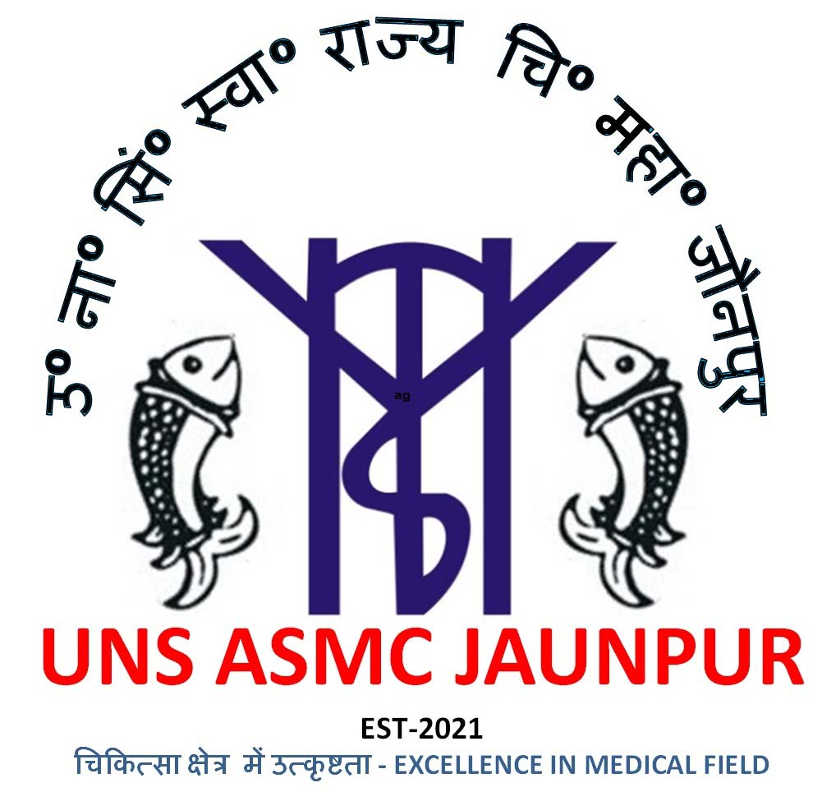
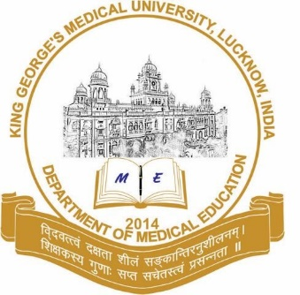


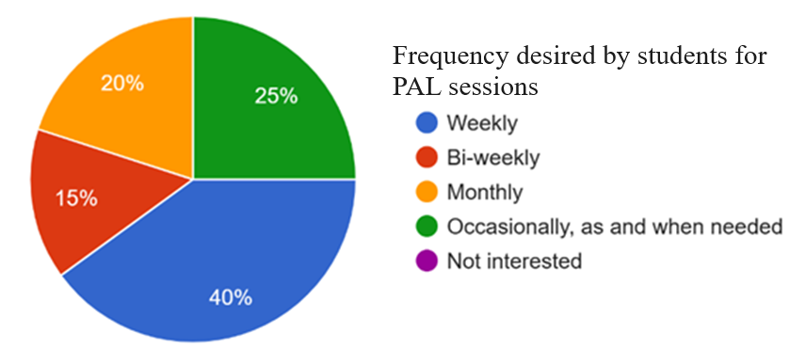
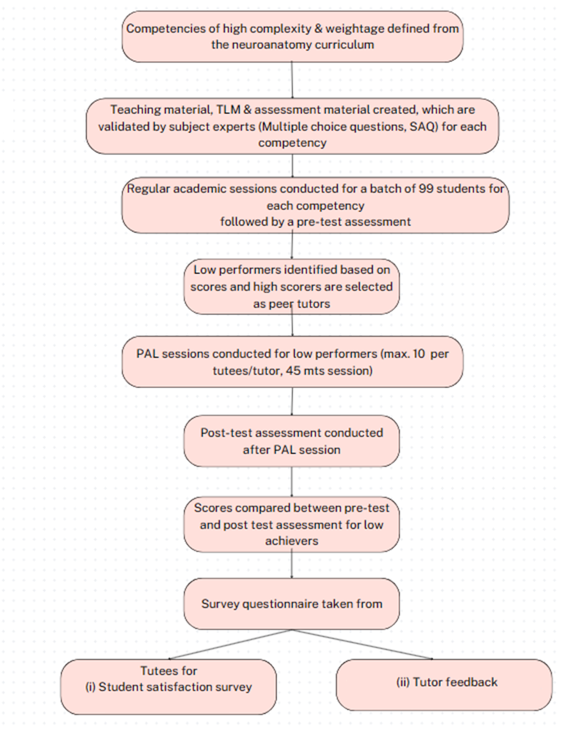



Effectiveness of Peer Assisted Learning on Academic Performance of First Phase Medical Students in Comprehending difficult topics of Neuroanatomy
Ruchira Sethi1 , Vimala Venkatesh 2, Nisha Mani 3
1.Professor Department of Anatomy UNS ASMC Jaunpur 2. Professor, Department of Microbiology, KGMU, Lucknow
3. Professor, Department of Geriatric Mental Health, KGMU, Lucknow
Peer assisted learning (PAL) activities include people from similar educational and social groupings who extend help to teach each other and otherwise are not professional teachers¹.
PAL has emerged as a dynamic and innovative approach with capacity to enhance knowledge acquisition and academic performance.
With the help of PAL, the struggle faced by first phase medical learners to complex competencies and learning patterns is addressed.
Flow chart for Methodology
INTRODUCTION
CONCLUSION
PAL is a valuable and effective teaching tool in medical education that helps enhance performance scores. It builds critical thinking, improves understanding of complex topics & contributes towards effective communication skills.
The survey report for benefits acquired by PAL is shown in graph below
AIM & OBJECTIVES
Is PAL an effective tool to enhance academic performance for difficult neuroanatomy topics from Anatomy curriculum for First Phase Medical Students
TAKE HOME MESSAGE
PAL appears more appealing to students as compared to standard teaching learning methods. It is an active-learning strategy that enhances learning outcomes.
To identify the difference in academic performance of students before and after the PAL- for both tutors and tutees
To evaluate the learners' perception of the PAL approach in enhancing their understanding of anatomical concepts of neuroanatomy.
The perception of PAL learners towards the teaching ability of Peer tutors is shown as under:
Data collected and statistical analysis done by SPSS 26.0 software. Descriptive analysis and paired T-test was done for level of significance (p<0.05).
RESULTS
ACKNOWLEDGEMENTS
METHODS
The results show a significant increase in performance metrics for learners after the PAL session, though the results were non-significant for peer tutors.
My sincere thanks to Dr Navin Kumar, Statistician –cum-AP UNS ASMC Jaunpur, for the data analysis.
Gratitude to my fellow batchmates for providing an energy driven group dynamics.
Study Design: Interventional study
Study group: 99 Phase 1 medical undergraduates (MBBS Batch 2022-23 students) of UNS ASMC Jaunpur
Duration of study: four months
Ethical Clearence: letter no.med coll.jnp/EC/01/2023/11
REFERENCES:1. KJ, T. The effectiveness of peer tutoring in future and higher education: a typology and review of the literature. High Educ, 1996;32(3), 321-45.
Erie AJ, S. S. Developing medical students as teachers: an anatomy-based student-as-teacher programme with emphasis on core teaching competencies. Anat Sci Educ 2013; 6, 385–92.
3. Anantharaman, L. R. Peer-assisted learning versus didactic teaching in osteology for first-year Indian undergraduate medical students: quasi-experimental studySurg Radiol Anat 2019; 41, 1163-1171

