Slide 1
JOINTS OF FOOT
By
Dr. AMBER RANA
JR 3
Department Of Anatomy
KGMU

Slide 2
Joints of Foot
Name of bones of foot
Names of different types of joints in foot
Type of joints
Ligaments attached to the bones formin joints
Action at these joints

Slide 3
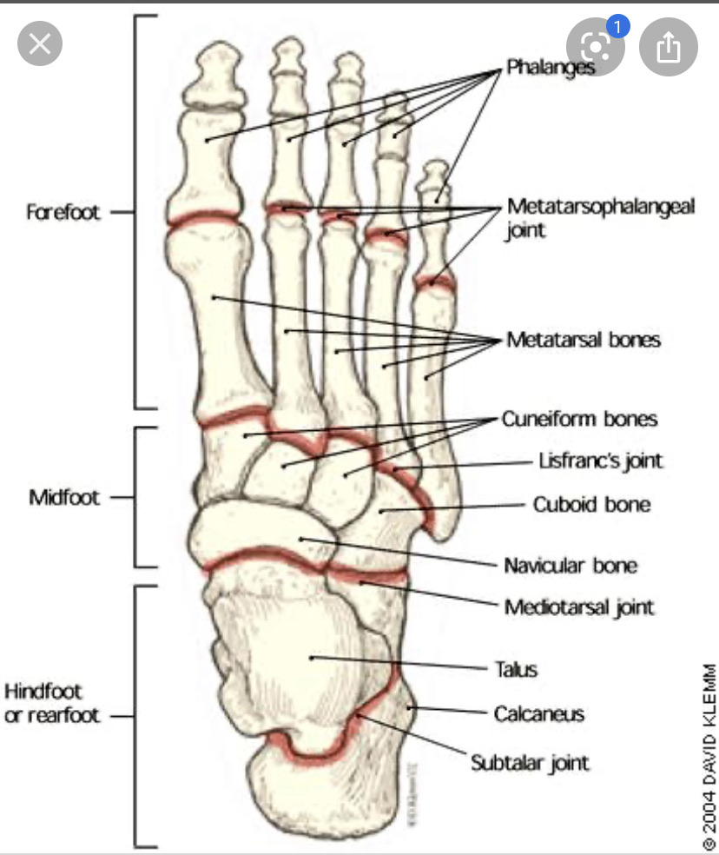
Foot comprises of the following bones from before backwards:
Phalanges – distal , middle, proximal (14)
Metatarsals- (5)
Cuneiform- Medial , intermediate and lateral(3)
Cuboid- (1)
Navicular –(1)
Talus –(1)
Calcaneum-(1)
Making a total of 26 bones.

Slide 4
Joints that are formed by these bones from before backwards are:
Interphalangeal joints
Metatarso-phalangeal joints
Tarso-metatarsal joints
Intertarsal joints-
Subtalar
Talo-calcaneo-navicular
Calcaneo-cuboid
Articulations of intermediate and lateral cuneiform bones with the bases of 2nd and 3rd metatarsal bones
Adjacent surfaces of the bases of 2nd, 3rd, and 4th metatarsal bones
Between the medial cuneiform and the base of 1st metatarsal bones
Between the cuboid and the bones of 4th and 5th metatarsal bones
Mid –tarsal or transverse tarsal joint
Talo-calcaneo-navicular joint
7. Calcaneo-cuboid joint

Slide 5
INTERPHALANGEAL JOINT
TYPE- type of typical hinge joints and each possesses capsular ligament and collateral ligament .
Movement- dorsi-flexion
plantar flexion
proximal interphalangeal joints are endowed with
greater range of movement

Slide 6
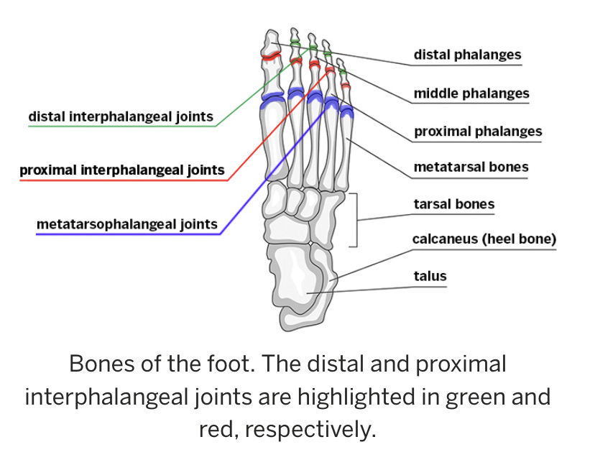

Slide 7
Metatarso-phalangeal joints
Type- Ellipsoid type of synovial joints
Ligaments- capsular, collateral, plantar, and deep transverse metatarsal ligament. The collateral ligament are 2 in number present on either side of each joint. Deep transverse ligament are 4 in number and connects the planter ligament of metatarso-phalangeal joint.
Articular surfaces- the head of first meta-tarsal is convex and the base of the proximal phalanx is reciprocally concave.
Movement at this joint- dorsi-flexion(50-60 degree), planter-flexion(30-40 degree), adduction and abduction.
Adduction and abduction are with reference to the axis passing through the 2 toe, because the 2nd toe is the least mobile.

Slide 8
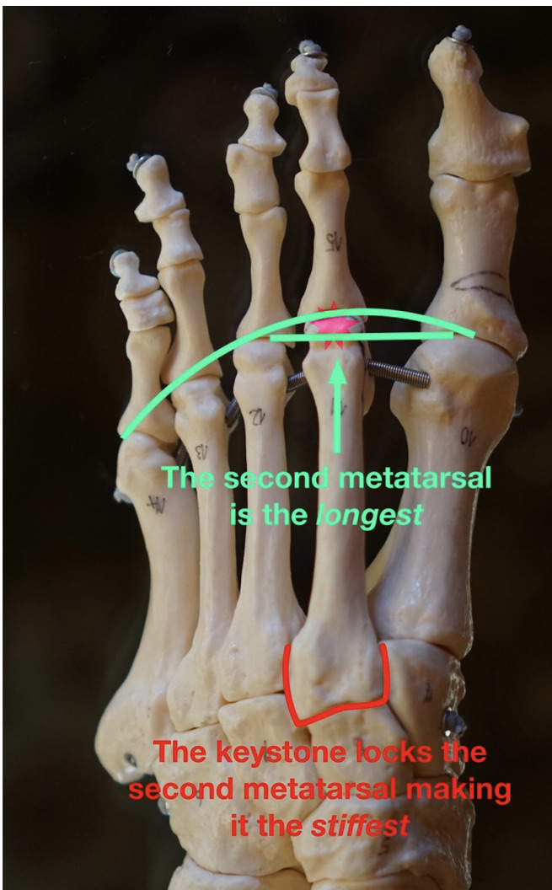

Slide 9
Tarso-meta tarsal joints
Total 5 in number
Type- plane synovial joint.
Ligaments- Dorsal, planter and interosseous cuneo-metatarsal ligaments.
1st tarso-metatarsal ligament is a separate joint cavity.
2nd and 3rd metatarsal join to form another joint cavity
4th and 5th again join to form a separate joint cavity.
Movement- gliding movement.

Slide 10
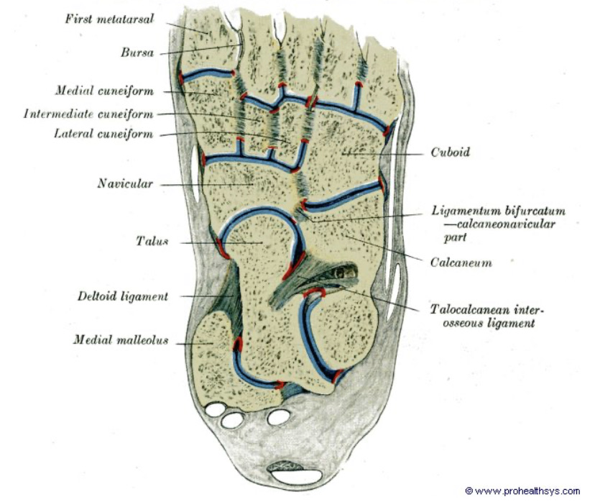

Slide 11
Intertarsal joint
Type- Synovial joint
Number- 6
Formed between- 3 cuneiform bone,
lateral cuneiform and cuboid
Names of 6 intertarsal joints are- a) Subtalar
b) talo-calcaneo-navicular
c) calcaneo-cuboid
d) a joint cavity comprising cuneo-navicular,
inter-cuneiform, cuneio-cuboid,intermediate and
lateral cuneiform bones with base of 2nd and 3rd
meta-tarsal bones,
adjacent surfaces of 2nd ,3rd and 4th metatarsal bones
e) medial cuneiform and base of 1st metatarsal bones
f) between cuboid and 4th and 5th meta- tarsal bones

Slide 12
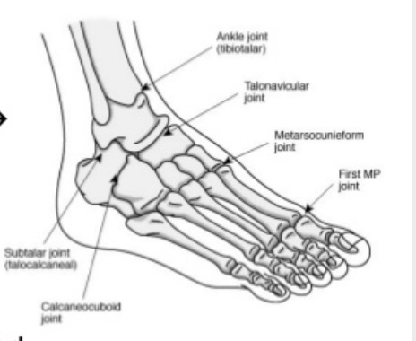

Slide 13
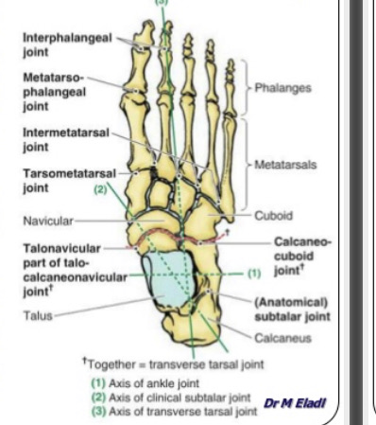
Mid-tarsal joint

Slide 14
Mid-tarsal joints
2 in number
One is medial joint cavity : talo-calcaneo-navicular
2nd is lateral joint cavitiy: calcaneo-cuboid joint
Both components are connected by the bifurcated ligament and move as one unit during inversion and eversion of the foot
Talo-calcaneo-navicular joint- Ball and socket joint.
Articular surfaces- spheroidal head of talus (ball)
concave posterior surface of navicular (socket)
upper surface of the plantar calcaneonavicular ligament
and the 2 talar facets on the upper surface of the
sustentaculum tali of calcaneus

Slide 15
The ligaments of this joint are- capsular ligament, talo-navicular, plantar calcaneo-navicular (spring ligament), and calcaneo-navicular part of bifurcated ligament
Capsule ligament loosely envelops the joint .
Talo- navicular ligament covers the capsule and connects the dorsal surface of navicular and neck of talus
Spring ligament- connects plantar surface of navicular with sustanteculum tali of calcaneus. Permanent stretching of the ligament produces flat foot

Slide 16
Calcaneo-cuboid joint
Type- saddle or sellar joint.
Articular surfaces: concavo-convex type between calcaneous and posterior surface of the cuboid.
Ligaments: articular capsule, bifurcated ligaments, short and long plantar ligaments.
The capsular ligament envelopes the joint and is strengthened on its dorsal surface by the dorsal calcaneocuboid ligament.

Slide 17
Subtalar joint
Type- modified multi-axial synovial joint
Also known as posterior talo-calcaneal joint.
Formed between the obliquely placed concave articular facet at the lower surface of body of talus and convex articular of calcaneum.
Ligaments- Capsular, medial and lateral talo-calcanean, interosseous talo-calcanean, and cervical ligament.
Action- inversion and eversion of foot.

Slide 18
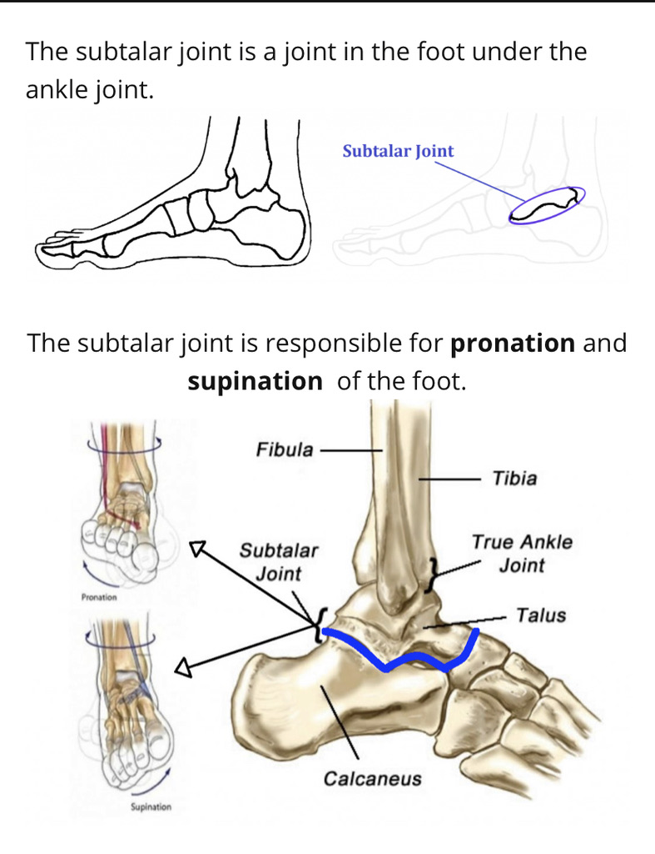

Slide 19
THANKYOU

