Slide 1
ANTERIOR COMPARTMENT OF LEG & DORSUM OF FOOT- II Dr Dewanshi Mishra Senior Resident King George’s Medical University, U.P Lucknow

Slide 2
DISCLAIMER
The presentation includes images which have been taken from Google, images of book.
They are being used in presentation only for educational purpose.
The author of presentation claims no personal ownership over images taken from books or Google images.

Slide 3
LEARNING OBJECTIVES
At the end of this teaching session on anterior compartment of leg & foot, all the MBBS 1st year students must be able to:
Describe the origin, course, relations and branches of anterior tibial artery.
Describe the origin, course, relations and branches of deep peroneal nerve.
Describe the origin, course, relations and branches of dorsalis pedis artery in foot.
Describe fresher’s syndrome.
Describe the anatomical basis of foot drop.

Slide 4
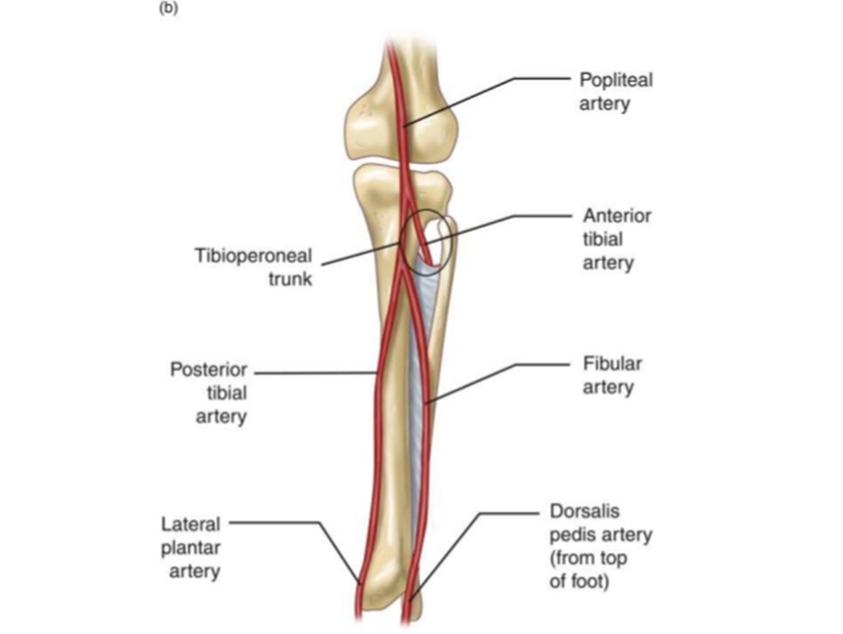
ANTERIOR TIBIAL ARTERY
Main artery of anterior compartment of leg.
Origin-Smaller terminal branch of popliteal artery
Begins on back of leg at lower border of popliteus, opposite to tibial tuberosity
Enters anterior compartment of leg by passing forwards close to fibula, through opening in upper part of interosseous membrane
Runs vertically downwards & continues as Dorsalis pedis artery in dorsum of foot

Slide 5
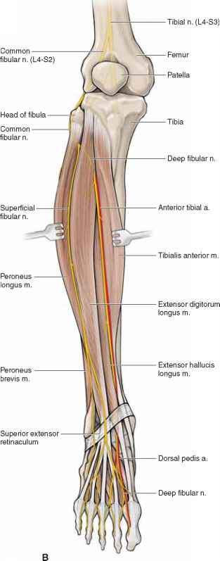
Relations
In upper 1/3rd - lies between tibialis anterior & extensor digitorum longus.
In middle 1/3rd - lies between tibialis anterior & extensor hallucis longus
In lower 1/3rd - lies between extensor digitorum longus & extensor hallucis longus.
Deep peroneal nerve is lateral to it in upper and lower thirds, and anterior in middle 1/3rd

Slide 6
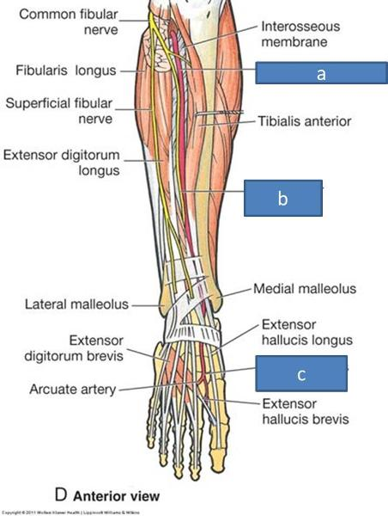

Slide 7
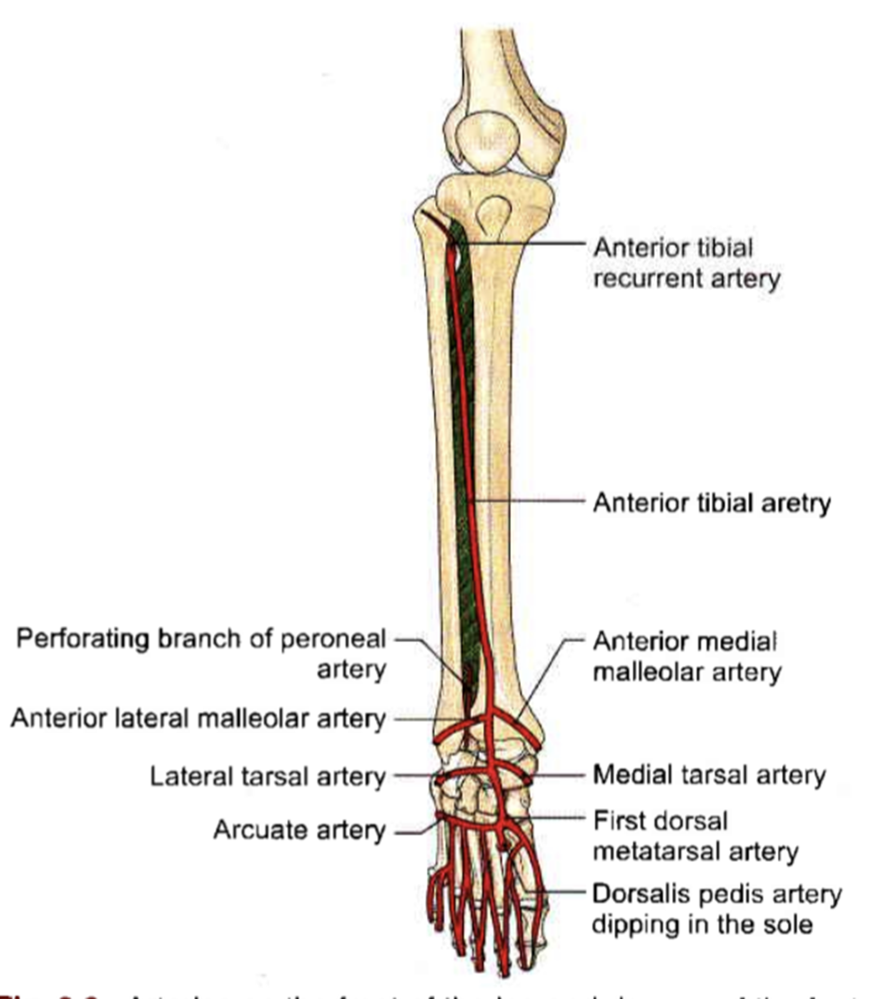
Branches
Muscular branches
Anastomotic branches to knee and ankle
around knee- anterior and posterior tibial recurrent branches
ankle joint- anterior medial malleolar and anterior lateral malleolar branches

Slide 8
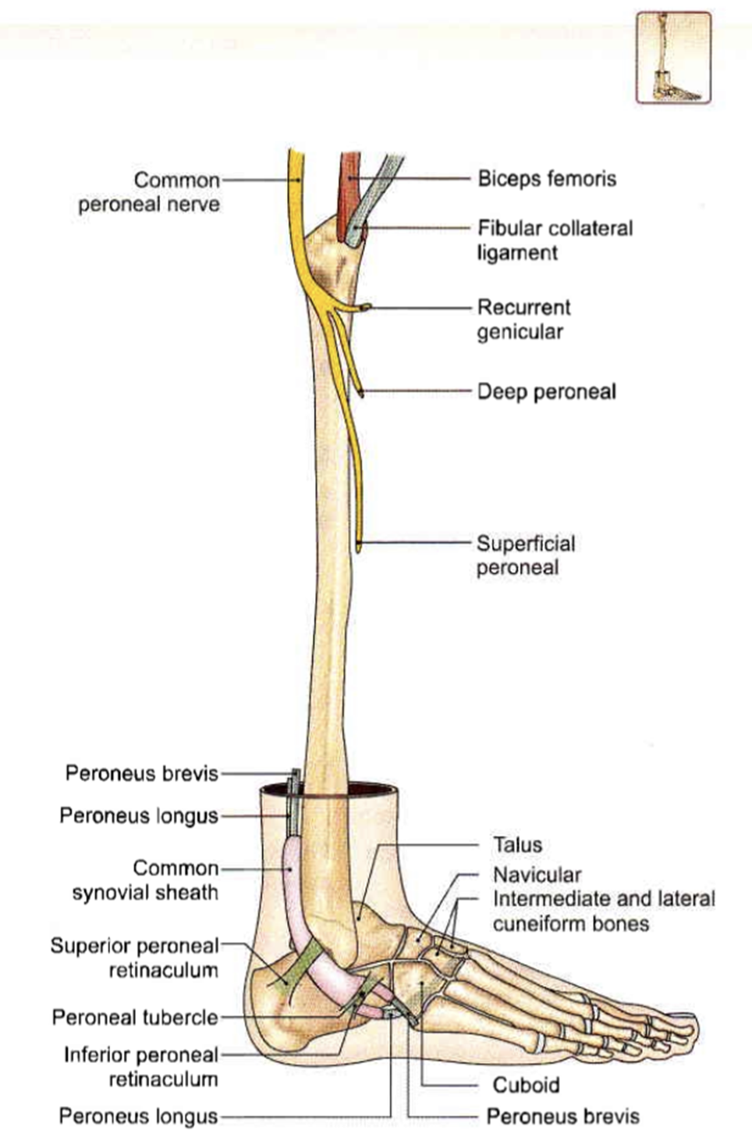
Deep peroneal nerve
Nerve of anterior compartment of leg and dorsum of foot.
Is one of the two terminal branches of common peroneal nerve.
It arises from the bifurcation of common peroneal nerve lateral to neck of fibula.

Slide 9
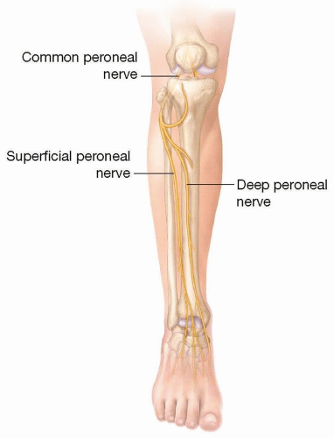
Course
Spiral around the fibular neck, pierces anterior intermuscular septum and enters anterior compartment
Then pierces Extensor digitorum longus and lies next to anterior tibial artery and accompanies it in leg
Ends in dorsum of foot close to ankle joint by dividing into medial and lateral terminal branch
Lateral terminal branch end in pseudoganglion and supplies Extensor digitorum brevis
Medial terminal branch ends by supplying skin in 1st interdigital cleft .

Slide 10
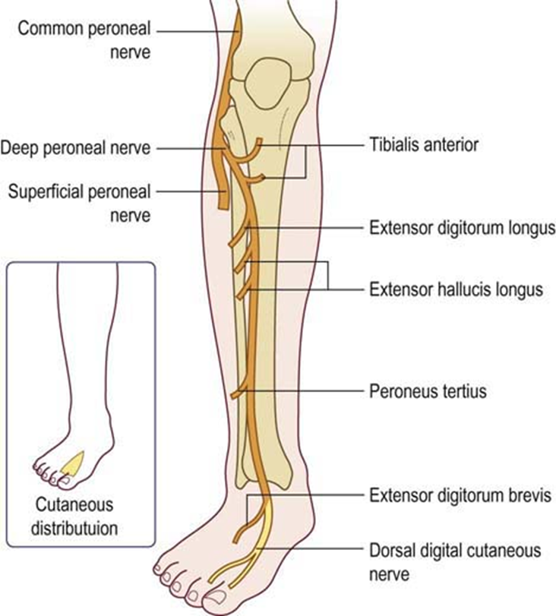
.
Branches:
1- Muscular branches to anterior compartment muscles.
2- Branch to extensor digitorum brevis in dorsum of foot
3- Articular branches to ankle joint.
4- Cutaneous branch to adjacent sides between 1st and 2nd toe

Slide 11
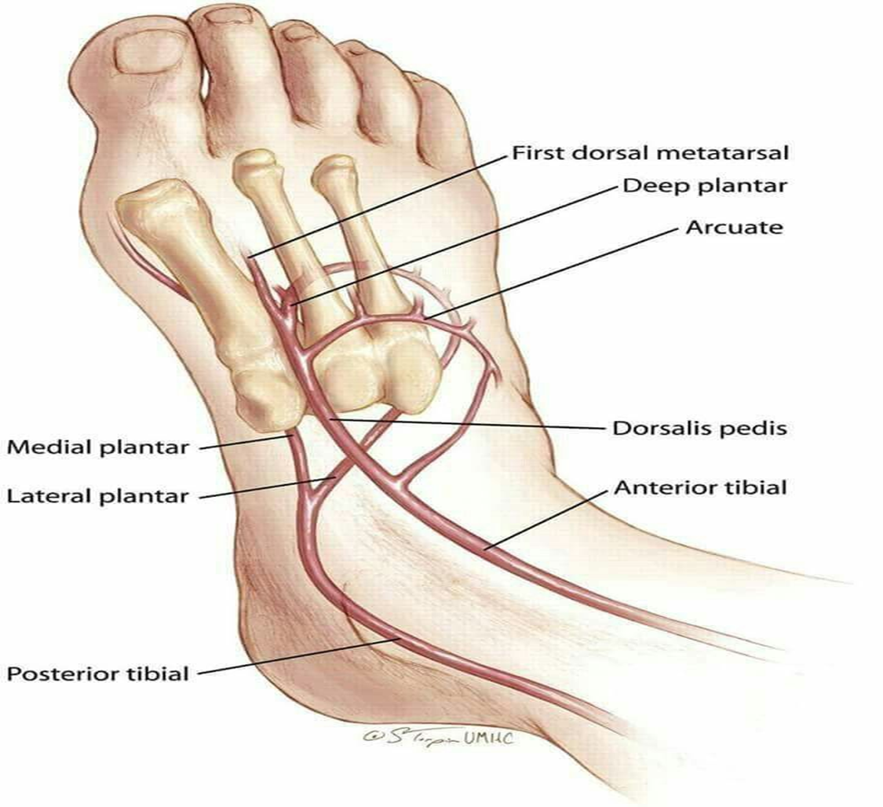
Dorsalis pedis artery
Chief palpable artery of dorsum of foot.
Begins in front of ankel b/w two malloeoli.
Passes forward to the medial side of dorsum into the two heads of first dorsal interrosseous muscle.
Ends in sole and forms plantar arch by joining with the deep branch of lateral plantar artery.

Slide 12
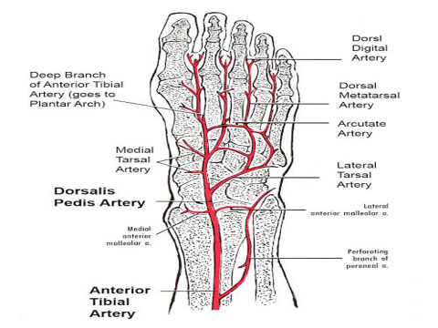
Branches
Lateral & medial tarsal artery,arcuate artery,first dorsal metatarsal artery.
Relations-
medial- EHL
lateral- 1st tendon of EDL & medial terminal branch of deep peroneal nerve.

Slide 13
Applied anatomy
Dorsal pedis artery pluse can be palpated b/w tendon of extensor hallucis longus and first tendon of extensor digitorum longus in case of vaso-occlusive disorders of lower limb.
Anterior tibial compartment syndrome / fresher’s syndrome- pain in legs, increased compartmental pressure , tenderness.

Slide 14
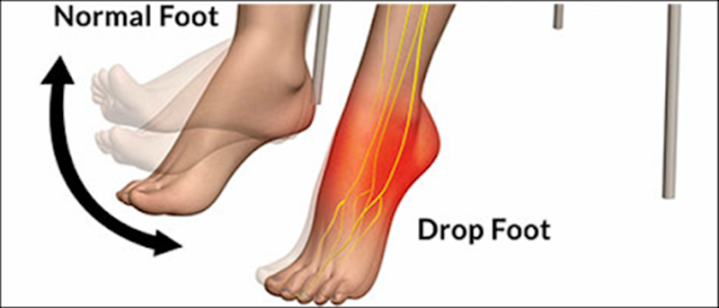
Foot drop
injury to deep peroneal nerve ( traumatic, leprosy, peripheral neuritis)
Paralysis of muscles of anterior compartment
Loss of power of dorsiflexion of foot
Foot in plantar flexed position

Slide 15



