Slide 1
Respiratory System
Dr Archna Ghildiyal
Associate Professor
Department of Physiology
KGMU

Slide 2
LECTURE:6
Contents
Composition of air
Gaseous transport: Oxygen
O₂-Hb dissociation curve
Factors affecting O₂-Hb dissociation

Slide 3
Learning Objectives
Composition of air
Partial pressure of gases
Oxygen Transport : Methods
Role of hemoglobin
O₂-Hb dissociation curve
Factors :Shifting the curve

Slide 4
Atmospheric Air:Composition Total Pressure (at sea level)=760mm Hg
N₂ = 78.6%
O₂ = 20.8%
CO₂=0.04%
H₂0=0.5%
P_{N2} = 596mm Hg
Po₂ = 160 mm Hg
P_{Co2}=0.3mm Hg
P_{H2O}=3.7mm Hg

Slide 5
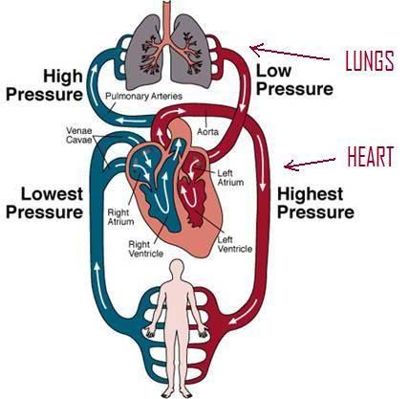

Slide 6
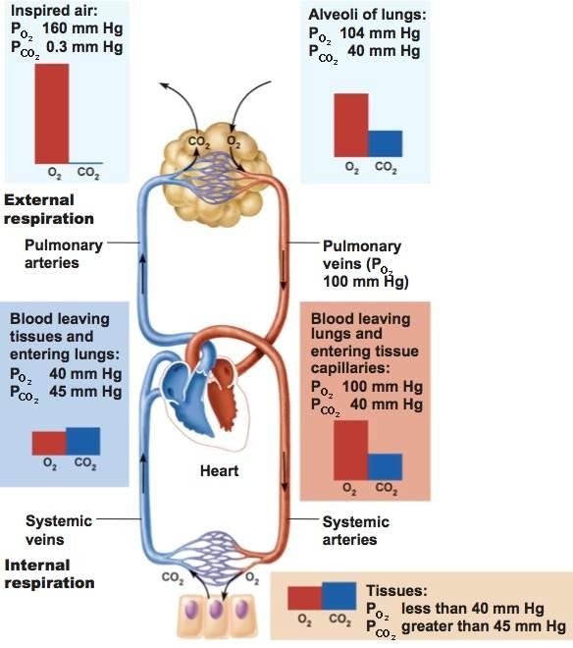

Slide 7
Diffusion of Gases
Alveolocapillary Membrane
Along partial pressure gradient,
Until equilibrium is reached
Oxygen diffuses from the alveolus into the blood
Carbon dioxide from the blood into the alveolus

Slide 8
Contd…
Carbon dioxide : very soluble in blood, allowing many molecules to diffuse along small pressure gradient
Oxygen : less soluble, requires a larger concentration gradient

Slide 9
Effect of water vapor
Fresh air enters respiratory passage
Immediately mixes with water vapor (Humidification)
Water vapor lowers the partial pressure of gases (total pressure remains constant)
P_{O2} is lowered to about 149 mmHg
Constant P_{H2O}=47mmHg

Slide 10
Oxygen Transport
Method Percentage
Dissolved in Plasma 3 %
Combined with Hemoglobin 97 %

Slide 11
O₂ Dissolved in plasma
0.3 ml O₂ per 100 ml of blood(arterial P_{O2}
Of 100 mm Hg)
Normal P_{O2} of 95mmHg :0.29 ml of O₂ is dissolved per 100 ml of water in blood
P_{O2} 40 mmHg in tissue capillaries-0nly 0.12 ml of O₂ remains dissolved
0.17 ml of O₂ is normally transported in dissolved state to the tissues by each 100 ml of arterial blood flow

Slide 12
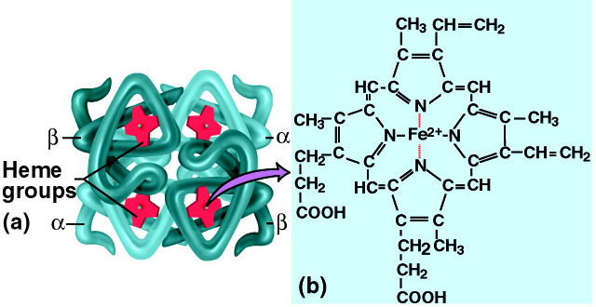
Hemoglobin Structure
Protein made up of 4 subunits
Every subunit contains a heme moiety attached to a polypeptide chain.

Slide 13
Haemoglobin
Haemoglobin molecules can transport up to four O₂’s
When 4 O₂’s are bound to haemoglobin, it is 100% saturated, with fewer O₂’s it is partially saturated
Haemoglobin’s affinity for O₂ increases as its saturation increases
Oxygen binding occurs in response to the high P_{O2} in the lungs

Slide 14
Oxyhemoglobin Formation
Oxygen molecule reversibly attaches to the heme portion of hemoglobin
Heme unit contains iron ( Fe⁺² ) which provides the attractive force
0₂ +Hb HbO₂

Slide 15
Terms
Oxygen Capacity : Maximum quantity of oxygen that will combine chemically with the hemoglobin in a unit volume of blood
Oxygen Content: how much oxygen is in the blood

Slide 16
Contd…
Oxygen Saturation : Percentage of all the available heme binding sites saturated with oxygen
Volume percent (vol%) refers to the milliliters of oxygen extracted from a 100 ml sample of whole blood

Slide 17
Maximum amount of O2 that can combine with Hb of blood
Normal Hb -15 gms/100 ml of blood
Each gm of Hb can bind 1.34 ml of O₂ (In chemically pure Hb-1.39 ml O₂)
Total O₂ bound with Hb :
15x1.34=20 ml (if Hb 100%
saturated)

Slide 18
O₂ released from Hb in tissues
In normal systemic arterial blood -Total O₂ bound with Hb 19.4ml/100 ml of blood(97% saturated)
Tissue capillaries: Combined O₂- 14.4ml/100 ml of blood(P_{O2} 40mmHg,75% saturated Hb)
Under normal conditions about 5ml of O₂ is transported from the lungs to the tissues by each 100 ml of blood flow

Slide 19
O₂-Hb dissociation curve
Illustrates the %saturation of Hb with oxygen at various P_{O2} values
Sigmoid shaped curve
Progressive increase in the % of Hb bound with O₂ as blood P_{O2} increases
P₅₀ :point at which Hb is 50% saturated

Slide 20
Contd…
Plateau: Provides a margin of safety in the oxygen carrying capacity of the blood
Steep portion: Small changes in Oxygen levels can cause significant changes in binding. This promotes release of O₂ to the tissues

Slide 21
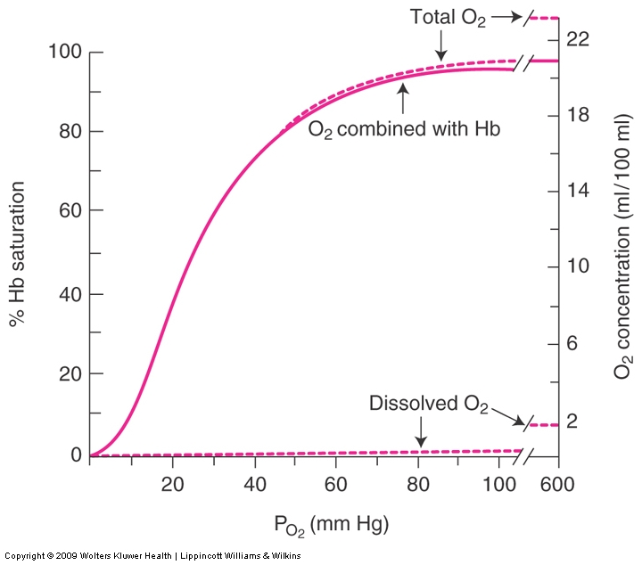
Oxygen-Hb dissociation curve

Slide 22
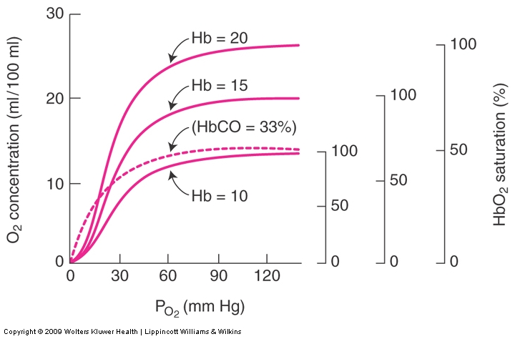
Effect of changing hemoglobin concentration

Slide 23
Role of Hb in maintaining nearly constant PO₂ in tissues
Function as Tissue O₂ buffer system
Stabilize the O₂ pressure in the tissues
Tissue P_{O2} can not rise above 40 mmHg

Slide 24
Factors that Shift the Oxygen-Hemoglobin Dissociation Curve
pH and P_{CO2}
Temperature
2,3-diphosphoglycerate(2,3-DPG)

Slide 25
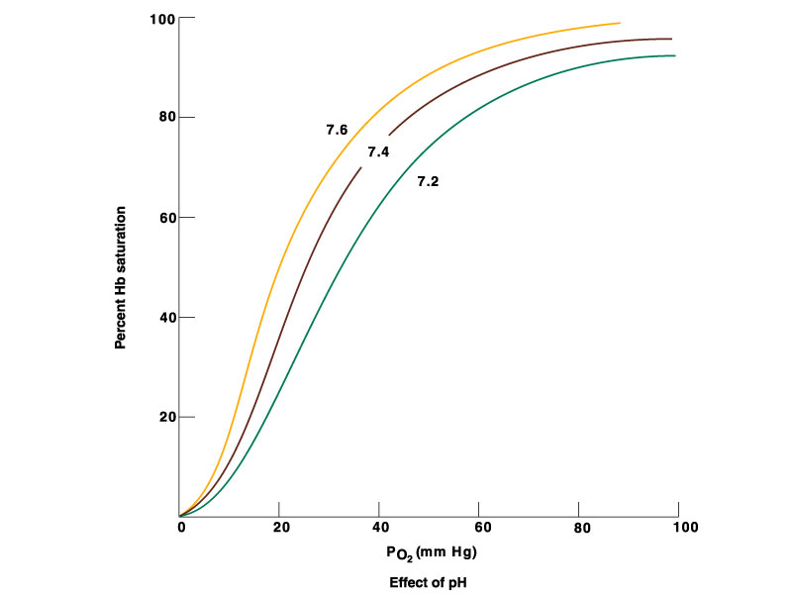
pH and P_{CO2}: Bohr effect
Increased delivery of O₂ to the tissues when CO₂ & H+ ions shift the O₂-Hb Dissociation curve to the right

Slide 26
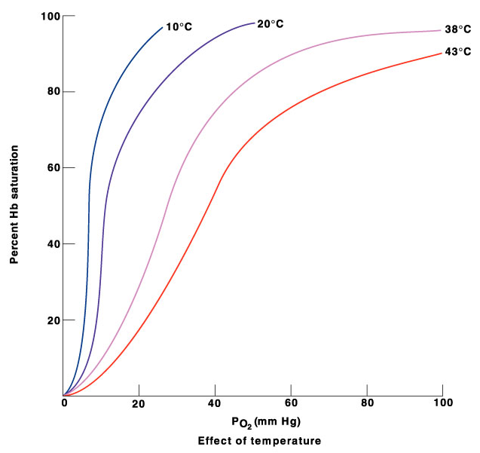
Temperature

Slide 27
2,3-diphosphoglycerate
Byproduct of anaerobic glycolysis
Present in high concentration in red blood cells because of their content of 2,3-DPG mutase
Diminishes the affinity of hemoglobin for O₂ (Right Shift)

Slide 28
Contd…
Importance:
Normal DPG in blood keeps the curve slightly to the right all the time
In Hypoxic condition
Disadvantage:
Excess DPG : Difficulty for the hemoglobin to combines with O₂ in the lungs

Slide 29
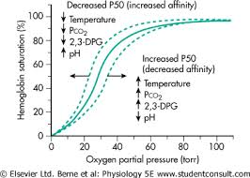

Slide 30
Question:1
At which of the following sites is the partial
pressure of oxygen (P_{O2}) highest?
Exhaled gas
Anatomical dead space at the end of expiration
Anatomical dead space at the end of inspiration
Alveolar gas

Slide 31
Question:2
The exchange of gases between
inhaled air and Pulmonary blood is
referred as:
A) Cellular respiration
B) External respiration
C) Internal respiration
D) Circulatory respiration

Slide 32
Question:3
Most Oxygen in the blood is transported as:
A)De-oxyhemoglobin
B)Dissolved in plasma
C)Oxy-hemoglobin
D)Reduced hemoglobin

Slide 33
Question:4
Shift of O₂-Haemoglobin dissociation curve to the right is caused by…. (in blood):
A) Decreased hydrogen ions
B) Increased CO₂
C) Decreased temperature
D) Decreased BPG

Slide 34
Question:5
Oxyhaemoglobin dissociation curve is shifted to the left by:
A) increase in arterial PCO2
B) acidosis
C) increase in 2,3 DPG
D) fall in temperature

Slide 35
Answers
1- C
2- B
3- C
4- B
5- D

Slide 36
References
Guyton & Hall.Text book of Medical Physiology
Ganong’s Review of Medical Physiology
Berne & Levy Physiology

