Slide 1
Furcation: The Problem and Its Management
Dr. Shalini Kaushal
Assoc. Prof.
Periodontology

Slide 2
Definition
It can be defined as: an area of complex anatomic morphology that may be difficult or impossible to be debrided by routine periodontal instrumentation.

Slide 3
Anatomical Considerations
Root trunk
Furcation entrance
Root surface anatomy
Enamel projections
Accessory canals

Slide 4
Glickman`s Classification(1953)
Grade I Incipient Furcation
Grade II cul-de-sac
Grade III Communicating or Through and Through Furcation
Grade IV

Slide 5
Therapy

Slide 6
Objective of furcation Treatment
The elimination of the microbial plaque from the exposed surfaces of the root complex.
The establishment of an anatomy of the affected surfaces that facilitates proper self-performed plaque control.

Slide 7
Selection of therapeutic mode
Varies with:
-The class of furcation defect.
-The extent and configuration of bone loss.
-Other anatomic factors.

Slide 8
Therapeutic classes of furcation defects
Class I: Early defects
Class II:
a) Shallow horizontal involvement
b) Isolated deep class II furcations
Class II to IV: Advanced defects

Slide 9
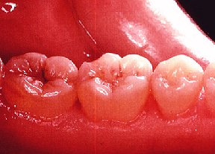
Scaling and root planing
In most situations, it results in the resolution of the inflammatory lesion in the gingiva.
Most effective in grade I and shallow grade II.
Deeper sites respond less favorably.

Slide 10
Antimicrobials
Adjunct to scaling and root planning
Chlorhexidine
Tetracycline fibers
No clinically significant difference in clinical parameters after irrigation

Slide 11
Open Debridement
Greater calculus removal than closed
Ultrasonic
Narrow furcations
Dome of furcation
Surgical access and increased operator experience significantly enhance calculus removal in molar furcation.

Slide 12
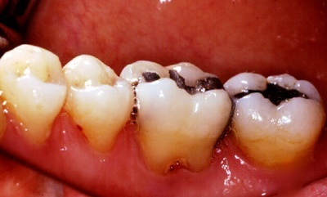
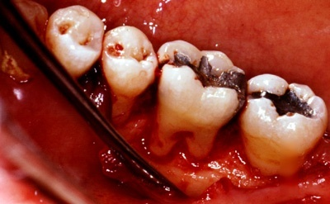
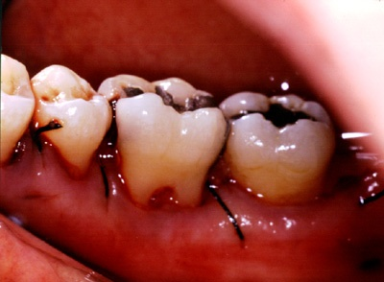
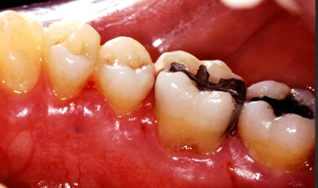

Slide 13
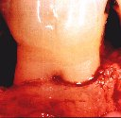
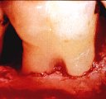
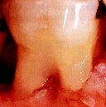
Osseous Surgery
Most effective in grade II furcation
Osteoplasty and ostectomy techniques
Remove the lip of defect to reduce horizontal depth
Bone ramps into the furcation to enhance plaque control
Reduce probing depths

Slide 14
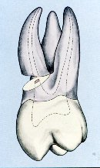
Root Resection
Indications
Teeth serving as abutments
Teeth with furcation defect treated successfully with endodontic procedure
Patient considerations
Grade II or Grade III

Slide 15
Root Resection
Contraindications
Inadequate bone support
Fused roots
Inoperable endodontically
Patient considerations
Grade II or grade III

Slide 16
Sequence of treatment at RSR
Endodontic treatment
Provisional restoration
RSR
Periodontal surgery
Final prosthetic restoration

Slide 17
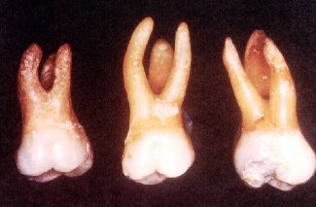
Which root to remove
Remove the root-
That will eliminate the furcation and allow maintenance.
With the greatest amount of bone and attachment loss.
That will eliminate periodontal problem on adjacent teeth
With the greatest number of anatomic problem
That least complicate future periodontal maintenance.

Slide 18
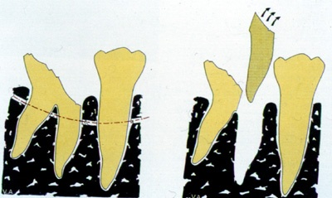
Hemisection
Mandibular molars
Grade III furcation
Need widely separated roots

Slide 19
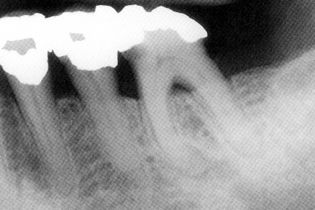
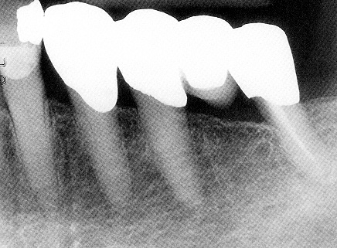
Hemisection

Slide 20
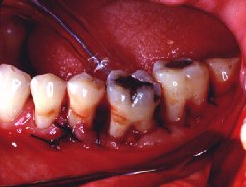
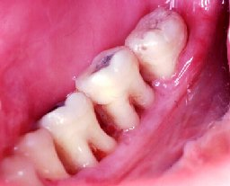
Tunnel Preparation
Grade III furcation
Permits plaque removal
Root caries (4% stannous fluoride)
25% failure rate at 5 years
Recurrent periodontitis

Slide 21
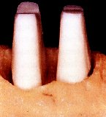
Root Separation
Root separation involves the sectioning of the root complex and the maintenance of all roots

Slide 22
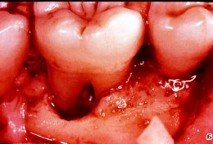
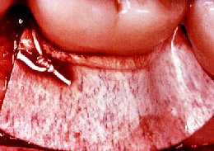
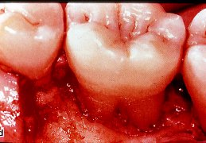
Regeneration of Furcation Defects
Guided tissue regeneration
Predictable outcome of GTR therapy was demonstrated only in grade II furcation involved mandibular molars
less favorable results have been reported in other types of furcation defects
GTR could be considered in areas with isolated degree II furcation defects

Slide 23
Furcation Defects
Most predictable Mandibular or Buccal Maxillary Class II Furcations
Mesial or Distal Maxillary Class II Furcations
Class III Furcations
Least predictable

Slide 24
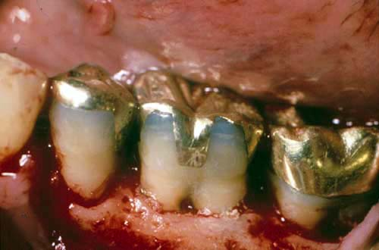
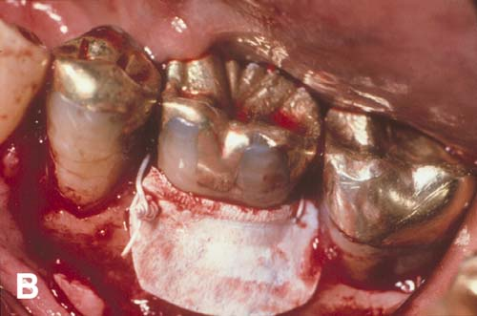
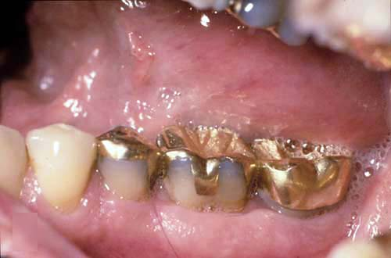
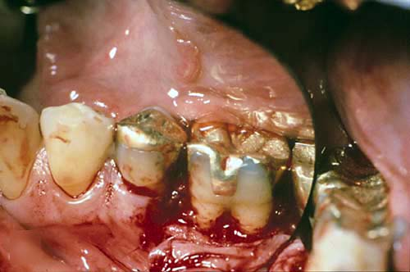

Slide 25
Osseous Grafting
Autogenous bone
Allografts
Freeze dried bone
Demineralized Freeze dried bone
Alloplasts
Hydroxyapatite
Non-porous
Porous
Bioglass

Slide 26
Extraction
Attachment loss is so extensive that no root can be maintained
If tooth/gingival anatomy will not allow proper plaque control
For endodontic or restorative reason
Osseointegrated implant substitute

Slide 27
Prognosis
Previous concept: Significant furcation involvement means a hopeless long-term prognosis.
Recent trends: Simple periodontal therapy is sufficient to maintain long term prognosis unless development of caries in furcation area.

Slide 28
Prognosis
Key to long term success:
Thorough diagnosis
Selection of patients with good oral hygiene
Careful surgical and restorative management

Slide 29
Patients Factors
Determine patient`s goals and expectations
Screen for local, behavioral and systemic factors;
Oral hygiene
Compliance
Stress
Intraoral Accessibility
Uncontrolled Diabetes
Smoking
Healing response to Previous Therapy

Slide 30
MCQs on Furcation management
1.The treatment of choice in grade II furcation involvement is/are
a) Nonsurgical periodontal therapy
b) Flap procedure
c) Odontoplasty and osteoplasty
d) Both (b) and (c)

Slide 31
MCQs on Furcation management
2. Osseous surgery is most effective in
A) Grade I furcation
B) Grade II furcation
C) Grade III furcation
D) None

Slide 32
MCQs on Furcation management
3.Which of the following is a major contraindication to resection of root in furcation management ?
a) Inadequate bone support
b) Inoperable endodontically
c) Poor oral hygiene
d) None of the above

Slide 33
MCQs on Furcation management
4.Hemisection can be done in
A) Mandibular molars
B) Grade III furcations
C) In widely separated roots
D) All

Slide 34
MCQs on Furcation management
5. Recent trend for the prognosis of furcation defect is
A) Significant furcation involvement means a hopeless long-term prognosis.
B) Simple periodontal therapy is sufficient to maintain long term prognosis.
C) Simple periodontal therapy is sufficient to maintain long term prognosis unless development of caries in furcation area.
D) None

