Slide 1
PLAQUE CONTROL

Slide 2
DEFINITION
Prevention of accumulation of dental plaque and other deposits on the teeth and adjacent gingival tissues.

Slide 3
METHODS OF PLAQUE CONTROL
Mechanical- Tooth brushes
Interdental aids
Aids for gingival stimulator
Others – tongue scraper
Chemical -

Slide 4
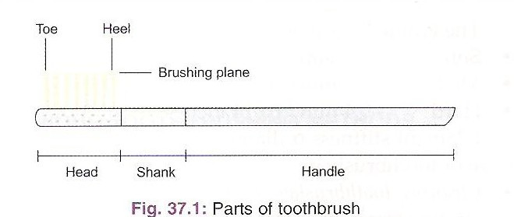
Tooth Brush

Slide 5
Handle
Dimension
Adult- 6 inches
Junior- 1/6 smaller than adult size
Child- 1/3 smaller than adult size

Slide 6
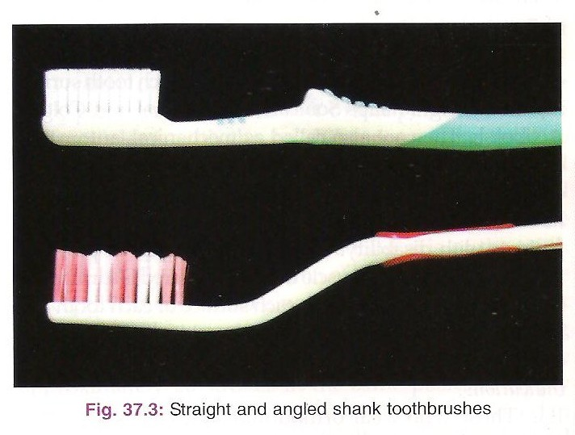
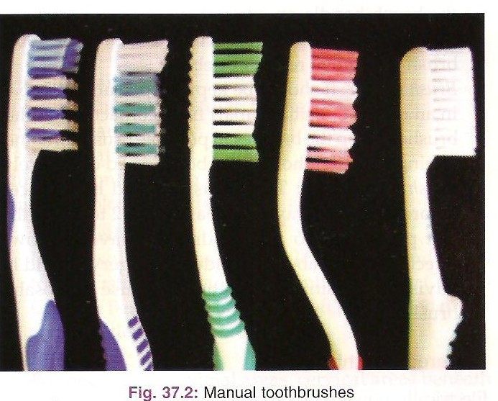
Shank
Parts that connects the head and handle.
May be straight, curved or angled.

Slide 7
Head
Length – 1- 1.25 inches
Width - 5/16- 3/8 inches
Rows - 2-4 rows of bristles
Tufts - 5-12/rows
Bristle length- 10- 12 mm

Slide 8
Hardness of bristle- α D²/L²
^{Soft- 0.2 mm / 0.007 inches}
^{Medium- 0.3 mm / 0.012 inches}
^{Hard - 0.4 mm / 0.014 inches}

Slide 9
Bristle Material
Natural - from Hogs/ wild Boar
Synthetic - Nylon

Slide 10
Recommendations
Soft nylon bristles
needs to be replaced every 3 months.
if patients perceive a benefit from a particular tooth brush design, they should use it.

Slide 11
THANK YOU

Slide 12
1. Portion of the brush that assists in removal of plaque? a. tip of the brush b. tip of bristle c. sides of bristle d. Whole brush

Slide 13
2. The stiffness of the bristles of a nylon toothbrush is dependent on the
Diameter and length of filament
Amount of polish of filament
Color of filament
Consistency of shape of the filament

Slide 14
Natural bristles used in toothbrushes are extracted from
Hogs
Dogs
Hares
Horses

Slide 15
4. The angle that should be established between long axis of tooth and toothbrush bristles in bass method
55
75
45
65

