Slide 1
SPLINTS AND TRACTIONS iN ORTHOPAEDICS

Slide 2
INTRODUCTION
SPLINT – SPLINTS ARE DEVICES USED TO IMMOBILIZE A PARTICULAR PART OF THE BODY.
TYPES OF SPLINTS:
1. WOODEN SPLINTS – COMMONLY USED
2. METALLIC SPLINTS
3. PLASTER SPLINTS
4. PNEUMATIC / INFLATABLE SPLINTS
5. MISCELLANEOUS – NEWSPAPERS, CARDBOARDS ETC

Slide 3
WOODEN SPLINTS :
LISTONS LONG SPLINT
POSTERIOR LEG SPLINT (ABOVE AND BELOW KNEE)
LATERAL ELBOW SPLINT
AIRPLANE SPLINT
METALLIC SPLINTS :
THOMAS KNEE SPLINT
CRAMER WIRE SPLINT
COCK UP SPLINT (DYNAMIC AND STATIC)

Slide 4
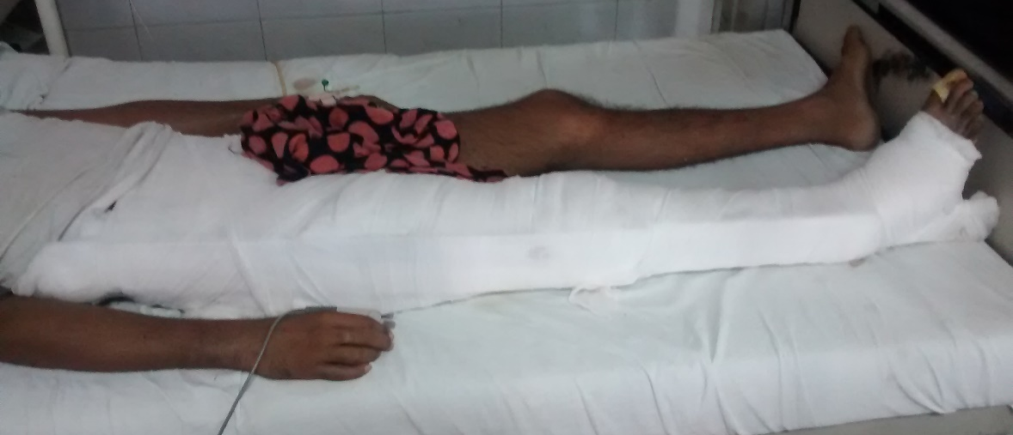
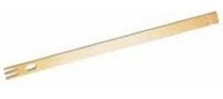
LISTONS LONG SPLINT
PRIMARY SPLINTAGE IN CASES OF –
FRACTURES AND DISLOCATIONS AROUND HIP (FRACTURE NECK / INTERTROCHANTERIC FEMUR)
FRACTURE OF SHAFT OF FEMUR
FRACTURES AROUND THE KNEE (SUPRACONDYLAR FEMUR) – USED ALONG WITH POSTERIOR LEG SPLINT
EXTENT – LOWER BOUNDARY OF AXILLA TO 3 INCHES BEYOND THE SOLE OF FOOT.
PRECAUTIONS – THE THREE BONY PROMINENCES – GREATER TROCHANTER, HEAD OF FIBULA AND MEDIAL MALLEOLUS SHOULD BE WELL PADDED.
COMPLICATIONS – LATERAL PERONEAL NERVE PALSY

Slide 5
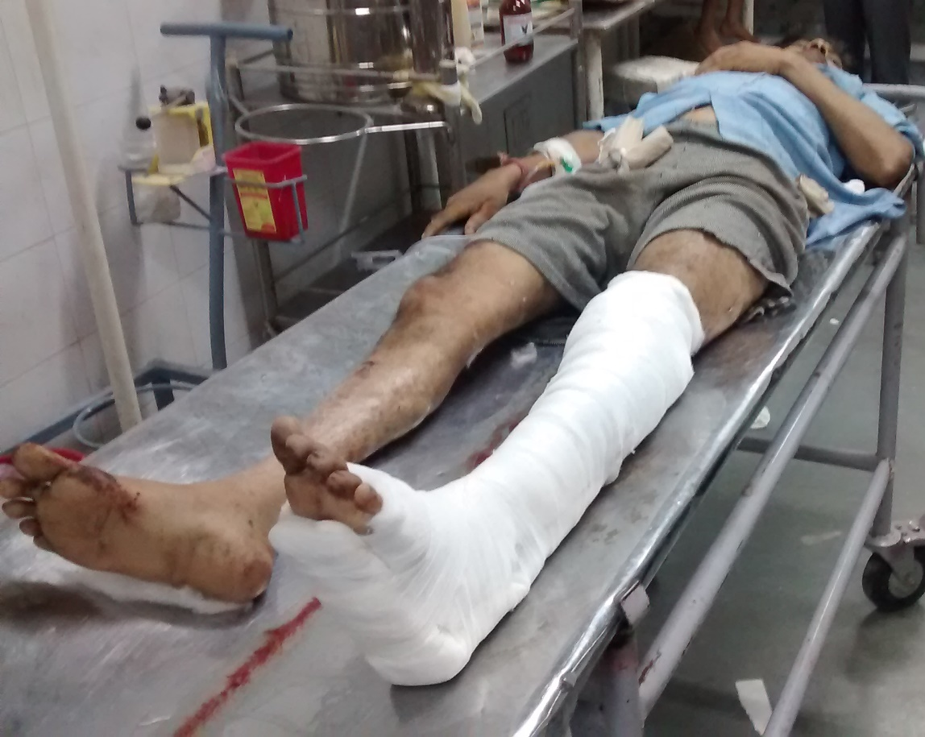
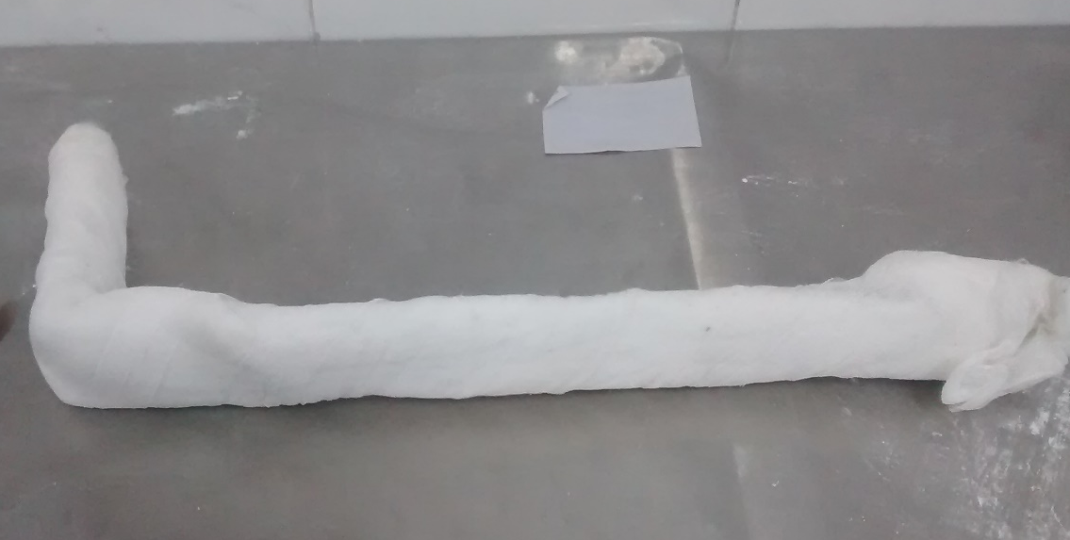
POSTERIOR LEG SPLINT
PRIMARY SPLINTAGE IN CASES OF –
FRACTURES OF TIBIA AND FIBULA
FRACTURES AROUND THE KNEE (SUPRACONDYLAR FEMUR, PATELLA) – USED ALONG WITH LISTONS LONG SPLINT
FRACTURES OF FOOT ( CALCANEUM, TARSALS AND METATARSALS)
EXTENT – JUNCTION OF UPPER AND MIDDLE THIRD OF THIGH TO TOES OF FOOT.
PRECAUTIONS – THE BONY PROMINENCE OF HEEL AND TENDOACHILLES SHOULD BE WELL PADDED.

Slide 6
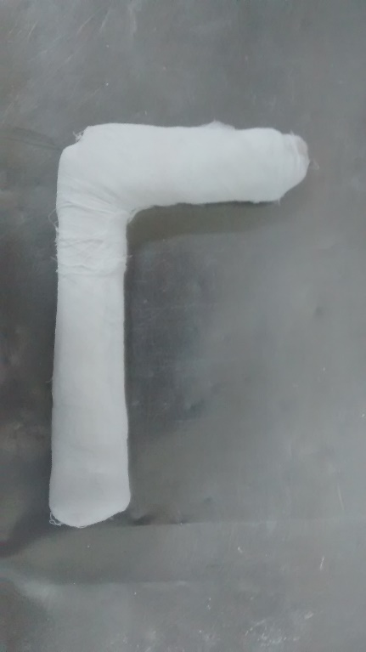
LATERAL ELBOW SPLINT
PRIMARY SPLINTAGE IN CASES OF –
FRACTURES OF RADIUS AND ULNA
FRACTURES AND DISLOCATIONS AROUND THE ELBOW (SUPRACONDYLAR AND INTERCONDYLAR FRACTURES OF HUMERUS)
FRACTURES OF SHAFT HUMERUS (UPPER ARM OF SPLINT IS EXTENDED UPTO ACROMION PROCESS)
POSITION – FOREARM IN MIDPRONE AND WRIST IN NEUTRAL POSITION.
EXTENT – INSERTION OF DELTOID TO METACARPO-PHALANGEAL JOINT.
PRECAUTIONS – THE BONY PROMINENCES – LATERAL EPICONDYLE AND STYLOID PROCESS SHOULD BE WELL PADDED.

Slide 7
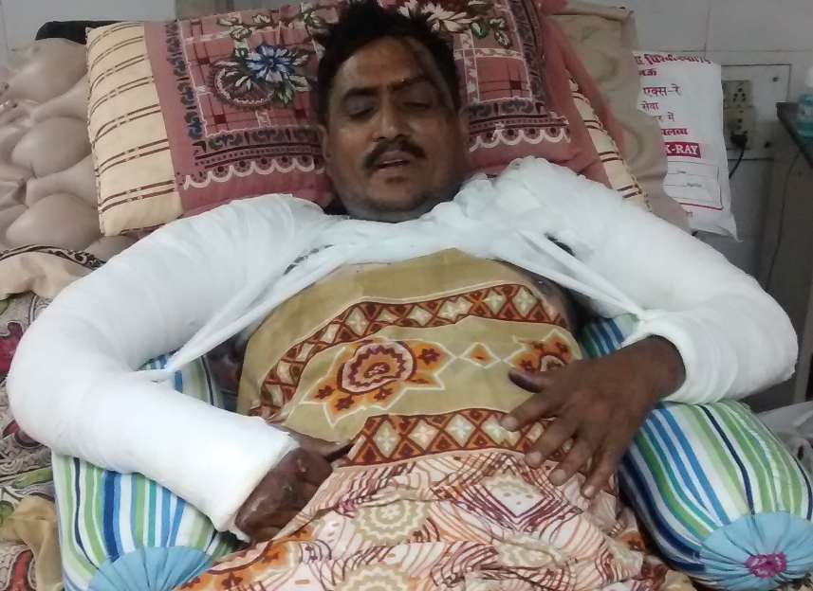
PLASTER SPLINTS
EXTENT IS SAME AS DESCRIBED FOR WOODEN SPLINTS
MOULDS TO THE CONTOUR OF LIMB
ABOVE ELBOW POP SLAB
ABOVE ELBOW POP SLAB WITH SHOULDERHOOD EXTENSION

Slide 8
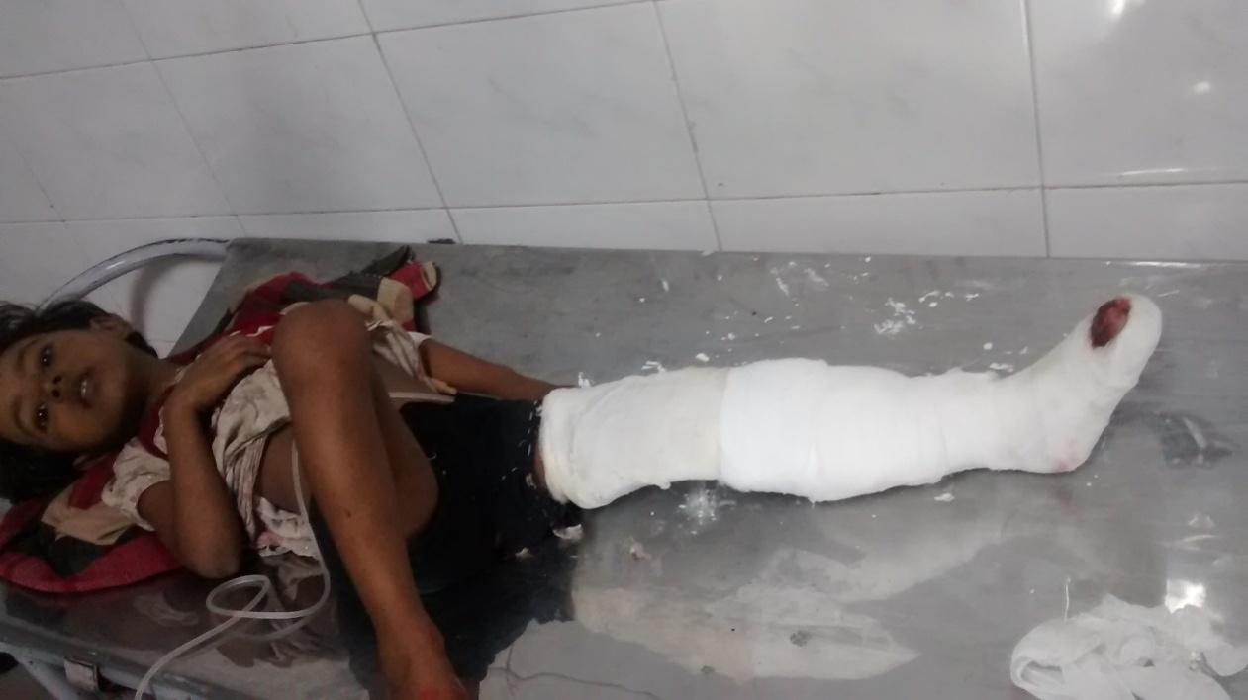
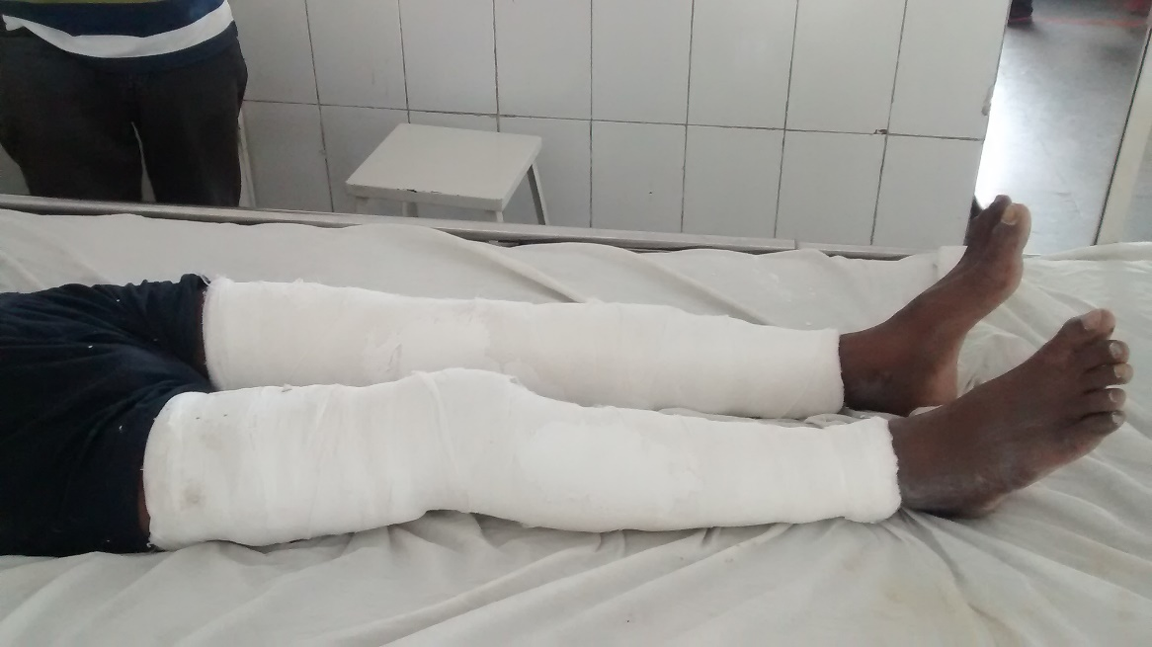
ABOVE KNEE POP SLAB
ABOVE KNEE CYLINDER POP SLAB FOR PATELLA FRACTURE

Slide 9
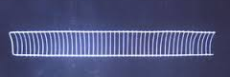
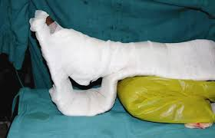
CRAMER WIRE SPLINT
MADE OF GALVANISED IRON WIRES
MANUALLY MOULDABLE
BED OF SPLINT IS CONCAVE TO ACCOMMODATE ROUND CONTOUR OF LIMBS
ADVANTAGES –
MOULDABLE AND FITS ALL SIZES AND SHAPES OF LIMBS.
CAN BE AUTOCLAVED
DISADVANTAGES –
DOES NOT PROVIDE RIGID IMMOBILIZATION
CASTS RADIOOPAQUE SHADOW ON XRAYS.
USED AS A REPLACEMENT TO WOODEN SPLINTS

Slide 10
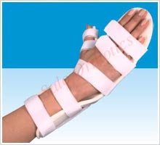
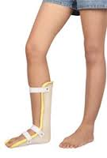
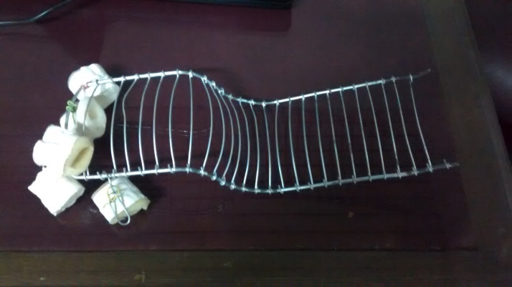
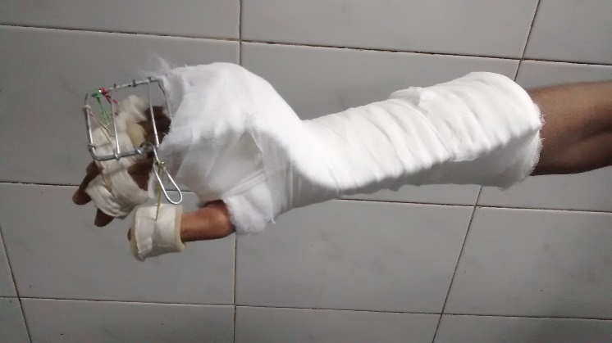
FEW SPLINTS USED IN NERVE INJURIES
COCK UP SPLINTS FOR RADIAL NERVE PALSY
DYNAMIC
STATIC
FOOT DROP SPLINT

Slide 11
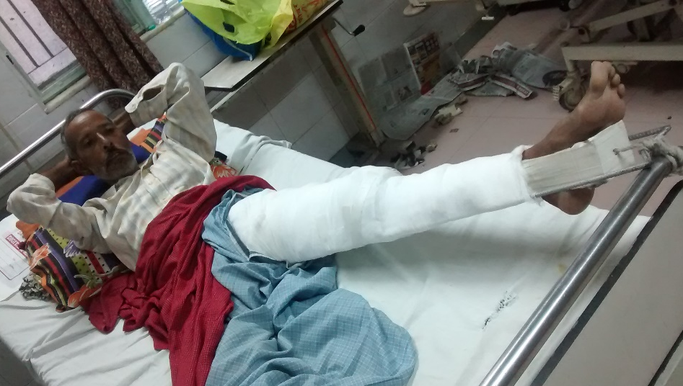
THOMAS KNEE SPLINT
DEVISED BY SIR HUGH’ OVEN THOMAS
WAS USED IN PATIENTS OF TUBERCULOSIS KNEE (HENCE THE NAME)
THREE PARTS –
CIRCULAR RING – RESTS ON THE ISCHIAL TUBEROSITY AND ANTERIOR SUPERIOR ILIAC SPINE.
PARALLEL BARS – LATERAL BAR HAS A BEND TO ACCOMMODATE THE GREATER TUBEROSITY
NOTCHED END – TO APPLY TRACTION.
USES –
FRACTURE SHAFT FEMUR IN CHILDREN (TREATMENT) AND ADULTS (SPLINTAGE).
FRACTURE INTERTROCHANTERIC FEMUR
IMMOBILIZATION AFTER REDUCTION OF POSTERIOR DISLOCATION OF HIP
PRECAUTIONS –
ADEQUATE PADDING OF RING AND BONY PROMINENCES
POSITION THE LIMB IN FLEXION AND ABDUCTION (TO COUNTER MUSCULAR FORCES ON PROXIMAL FRAGMENT AND PREVENT COXA VARA)

Slide 12
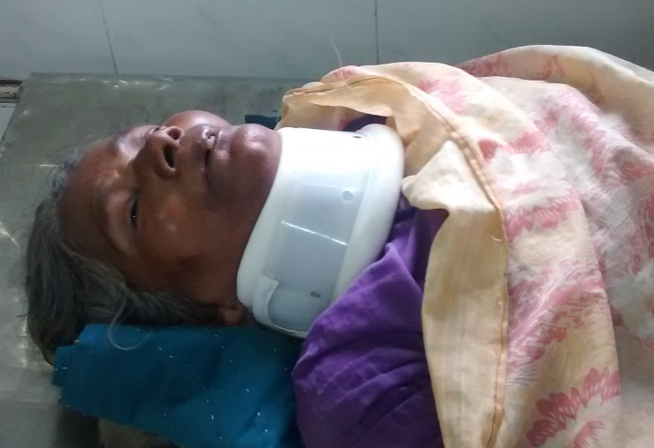
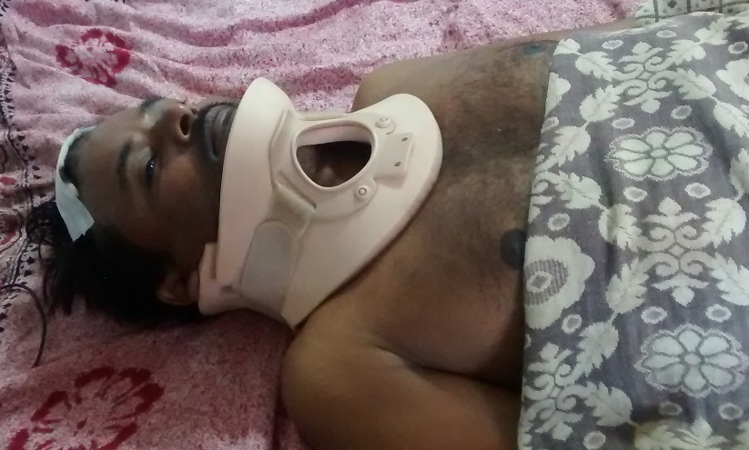
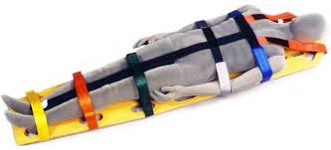
SPLINTS TO IMMOBILIZE THE SPINE
HARD CERVICAL COLLAR
PHILADELPHIA COLLAR
LONG SPINE BOARD

Slide 13
COMPLICATIONS OF SPLINTS
TIGHT STRAPPING OF SPLINTS CAUSE LIMB ISCHAEMIA AND COMPARTMENT SYNDROME
INADEQUATELY PADDED SPLINTS CAN CAUSE PRESSURE SORES ON BONY PROMINENCES
INADEQUATELY PADDED SPLINTS CAN CAUSE NERVE INJURIES.

Slide 14
TRACTIONS
TRACTION IS A FORCE APPLIED MANUALLY OR MECHANICALLY GENERATED BY WEIGHTS, USED TO REDUCE FRACTURES / DISLOCATIONS OR TO ACHIEVE RELATIVE IMMOBILIZATION.
USES –
TO REDUCE FRACTURE / DISLOCATION BY COUNTERACTING MUSCLE SPASM.
TO RELIEVE PAIN BY RELATIVE IMMOBILISATION AND RELIEVING SPASM
TO KEEP JOINT SURFACES APART IN INFLAMMATORY CONDITIONS LIKE SEPTIC / TUBERCULAR ARTHRITIS.
CLASSIFICATION I –
SKIN TRACTION
SKELETAL TRACTION
MANUAL TRACTION
CLASSIFICATION II –
BALANCED TRACTION
FIXED TRACTION

Slide 15
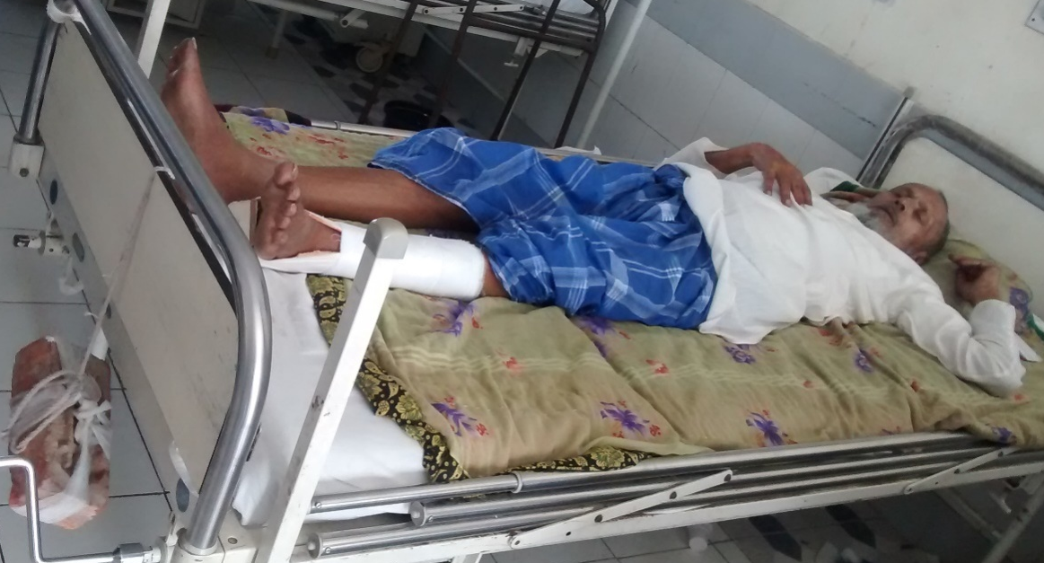
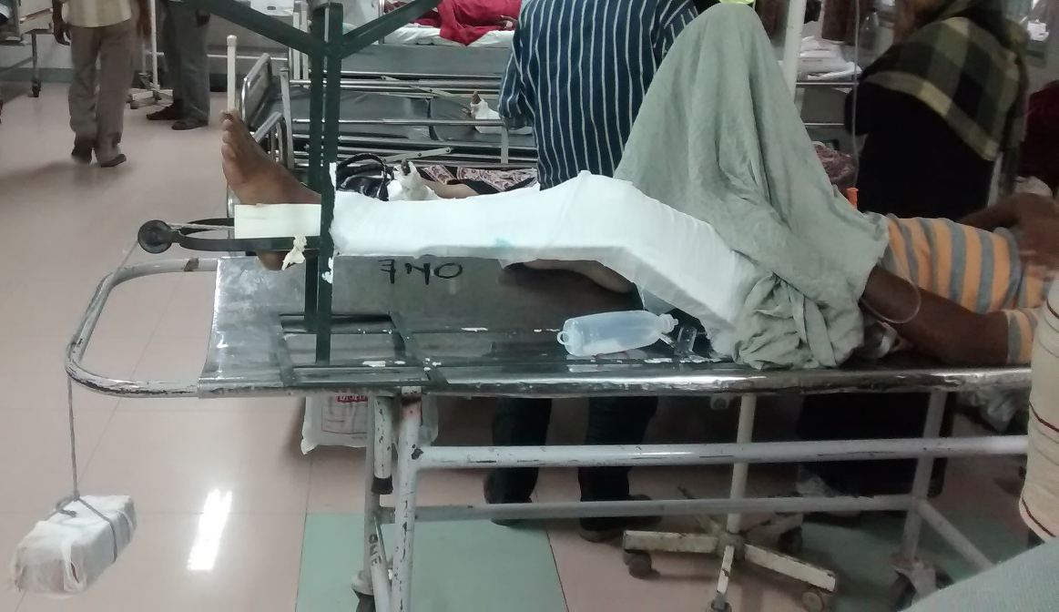
SKIN TRACTION – TRACTION IS APPLIED THROUGH SKIN BY ADHESIVE BANDAGE
SKELETAL TRACTION – TRACTION IS APPLIED TO BONE USING STEINMANN PIN / K – WIRES
BALANCED TRACTION – USES GRAVITY FOR COUNTER-TRACTION
FIXED TRACTION – TRACTION IS GIVEN BETWEEN TWO FIXED POINTS

Slide 16
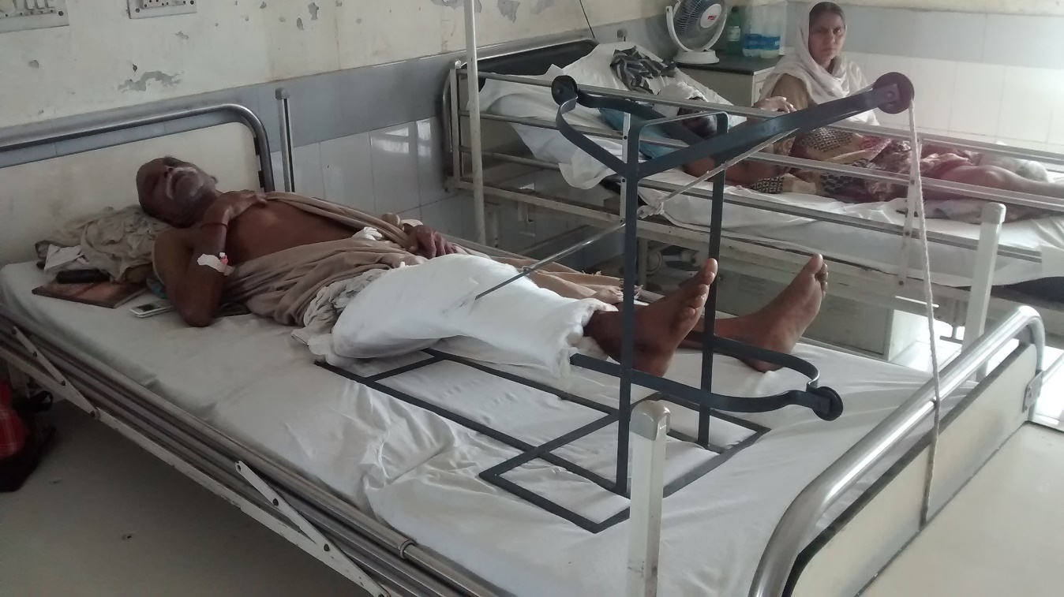
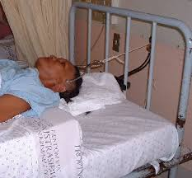
COMMON TYPES OF SKELETAL TRACTION
DISTAL FEMORAL
UPPER TIBIAL
LOWER TIBIAL
CALCANEAL
PATELLAR
CRUTCHFIELD

Slide 17
COMPLICATIONS OF SKIN TRACTION –
BLISTERING OF UNDERLYING SKIN
DISTAL ISCHAEMIA
ALLERGIC REACTION TO ADHESIVES
PEELING / SLOUGHING OF SKIN
COMPLICATIONS OF SKELETAL TRACTION –
PIN TRACK INFECTION / OSTEOMYELITIS
BITE OUT
NEUROVASCULAR INJURY
FRACTURE

Slide 18
THOMAS KNEE SPLINT IS USED for WHICH OF THE FOLLOWING FRACTURE
FRACTURE DISTAL END RADIUS
FRACTURE INTERTROCHANTERIC FEMUR
FRACTURE SURGICAL NECK HUMERUS
MONTEGGIA RACTURE DISLOCATION

Slide 19
WHAT SPLINT CAN BE USED FOR COLLES FRACTURE
POSTERIOR LEG SPLINT
LISTONS LONG SPLINT
THOMAS KNEE SPLINT
4. LATERAL ELBOW SPLINT

Slide 20
WHICH IS NOT A COMPLICATION OF SPLINTS
PRESSURE SORE
NERVE INJURY
COMPARTMENT SYNDROME
FAT EMBOLISM

Slide 21
LISTONS LONG SPLINT EXTENDS PROXIMALLY UPTO
GREATER TROCHANTER
ILIAC CREST
AXILLA
LESSER TROCHANTER

Slide 22
A PATIENT WITH BELOW KNEE SKIN TRACTION DEVELOPS SWELLING OVER FOOT. FIRST LINE OF MANAGEMENT WILL INCLUDE -
LIMB ELEVATION
HYGROSCOPIC DRESSING
REMOVAL OF SKIN TRACTION
FASCIOTOMY

Slide 23
A PATIENT INVOLVED IN A ROAD CRASH IS BROUGHT TO THE CASUALTY WITH A BROKEN LEG AND FOREARM ALSO COMPLAINING OF NECK PAIN. HE WILL NEED ALL OF THE FOLLOWING EXCEPT -
POSTERIOR LEG SPLINT
PELVIC BINDER
LATERAL ELBOW SPLINT
HARD CERVICAL COLLAR

Slide 24
CRUTCHFIELD TRACTION IS USED IN INJURIES OF -
CERVICAL SPINE
THORACIC SPINE
LUMBAR SPINE
SACRUM

Slide 25
AN UNCONSCIOUS PATIENT WITH HISTORY OF TRAUMA IS BROUGHT TO THE CASUALTY. THE FIRST SPLINT TO BE APPLIED IS -
LISTONS LONG SPLINT
PELVIC BINDER
RIB BINDER
HARD CERVICAL COLLAR

Slide 26
WHICH SPLINT IS IDEAL FOR TRANSPORTATION OF A TRAUMA PATIENT?
HARD CERVICAL COLLAR
THOMAS KNEE SPLINT
LONG SPINE BOARD
AEROPLANE SPLINT

