Slide 1
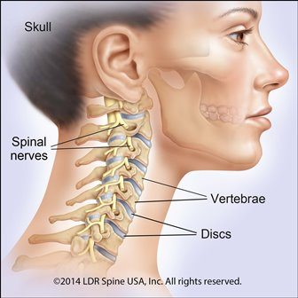
CERVICAL SPINE INJURIES

Slide 2
Anatomy
The spine contains 33 vertebrae: seven cervical, 12 thoracic, 5 lumbar, 5 fused sacral and 4 fused coccygeal vertebrae
The vertebral bodies generally increase in width craniocaudally (exception of T1–T3)
Normal spinal curves include cervical lordosis, thoracic kyphosis, lumbar lordosis and sacral kyphosis

Slide 3
Cancellous bone in cortical shell
Vertebral canal between body and lamina: houses the spinal cord
Vertebrae:
1. Body (centrum): have articular cartilage on superior/inferior aspects; get larger inferiorly
2. Arch (pedicles & lamina)
3. Processes: spinous, transverse, costal, mamillary
4. Foramina: vertebral, intervertebral, transverse

Slide 4
CERVICAL VERTEBRAE
Readily identified by the foramen transversarium perforating the transverse processes. This foramen transmits the vertebral artery, the vein,and sympathetic nerve fibres
Spines are small and bifid (except C1
and C7 which are single)
Articular facets are relatively horizontal

Slide 5
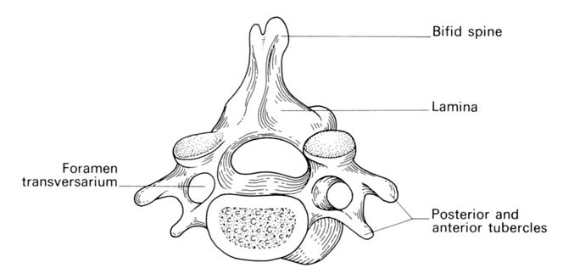

Slide 6
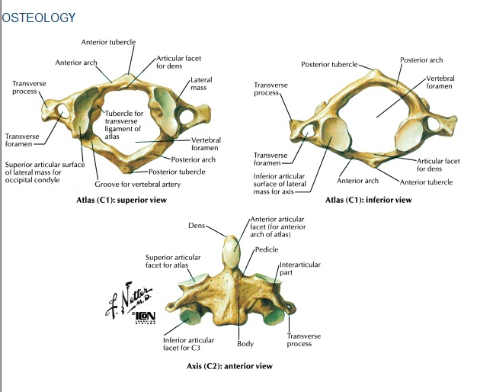

Slide 7
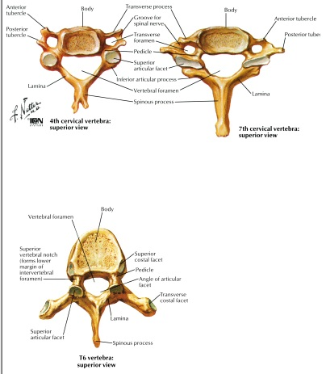

Slide 8
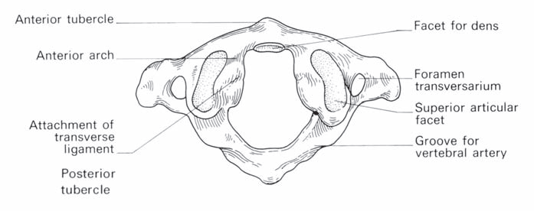
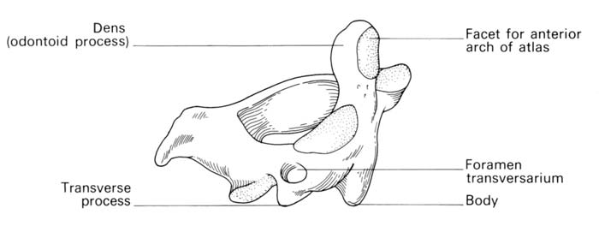
CERVICAL VERTEBRAE
Nodding and lateral flexion movements occur at the atlanto-occipital joint
Rotation of the skull occurs at the atlanto-axial joint around the dens, which acts as a pivot

Slide 9
CERVICAL SPINE INJURIES
Carry a double threat: damage to the vertebral column and damage to the neural tissues
Movement may cause or aggravate the neural lesion; hence the importance of establishing whether the injury is stable or unstable and treating it as unstable until proven otherwise

Slide 10
STABILITY OF C-SPINE INJURIES
A Stable Injury is one in which the vertebral components will not be displaced by normal movements
In a Stable injury, if the neural elements are undamaged there is little risk of them becoming further damaged
An Unstable Injury is one in which there is a significant risk of displacement and consequent damage – or
further damage – to the neural tissues

Slide 11
DENIS’ 3-COLUMN CONCEPT (1983)
Three structural elements must be considered:
The Posterior Osseo-ligamentous complex (or Posterior Column) consisting of the pedicles, facet joints, posterior bony arch, interspinous and supraspinous ligaments
The Middle Column comprising the posterior half of the vertebral body, the posterior part of the intervertebral disc and the posterior longitudinal ligament
The Anterior Column composed of the anterior half of the vertebral body, the anterior part of the intervertebral disc and the anterior longitudinal ligament

Slide 12
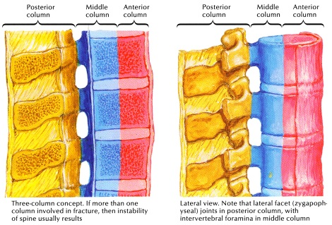

Slide 13
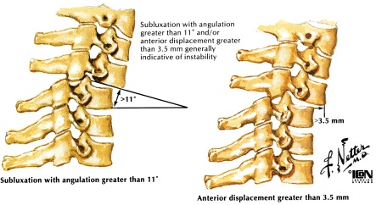
All fractures involving the middle column and at least one other column should be regarded as unstable
Only 10 per cent of spinal fractures are unstable
Less than 5 per cent are associated with cord damage

Slide 14
MECHANISM OF INJURY
Traction injury
Direct injury: Penetrating injuries to the spine, particularly from firearms and knives, are becoming increasingly common
Indirect injury: Most common cause. A variety of forces may be applied to the spine (often simultaneously):
axial compression flexion
lateral compression
flexion-rotation
Shear
flexion-distraction
Extension
Insufficiency fractures may occur with minimal force in bone which is weakened by osteoporosis or a pathological lesion

Slide 15
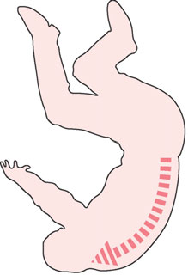
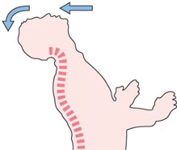

Slide 16
PRINCIPLES OF DIAGNOSIS AND INITIAL MANAGEMENT
Diagnosis and management go hand in hand
Inappropriate movement and examination can irretrievably change the outcome for the worse
Early management
Airway, Breathing and Circulation
Slightest possibility of a spinal injury in a trauma patient, the spine must be immobilized until the patient has been resuscitated and other life-threatening injuries have been identified and treated.

Slide 17
RADIOLOGY
Lateral view
Top of T1 visible
Three smooth arcs maintained
Vertebral bodies of uniform height
Odontoid intact and closely applied to C1
AP view
Spinous processes straight and spaced equally
Intervertebral spaces roughly equal
Odontoid view
Odontoid intact
Equal spaces on either side of odontoid
Lateral margins of C1 and C2 align

Slide 18
Alignment
Notes:
1. Anterior vertebral line (anterior margin of vertebral bodies) 2. Posterior vertebral line (posterior margin of vertebral bodies) 3. Spinolaminar line (posterior margin of spinal canal) 4. Posterior spinous line (tips of the spinous processes) These lines should follow a slightly lordotic curve, smooth and without step-offs. Any malalignment should be considered evidence of ligmentous injury or occult fracture, and cervical spine immobilization should be maintained until a definitive diagnosis is made.

Slide 19
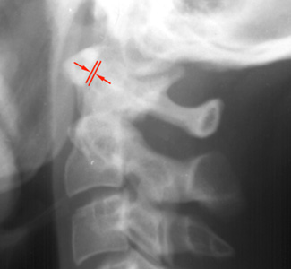
Key Things to Identify
Predental space – should be 3mm or less

Slide 20
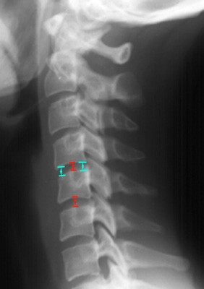
Disc spaces should be the equal and symmetric

Slide 21
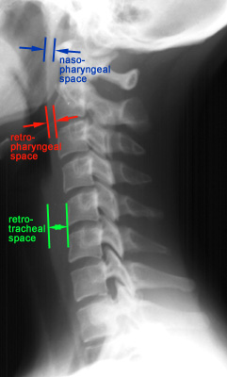
Prevertebral soft tissue swelling
May be due to hematoma from a fracture
Soft tissue swelling may make fracture diagnosis difficulty
Notes:
Nasopharyngeal space (C1) - 10 mm (adult) Retropharyngeal space (C2-C4) - 5-7 mm Retrotracheal space (C5-C7) - 14 mm (children), 22 mm (adults).

Slide 22
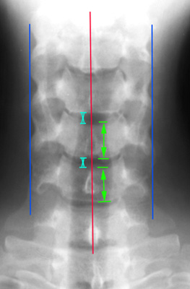
AP View
The height of the cervical vertebral bodies should be approximately equal
The height of each joint space should be roughly equal at all levels
Spinous process should be in midline and in good alignment
Notes:
If one of the spinous process is displaced to one side, a facet dislocation should be suspected.

Slide 23
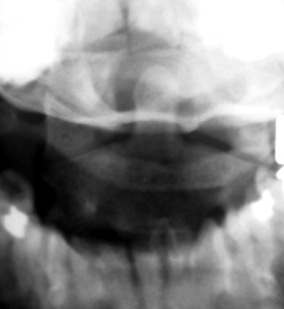
Odontoid View
An adequate film should include the entire odontoid and the lateral borders of C1-C2.
Occipital condyles should line up with the lateral masses and superior articular facet of C1.
The distance from the dens to the lateral masses of C1 should be equal bilaterally.
The tips of lateral mass of C1 should line up with the lateral margins of the superior articular facet of C2.
The odontoid should have uninterrupted cortical margins blending with the body of C2.
Notes:
AABCDS Adequacy, Alignment, Bone, Cartilage, Disc, Soft tissues
Any asymmetry is suggestive of a fracture of C1 or C2 or rotational abnormality. It may also be caused by tilting of the head, so if the vertebrae is shifted in on one side, then it should be shifted out on the other side.

Slide 24
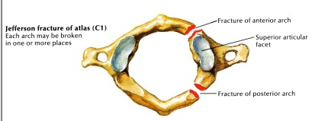
JEFFERSON FRACTURE
Compression fracture of the bony ring of C1, characterized by lateral masses splitting and transverse ligament tear
Mechanism: Diving into shallow water, RTA
Best seen on Odontoid view
Signs: Displacement of the lateral masses of vertebrae C1 beyond the margins of the body of vertebra C2
Notes:
Mechanism: axial blow to the vertex of the head (e.g. diving injury).

Slide 25
CT is required to define the extent of fracture
C/F: Pain in the neck usually without neurological signs.
Treatment
Stable #: (intact transverse ligament) SOFT/HARD CERVICAL COLLAR x 3 months
Unstable #: (broken transverse ligament)
SKELETAL TRACTION, HALO-VEST or SURGERY (fusion of C1-C2-C3) x 3 months

Slide 26
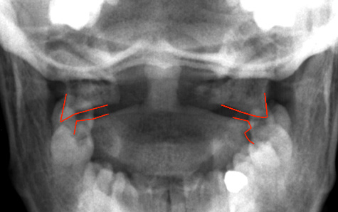

Slide 28
HANGMAN’S FRACTURE
Fracture through the pedicle at pars interarticularis of C2 secondary to hyperextension
Mechanism: Hanging or hitting a dashboard
Best seen on lateral view
Signs:
Prevertebral soft tissue swelling
Avulsion of anterior inferior corner of C2 associated with rupture of the anterior longitudinal ligament
Anterior dislocation of the C2 vertebral body
Bilateral C2 pars interarticularis fractures
After reduction, the neck is held in a halo-vest until union occurs. Rx: PHILADELPHIA COLLAR IMMOBILIZATION

Slide 29
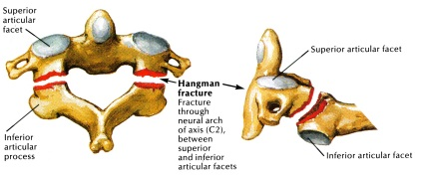

Slide 30
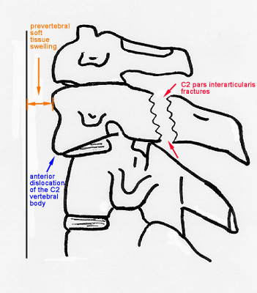

Slide 32
ODONTOID FRACTURE
Fracture of the odontoid (dens) process of C2
Best seen on the lateral view
Anderson and D’Alonzo Classification(1974)
Type I – Fracture through superior portion of dens (Stable)
Type II – Fracture through the base of the dens (most common, most dangerous, prone to non-union; Unstable; requires ORIF – worse with traction!)
Type III – Fracture that extends into the body of C2 (Stable)

Slide 33
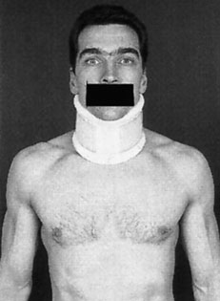
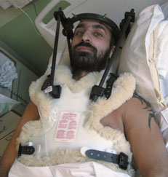

Slide 34
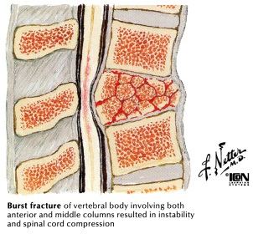
BURST FRACTURE
Fracture of C3-C7 that results from axial compression
CT is required for all patients to evaluate extent of injury
Injury to spinal cord, secondary to displacement of posterior fragments, is common
Rx: RIGID IMMOBILIZATION
SURGERY

Slide 35
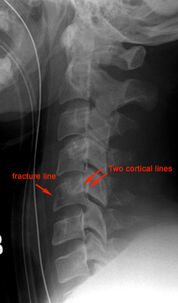

Slide 36
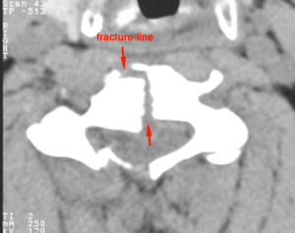

Slide 37
CLAY SHOVELER’S FRACTURE
Fracture of a spinous process C6-T1
Mechanism: powerful hyperflexion, usually combined with contraction of paraspinous muscles pulling on spinous processes (e.g. shoveling). Stable #. Stress #
Best seen on lateral view
Signs:
Spinous process fracture on lateral view
Ghost sign on AP view (i.e. double spinous process of C6 or C7 resulting from displaced fractured spinous process)

Slide 38
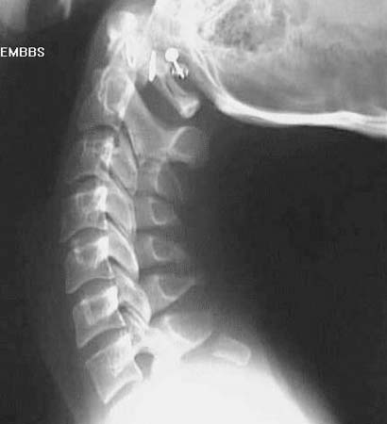
C7 Clay-Shoveller’s #

Slide 39
WEDGE FRACTURE
Compression fracture resulting from flexion
Mechanism: Hyperflexion and compression
Signs:
Buckled anterior cortex
Loss of height of anterior vertebral body
Anterosuperior fracture of vertebral body

Slide 40
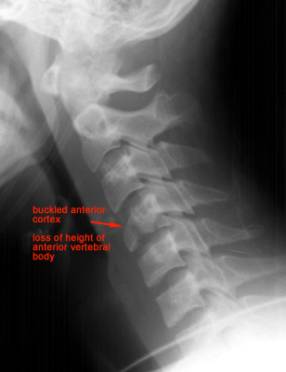

Slide 41
FLEXION TEARDROP FRACTURE
Posterior ligament disruption and anterior compression fracture of the vertebral body which results from a severe flexion injury
Mechanism: hyperflexion and compression (e.g. diving into shallow water)
Best seen on lateral view
Signs:
Prevertebral swelling associated with anterior longitudinal ligament tear
Teardrop fragment from anterior vertebral body avulsion fracture
Posterior vertebral body subluxation into the spinal canal
Spinal cord compression from vertebral body displacement
Fracture of the spinous process

Slide 42
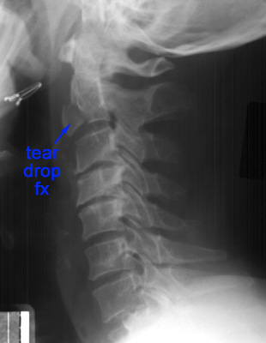

Slide 43
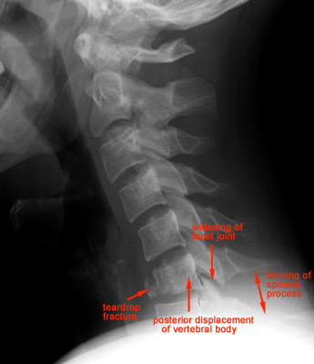

Slide 44
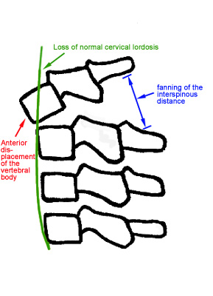
ANTERIOR SUBLUXATION
Disruption of the posterior ligamentous complex resulting from hyperflexion
Difficult to diagnose because muscle spasm may result in similar findings on the radiograph. May be stable initially, but it associates with 20%-50% delayed instability
Flexion and extension views are helpful
in further evaluation.
Signs:
Loss of normal cervical lordosis
Anterior displacement of the vertebral body
Fanning of the interspinous distance
Notes:
It may be

Slide 45
BILATERAL FACET DISLOCATION
Complete anterior dislocation of the vertebral body resulting from extreme hyperflexion injury. It is associated with a very high risk of cord damage
Best seen on lateral view
Signs:
Complete anterior dislocation of affected vertebral body by half or more of the vertebral body AP diameter
Disruption of the posterior ligament complex and the anterior longitudinal ligament
Bow tie or bat wing appearance of the locked facets
Notes:
Mechanism: extreme flexion of head and neck without axial compression.

Slide 46
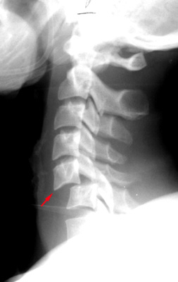

Slide 47
UNILATERAL FACET DISLOCATION
Facet joint dislocation and rupture of the apophyseal joint ligaments resulting from rotatory injury of the cervical vertebrae
Best seen on lateral or oblique views
Signs:
Anterior dislocation of affected vertebral body by less than half of the vertebral body AP diameter
Discordant rotation above and below involved level
Facet within intervertebral foramen on oblique view
Widening of the disk space
Bow tie or bat wing appearance of the overriding locked facets.
Notes:
Mechanism: simultaneous flexion and rotation

Slide 48
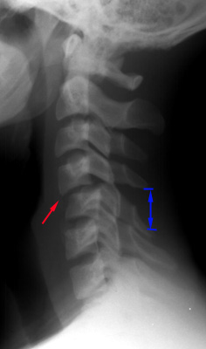

Slide 49
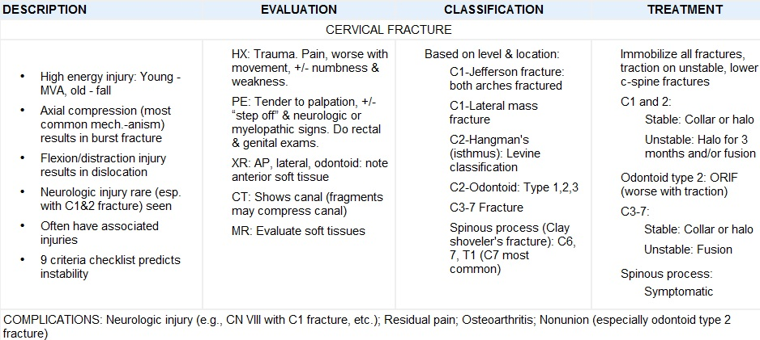

Slide 50
THANK YOU

