Slide 1
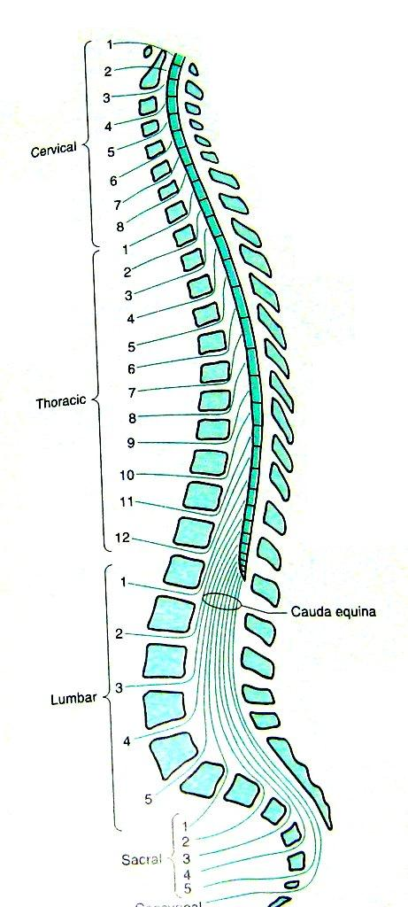
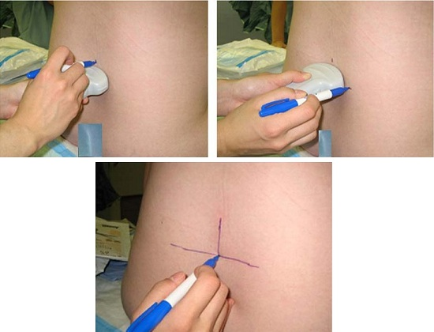
SPINAL ANESTHESIA
Dr. Jaishri Bogra
Deptt. of Anaesthesiology
King George’s Medical University,
Lucknow

Slide 2
DEFINITION OF REGIONAL ANESTHESIA
Local anesthetic applied around a peripheral nerve at any point along the length of the nerve (from spinal cord)- reducing or preventing impulse transmission
No CNS depression; patient conscious
Regional anesthetic techniques categorized as follows
Spinal anesthesia and Epidural
Peripheral nerve blockades

Slide 3
The Advantages of Spinal Anaesthesia
1.Cost
2.Patient satisfaction
3.Respiratory disease
4.Patent airway
5.Diabetic patients
6.Elderly Patients
7.Muscle relaxation
8.Blood loss during operation is less
9. Post operative pain relief

Slide 4
Contd…
Full and complete anaesthesia
Prolonged block: Pain free postoperatively
Alternative to GA for certain poor risk patients esp.:
Difficult airway
Respiratory disease
Contracted bowel
Suitable for certain surgical procedures
Blunt the stress response to surgery

Slide 5
Indication of SA
Subarachnoid block can be used to provide surgical anesthesia for all procedures carried out on the lower half of the body.
Indications include surgery on the lower limb, pelvis, genitals, and perineum, and most urological procedures.
Can be used for analgesia (Intrathecal opoid)

Slide 6
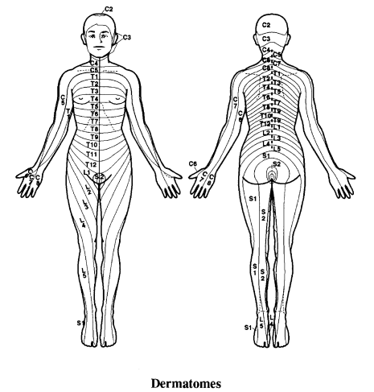
Dermatomal Level | Surface Landmark
C8 | Little finger
T1,T2 | Inner aspect of the arm
T4 | Nipple line, root of scapula
T7 | Inferior border of scapula ,Tip of xiphoid
T10 | Umbilicus
L2 to L3 | Anterior thigh
S1 | Heel of foot
Dermatomes

Slide 7
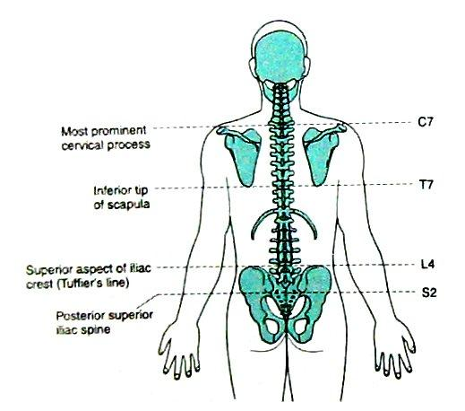
SURFACE ANATOMY
Anatomic Landmarks to Identify Vertebral Levels
Anatomic Landmark | Features
C7 | Vertebral prominence, the most prominent process in the neck
T7 | Inferior angle of the scapula
L4 | Line connecting iliac crests
S2 | Line connecting the posterior superior iliac spines
Sacral hiatus | Groove or depression just above or between the gluteal clefts above the coccyx

Slide 8
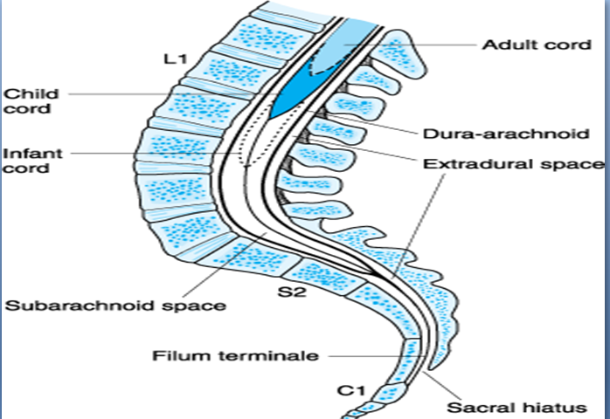
Spinal Cord
Extends from foramen magnum to
Adult : lower border of L1 in /upper border of L2
Infants/children : L3
It is about 45 cm long
Duramater, Subarachnoid space & subdural space: S2 in adults( S3 in children)
S. C gives 31 pairs of spinal nerve
An extension of piamater , the FILUM TERMINALE penetrate the dura and attach the terminal end of spinal cord [conus medullaris]to the periosteum of the coccyx

Slide 9
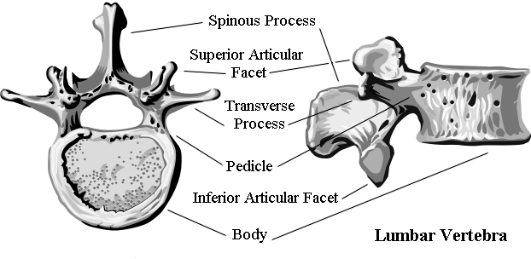
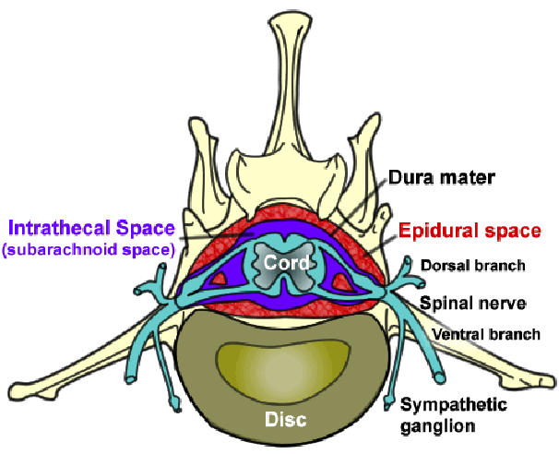
Vertebrae Anatomy

Slide 10
Important Facts
Cardiac accelerator fibre: T1-T4(Bradycardia & ↓ contractility)
Vasomotor fibre : T5-L1( Determine vasomotor tone)(vasodilation on blockade)
Sympathetic outflow arise from T5-L1(Block ↑vagal tone, small contacted gut with active peristalsis)
Most dependent part in supine position is T4-T8 (imp. For hyperbaric solution)

Slide 11
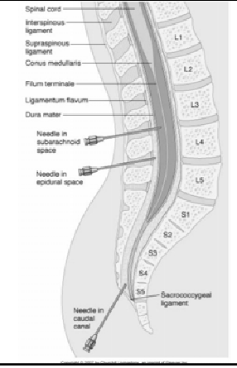
Spinal Anesthesia/Analgesia

Slide 12
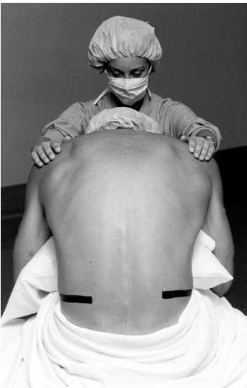
SITE
Adult : L3-L4 or L4-L5 ( or even L2-L3)
Infant : L4-L5
A line drawn b/w the highest pt. of iliac crests (Tuffier’s line) usually cross either body of L4 or the L4-L5 interspace
Position
Sitting
lateral
Prone(anorectal procedure, hypobaric solution, jackknife position)

Slide 13
Positioning the Patient
Sitting
With Legs hanging over side of bed
Put Feet up on a Stool (no wheels)
Assistant MUST keep the patient from Swaying
Curve her back like a “C”,
Lateral Decubitus (Left or Right?)
Needs to be Parallel to the Edge of the Bed
Legs Flexed up to Abdomen
Forehead Flexed down towards Knees
Jack-knife Position
Chosen for ano-rectal surgery
CSF will not drip from hub of needle
Use hypobaric solution

Slide 14
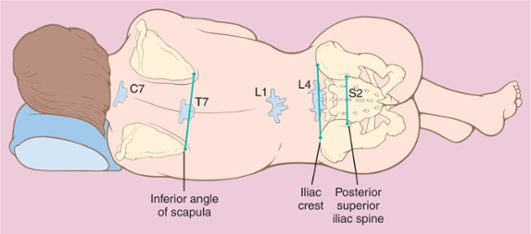
Surface landmarks

Slide 15
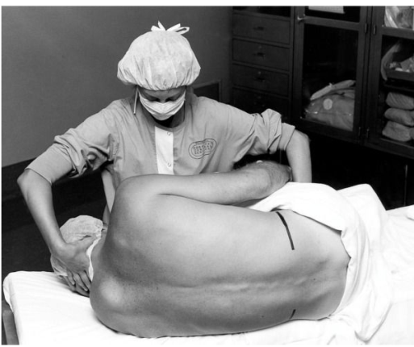
.
The patient and operating table should then be placed in the position appropriate for the surgical procedure and drugs chosen.
Anesthetic dose is injected at a rate of approximately 0.2 mL/sec
Lateral decubitus positioning for a neuraxial block. The assistant can help the patient assume the ideal position of “forehead to knees.”

Slide 16
Spinal Anesthesia
A single injection of a local anesthetic solution into the subarachnoid space usually at the lumbar level
Intrathecal Narcotics
Commonly at L3-L4
Largest Interspace
L5-S1

Slide 17
Important Factors Affecting Block Height - SAB
Baricity of anesthetic solution
Position of the patient
During injection
Immediately after injection
Drug Dosage (mg)
Concentration times volume
Addition of Opioids
Site of Injection

Slide 18
Additional Factors to Consider with SAB Height
Patient Age
Elderly patients > 80 yrs
Patient Height
Intra-abdominal Pressure
Pregnancy & Obesity
Drug Volume

Slide 19
Differential Block with SAB
Sympathetic Block- 2-6 dermatomes higher than the sensory block
Motor Block- 2 dermatomes lower than sensory block

Slide 20
Technique of Lumbar Puncture
When performing a spinal anesthetic, appropriate monitors should be placed, and airway and resuscitation equipment should be readily available.
All equipment for the spinal blockade should be ready for use, and all necessary medications should be drawn up prior to positioning the patient for spinal anesthesia.
Adequate preparation for the spinal reduces the amount of time needed to perform the block and assists with making the patient comfortable.
Proper positioning is the key to making the spinal anesthetic quick and successful.

Slide 21
Once the patient is correctly positioned, the midline should be palpated. The iliac crests are palpated, and a line is drawn between them in order to find the body of L4 or the L4-5 interspace.
Other interspaces can be identified, depending on where the needle is to be inserted.
The skin should be cleaned with sterile cleaning solution, and the area should be draped in a sterile fashion.
A small wheal of local anesthetic is injected into the skin at the site of insertion.
More local anesthetic is then administered along the intended path of the spinal needle insertion to a depth of 1 to 2 in.

Slide 22
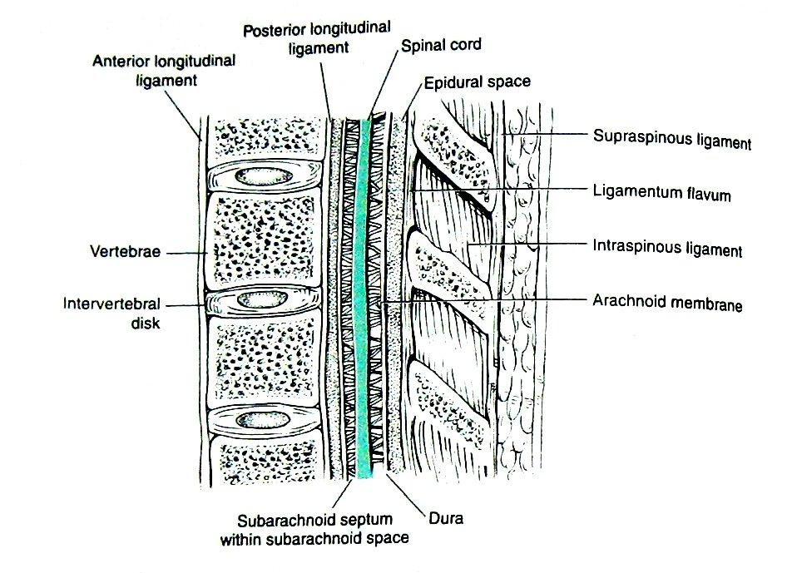
Spinal : approaches
Structure Pierced
1. MIDLINE APPROACH
2. PARAMEDIAN APPROACH
Midline Approach | Paramedian approach
Skin | Skin
Subcutaneous fat | Subcutaneous fat
Supraspinous ligament
Interspinous ligament
Ligamentum flavum | Ligmentum flavum
Dura mater | Dura mater
Subdural space | Subdural space
Arachnoid mater | Arachnoid mater
Subarachnoid space | Subarachnoid space

Slide 23
Midline Approach
The back should be draped in a sterile fashion.
With advancement of needle Two “pops” are felt. The first is penetration of the L. flavum & second is the penetration of dura-arachnoid membrane.
The stylet is then removed, and CSF should appear at the needle hub.
For spinal needles of small gauge (26-29 gauge), this usually takes 5-10 sec

Slide 24
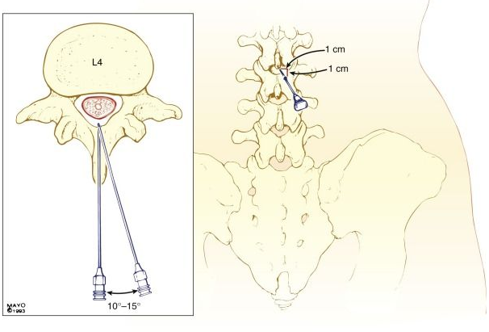
Paramedian Approach
Calcified interspinous ligament or difficulty in flexing the spine
The needle should be inserted 1 cm lateral and 1 cm inferior of the superior spinous process of desired level.
Angle should be 10-25 toward midline
The ligamentum flavum is usually the first resistance identified.

Slide 25
SPINAL NEEDLE
Spinal needles fall into two main categories:
(i) those that cut the dura : Quincke- Babcock needle, the traditional disposable spinal needle
(iI) those with a conical tip(Pencil tip) : Whitacre and Sprotte needles
If a continuous spinal technique is chosen, use of a Tuohy or Hustead needle can facilitate passage of the catheter
QUINCKE WHITACRE SPROTEE

Slide 27
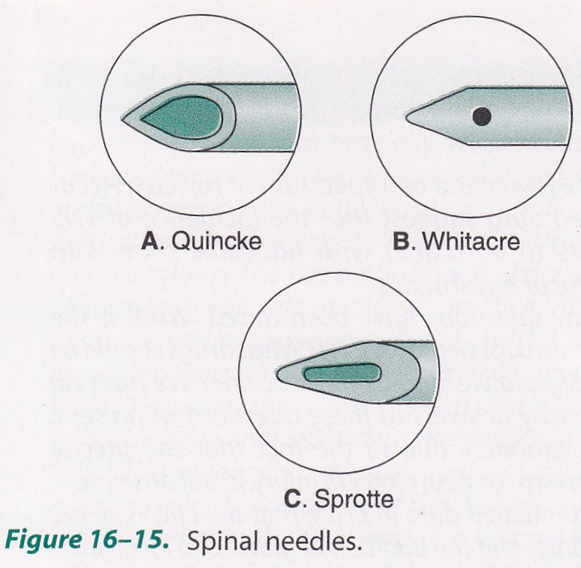
Blunt tip (pencil-point) needle decreased the incidence of PDPH
Sprotte is a side-injection needle with a long opening.
It has the advantage of more vigorous CSF flow compared with similar gauge needles.

Slide 28
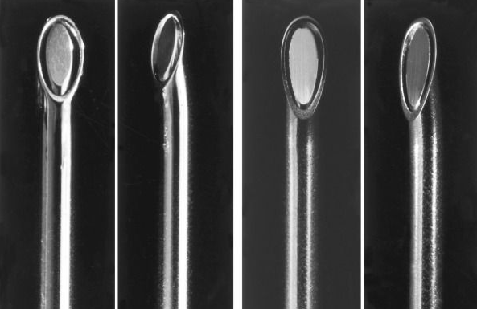
Hustead
Tuohy
Examples of continuous spinal needles, including a disposable, 18-gauge Hustead (A) and a 17-gauge Tuohy (B) needle. Both have distal tips designed to direct the catheters inserted through the needles along the course of the bevel opening; 20-gauge epidural catheters are used with these particular needle sizes.

Slide 29
Mechanism of Action
Differential blockade
 Autonomic>sensory>motor
Sensitivity to blockade determined by axonal diameter, degree of myelination, anatomy
 Sympathetic blockade may be two dermatomes higher than sensory block (pain, light touch)

Slide 30
Baricity of Local Anesthetics
Isobaric – Stays where you put it
LA has the same density or specific gravity as CSF (1.003-1.008) – Normal Saline
Hypobaric – “Floats” up – Lighter than CSF
LA has a density or specific gravity that is less than CSF (<1.003) – Sterile Water
Hyperbaric – Settles to Dependent aspect of the subarachnoid space – Heavier than CSF
LA has a density or specific gravity that is greater than CSF (>1.008) - Dextrose

Slide 31
Hypobaric and Isobaric Spinal Anesthesia
To make a drug hypobaric to CSF, it must be less dense than CSF, with a baricity appreciably less than 1.0000 or a specific gravity appreciably less than 1.0069 (the mean value of the specific gravity of CSF).
A common method of formulating a hypobaric solution is to mix solution with sterile water & for hyperbaric mix with dextrose

Slide 32
Drug Selection for Hyperbaric Spinal Anesthesia(Miller)
Local Anesthetic Mixture | Dose (mg) * |  | Duration (min)
 | To T10 | To T4 | Plain | Epinephrine, 0.2 mg
Lidocaine (5% in 7.5% dextrose) | 50-60 | 75-100 | 60 | 75-100
Tetracaine (0.5% in 5% dextrose) | 6-8 | 10-16 | 70-90 | 100-150
Bupivacaine (0.75% in 8.5% dextrose) | 8-10 | 12-20 | 90-120 | 100-150
Ropivacaine (0.5% in dextrose) | 12-18 | 18-25 | 80-110 | —
Levobupivacaine | 8-10 | 12-20 | 90-120 | 100-150
* | Doses are for use in a 70-kg adult male of average height.

Slide 33
Spinal Anesthetic Additives
Fentanyl(<25µg)
Clonidine(25-50µg) an α₂-agonist, prolongs the motor & sensory blockade
Dexmedetomidine (3-5 µg)
Neostigmine: inhibits the breakdown of acetylcholine and thereby induces analgesia.
It also prolongs and intensifies the analgesia
Epinephrine (0.2 mg) or phenylephrine (5 mg)

Slide 34
In patients should be allowed to leave the recovery room after spinal anesthesia as soon as it can be demonstrated that their block is receding appropriately (at least four dermatomes’ regression or a spinal level of less than T10), they are hemodynamically stable, and they are comfortable.
Outpatients should be able to ambulate without orthostatic changes and void before discharge if they are in a high-risk group for urinary retention

Slide 35
Contraindications of Spinal
ABSOLUTE
Infection at the site of injection
Patient refusal
Coagulopathy and other bleeding disorders
Severe hypovolemia
Increased intracranial pressure
Severe MS & AS

Slide 36
Cont…
Relative
Sepsis
Uncoperative patient
Preexisting neurological deficits
Severe spinal deformity
Controversial
Prior surgery at the site of injection
Complicated surgery
Prolonged operation
Major blood loss

Slide 37
Complications
BRADYCARDIA
Defined as HR < 50 beats/ min.
T1-4 involvement leads to unopposed vagal tone and
decreased venous return which leads to bradycardia and asystole
NAUSEA AND VOMITING
Causes(Hypotension, Increased peristalsis, Opioid analgesia)
Nausea and vomiting may be associated with neuraxial block in up to 20% of patients,
atropine is almost universally effective in treating the nausea associated with high (T5) neuraxial anesthesia.

Slide 38
CRANIAL NERVE PALSY
TRANSIENT NEUROLOGICAL SYMPTOM (More common with lidocaine)
CAUDA EQUINA SYNDROME (Bowel-bladder dysfunction)
HIGH NEURAL BLOCKADE :
Excessive dose, failure to reduce standard dose[elderly, pregnant, obese, very short stature]
Unconsciousness, hypotension, apnea is referred to as high spinal or total spinal

Slide 39
HYPOTENSION
Prevented by: Volume loading with 10-20 mL/kg of intravenous fluid
Predictors of hypotension
low intravascular volume in case of hypovolemia due external loss by trauma, dehydration, internal loss
sensory block ≥ T5
age > 40 years
systolic BP < 120 mm Hg
combined spinal and general anesthesia
dural puncture between L2-3 and above
emergency surgery
pt with h/o uncontrolled hypertension
underlying autonomic dysfunction

Slide 40
Treatment of hypotension
100% O2
Elevation of leg .
Head down position
FLUIDS-
crystalloid
Colloid [500-1000ml] preferred due to increased intravascular time, maintaining CO, uteroplacental circulation.

Slide 41
Contd…
SYMPATHOMIMETICS:
Epinephrine: increases HR, CO, SBP, decrease DBP.
Phenylephrine: Increase in SVR, SBP, DBP. Causes reflex bradycardia, coronary blood flow increased.
Ephedrine; increase myocardial contractility and rate.
- Mephentermin

Slide 42
Total Spinal
Management of total spinal
Airway - secure airway and administer 100% oxygen
Breathing - ventilate by facemask and intubate.
Circulation - treat with i/v fluids and vasopressor
e.g. ephedrine 3-6mg or metaraminol 2mg increments or 0.5-1ml adrenaline 1:10 000 as required
Continue to ventilate until the block wears off (2 - 4 hours)
As the block recedes the patient will begin recovering consciousness followed by breathing and then movement of the arms and finally legs.

Slide 43
Post Dural Puncture Headache:
Due to leak of CSF from dural defect leads to traction in supporting structure especially in dura and tentorium & vasodialatation of cerebral blood vessels.
Usually bifrontal and or occipital, usually worse in upright , coughing , straining
Causes nausea, photophobia, tinnitus, diplopia[6th nerve], cranial nerve palsy
Treatment plan include keeping patient supine, adequate hydration, NSAIDS with without caffeine [increases production of csf and causes vasoconstriction of intracranial vessels], if not relieved within 12-24 hr then epidural blood patch.
Epidural blood patch consists of giving 20 ml

Slide 44
Relationships Among Variables and Post–spinal Puncture Headache
Factors that May Increase the Incidence of Post–spinal Puncture Headache
Age | Younger more frequent
Gender | Females > males
Needle size | Larger > smaller
Needle bevel | Less when the needle bevel is placed in the long axis of the neuraxis
Pregnancy | More when pregnant
Dural punctures (no.) | More with multiple punctures
Factors Not Increasing the Incidence of Post–spinal Puncture Headache
Continuous spinals
Timing of ambulation
Onset of headache :Usually 12-72 h following the procedure

Slide 45
References
Miller’s Anesthesia, 6th edition.
Morgan Anesthesia 4th edition.
Textbook of regional Anesthesia & Pain MX; By Prithviraj
Baras Clinical Anesthesia
Neuraxial Anesthesia by D.E. Longnecker et al New York: McGraw-Hill Medical.
Wylie Anesthesia
Internet Google Scholar

Slide 46
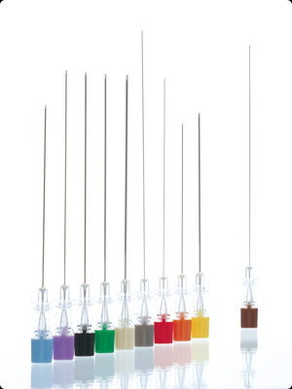
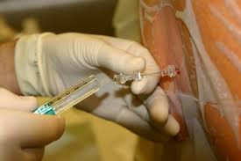
Thank You

