Slide 1
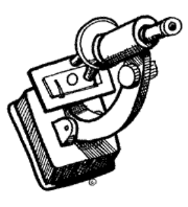
Microscopy and
Specimen Preparation

Slide 2
Microscope
Basics
T. Trimpe 2005 http://sciencespot.net/

Slide 3
Microscopy
Microscopes are scientific instruments designed to produce magnified visual or photographic images of small objects which are not visible by naked eye.
Micro - Small
Scope - Look

Slide 4
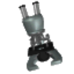
Introduction to the Microscope
        History
        Parts
        Focusing
        Types
        Care
Notes:
Students will have their microscopes out, for reference as we go through each of the steps. As an introduction, students will be asked what kinds of things they can do with this tool.

Slide 5
History of the Microscope
Antony van Leeuwenhoek
1st to see single-celled organisms in pond water
(1632-1723)
  first person to observe and describe micro-organisms accurately

Slide 6
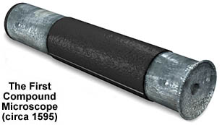
History of the Microscope
1590 –first compound microscope

Slide 7
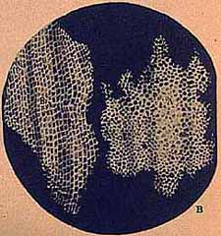
History of the Microscope
1655 – Robert Hooke used a compound microscope to observe pores in cork
  He called them “cells”

Slide 8
Microscope Vocabulary
Magnification: increase of an object’s apparent size
Resolution: power to show details clearly
Both are needed to see a clear image

Slide 9

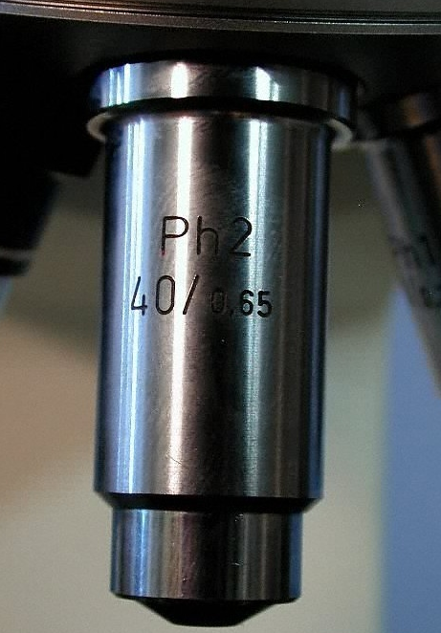
What’s my power?
To calculate the power of magnification, multiply the power of the ocular lens by the power of the objective.
What are the powers of magnification for each of
the objectives we have on our microscopes?

Slide 10
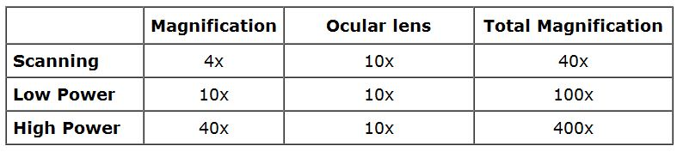
Magnification
Microscope has 3 magnifications:
Scanning, Low and High.
The total magnification is the ocular x objective

Slide 11

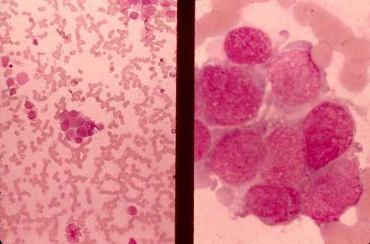
Comparing Powers of Magnification
We can see better details with higher the powers of magnification, but we cannot see as much of the image.
Which of these images would be viewed at a higher power of magnification?

Slide 12
Microscope Resolution
ability of a lens to separate or distinguish small objects that are close together
wavelength of light used is major factor in resolution
  shorter wavelength ⇒ greater resolution

Slide 13
Parts of the Microscope
Three main parts:
Optical
Illuminating
Mechanical

Slide 14
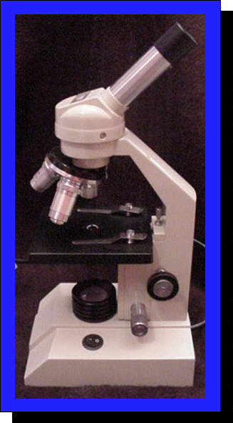
Optical Parts
Used for the Magnification of an image.
Ocular or Eye Piece
Objectives

Slide 15
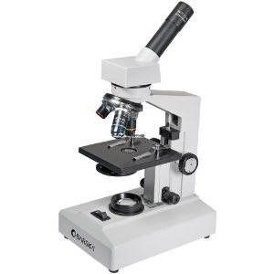
Illuminating Parts
Mirror:
Used for reflecting the light rays to the condenser.
Diaphragm: regulates the amount of light reflected

Slide 16
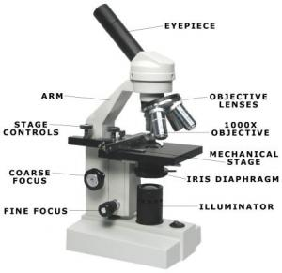
Mechanical Parts
Movement and support
Base
Pillar
Stage
Arm
Revolving Nose Piece
Draw Tube
Coarse and Fine Adj knobs
Inclination Points
Mirror Rack
Stage Clips

Slide 17
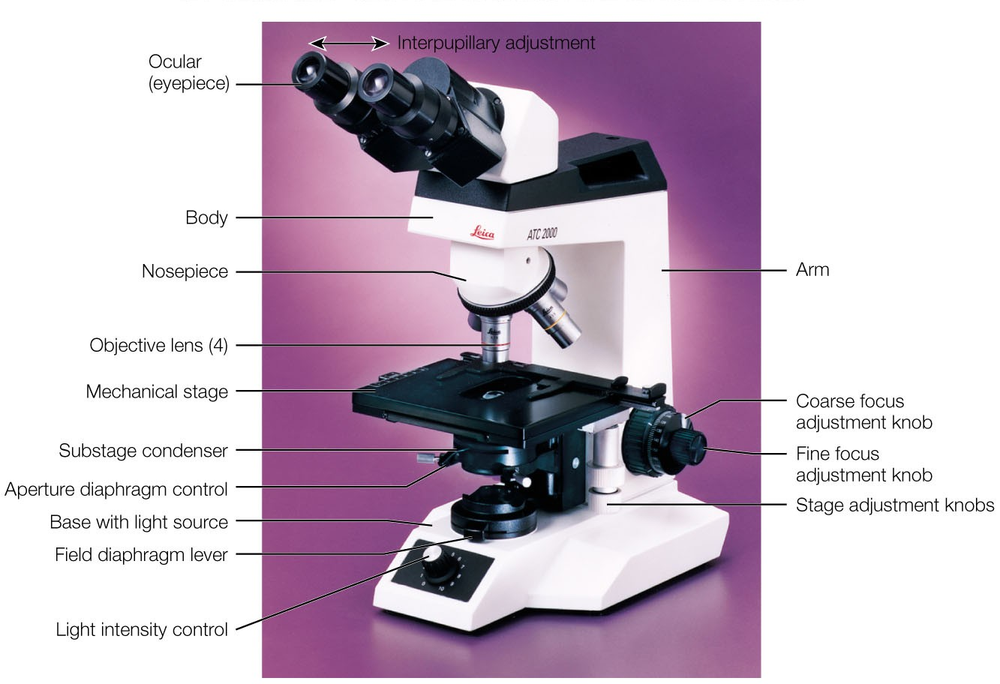
Binocular Microscope

Slide 18
Types of Microscopes
Light Microscope
Dark Ground
Phase-Contrast
Polarizing
Fluorescent
Stereoscopic
Confocal
Electron

Slide 19
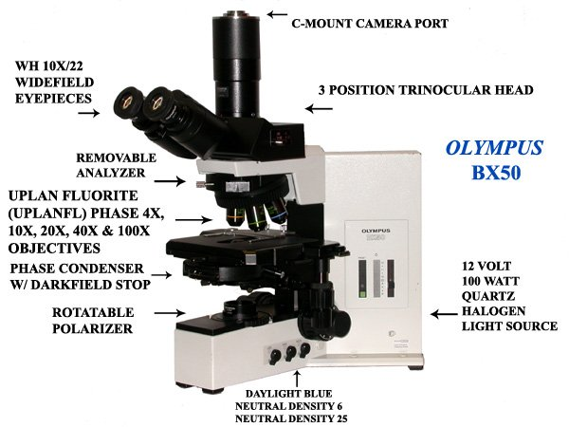
Darkground microscope

Slide 20
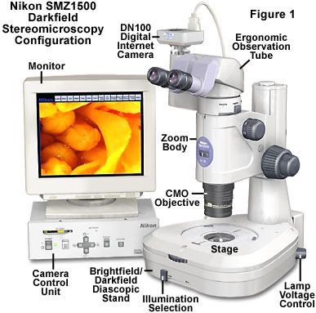
Darkfield microscope

Slide 21
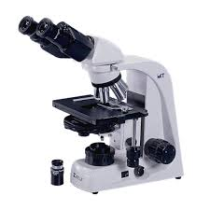
Phase contrast microscope

Slide 22
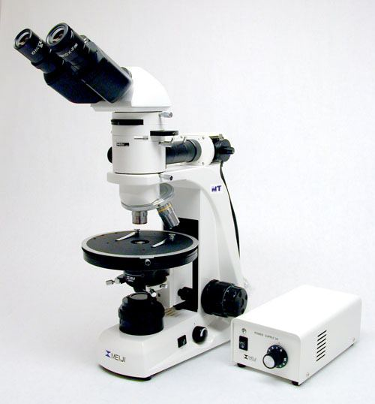
Polarizing microscope

Slide 23
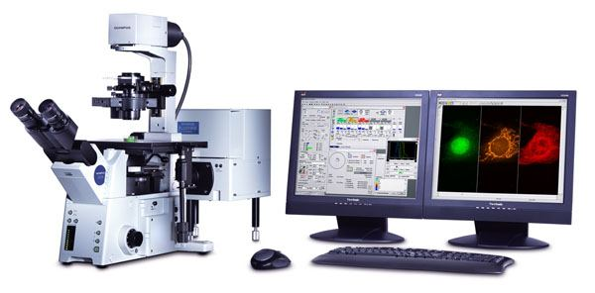
Confocal Microscope

Slide 24
Light Microscope
This model is found in most schools
use compound lenses to magnify objects
The lenses bend or refract light to make the object beneath them appear closer.

Slide 25
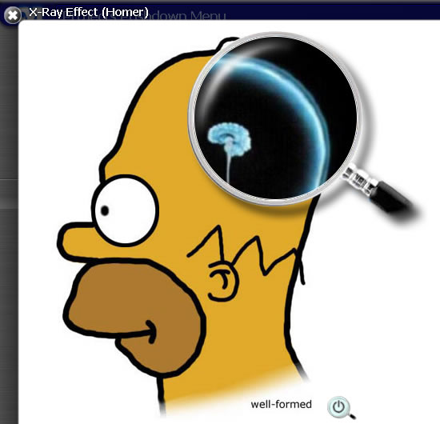

Simple Microscope
Light passes through only 1 lens
Example: magnifying glass

Slide 26
Compound Microscope
Light passes through an object and then through two or more lenses.
Most widely used.
Can magnify upto 2000X

Slide 27
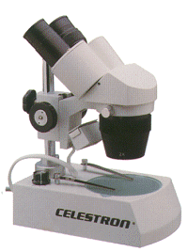
Stereoscopic Microscope
Gives a three dimensional view of an object. (Examples: insects and leaves)
Used for dissections

Slide 28
Fluorescence Microscope
exposes specimen to ultraviolet, violet, or blue light
specimens usually stained with fluorochromes
shows a bright image of the object resulting from the fluorescent light emitted by the specimen
Fluorescence. Shows the locations of specific
` molecules in the cell by tagging the molecules
with fluorescent dyes or antibodies. These
fluorescent substances absorb ultraviolet
radiation and emit visible light.

Slide 29
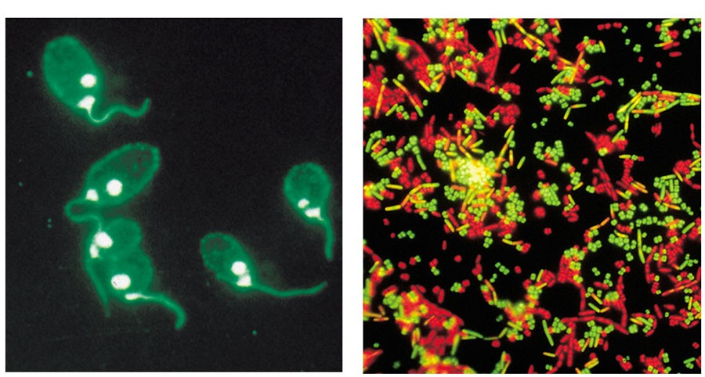
Images seen through Fluorescence Microscope

Slide 30
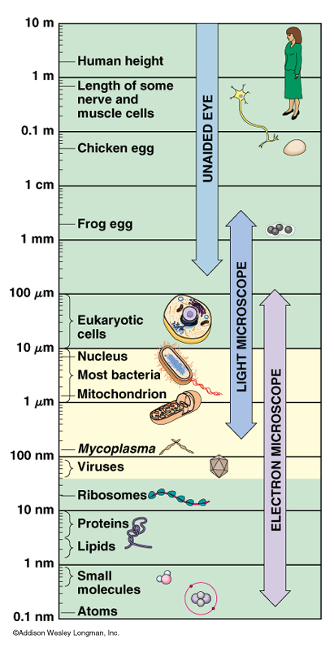
Scale

Slide 31
Electron Microscope
Used to observe VERY small objects: viruses, DNA, parts of cells
Uses beams of electrons rather than light
Much more powerful
wavelength of electron beam is much shorter than light, resulting in much higher resolution

Slide 32
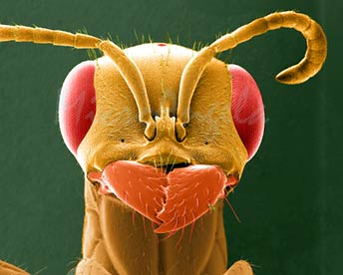
Electron Microscopes
can achieve 3D images using electrons

Slide 33
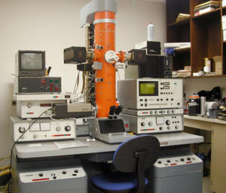
Transmission Electron Microscope (TEM)
magnification of objects in the order of 100, 000’s.
detailed study of the internal ultrastructure of cells

Slide 34
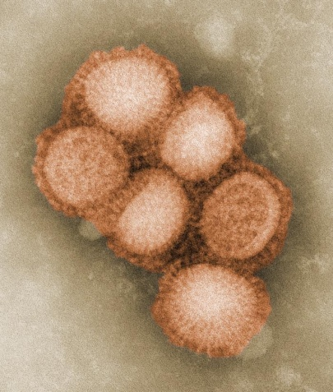
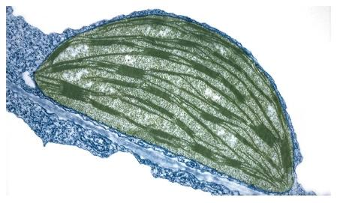
  Transmission electron microscope (TEM)
  a beam of electrons is transmitted through the specimen for a 2D view
  transmitted electrons (those that do not scatter) are used to produce image
  denser regions in specimen, scatter more electrons and appear darker
H1N1 virus
Chloroplast from atobacoo leaf

Slide 35
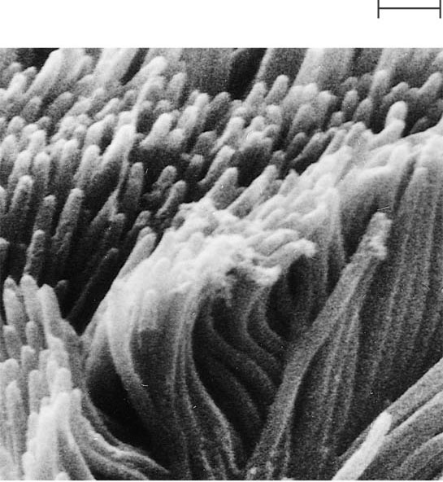
Scanning Electron Microscope(SEM)
  Can magnify up to 100,000x
Provides for detailed study of the surface of a specimen
uses electrons reflected from the surface of a specimen to create image
produces a 3-dimensional image of specimen’s surface features
E
1 µm
Cilia

Slide 36
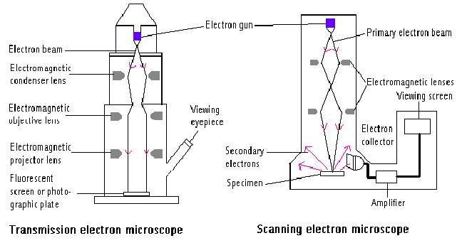
Electron microscopes – use a beam of electrons instead of a beam of light to magnify the image

Slide 37
Newer Techniques in Microscopy
confocal microscopy and scanning probe microscopy
have extremely high resolution
can be used to observe individual atoms

Slide 38
Confocal Scanning Laser Microscope
laser beam used to illuminate spots on specimen
computer compiles images created from each point to generate a 3-dimensional image

Slide 39
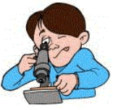
The Light Microscope
Guidelines for Use
  Always carry with 2 hands
  Only use lens paper for cleaning
  Do not force knobs
  Always store covered
Notes:
Teacher demonstrates how to hold the microscope, where the lens paper is located and how to use it. Students will be invited to turn the knobs and observe the stage as it moves up and down. Teacher will demonstrate how to store the microscope.

Slide 40
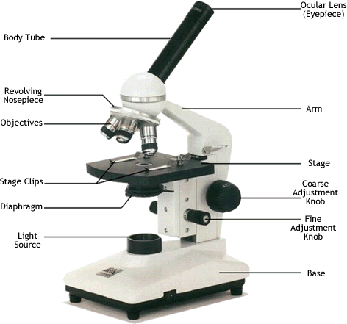
Ocular lens
(Eyepiece)
Body Tube
Nosepiece
Arm
Objectives
Stage
Stage Clips
Coarse Adjustment
Diaphragm
Fine Adjustment
Light
Base
Always carry a microscope with one hand holding the arm and one hand under the base.

Slide 41
Focusing Specimens
1. Always start with the scanning objective.
You will be able to see something on this setting.
Use the Coarse Knob to focus and then the fine adjustment knob until clear,
image may be small at this magnification, but you won't be able to find it on the higher powers without this first step.
Do not use stage clips, try moving the slide around until you find something.

Slide 42
2. Once you've focused on Scanning, switch to Low Power. Use the Coarse Adjustment Knob to refocus. Then use the Fine Adjustment Knob to make the image crystal clear. Again, if you haven't focused on this level, you will not be able to move to the next level.
3. Now switch to High Power. (If you have a thick slide, or a slide without a cover, do NOT use the high power objective). At this point, ONLY use the Fine Adjustment Knob to focus specimens.
Recap
1. Scanning --> use coarse and fine knob
2. Low power --> use coarse and fine knob
3. High power --> use fine knob only
DO NOT SKIP STEPS!!!!

Slide 43

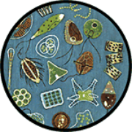
  Your slide MUST be focused on low power before attempting this step
  Click the nosepiece to the longest objective
  Do NOT use the Coarse Focusing Knob, this could crack the slide or the lens
  Use the Fine Focus Knob to bring the slide
Notes:
Emphasize not using the coarse objective during this process, as it will crack the slides.

Slide 44
Quiz Over the Microscope
1. When focusing a specimen, you should always start with the ___________________ objective.
2. When using the high power objective, only the ________ ___________ knob should be used.
3. The type of microscope used in most science classes is the _________________ microscope
4. What part of the microscope can adjust the amount of light that hits the slide? ______________________________

Slide 45
5. You should carry the microscope by the ________ and the __________.
6. The objectives are attached to what part of the microscope (it can be rotated to click the lenses into place):
_______________ ________________
7. A microscope has an ocular objective of 10x and a high power objective of 50x. What is this microscope's total magnification? ____________

Slide 46
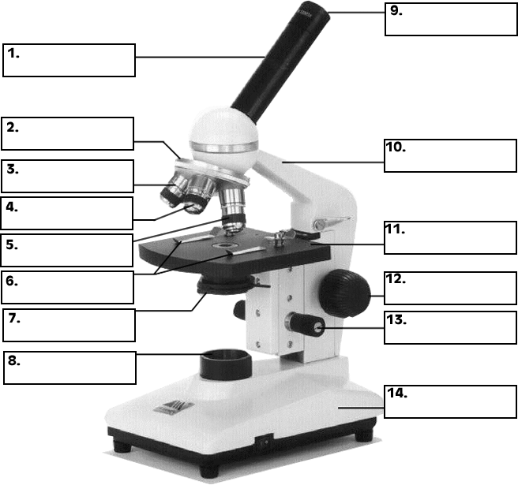
Practice Labeling the Parts

Slide 47
MCQ
When using the high power objective, which knob should be used.
Fine Focus.
Coarse Focus
Iris Diaphram
Mirror

Slide 48
MCQ
What part of the microscope can adjust the amount of light that hits the slide?
Mirror
Diaphram
Objective lens
Condenser

Slide 49
MCQ
The optical part(s) of a light microscope involved in magnification is/are
1.Condenser and filter
2.Eyepiece only
3.Objective only
4.Both objective and eyepiece

Slide 50
STEPS OF TISSUE PROCESSING
FIXATION
DEHYDRATION
CLEARING
EMBEDDING

Slide 51
Preparation and Staining of Specimens
Increases visibility of specimen
Accentuates specific morphological features
Preserves specimens

Slide 52
Purpose of Fixation
Preserve morphology of the tissue
Preserve the chemical composition
Prevent autolysis and putrefaction
Harden the tissue for easy manipulation
Solidify colloidal material
Examples: Formalin, acetic acid, picric acid,gluteraldehyde

Slide 53
Dehyration
Immersing tissue in ascending grades of alcohol.
50%, 70%, 90% and absolute alcohol.
30 – 60 minutes each.
Embed it in paraffin wax.
Wax not miscible in water.

Slide 54
Clearing
Clearing agents are Paraffin solvents
Example: Xylene and toluene
2 – 3 hours
Replaces alcohol from tissue
Makes it clear

Slide 55
Embedding
To obtain thin sections with microtome
Tissue is infiltrated with embedding medium
Gives a rigid consistency to the tissue
Examples: Paraffin wax, celloidin, gelatin, plastic resins(EM)
2 steps: Impregnation and Block making
Melting point of wax – 56*C
Tissue impregnated with molten wax at 58-60*C

Slide 56
Block Making
Tissue placed in “L” moulds
Moulds containing molten paraffin wax
Molten wax cube is allowed to cool
Paraffin block is removed from the mould

Slide 57
Section Cutting (Microtomy)
Rotary Microtome
5 – 7 micronm thin sections are cut
Flattening the sections on warm water
Paraffin sections fixed on albuminised glass slides
Dried in an incubator overnight at 37*C or air dried
Stored for staining at room temperature

Slide 58
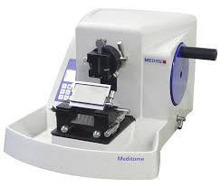
Rotary microtome

Slide 59
Steps of Staining
Deparaffinization
Hydration
Staining
Dehydration
Clearing
Mounting

Slide 60
HISTOLOGICAL STAINING
STAINING- Artificial coloration of a cell component to facilitate examination of tissue under the microscope.
STAIN is the substance used to impart colour to the tissues or the cells to facilitate microscopic study and identification.

Slide 61
Haematoxylin Staining
Hematoxylin : basic dye
Stains the acidic component of the cell (Nucleus)
Stains nucleus blue or black
Used in demonstration of cell nuclei, myelin, elastic fibres, fibrin, and muscle striation.
The oxidative product haematein is the active (staining) component.

Slide 62
Eosin Staining
Eosin: an acidic dye
Stains the basic components of the cytoplasm
Pink
Combination of H & E are commonly used in histological staining procedures.

Slide 63
Tissue Processing
Ready to be viewed under microscope
Minimum 3 days
Now faster techniques are also available

Slide 64
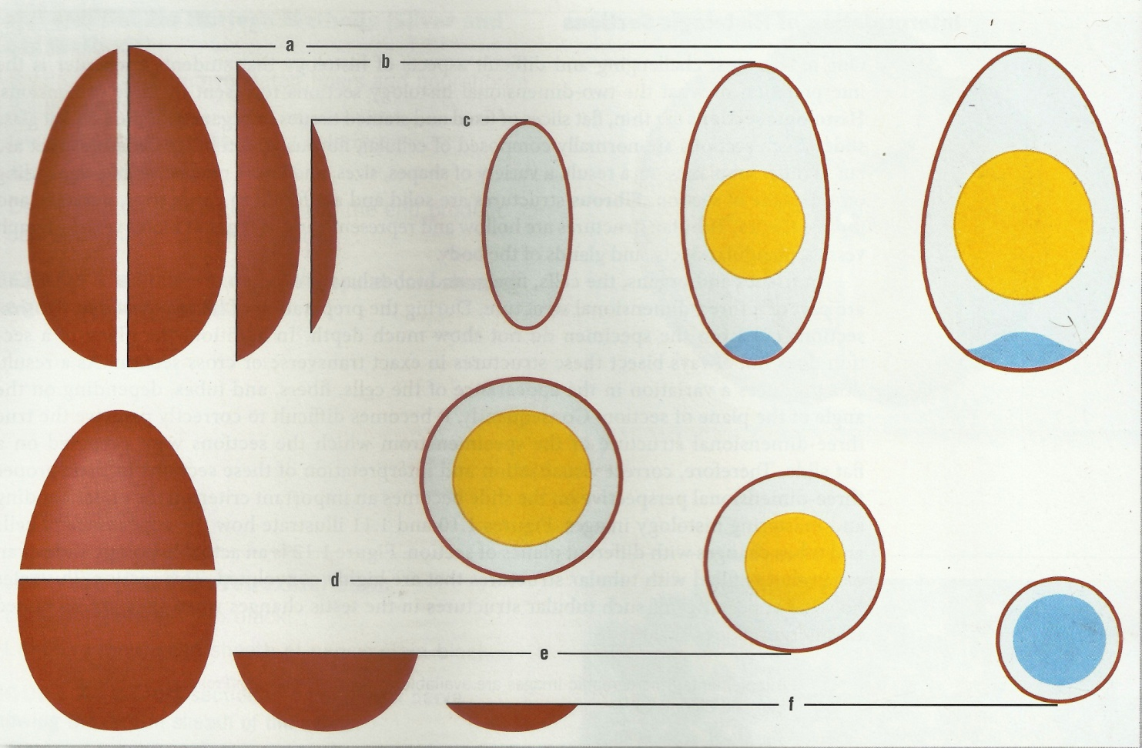
Sections in different Planes

Slide 65
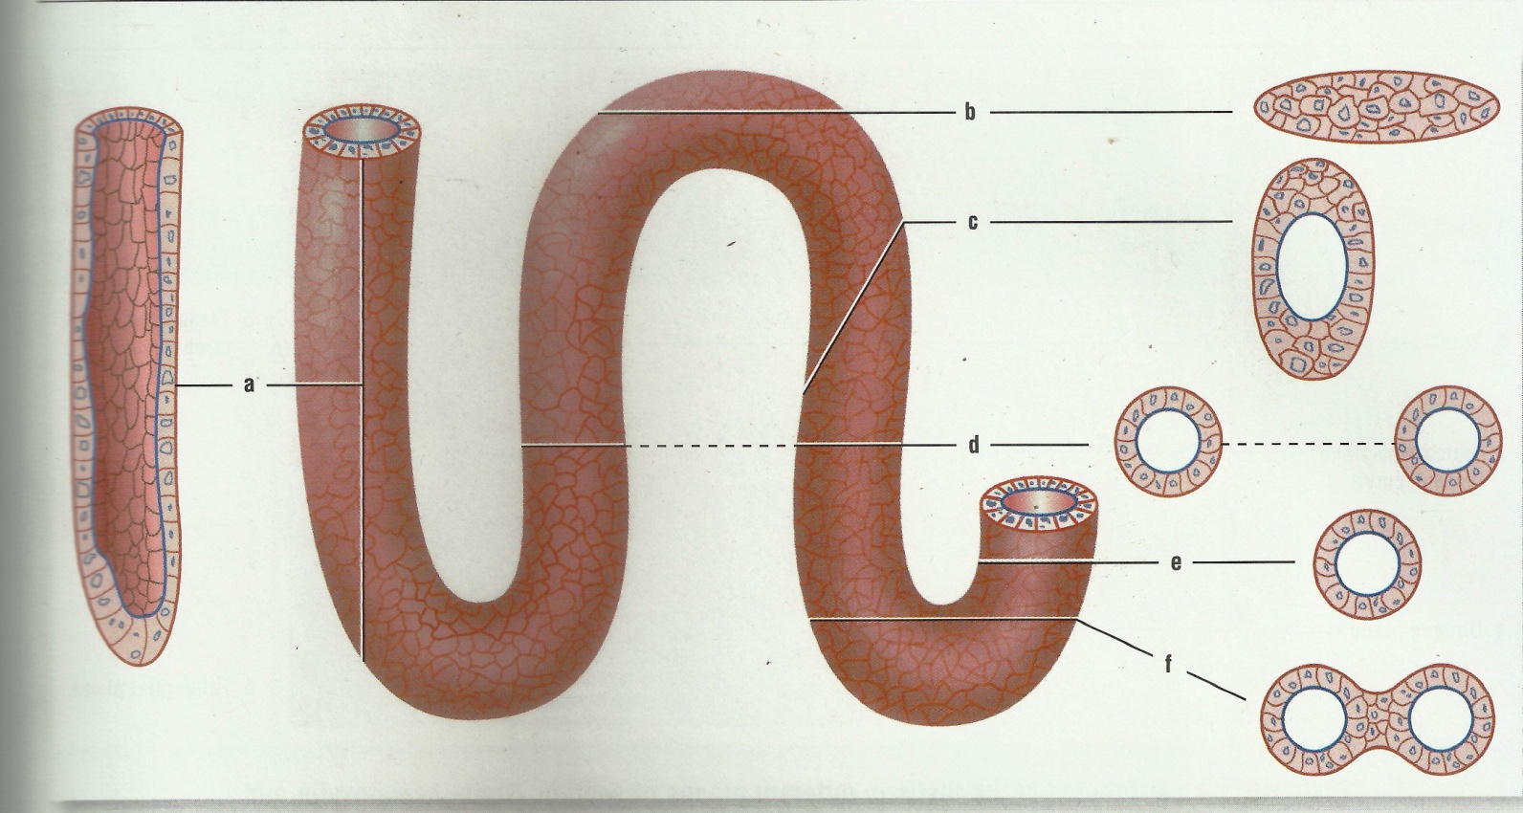
Sections of tubular organs

Slide 66
MCQ
Commonest fixative used is
1. Formalin
2. Picric acid
3. Acetic acid
4. Glutaraldehyde

Slide 67
MCQ
While processing the tissues for paraffin embedding, dehydration is done by immersing the tissue in
1. Alcohol
2. Xylol
3. Alcohol and Xylol
4. Phenol

Slide 68
MCQ
Haematoxylin is a basic dye and it stains
1. the basic components of a cell
2. the acidic components of a cell
3. both basic and acidic components of a cell
4. None of the above

Slide 69
MCQ
The melting point of paraffin wax is
1. 85* C
2. 75* C
3. 65* C
4. 55* C

