Slide 1
Muscle Tissue

Slide 2
What is Muscle Tissue?
Composed of cells that are highly specialized to shorten in length by contractility.
Made up of cells that are called myocytes.
Elongated in one direction (muscle fibres).

Slide 3
Special Terms
Plasma Membrane Sarcolemma
Cytoplasm Sarcoplasm
Smooth Endoplasmic Reticulum Sarcoplasmic
Mitochondria Sarcosomes

Slide 4
Types of Muscles
Smooth Muscle
Skeletal Muscle
Cardiac Muscle

Slide 5
Skeletal Muscle
Striated or voluntary muscle
Present mainly in limbs and in relation to body wall.
Elongated, Cylindrical, multinucleated cells
Varies in length from a few mm to few cm.
Alternate dark & light bands (cross-striations).
Mostly originate from somatic mesoderm
Basic unit is long, cylindrical fiber

Slide 6
General Architecture
Skeletal Muscle fibres are supported by Connective Tissue framework, well appreciated in cross section of a muscle
Epimysium Entire Muscle
Permysium Bundles of Muscle fibres
Endomysium- Individual muscle fibre

Slide 7
Skeletal Muscle
Fibres are arranged parallel to each other.
Formed by fusion of multiple myoblasts during embryonic life.
Myofibrils: contractile elements
Sarcomere: fundamental contractile unit
Myofilaments: contain thick (myosin) and thin (actin) filaments

Slide 8
Skeletal Muscle
Nerve supply:
Motor fibres
Sensory fibres

Slide 9
Skeletal Muscle

Slide 10
Skeletal Muscle

Slide 11
Skeletal Muscle

Slide 12
Skeletal Muscle

Slide 13
Cardiac Muscle
Striated and involuntary
Present exclusively in heart
Originates in splanchnopleuric mesoderm
Supplied by ANS (sympathetic & parasympathetic)

Slide 14
Microscopic structure of Cardiac Muscle
Consists of long and thick branching muscle fibres
Intercalated discs- specialized cell junctions
These junctions are gap junctions & Desmosomes
Acts as a FUNCTIONAL SYNCYTIUM
Centrally placed single oval nucleus
Faint transverse lines
Supplied by ANS (sympathetic & parasympathetic)

Slide 15
Cardiac Muscle

Slide 16
Cardiac Muscle

Slide 17
Cardiac Muscle

Slide 18
Cardiac Muscle

Slide 19
Cardiac Muscle

Slide 20
Smooth Muscle
Spindle elongated cells
30 micron in length
200-500 micron length in pregnancy
Non-striated, involuntary
Supplied by Autonomic Nervous System

Slide 21
Smooth Muscles
Adjacent smooth muscle cells are in contact with each other through gap junctions which help to transmit the electric impulses from one cell to another.
Spindle shaped cells
Centrally placed oval nucleus

Slide 23
Smooth Muscle

Slide 24
Smooth Muscle

Slide 25
Smooth Muscle

Slide 26
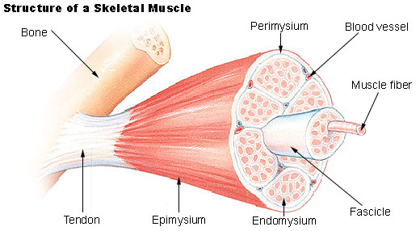
Connective tissue frame work

Slide 27
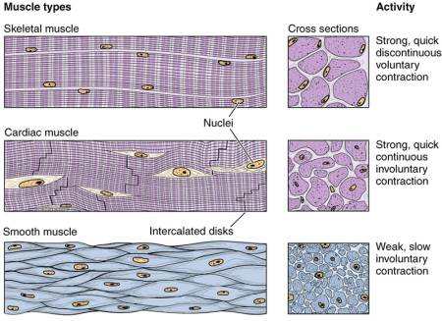
Muscle Tissue

Slide 29
Muscle
Mesodermal in origin
Composed predominantly of Specialized cells which shorten in length by contraction and this is how they bring about Movement

Slide 30
Muscle
Muscle fibres are elongated cells which contain contractile proteins, mainly Actin and Myosin.
Interaction between these proteins bring about contraction.

Slide 31
Other Contractile Cells
Myoepithelial cells
Myofibroblasts

Slide 32
