Slide 1
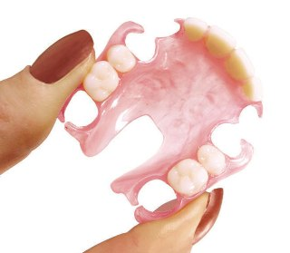
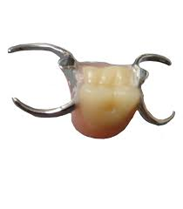
OTHER FORMS OF REMOVABLE PARTIAL DENTURE
Dr Niraj mishra
Prosthodontics

Slide 2
CONTENTS
GUIDE-PLANE RPD
SWING-LOCK RPD
REMOVABLE PARTIAL OVERDENTURE
IMPLANT SUPPORTED RPD
UNILATERAL RPD
Cu-Sil PARTIAL DENTURE
FLEXIBLE PARTIAL DENTURE
FIXED-REMOVABLE PARTIAL DENTURE
Dr Niraj mishra

Slide 3
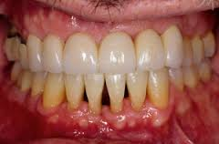
GUIDE PLANE RPD
Carefully planned and constructed partial dentures with guiding planes appear to be effective in stabilizing weakened teeth.

Slide 4
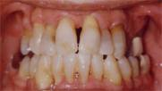
Considerations for periodontally involved teeth
How teeth can be protected from further insult by continuous movement.
how the gingival and interproximal tissues can be protected
how forces of occlusion can be directed favourably to prevent unnecessary trauma to supporting structures.

Slide 5
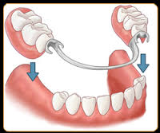
Use of guiding planes
Broad distribution of stress through use of
rigid major and minor connectors
multiple rests and clasps is of primary importance.
periodontally weakened teeth must be supported rigidly not only when the prosthesis is in place but, also, while it is being placed and removed.

Slide 6
The framework should be completely passive when it is in place in the mouth.
This is accomplished by creating areas of parallelism on the surfaces of the teeth called guiding planes.
These planes guide the framework into place without creating lateral pressures.

Slide 7
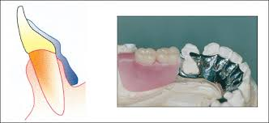
Bracing periodontally weakened teeth
Bracing periodontally weakened teeth against lateral forces is accomplished by using properly designed, properly, constructed and correctly seated lingual plates.

Slide 8
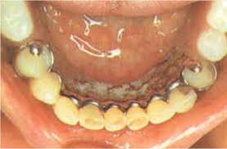
The role of the lingual plate is twofold:
It contributes to horizontal stability for removable
partial dentures.
It helps to prevent the application of excessive forces
on the teeth in a buccolingual or lateral direction.

Slide 9
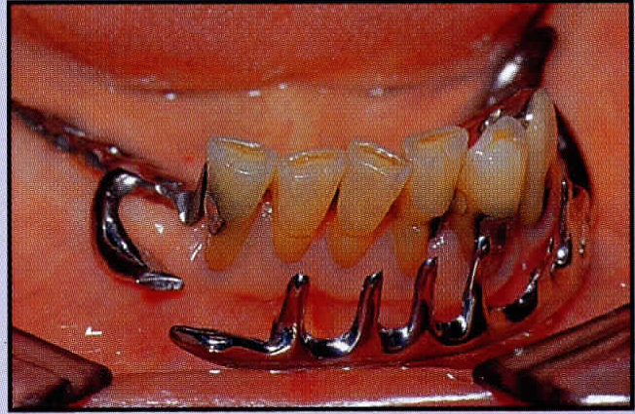
SWING-LOCK REMOVABLE PARTIAL DENTURE
The SLRPD design consists of a labial/buccal retaining bar, hinged at one end and locked with a latch at the other, together with a reciprocating lingual plate to gain a maximum retention and stability.
The bar incorporate rigid struts or an acrylic veneer which make prosthesis immobile.

Slide 10
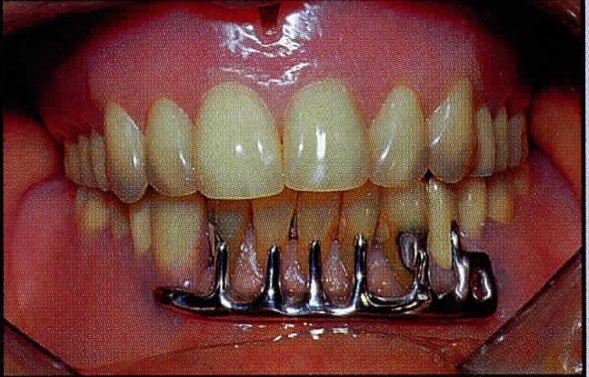
INDICATIONS
Missing key abutment
Reduced bone support

Slide 11
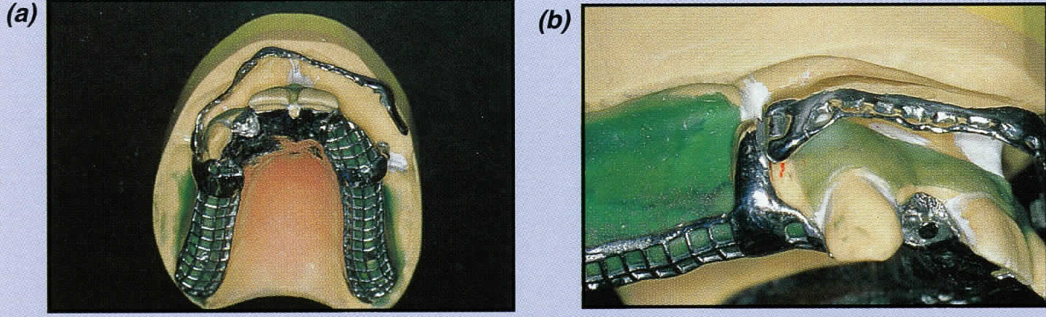
Unfavourable tooth contour
Unilateral abutments

Slide 12
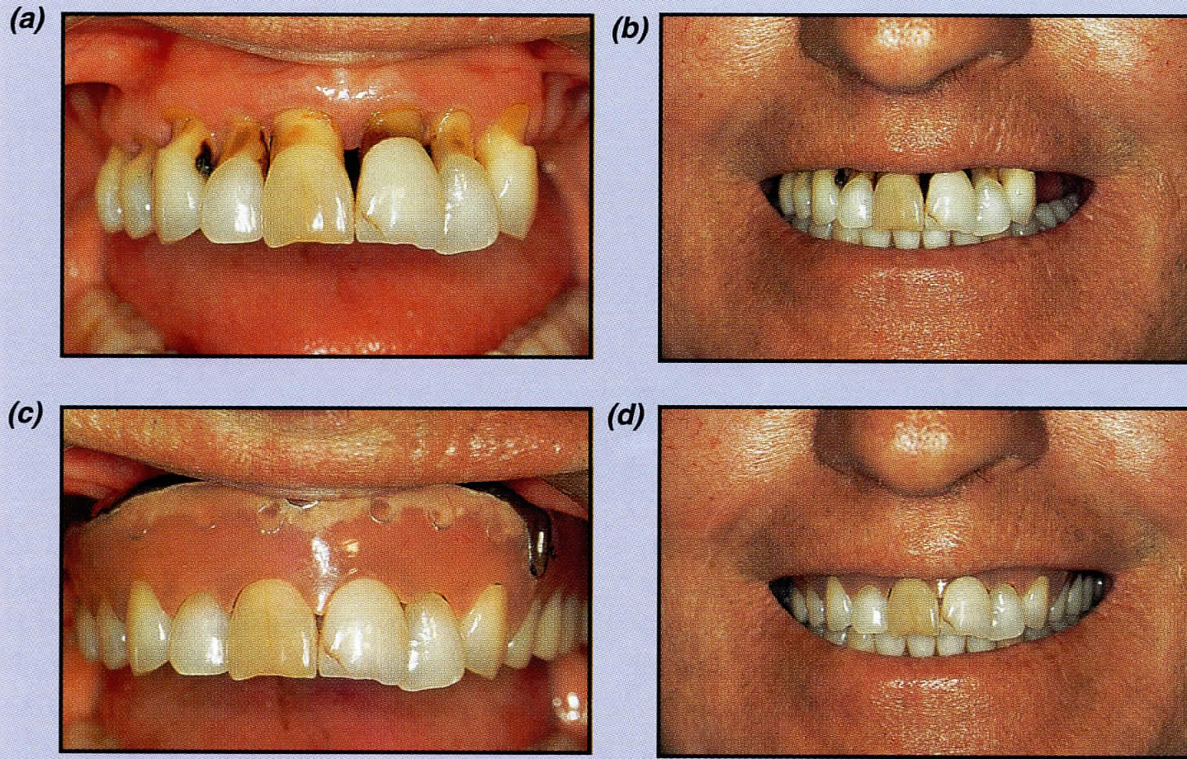
Gingival recession

Slide 13
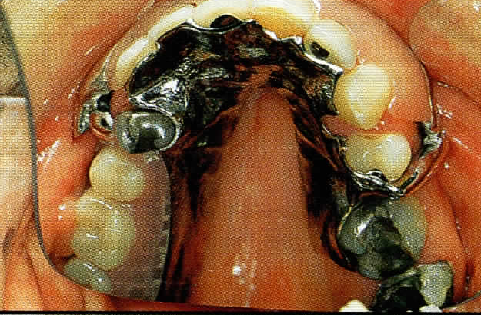
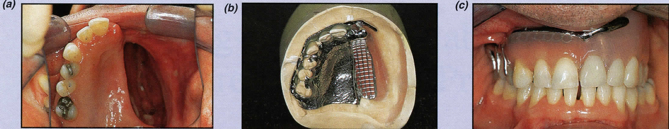
The retching patient
Maxillofacial defects

Slide 14
CONTRINDICATIONS
Poor oral hygiene
High smile line
Soft-tissue limitations
Certain malocclusion
Alveolar limitations

Slide 15
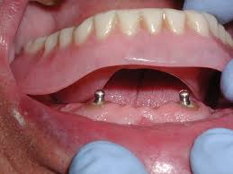
REMOVABLE PARTIAL OVERDENTURE
OVERDENTURE-
any removable dental prosthesis that covers and rests on one or more remaining natural teeth, the roots of natural teeth, and/or dental implants.
= overlay denture,
= overlay prosthesis,
= superimposed prosthesis

Slide 16
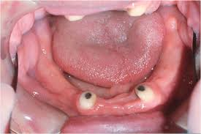
The endodontically treated abutment is prepared by removing the clinical crown few millimeters above the free gingival margin to create a dome-shaped preparation with a lightly chamfered margin extending slightly subgingivally.

Slide 17
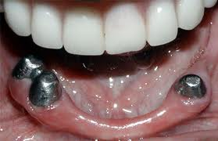
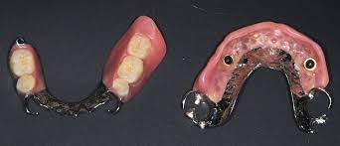
Metal coping is made and cemented over the abutments.
The removable partial overdenture is then completed in the usual manner.

Slide 18
Advantages-
(1) An alternative treatment plan
(2) The tooth and its alveolar bone would be preserved
(3) The crown-root ratio would be greatly improved
(4) Improvement in tooth mobility might be achieved;
(5) Support and stability improved
(6) Abuse to the soft tissues and residual ridges by
functional forces might be reduced

Slide 19
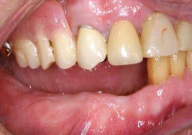
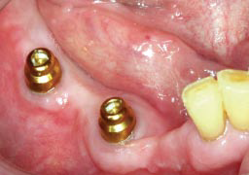
IMPLANT SUPPORTED RPD
Lack of adequate support (tooth/soft tissue) results in displacement of bilateral and unilateral distal extension removable partial dentures.
Placement of implants is one option for managing this problem
Distal implants effectively convert a Kennedy Class I or II denture to a Kennedy Class III denture.

Slide 20
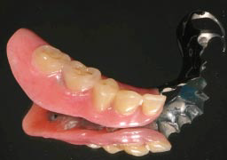
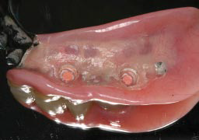
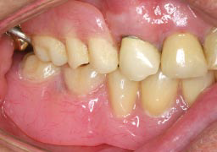
A tooth and implant-supported RPD is cheaper (because fewer implants are needed) and more stable, and may therefore be a better option for patients with limited financial resources than an implant-supported fixed partial denture.

Slide 21
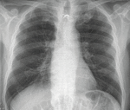
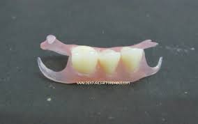
UNILATERAL PARTIAL DENTURES

Slide 22
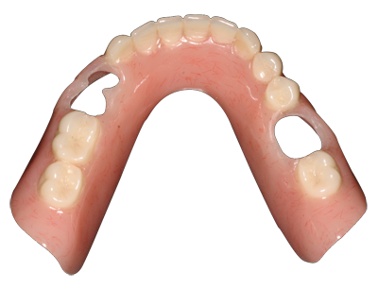
Cu-Sil® Partial Overdentures
Cu-Sil is a tissue-bearing appliance featuring a soft elastomeric gasket
It clasps the neck of each natural tooth, sealing out food and fluids, cushioning and splinting each natural tooth from the hard denture base.
It helps prevent tooth loss and improves the prognosis of loose, mobile, isolated, elongated or periodontally involved abutments by eliminating wear, stress and torque.

Slide 23
      Flexible (Polystyrene/Valplast)
Biocompatible nylon and thermoplastic
resin-flexibility and stability.
Color, shape and design of valplast partials blend with natural appearance of gingiva making prostheses nearly invisible.
Strenght of valplast resin doesn’t require a metal framework-eliminates metallic taste.
Enables partial to be fabricated thin enough with non metallic clasps.

Slide 24
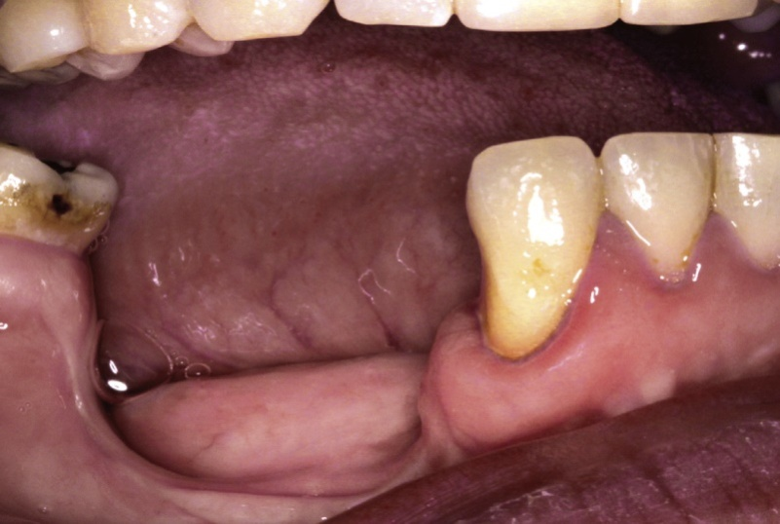
FIXED-REMOVABLE PARTIAL DENTURE
The replacement of missing teeth and restoration of alveolar contour.
Situations of trauma and cleft lip and palate, and after the surgical excision of pathoses.
Reduction of the surrounding volume of hard and soft tissues is even more pronounced

Slide 25
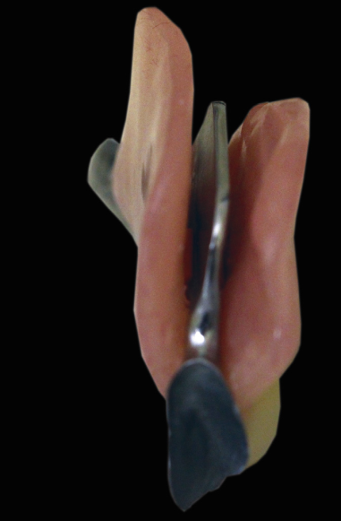

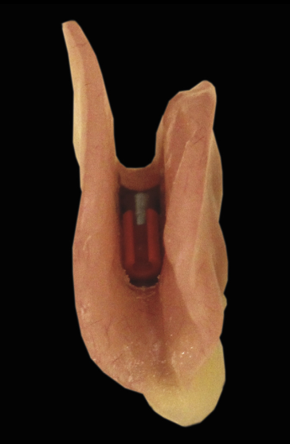
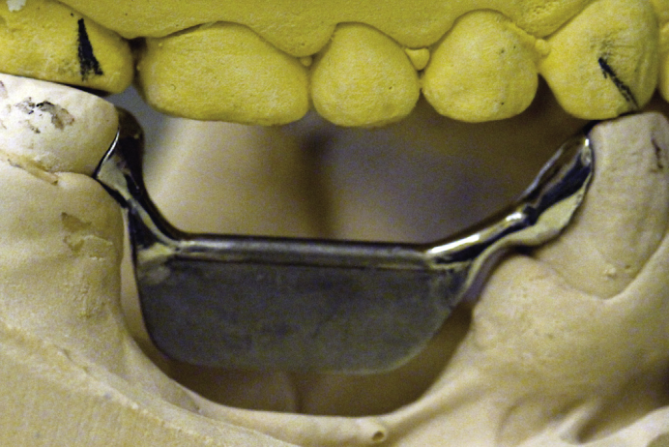
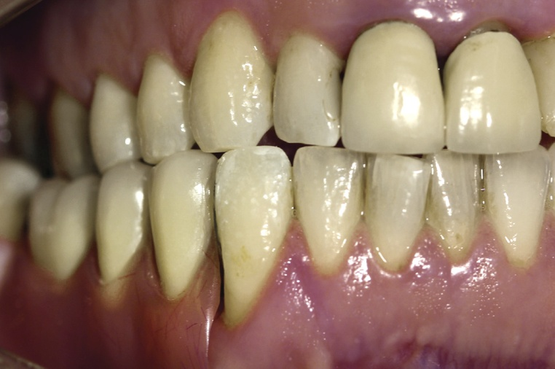
The Andrews fixed dental prosthesis was first introduced in 1976 by James Andrews,
Consisted of a bar soldered to retainers at each end onto which a denture is clipped.

Slide 26
INDICATIONS
Extensive alveolar bone loss,
Median diastema, and
Unfavorable skeletal relationships

Slide 27


