Slide 1
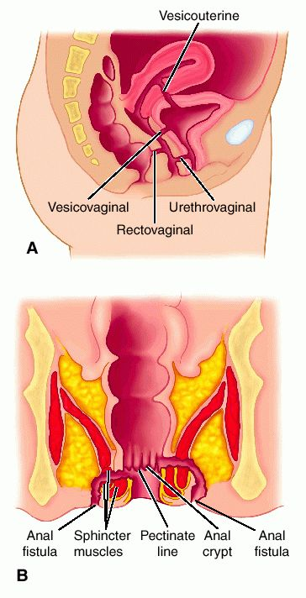
Genital Fistulae
Dr. Sujata Deo
Professor
Deptt of OB/GYN

Slide 2
Vesicovaginal Fistula

Slide 4
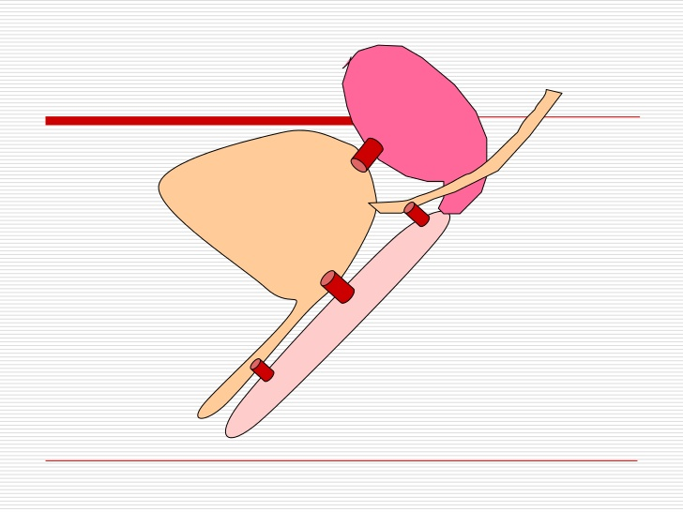

Slide 7
Causes
Obstetrical
Gynaecological
1.Obstetrical causes – Ishemic: Due to prolonged compression effect on the bladder base between the head and pubic symphysis
eg : obstructed labour
Traumatic :
Instrumental vaginal delivery – in destructive operation, forcep delivery
Abdominal operation – Hysterectomy for rupture uterus ,LSCS

Slide 8
Gynaecological causes
Operative Injury – Ant. Colporraphy , Abdominal hysterectomy
Traumatic - ant. Vaginal wall & bladder may be injured following fall on a pointed objects, by a stick used for criminal abortion
Malignancy – by direct spread in cases of Advanced ca of cervix, vagina or bladder
Radiation - Due to radiation effect ishemic necrosis may occur

Slide 9
Types
Simple - Healthy tissues with good acces
Complicated – Tissue loss,scarring, difficult access associated with RVF
Depanding upon SITE of the Fistula –
Juxtracervical :( close to cx) –communication between supratrigonal region of bladder and vagina
Midvaginal : communication between base(Trigone) of bladder and vagina
Juxtraurethral: communication between neck of bladder and vagina

Slide 15
Management
Prophylaxis
Immediate management– once the diagnosis is made ,continous catherization for 6-8 is maintained.
Operative – surgery is choice - preoperative assessment preoperative preperations

Slide 17
Definitive Surgery
Ideal time for surgery is after 3 months following delivery
Surgical Fistula–
If recogniged <24 hrs: immediate repair
If recogniged >24 hrs : repair after 3 months
Radiation Fistula : repair after 12 months

Slide 21
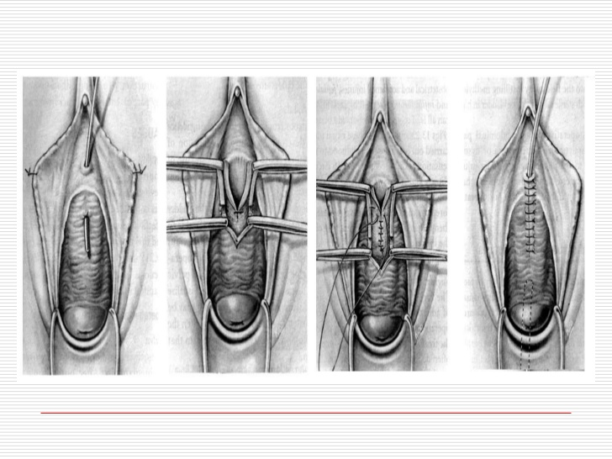

Slide 25
Rectovaginal Fistula

Slide 26
Definition
Abnormal communication between the rectum andvagina with involuntry escape of flatus and or feces into vagina is called RVF

Slide 27
Causes
1-Acquired
2- Congenital
Acquired –
Obstatrical causes –
Incomplete healing or unrepaired recent complete perineal tear is commonest
Obstructed labour- During obstructed labour the compression effect produces necrosis →infection→ sloughing→ fistule

Slide 28
Instrumental injury inflicted during destructive operation
Gynaecological –
Following incomplete healing of repaired CPT
Trauma during operative procedure
Malignancy of vagina, cervix or bowel
Radiation
Fall on sharp object

Slide 29
Congenital –
Anal canal may open into vestibule or in vagina

Slide 30
Diagnosis
Involuntry escape of flatus & or feces into vagina
Rectovaginal examination – size &shape of fistula
Confirmation done by probe passing through vagina into rectum

Slide 31
Investigation
Barium enema
Barium meal &follow trough to confirm intestinal fistula
Sigmoidoscopy & proctoscopy

Slide 32
Treatment
Preventive
Good intranatal care
Identification of CPT & repair it
Care during gynaecological surgeries
Surgery
Situated in low down- make CPT &repair
Situated in middle third –repair by flap method
Situated high up-
Prelimenary colostomy→local repair after 3 wks→closure of colostomy after 3 wks

Slide 33
MCQ
Most common cause of VVF in india is:
Obstructed labour
Gynae surgery
Radiation
Trauma

Slide 34
2.Postpartum VVF is best repaired after:
6 weeks
8 weeks
3 months
6 months
3. Mrs A, 48yrs had hysterectomy. On seventh day,she devoloped fever,burning micturation& continous dribbling of urine. She can also pass urine voluntarily. The diagnosis is
V V F
Uretrovaginal fistula
Stress incontinence
Urge incontinance

Slide 35
4.Most useful preoperative investigation for VVF is:
Three swab test
Cystoscopy
IVP
Urine culture
5. If RVF is present in high up(upper part ) preliminary treatment should be:
Colostomy
Colporraphy
Primary repair
Anterior resection

