Slide 1
HYPERKALEMIA
DR. K. K. GUPTA _{MD}
ASSOCIATE PROF.
DEPARTMENT OF MEDICINE, KGMU

Slide 2
Hyperkalemia MCQs
1.Hyperkalemia can occur in all except---
a) Insulin Deficiency
b) Metabolic Acidosis
c) Acute Renal Failure
d) Cushing’s Syndrome

Slide 3
2.True about Hyperkalemia---
a) ECG changes correlates with S.potassium
b) ECG is diagnostic
c) Stops heart in systole
d) Insulin –Glucose is given

Slide 4
3.All of following are used for treatment of hyperkalemia except---
a)Calcium gluconate
b)Sodium bicarbonate
c) Beta blockers
d)i.v. infusion of glucose with insulin

Slide 5
4.Which secretion contributes to the maximum ammount of K⁺ ---
Gastric
Pancreatic
Salivary
Biliary

Slide 6
5. All are TRUE about hyperkalemia except—
a) Prolonged PR interval
b) Prolonged QRS interval
c) Sine wave pattern
d) Prolonged QT interval

Slide 7
DEFINITION :
Hyperkalemia is defined as a plasma potassium level of 5.5 mM.
It occurs in up to 10% of hospitalized patients;
severe hyperkalemia(>6.0 mM) occurs in approximately 1%, with a significantly increased risk of mortality

Slide 8
factitious hyperkalemia or pseudohyperkalemia:
an artifactual increase in serum K+ due to the release of K+ during or after venipuncture.
Pseudohyperkalemia can occur in the setting of excessive muscle activity during venipuncture (fist clenching, etc.),

Slide 9
Causes of Hyperkalemia
“Pseudo” hyperkalemia:
A. Cellular efflux: thrombocytosis, erythrocytosis, leukocytosis, in vitro hemolysis
B. Hereditary defects in red cell membrane transport

Slide 10
II. Intra- to extracellular shift
A. Acidosis
B. Hyperosmolality; radiocontrast, hypertonic dextrose, mannitol
C. β-adrenergic antagonists (noncardioselective agents)
D. Digoxin and related glycosides (yellow oleander, foxglove, bufadienolide)
E. Hyperkalemic periodic paralysis
F. Lysine, arginine, and ε-aminocaproic acid (structurally similar, positively charged)
G. Succinylcholine; thermal trauma, neuromuscular injury, disuse atrophy, mucositis, or prolonged immobilization
H. Rapid tumor lysis

Slide 11
III. Inadequate excretion
A. Inhibition of the renin-angiotensin-aldosterone axis; ↑ risk of hyperkalemia when used in combination 1. Angiotensin-converting enzyme (ACE) inhibitors 2. Renin inhibitors: aliskiren [in combination with ACE-inhibitors or angiotensin receptor blockers (ARBs)] 3. ARBs 4. Blockade of the mineralocorticoid receptor: spironolactone, eplerenone, drospirenone 5. Blockade of ENaC: amiloride, triamterene, trimethoprim, pentamidine, nafamostat
B. Decreased distal delivery 1. Congestive heart failure 2. Volume depletion

Slide 12
C. Hyporeninemic hypoaldosteronism 1. Tubulointerstitial diseases: systemic lupus erythematosus (SLE), sickle cell anemia, obstructive uropathy 2. Diabetes, diabetic nephropathy 3. Drugs: nonsteroidal anti-inflammatory drugs, cyclooxygenase 2 (COX-2) inhibitors, beta blockers, cyclosporine, tacrolimus 4. Chronic kidney disease, advanced age 5. Pseudohypoaldosteronism type II: defects in WNK1 or WNK4 kinases
D. Renal resistance to mineralocorticoid 1. Tubulointerstitial diseases: SLE, amyloidosis, sickle cell anemia, obstructive uropathy, post-acute tubular necrosis 2. Hereditary: pseudohypoaldosteronism type I: defects in the mineralocorticoid receptor or ENaC

Slide 13
E. Advanced renal insufficiency 1. Chronic kidney disease 2. End-stage renal disease 3. Acute oliguric kidney injury
F. Primary adrenal insufficiency 1. Autoimmune: Addison’s disease, polyglandular endocrinopathy 2. Infectious: HIV, cytomegalovirus, tuberculosis, disseminated fungal infection 3. Infiltrative: amyloidosis, malignancy, metastatic cancer 4. Drug-associated: heparin, low-molecular-weight heparin 5. Hereditary: adrenal hypoplasia congenita, congenital lipoid adrenal hyperplasia, aldosterone synthase deficiency 6. Adrenal hemorrhage or infarction, including in antiphospholipid syndrome

Slide 14
Clinical features
Cardiac arrhythmias associated with hyperkalemia include sinus bradycardia, sinus arrest, slow idioventricular rhythms, ventricular tachycardia, ventricular fibrillation, and asystole.
Other effects of hyperkalemia include weakness, neuromuscular paralysis (without central nervous system disturbances)
And suppression of renal ammonia genesis, which may result in metabolic acidosis.
Mild increases in extracellular K+ resulting in changes in T-wave morpho logy; further increase in plasma K+ concentration depresses intracardiac conduction, with progressive prolongation of the PR and QRS intervals.
Severe hyperkalemia results in loss of the P wave and a progressive widening of the QRS complex.

Slide 15
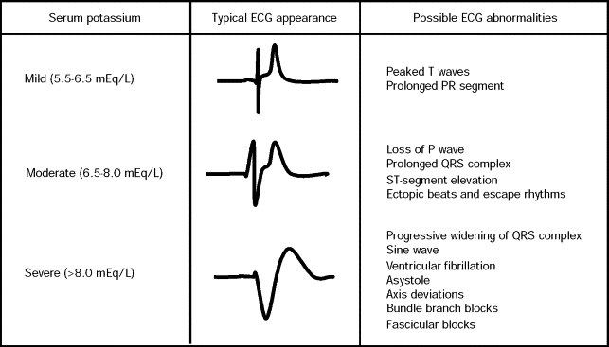
electrocardiographic manifestations in hyperkalemia

Slide 16
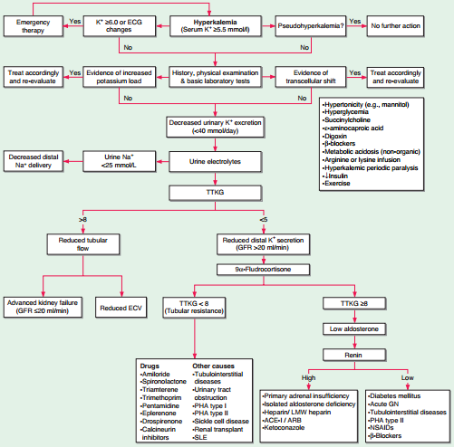
DIAGNOSTIC APPROACH

Slide 17
Treatment of Hyperkalemia
1. Immediate antagonism of the cardiac effects of hyperkalemia: Use of 10 ml of 10% calcium gluconate(3-4 ml of calcium chloride) infused intravenously over 2 to 3 min. The effect of the infusion starts in 1-3min and lasts 30-60 minutes.

Slide 18
Reduction of plasma K⁺ by redistribution into the cells:
1. The recommended drug is 10 units of IV regular Insulin followed immediately by 50 ml of 50% dextrose. The effect begins in 10-20 minutes, peaks at 30-60 minutes and lasts 4-6 hours.
As hypoglycemia is common with insulin and glucose this should be followed by 10% of dextrose at 50-75 ml/hour.

Slide 19
2. Beta 2 agonists most commonly albuterol are also effective agents in the treatment of hyperkalemia.
However ~20% of patients with end stage renal disease are resistant to the effects of beta 2 agonists.
The recommended dose of nebulized albuterol is 10-20 mg in 4 ml of normal saline inhaled over 10 minutes.

Slide 20
The effect of beta 2 agonists starts at about 30 minutes reaches its peak at about 90 minutes and lasts 2-6 hours.
3. Intravenous bicarbonate has no role in the routine treatment of hyperkalemia. It should be reserved for patients with hyperkalemia and metabolic acidosis. It should be infused in an isotonic or hypotonic fluid.

Slide 21
4. Removal of potassium: Accomplished by the use of cation exchange resins, diuretics or dialysis.
Sodium polystyrene sulfonate exchanges Na⁺ for K⁺ in the gastrointestinal tract and increases the fecal excretion of K^{+.} The dose of SPS is 15-30 gram. The full effect may take up to 24 hours and usually requires repeated doses every 4-6 years. Intestinal necrosis is the most serious complication of SPS.

Slide 22
Loop and Thiazide diuretics can be utilized to reduce plasma K⁺.
Hemodialysis is the most effective and reliable method to reduce K⁺ concentration.
Peritoneal dialysis is considerably less effective.

Slide 23
THANKING YOU

