Slide 1
Formative Assessment
Dr. Pratibha Gupta
Associate professor
Deptt. of Community Medicine
ELMC & H, Lucknow

Slide 2
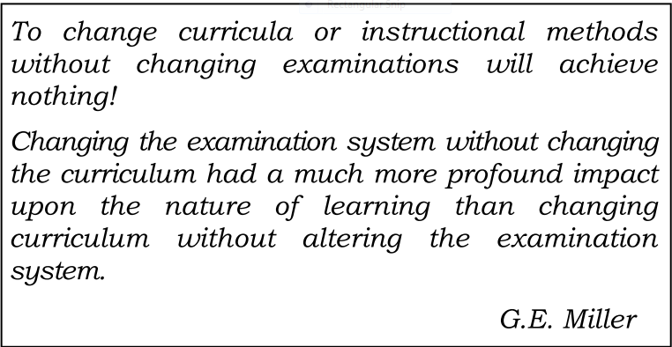

Slide 3
What is Assessment ?

Slide 4
Assessment in education is the process of gathering, interpreting, recording, and using information about pupils’ responses to an educational task. (Harlen, Gipps, Broadfoot, Nuttal,1992).
Assessment is the process of gathering data. More specifically, assessment is the ways instructors gather data about their teaching and their students’ learning (Hanna & Dettmer, 2004).

Slide 5
Purpose of Assessment

Slide 6
Certification
Ranking ( For Selection/ Grading)
Feedback to the teachers
Feedback to the students

Slide 7
Types of Assessment:

Slide 8
Three types of assessment
Diagnostic,
Formative, and
Summative.
Notes:
Although three are generally referred to simply as assessment, there are distinct differences between the three.

Slide 9
Diagnostic Assessment
To identify students’ current knowledge of a subject, their skill sets and capabilities, and to clarify misconceptions before teaching takes place.
Types of Diagnostic Assessments:
Pre-tests (on content and abilities)
Self-assessments (identifying skills and competencies)
Discussion board responses (on content-specific prompts)
Interviews (brief, private, 10-minute interview of each student)

Slide 10
Formative Assessment
Provides feedback and information during the instructional process, while learning is taking place.
Measures student progress but it can also assess your own progress as an instructor.

Slide 11
Contd..
The goal of formative assessment is to monitor student learning to provide ongoing feedback
More specifically, formative assessments:
help students to identify their strengths and weaknesses and target areas that need work
help faculty to recognize where students are struggling and address problems immediately
Notes:
that can be used by instructors to improve their teaching and by students to improve their learning

Slide 12
Contd..
It is good practice to incorporate this type of assessment to “test” students’ knowledge before expecting all of them to do well on an examination.

Slide 13
Purposes of Formative assessment:
to provide feedback for teachers to modify subsequent learning activities and experiences;
to identify and remediate group or individual deficiencies;
"frequent, ongoing assessment allows both for fine-tuning of instruction and student focus on progress."

Slide 14
Feedback
Feedback is the central function of formative assessment.
Seven principles of good feedback practice:
It clarifies what good performance is (goals, criteria, expected standards);
It facilitates the development of self-assessment in learning;
It provides high quality information to students about their learning;
Notes:
It typically involves a focus on the detailed content of what is being learnt, rather than simply a test score or other measurement of how far a student is falling short of the expected standard.

Slide 15
Contd..
It encourages teacher and peer dialogue around learning;
It encourages positive motivational beliefs and self-esteem;
It provides opportunities to close the gap between current and desired performance;
It provides information to teachers that can be used to help shape teaching.

Slide 16
10 Principles for Formative Assessment
Assessment for learning should:
be part of effective planning of teaching and learning
focus on how students learning attitude
be recognised as central to classroom practice
be regarded as a key professional skill for teachers
be sensitive and constructive because any assessment has an emotional impact

Slide 17
Contd…
take account of the importance of learner motivation
promote commitment to learning goals and a shared understanding of the criteria by which they are assessed
enable learners to receive constructive guidance about how to improve
develop learners’ capacity for self-assessment
recognise the full range of achievements of all learners

Slide 18
Benefits of Formative Assessments for Teachers (Boston, 2002)
Teachers are able to determine what standards students already know and to what degree.
Teachers can decide what minor modifications or major changes in instruction they need.
Teachers can create appropriate lessons and activities for groups of learners or individual students.
Teachers can inform students about their current progress in order to help them for improvement.

Slide 19
Benefits for students
Students are more motivated to learn.
Students take responsibility for their own learning.
Students can become users of assessment alongside the teacher.
Students learn valuable lifelong skills such as self-evaluation, self-assessment, and goal setting.

Slide 20
Types of Formative Assessment
Observations during in-class activities
Homework exercises as review for exams and class discussions
Question and answer sessions, both formal—planned and informal—spontaneous

Slide 21
Contd…
In-class activities where students informally present their results
Student feedback collected by periodically answering specific question about the instruction
draw a concept map in class to represent their understanding of a topic
submit one or two sentences identifying the main point of a lecture

Slide 22
SUMMATIVE ASSESSMENT
Takes place after the learning has been completed
Provides information and feedback that sums up the teaching and learning process
Product-oriented and assesses the final product
Notes:
Typically, no more formal learning is taking place at this stage, other than incidental learning which might take place through the completion of projects and assignments

Slide 23
Type of Questions for Formative & Summative assessment
Type of Questions for Formative & Summative assessment
Matching Type
Multiple Choice Type
Alternative Response Type
Right/Wrong
Question Form
Incomplete Statement
True/False
Yes/ No
Matrix
Fill in the blank
Key/Check List
Single
Double

Slide 24
Types of Summative Assessment
Examinations (major, high-stakes exams)
Final examination (a truly summative assessment)
Term papers (drafts submitted throughout the semester would be a formative assessment)
Projects (project phases submitted at various completion points could be formatively assessed)

Slide 25
Summary
Assessment measures if and how students are learning
It may be more beneficial to begin planning assessment strategies at the beginning of the semester and implement them throughout the entire instructional experience
The selection of appropriate assessments should also match course and program objectives necessary for accreditation requirements

Slide 26
Thank You!

