Slide 1
Blueprinting for assessment
Uma Gupta

Slide 2
Blueprinting refers to the process where test content is carefully planned against the learning objectives.

Slide 3
The examination blueprint specifies the objectives that are to be tested in the given examination as well as their relative weight on the examination.

Slide 4
A proper blueprint - first crucial step in developing a valid examination and must not be overlooked.
It will ensure fair representation of all the important curricular objectives in the examination.

Slide 5
simplified step-by-step approach to developing a test blueprint in an integrated curriculum
1. Create a table with major systems (cardiovascular, respiratory, etc.)
on the top row and physician tasks (history taking, data interpretation,
management, etc.) on the left-most column
2. Determine the major disease or presenting problem of interest for
each system
3. Determine the weight to be assigned to each problem
4. Map the physician's task against the disease or presenting problem
5. Make sure that there is a cross-mark for each column and each row

Slide 6
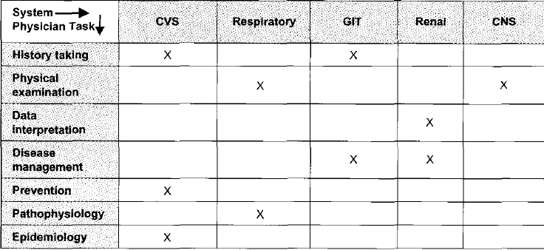
A simplified approach to examination blueprint development in an integrated curriculum.

Slide 7
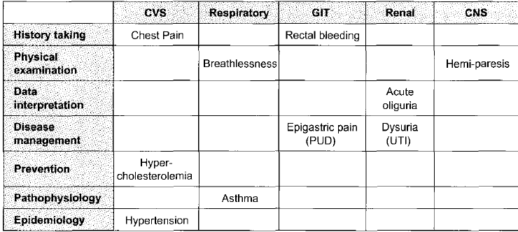
A simplified approach to examination blueprint development in an integrated curriculum.

Slide 8
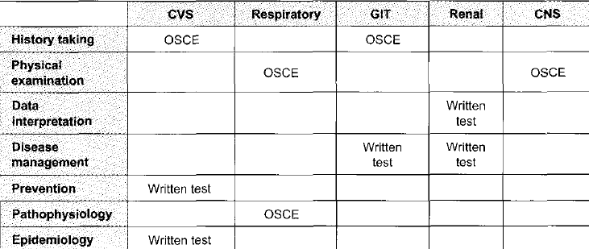
A simplified approach to examination blueprint development in an integrated curriculum.

Slide 9
Happy learning

