Slide 1
PREVENTIVE MEASURES IN RESTORATIVE PRACTICE

Slide 2
PLAQUE CONTROL: MECHANICAL AND CHEMICAL METHODS OF PLAQUE CONTROL

Slide 3
Mechanical plaque control
(a) Toothbrush
(b) Dentifrice
(c) Interdental cleaning aids
- Dental floss
- Interdental brushes
- tooth pick
(d) Oral irrigation
(e) Salvadora persica

Slide 4
Introduction:
Mechanical plaque control is the removal of microbial plaque and the prevention of its accumulation on the teeth and adjacent gingival surface by the use of tooth brush and other mechanical hygiene aids.

Slide 5
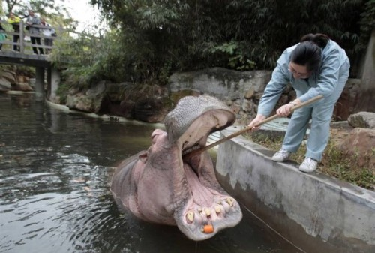
Mechanical plaque control
(a) Toothbrush
(b) Dentifrice
(c) Interdental cleaning aids
- dental floss
- toothpick
- interproximal brushes
(d) Oral irrigation
(e) Salvadora persica

Slide 6
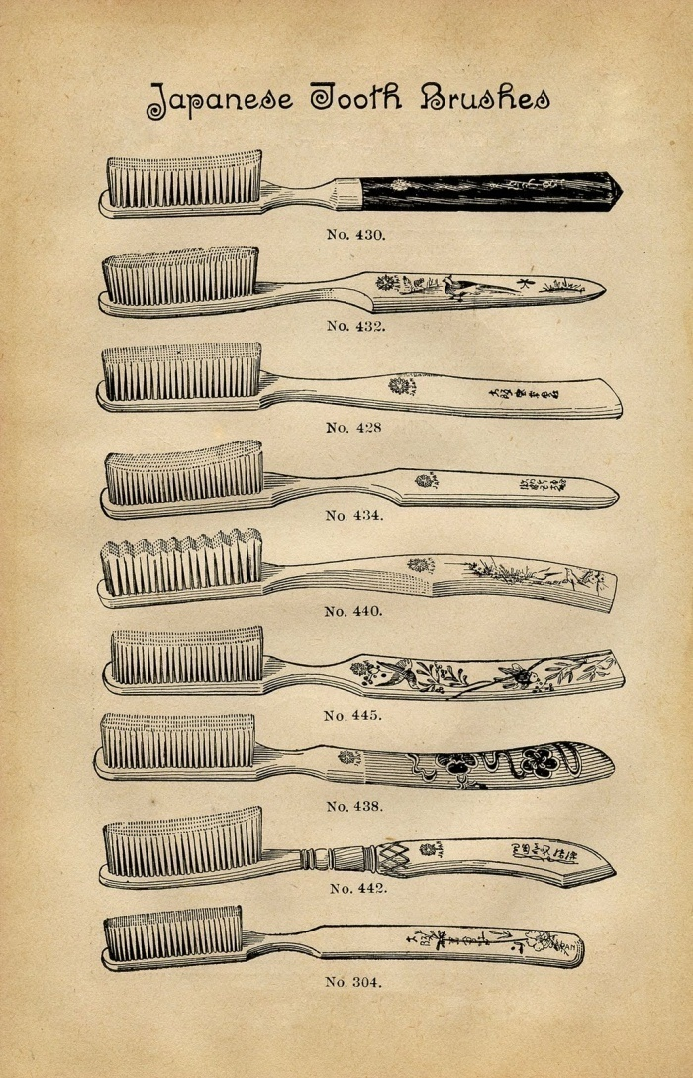
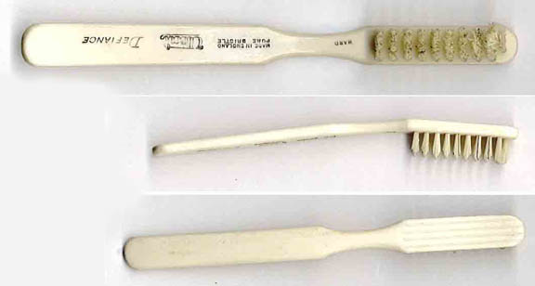
TOOTH BRUSH
The bristle tooth brush appeared about the year of 1600 in China and later was patented in America in 1857.
Originally, they are varied in size, length, hardness of the bristle, and even in the arrangement of the bristle

Slide 7
Soft, nylon bristle toothbrush clean effectively ( when used properly),remain effective for a reasonable time , Soft bristle are more flexible, clean beneath the gingival margin, and reach farther into the proximal tooth surfaces.
soft toothbrush is atraumatic , eliminates gingival recession, tooth surface abrasion (classical wedge shape defect in the cervical area of root surfaces), and trauma to soft tissue.

Slide 8
METHODS OF TOOTH BRUSHING
Today, there are three methods that are widely accepted: the bass method, the modified stillman method( stillman 1932), and the charters method( Carter’s 1948) .
Controlled studied evaluating the most common brushing technique have shown that no one method is superior
The method which is often recommended is Bass technique , because it emphasize sulcular placement of the bristle

Slide 9
Method | Bristle placement | Motion | Advantage/ disadvantage
Scrub | Horizontal on gingival margin | Scrub in anterior position direction keeping brush horizontal | Easy to learn & best suited fro children
BASS | Apical towards gingival into sulcus at 45⁰ to tooth surface | Short back and forth vibratory motion while bristles remain in sulcus. | Cervical plaque removal Easily learned Good gingival stimulation
Charter's | Coronally 45^{o,} sides of bristles half on teeth and half of gingiva | Small circular motions with apical movements towards gingival margin | Hard to learn and position brush Clears inter proximal Gingival stimulation
Fones | Perpendicular to the tooth | With teeth in occlusions, move brush in rotary motion over both arches and gingival margin | Easy to learn Inter proximal areas not cleaned May cause trauma
Roll | Apically, parallel to tooth and then over tooth surface | On buccal and lingual inward pressure, then rolling of head to sweep bristle over gingiva & tooth | Doesn't clean sulcus area Easy to learn good gingival stimulation
Stillman's | On buccal and lingual, aplically at an ablique angle to long axis of tooth. Ends rest on gingiva and cervical part. | On buccal and lingual slight rotary motions with bristle ends stationary | Excellent gingival stimulation Moderate dexterity required Moderate cleaning of interproximal area
Modified stillman's | Pointing apically at and angle of 45º to tooth surface | Apply pressure as in stillmans's method but vibrate brush and also move occlusally | Easy to master Gingival stimulation

Slide 10
Method | Bristle placement | Motion | Advantage/ disadvantage
Scrub | Horizontal on gingival margin | Scrub in anterior position direction keeping brush horizontal | Easy to learn & best suited fro children
BASS | Apical towards gingival into sulcus at 45⁰ to tooth surface | Short back and forth vibratory motion while bristles remain in sulcus. | Cervical plaque removal Easily learned Good gingival stimulation
Charter's | Coronally 45^{o,} sides of bristles half on teeth and half of gingiva | Small circular motions with apical movements towards gingival margin | Hard to learn and position brush Clears inter proximal Gingival stimulation
Fones | Perpendicular to the tooth | With teeth in occlusions, move brush in rotary motion over both arches and gingival margin | Easy to learn Inter proximal areas not cleaned May cause trauma
Roll | Apically, parallel to tooth and then over tooth surface | On buccal and lingual inward pressure, then rolling of head to sweep bristle over gingiva & tooth | Doesn't clean sulcus area Easy to learn good gingival stimulation
Stillman's | On buccal and lingual, aplically at an ablique angle to long axis of tooth. Ends rest on gingiva and cervical part. | On buccal and lingual slight rotary motions with bristle ends stationary | Excellent gingival stimulation Moderate dexterity required Moderate cleaning of interproximal area
Modified stillman's | Pointing apically at and angle of 45º to tooth surface | Apply pressure as in stillmans's method but vibrate brush and also move occlusally | Easy to master Gingival stimulation

Slide 11
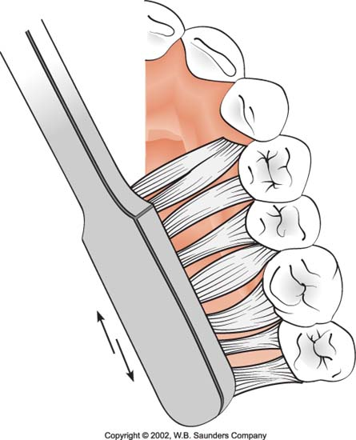
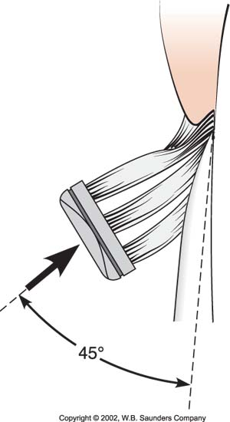
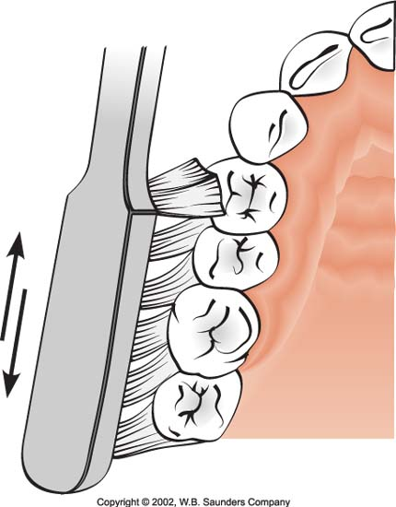
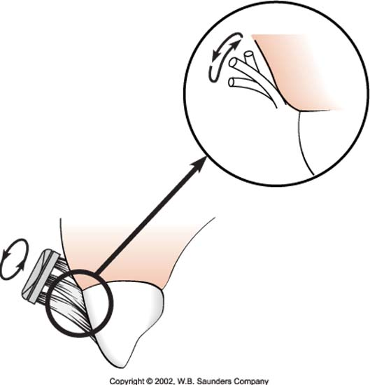
Bass method
Charters method

Slide 12
Electric toothbrush ( powered)
In 1939 powered tooth brush invented to make plaque control easier.
Its mainly recommended for
Individual lacking motor skills
Hospitalized patients whose teeth are cleaned by the caregivers.
Special needs patient ( physical and mental disability)
Patient with orthodontic applied
Whosoever wants to use
There are many powered tooth brushes some with reciprocal of back and back motions and some with combination of both some are circular and elliptical motion.
Powered tooth cleaner resembles a dental prophylaxis and hand piece with rotary rubber cap.
Patient should be lustrated for proper use.

Slide 14
No evidence of a statistically significant difference between powered and manual brushes. However, rotation oscillation powered brushes significantly reduce plaque and gingivitis in both the short and long-term.(C. Deery , et al 2003)
electric toothbrush have not been shown to provide benefits routinely for patients with RA, children who are well-motivated brushers , or patients with chronic periodontitis.( Heasman, 1999)

Slide 15
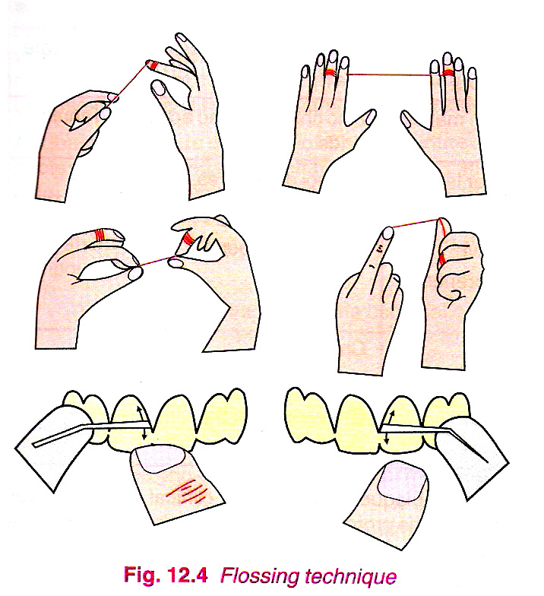
Dental floss:
Dental floss is the most widely recommended mehtod for removing proximal plaque.
The floss is wrapped around each proximal surface and is activated with repeated up and down stroke.
Floss should pass gently through the contact area. Do not snap the floss pass the contact area as it may injure the interdental papilla.

Slide 16
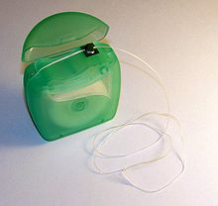
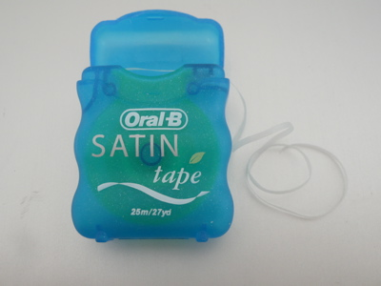
Floss is available in many types: unwaxed, waxed, tape floss, PTFE floss, and Superfloss.
Waxed floss contained wax to facilitate passing the floss through the contact and alleviate fraying.
Tape floss contain criss-cross fiber and eliminate fraying.
PTFE floss (Glide floss) is the teflon floss which allow passing through very tight contact easily without fraying.
Superfloss is the web-like material which improved proximal cleaning efficiency.

Slide 17
There are no significant difference between various types of floss to remove dental plaque , they all work equally well ( Grossman 1979, Keller 1969).
Graves et al. in 1989 evaluated in a 2 week clinical trial the efficacy of unwaxed dental floss, dental tape, waxed floss, and tooth brushing alone in reduction of interproximal bleeding.
The result showed that the dental tape and dental floss were equally effective in reducing interproximal bleeding and twise effective as toothbrushing alone.

Slide 18
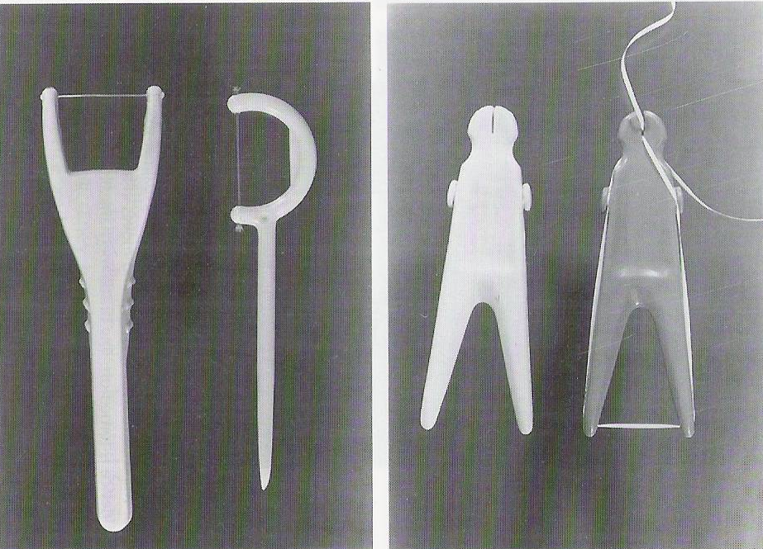
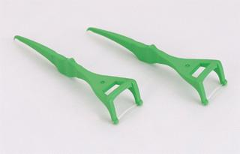
Floss holder
Flossing can be made easier by using a floss holder –
Floss holder should have –
One or two fork that enough to keep the floss tent even when its moved pass tight contact area
An effective and simple mounting mechanisms

Slide 19
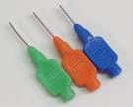
Interdental brush (proxy brush):
Interdental brush are conical shape brushes made of bristles mounted on a handle, single tufted brushes, or small conical brushes.
They are suitable for cleaning large, irregular, or concave tooth surfaces adjacent to wide interdental spaces.
They are inserted interproximally and are activated with short back and forth strokes in between the teeth.

Slide 21
Toothpick
Studies have been conducted to compare the efficacy of tooth pick, dental floss, and multi-tufted brush.
Dental floss removed more plaque at lingual interproximal surface than toothpicks.
Toothpicks combined with multi-tufted brush used on oral surfaces were as effective in removing interproximal plaque as dental floss.
The use of floss or tooth pick combined with single tufted brush may reduce the amount of plaque adhering to the proximal surfaces by an average of 50%

Slide 22
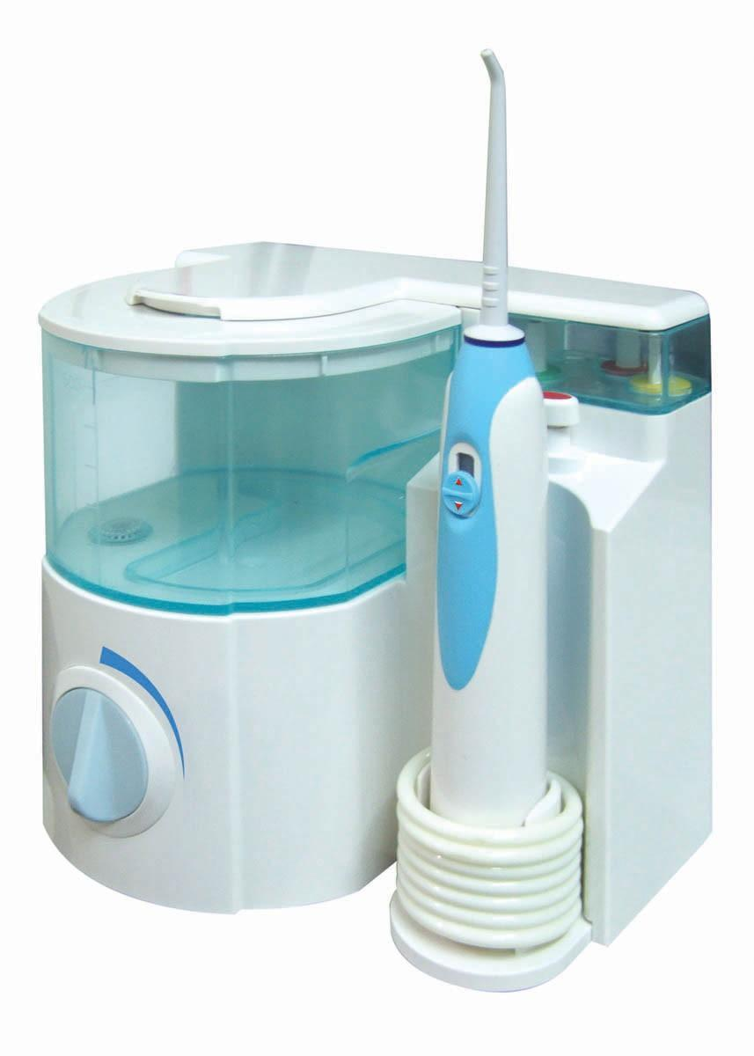
Oral irrigation
Oral irrigation device include the use of water picks.
The high pressure, pulsating stream of water through a nozzle is directed to the tooth surface and subgingivaly, washing away debris and plaque containing bacteria.
They are helpful surrounding orthodontic appliance, and when used as an adjunctive treatment in shallow pocket depth.
Patients require antibiotic premedication should not use oral irrigation.

Slide 23
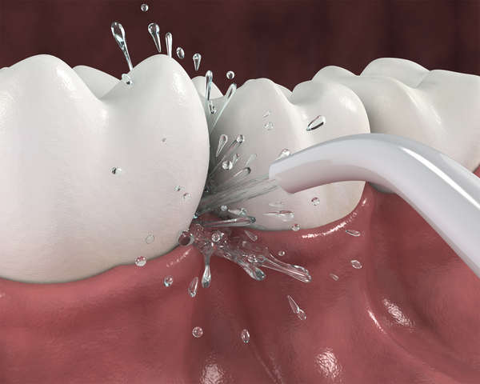
Oral irrigation devices
When used as adjuncts to toothbrushing , irrigation devises, can have a beneficial effect on periodontal health by reducing the accumulation of plaque and calculus and decreasing inflammation and pocket depth.
( Robinson and Hoover, 1971)

Slide 24
Eakle et al. in 1986 showed that the oral irrigator deliver an aqueous solution into the periodontal pocket and will penetrate an average to approximately half the depth of the periodontal pockets.
Penetration of 90 degree angle stream of water is about 70% for pocket less than 3mm, 44% for moderate pocket (4 to 7 mm) and 68% for deep pocket ( greater than 7mm).
For 45 degree angle, the result is 54%, 45%, and 58% respectively

Slide 25
CHEMICAL PLAQUE CONTROL
CHEMICAL PLAQUE CONTROL AGENTS
FIRST GENERATION
Eg: antibiotics, phenol,quarternary ammonium compounds & sanguinarine
SECOND GENERATION
Eg: Bisbiguanides,(chlorhexidine)
THIRD GENERATION
Eg: delmopinol

Slide 26
FIRST GENERATION AGENTS
TRICLOSAN
Phenol derivative
Is synthetic and ionic
Used as a topical antimicrobial agent
Broad spectrum of action including both gram positive and gram negative bacterias
It also includes mycobacterium spores and Candida species

Slide 27
MECHANISM OF ACTION
TRICLOSAN
ACT ON CYTOPLASMIC MEMBRANE
INDUCE LEAKAGE OF CELLULAR CONSTITUENTS
BACTERIOLYSIS

Slide 28
2. METALLIC IONS
eg: Zn & Cu ions
MECHANISM OF ACTION
It reduces the glycolytic activity in bacteria &delays bacterial growth

Slide 29
3.QUARTERNARY AMMONIUM COMPOUNDS
Cationic antiseptics & surface active agents
Effective against gram positive organisms

Slide 30
MECHANISM OF ACTION
Positively charged molecule reacts with negatively charged cell membrane phosphates and thereby disrupts the bacterial cell wall structure
Eg: Benzanthonium chloride, Benzalleonium chloride and cetylpyredinium

Slide 31
4.SANGUINARINE
It is a benzophenanthredine alkaloid
It is most effective against gram –ve organisms
Used in mouth rinse

Slide 32
BISBIGUANIDES
CHLORHEXIDINE GLUCONATE(0.2%)
It is a cationic bisbiguanide
Effective against gram +ve, gram –ve organisms, fungi, yeasts and viruses
Exhibit antiplaque & antibacterial properties

Slide 33
MECHANISM OF ACTION
Antiplaque action of chlorhexidine
Prevents pellicle formation by blocking acidic groups on salivary glycoproteins thereby reducing glycoprotein adsorption on to the tooth surface
Prevents adsorption of bacterial cell wall on to the tooth surface
Prevents binding of mature plaques

Slide 34
Antibacterial action of chlorhexidine
It shows two actions
Bacteriostatic at low concentrations
Bacterial cell wall(-ve charge)
Reacts with +ve charged chlorhexidine molecule
Integrity of cell membrane altered
CHX binds to inner membrane phospholipids & increase permeability
Vital elements leak out & this effect is reversible

Slide 35
ADVERSE EFFECTS OF CHLORHEXIDINE
Brownish staining of tooth or restorations
Loss of taste sensation
Rarely hypersensitivity to chlorhexidine has been reported
Stenosis of parotid duct has also been reported

Slide 36
ENZYMES
Enzymes has been used as active agents in antiplaque preparations
It is due to the fact that enzymes would be able to breakdown already formed matrix some plaques and calculus
Some are proteolytic and have bactericidal action
eg: Mucinase, mutanase , dextranase etc

Slide 37
DELMOPINOL
Inhibits plaque growth and reduces gingivitis
Mechanism of action
Interfere with plaque matrix formation & also reduces bacterial adherence
It causes weak binding of plaque to tooth, thus aiding in easy removal of plaque by mechanical procedures
It is therefore indicated as a pre brushing mouth rinse

Slide 38
Adverse effect of delmopinol
Staining of tooth & tongue
Taste disturbances
Mucosal soreness & erosion

Slide 39
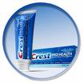
DENTIFRICES
Dentifrice is a substance used with a tooth brush for the purpose of cleaning the accessible surfaces of the tooth
It contains
therapeutic agent such as fluoride to inhibit caries
Antimicrobial agents- chlorhexidine , cetrimide
Anticalculus agent - Zn-chloride
Anticariogenic agents- sodium fluoride

Slide 40
COMPOSITION
Polishing/ abrasive agents
Ca carbonate
Dicalcium phosphate dihydrate
Alumina
Silica
Functions
Mild abrasive action aids in illuminating plaque
Removes stained pellicle, restores natural luster, enhances enamel whiteness

Slide 41
2.Binding/ thickening agents
Water soluble agents
Alginates, Sodium carboxy methyl cellulose etc
Water insoluble agents
Colloidal silica, Magnesium aluminium salts etc
Functions
Controls stability &constitency of tooth paste
3.Detergents/ surfactants
Sodium lauryl sulfate
Functions
Produces foam & removes food debris
Antimicrobial property

Slide 42
4. Humectants
Sorbitol, glycerine, polyethylene glycol
Function
reduces the loss of moisture from tooth paste
5. Flavoring agents
Peppermint oil, spearmint oil, oil of wintergreen
Function
Render the product pleasant to use & leaves a fresh taste in mouth after use

Slide 43
6. Sweeteners and colouring agents
7.Anti bacterial agents
Triclosan, delmopinol, metallic ions & Zn-citrate trihydrate
Anticaries agents
Na fluoride, stannous fluoride
Active agents-fluoride
Anticalculus agents(crystal growth inhibitors)
Pyrophosphate, Zn citrate, Zn chloride
Desensitizing agents
Sodium fluoride, potassium nitrate

Slide 44
DISCLOSING AGENTS
A disclosing agent is a preparation in liquid, tablet or lozenge from which contains a dye or other coloring agents
A disclosing agent is used for identifying bacterial plaque
When applied to the teeth, the agents imparts its colour to soft deposits but can be rinsed easily from clean tooth surface

Slide 45
Agents used for disclosing plaque
Iodine preparations
Skinners iodine solution
Diluted tincture of iodine
Mercurochrome preparations
Mercurochrome soln 5
Flavored mercurochrome disclosing solution
Bismark brown
Mebromin
Erythrosine
Fast green
Fluoresin
Two tone solutions
Basic fuschin

Slide 46
PREVENTIVE RESIN
RESTORATION

Slide 47
PREVENTIVE RESIN RESTORATION
Are among the newer techniques which show long term success.
This treatment of resin restoration has various distinct advantages over the traditional amalgam restorations.
But it requires an excellent isolation of moisture and saliva contamination.

Slide 48
PRR utilizes the invasive and non invasive treatment of borderline or questionable caries.
The resin placed in the carious areas and adjacent caries susceptible areas, seals them from the oral environment and provides a valuable treatment alternative to conventional restorations like amalgam.

Slide 49
Based on the extent and depth of the carious lesion , PRR are of 3 types
a) type A
b) type B
c) type C

Slide 50
TYPE A
Comprises of deep pit and fissures where caries is limited to enamel.
The preparation size is very small.
A slow speed round bur is used to remove any decalcified enamel.
Unfilled resin or sealant is used to restore the preparations of carious lesions.

Slide 51
TYPE B
Minimal exploratory carious lesion.
The preparation is by size 2 round bur.
The restoration requires some filler to the unfilled resin.

Slide 52
TYPE C
need for greater exploratory preparation into dentin.
large size bur is used.
A bevel is placed on the enamel cavosurface margin of the preparation.
Unfilled resin layer followed by filled composite is introduced into the preparation.

Slide 53
STEPS TO BE FOLLOWED
Thorough prophylaxis to be done.
Teeth should be isolated with rubber dam or cotton rolls.
Any decalcified areas over the tooth surface to be removed with the bur.
Acid etchant to be applied.
Washing and drying.
Bonding agent to be applied .
Then the cavity to be restored with sealant.

Slide 54
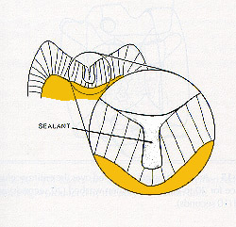
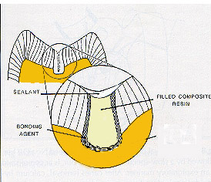
TYPE A
TYPE B

Slide 55
ADVANTAGES
Minimal cavity preparation is required thus prevents unnecessary removal of healthy tooth structure for retention.
Seals caries thus halting the destruction of tooth.
Eg: teeth with pit and fissure
Loss of the restoration and subsequent
replacement proves to be less invasive than
that for conventional restoration like amalgam.

Slide 56
PIT AND FISSURE SEALENT
Sealents acts as covering of deep pit and fissures and provides a mechanical barrier against cariogenic bacteria
The procedure is aesthetic, cost effective and non invasive

Slide 57
Criterias for sealent placement
Patients under high caries risk:
1.Pit and fissure anatomy
2. cariogenic diet
3.past history of high prevalance of caries
4.low fluoride intake
OTHER CONSIDERATIONS
1.Teeth with deep grooves and fissures will benefit from sealant placement immediately after placement

Slide 58
CONTRAINDICATIONS OF SEALENT PLACEMENT
Presence of decay
Primary teeth close to exfoliation
Inability to isolate and maintain a dry field

Slide 59
Glass ionomer vs resin based sealent
Fluoride releasing GIC is a good choice for sealant in case of
1.Partially erupted teeth
2.Teeth which is difficult to isolate
3.GIC is moisture tolerant and excellent as a transitional material

Slide 60
Resin based sealer
Resin based sealer higher bond strength and better retention
Once the tooth has totally erupted a resin based sealer should be used

Slide 61
Conclusion
One of the best preventive measures we can offer to the patients
Cost effective and conservative method
When properly placed sealants have proven longevity
Simple and fast method of placement

Slide 62
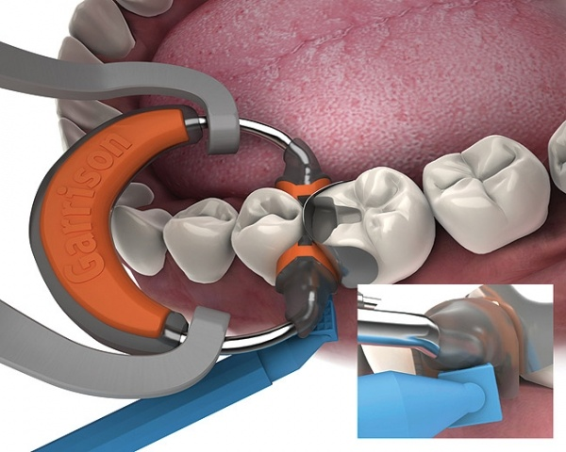
TOOTH SEPARATION MATRIX
AND WEDGES

Slide 63
INTRODUCTION
DEFNITIONS
NEED FOR TOOTH SEPARATION
METHODS OF TOOTH SEPARATION
MATRICING

Slide 64
INTRODUCTION
Seperation of teeth may be necessary inorder to-
Improve convenience form of dentist
Prevent damage to teeth & supporting tissues
Achieve functional contacts,contours & occlusion during restorations.

Slide 65
DEFINATION
Tooth movement or separation of teeth can be defined as the process of separating the involved teeth slightly away from each other or bringing them closer to each other or changing their spatial position in one or more dimensions..

Slide 66
NEED FOR TOOTH SEPARATION
1.DIAGNOSIS of initial proximal caries not seen on radiograph
2.CAVITY PREPARATION- adequate access in class2 & class3 cavity preparation
3.MATRIX PLACEMENT
4.POLISHING RESTORATION-polishing proximal surfaces of class3 & class 4 Restoration
5.REPOSITIONING DRIFTED TEETH
6.REMOVAL OF FOREIGN OBJECTS

Slide 67
METHODS OF TOOTH SEPARATION
Slow or delayed separation.
Rapid or immediate separation.

Slide 68
SLOW OR DELAYED SEPARATION
Causes slow movement of teeth over a period of several days or weeks
Indications- tilted,drifted or rotated tooth in which rapid movement is not possible
Advantage- no periodontal damage
Disadvantage- time consuming & require many visits

Slide 69
Methods of achieving slow separation
1 Separating rubber rings or bands
2 Rubber dam sheet
3 Ligature wire or copper wire
4 Gutta percha sticks
5 Oversized temporary crowns
6 Fixed orthodontic appliance

Slide 70
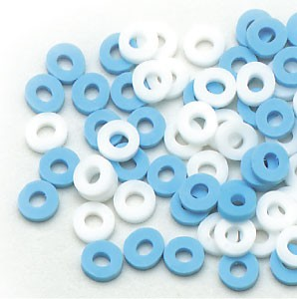
Separating rubber ring or band
Used in orthodontic cases
It is stretched and placed interproximally between two teeth to achieve seperation
It may take 2-3 days to 1 week.

Slide 71
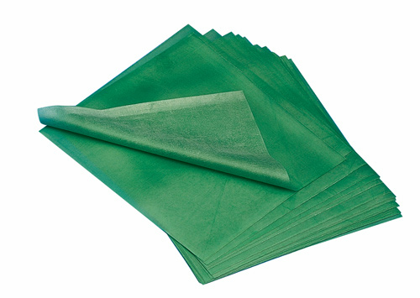
Rubber dam sheet
It is stretched and placed interproximally between the teeth
Usually heavy or extra heavy type is preferred
Time for separation varies from 1hr to 24 hrs
In case of pain or swelling a floss may be used to remove the sheet

Slide 72
LIGATURE WIRE OR COPPER WIRE
Wire is passed beneath the contact area to form loop
Tightening done by twisting two ends together.this causes increase in separation.
Separation achieved in 2-3 days

Slide 73
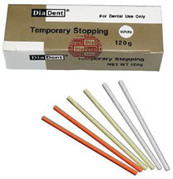
Gutta percha stick
It is softend with heat and packed into proximal area.
Usually indicated in posterior teeth
Tooth separation usually takes 1 to
2 weeks

Slide 74
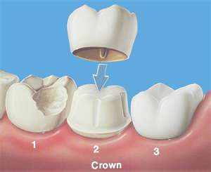
Over sized temporary crowns
Temporary crowns are made oversized in the mesiodistal dimensions and periodically resin is added to the contact area to increase the amount of separation.

Slide 75
Orthodontic appliances
Indicated only when extensive repositioning of tooth required
Most predictable and effective method..

Slide 76
RAPID OR IMMEDIATE SEPARATION
Here tooth movement achieved rapidly over a short period of time
It is achieved by two methods
Wedge principle
Traction principle

Slide 77
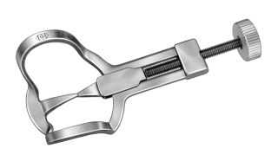
1.Separation by wedge principle
A pointed wedge shaped device is inserted between teeth to produce the desired amount of seperation…eg
1.elliot’s seperator,
2.wedges.
1. ELLIOTS SEPARATOR
Also known as crab claw separator because of
its design.
Mechanical device consisting of
-bow
-two holding jaws
-tightening screw

Slide 78
Clockwise rotation of tightening screw moves contacting teeth apart
Two holding jaws are positioned gingival to the contact area without damaging the interproximal area
Separation should not be more than thickness of pdl, ie,0.2-0.5mm
Used for examination and polishing of final restoration.

Slide 79
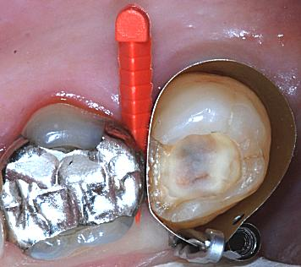
WEDGES
Wedges are devices that create rapid seperation during tooth preperation and restoration
Functions of wedges
Help in rapid seperation of teeth
Prevent gingival overhang of restoration
Provide space for compensate thickness of matrix band
Help in stabilization of retainer and matrix during restorative procedures
Help in retracting and depressing interproximal gingival area thus help in minimizing trauma to soft tissue.
Help in depressing rubber dam in interproximal area

Slide 80
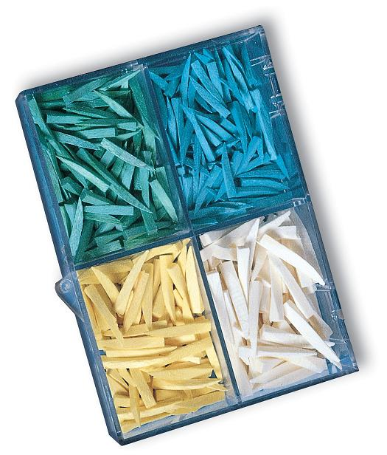
Wedges made of two materials
Wood or plastic
1.Wooden wedges
Soft wood like pine or hardwood like oak
They may be medicated
They are prefered because-
Easy to trim
Adapt well
Absorb moisture and swells to provide adequate stabilization to matrix band
They are used along with metal matrices

Slide 81
Wooden wedges can be of two shapes
Triangular or round
Triangular wedges are commercially available
Prefered for cavities with deep gingival margin
It has got an apex and a base
Apex usually lies in the gingival portion of contact area.
Base lies in contact with gingiva ,this helps in stabilization and retraction of gingiva
Used in tooth preperation with deep gingival margin.

Slide 82
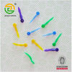
Round wedge
-Made from wooden tooth picks by trimming the apical portion
-It has a uniform shape
-Used in class11 tooth preparation

Slide 83
Light transmitting wedges.
Special plastic wedges which are transparent and have a light reflecting core
Used with transparent matrices while placing class11 composite restoration.
Transmits 90-95% incident light
It helps in reducing polymerization shrinkage as it transmits light.
Better adaptability

Slide 84
PLACEMENT AND LOCATION OF WEDGES
Correct location of the wedge is in the gingival embrasure below the contact area,
Select the appropriate wedge depending on the clinical situation
Wooden wedges can be trimmed with a knife or scalpel to produce a custom fit

Slide 85
Wedge is usually placed from the lingual embrasure which is normally larger in size
If it interferes with tongue it can be placed from buccal side.
Length of the wedge should be only 0.5inch or 1.3cm so that it does not irritate tongue or the cheek.
After placement wedge should be firm and stable.

Slide 86
Modified wedging techniques
Double wedging
Two wedges are used
One inserted from buccal
embrasure and another inserted
from lingual embrasure
Indication: large spacing between adjacent teeth where single wedge is not sufficient
Widening of proximal box in buccolingual dimension

Slide 87
Wedge wedging
Two wedges are used
One wedge is inserted from lingual embrasure area while another inserted between wedge and matrix band at right angle to first wedge.
Primarily indicated while treating mesial aspect of maxillary first premolar.
These tooth have flutes(concavities) in root near gingival area.

Slide 88
Piggyback wedging
Two wedges are used
One larger wedge is inserted as normally ,while the smaller wedge(piggyback) inserted above the larger one.
Indicated in case of shallow proximal box with gingival recession.
This technique provides closer adaptation and contour of matrix band.

Slide 89
2.Separation by traction principle
This employs a mechanical device to engage the proximal surfaces of contacting teeth and bodily moves them apart to bring about seperation.
eg: ferriers double bow seperator
This mechanical device has two bows.
The jaws of each bow engages the embrasure of the contacting teeth gingival to contact area
A wrench is used to turn the threaded bars slowly to create adequate separation

Slide 90
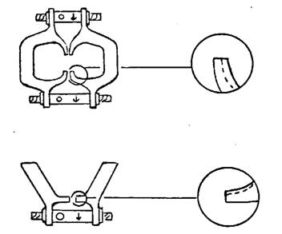
Impression compound is used to stabilize the bows on the teeth
Separation is achieved at the expense of both contacting tooth rather than one tooth.
Tooth preperation,finishing & polishing of class111 direct gold restoration
Ferrier bow separator

Slide 91
MATRICING
DEFINITIONS
‘Matricing ‘-is the procedure whereby a temporary wall is created opposite to axial walls, surrounding areas of the tooth structure that were lost during cavity preperation…
‘Matrix’-is a device used during restorative procedures to hold the plastic restorative material within the tooth while it is setting…

Slide 92
Ideal requirements of a matrix
Ease of application-
Ease of use- the retainer or its handle should not interfere with the condensation of the restoration or patient comfort
Ease of removal
Rigidity-the matrix should be rigid enough to confine the restorative material as it is condensed under presssure and should not get displaced easily from its position
Provide proper proximal contact and contour.

Slide 93
Positive proximal pressure-the matrix should exert a positive pressure against the adjacent tooth during insertion of the restoration so that after its removal normal contact between teeth is established
Non reactive-it should not react or stick to the restorative material.
Inexpensive
Easy to sterilize

Slide 94
Functions of matrix
To confine restorative material while it is hardening.
To establish optimal contacts and contours for the restoration.
To prevent gingival overhangs of restoration.
To provide acceptable surface texture for restoration.

Slide 95
Parts of matrix
Retainer-it holds the band in desired position and shape.
It may be a metallic ring, mechanical device, dental floss or impression compound.
Band-It is a piece of metal or polymeric material used to give support and give form to the restorative material during its insertion and hardening.
Commonly used materials for matrix bands are
Stainless steel
Polyacetate
Cellulose acetate
Cellulose nitrate

Slide 96
The bands are usually available as strips of various dimensions 0.001-0.002 inch thickness
Width- 3/16 or ¼th inches for permanent teeth
5/16th inch width for deciduous teeth
Matrix band should extend 2mm above marginal ridge height and 1mm below gingival margin of the preparation.

Slide 97
Classification of matrices
Depending on type of band material
Stainless steel
Copper band
Cellulose acetate
Polyacetate
Depending on its preparation
Custom made or anatomic matrix
eg; compound supported matrix
Mechanical matrix
eg; ivory no.1 and ivory no.8
Depending on mode of retention
1.with retainer
eg: tofflemire, ivory no.1 and ivory no 8 matrices
2.without retainer
eg: automatrix

Slide 98
Depending on cavity preparation for which it is used
Class1 cavity with buccal or lingual extension.
Double banded tofflemire matrix
Class 2 cavity
Single banded tofflemire matrix
Ivory no.1 & ivory no.8
Compound supported matrix
T-band matrix
Automatrix
Class 3 cavity
S-shaped matrix
Cellophane strips
Mylar strips

Slide 99
Class IV cavity
Cellophane strips
Transparent celluloid crown forms
Dead soft metal matrix strips
Class V cavity
Window matrix
Tin foil matrix
Preformed transparent cervical matrix

Slide 100
Description of various matrices
Ivory no.1 matrix.
This matrix consists of a stainless steel band which encircles one proximal surface of a posterior tooth.
This is attached to the retainer via a wedge shaped projection.
An adjusting screw at the end of the retainer adapts the band to the proximal contour of the prepared tooth
As the adjusting screw is rotated clockwise the wedge shaped projections engage the tooth at the embrasures of the unprepared proximal surface

Slide 101
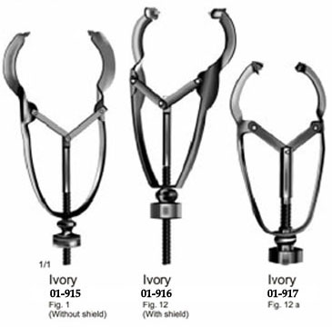
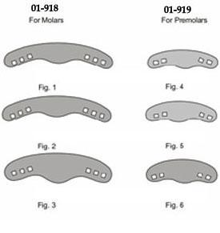
Indications
For restoring a unilateral class 2 cavity especially when the contact on the unprepared side is very tight
Advantages
Economical
Can be sterilized
Disadvantage
Difficult to apply &
remove

Slide 102
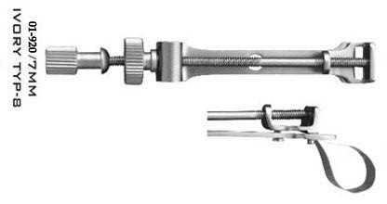
2 .Ivory no 8 matrix
This matrix consists of a band that encircle the entire crown of tooth
The circumference of the band can be adjusted by adjusting screw present in the retainer
Indications
Unilateral & bilateral class11 preparation(MOD)

Slide 103
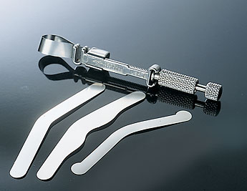
3 .Tofflemire matrix
Designed by Dr BF Tofflemire.
Also known as Universal matrix as it can be used in all types of tooth preparation of posterior teeth.
Indication
Class1 buccal or lingual extensions
Unilateral or bilateral class11(MOD) tooth preparation
Class11 compound tooth preparation having more than two missing walls.

Slide 104
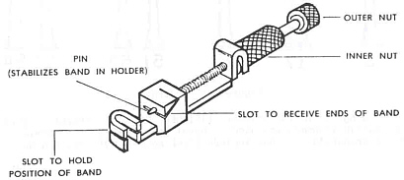
Parts of tofflemire retainer
Head: this part accomadates the matrix band.
It is u-shaped with two slots
The open side of the head should be facing gingivally when band is placed around the tooth
Slide(diagonol slot): amount of band extending beyond the slot depends upon type of tooth to be treated.
This portion is located near the head for installation of band in retainer,helps in placement of band around the tooth.

Slide 105
Knurled nuts
1.Two knurled nuts in retainer
a- large knurled nut-near the matrix band
Also known as rotating spindle
Helps in adapting the loop of matrix band against the tooth
Helps in adjusting the size of loop of matrix band against the tooth.
b-small knurled nut
Helps in tightening the band to the retainer
Assembly of retainer
The loop extending from retainer can project in following ways
straight-used near anterior teeth
left/right-used mostly in posterior areas of oral cavity.

Slide 107
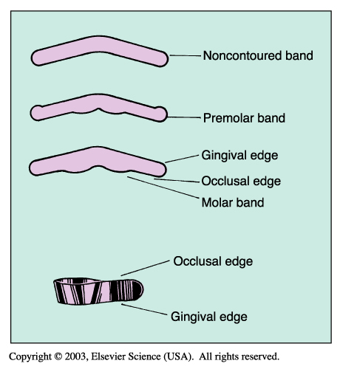
Types of bands
Two types of bands are usually used
1. Flat bands
2.Pre contoured bands
Flat bands
Available in two thickness
0.0020 inches
0.0015 inches
Available in 3 shapes
No1 universal band
No2 or MOD band used in molars
No 3 narrower than no 2

Slide 108
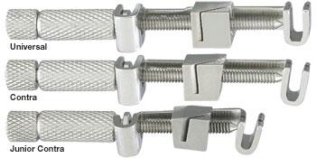
Available in two sizes
Standard for use in adult dentition.
Small for use in primary dentition.

Slide 109
OPERATIVE INSTRUCTION FOR PLACEMENT
First open the large knurled nut so that the slide is atleast ¼ inches from the head.
Hold the knurled nut (large) with one hand ,open the small nut in opposite direction for clearence of diagonal slot for reception of matrix band
Two ends of matrix band are secured together to form loop or either form preformed loop
Place the ends of band in diagonal slot
Then small knurled nut is tightened to secure the band to the retainer.
After securing the band tightly to the retainer it is placed around the tooth to be restored
For final adaptation of matrix band to tooth, tighten the large knurled nut
Wedge placement: wedge should be placed after the retainer and band fitted to the tooth.
always insert the wedge from widest embrasure area

Slide 110
Procedure for removal
Removal of retainer
Small knurled nut is moved counter clockwise to free the band from the retainer
While rotating the smaller knurled nut,hold the larger nut
Keep the index finger on the occlusal surface of band to stabilize the band
Removal of band
Carefully remove band from each contact point
Support the occlusal surface of restoration.while removing the band a condensor can be held against the marginal ridge of restoration
Do not pull band in occlusal direction rather move the band in facial or lingual direction
Band can be cut near to the teeth on the lingual side and try to pull it from buccal side.

Slide 111
4.Compound supported matrix ,custom made or anatomical matrix.
Introduced by sweeney.
It is entirely hand made and contoured specifically for each individual.
Employs a 5/16th inch wide,0.002 inch length stainless steel band.
The band is contoured with an egg shaped burnisher on a paper pad to achieve the approximate proximal as well as facial and lingual contours of prepared tooth.
The band is positioned and stabilized by applying softened impression compound facially,lingually and occlusally over the occlusal surface of adjacent tooth.
Following this amalgam condensation and carving can be completed.

Slide 112
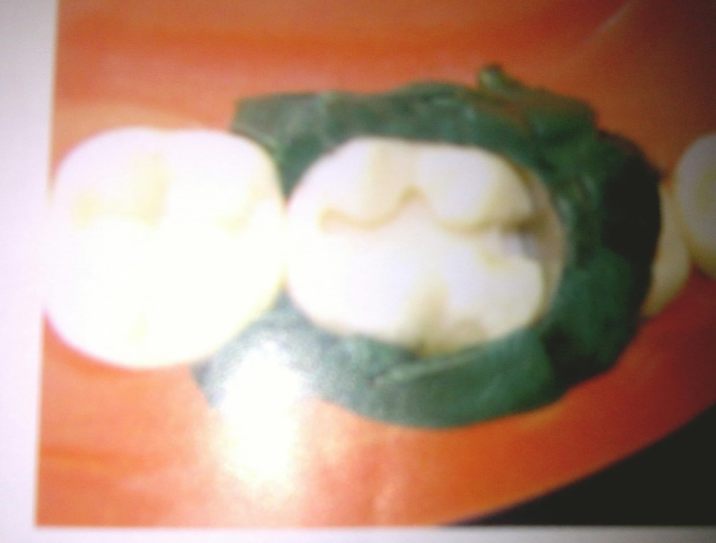
To remove the matrix, compound can be broken away with a sharp explorer tip and matrix strip can be removed.
Indication: classII cavities involving one or both proximal surfaces.
Complex situations like pin amalgam restoration.

Slide 113
5.T-band matrix system
Preformed T-shaped stainless steel matrix without a retainer
Long arm of T-surrounds the tooth and overlaps short arm of T.
The band is adjusted according to circumference of tooth,stabilized by wedging and supported by low fusing compound.
Indication: for class11 cavities involving one or both proximal surfaces of posterior tooth.
Simple and inexpensive .
Rapid and easy to apply.

Slide 114
6.S-shaped matrix band
used for restoring distal part of canine and premolar.
Stainless steel matrix band is taken and twisted like ‘s’ with the help of mouth mirror handle.
Advantage: it offers the optimal contour for distal part of canine and premolar.

Slide 115
7.Precontoured matrix
Consists of small, precontoured dead soft metal matrices ready for application to tooth.
They are selected according to the tooth to be restored and wedged to adapt to gingival contour.
Following this, the band is held in place by a flexible metal ring called BiTine ring.
eg:palodent bitine matrix system, composi-tight matrix system.
Used for both amalgam and composite restorations.
Easy to apply and provides slight tooth seperation.
Tight contacts may prevent insertion of band
Expensive.

Slide 116
8.Copper band matrix
Copper band of assorted sizes makes excellent matrices.
Cylindrical in shape and can be selected according to the diameter of tooth to be restored.

Slide 117
The bands are softened by heating to redness in a flame and quenching in water.
After this the bands can be stretched and shaped with contouring players.
The occlusal height of band is adjusted.
With contouring players the band is contoured to reproduce the proper shape of the contact area and the buccal and lingual contours.
After condensation and carving of amalgam the band is left in place it is sectioned and removed in next appointment

Slide 118
Indication: for badly broken teeth especially those receiving pin amalgam restoration.
For complex situations like classII cavities with large buccal or lingual extensions.
Advantage:provide excellent contour.
Disadvantage:time consuming.

Slide 119
Automatrix System
The automatrix system is an alternative to a universal retainer.
There is no retainer used to hold the band in place.
Bands are already formed into a circle and are available in assorted sizes in both metal and plastic.
Each band has a coil like autolock loop.
A tightening wrench is inserted into the coil and turned clockwise to tighten the band.
When finished, the tightening wrench is inserted into the coil and turned counterclockwise to loosen the band.
Removing pliers are used to cut the band.

Slide 120
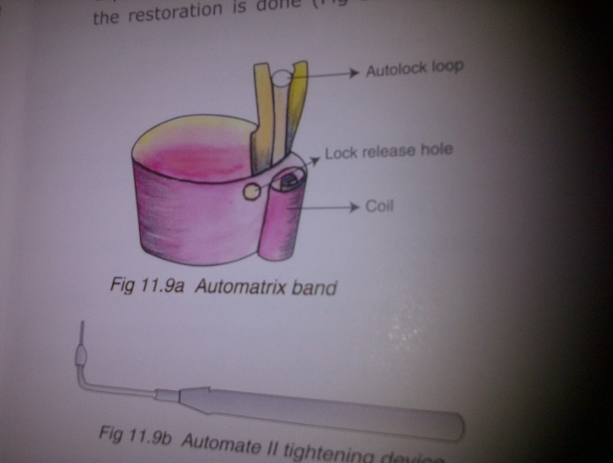
Automatrix bands available in thickness of 0.0015 to 0.002 inch.
Available in three widths
Narrow -3/16th inch
Medium-1/4th inch
Wide-5/16th inch
Automate II tightening device –used to adjust the loop of the band according to circumference of tooth to be restored.
Shielded nippers-used to cut the autolock loop so that band can be seperated and removed from the tooth after restoration.

Slide 121
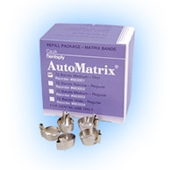
Indication:complex amalgam restoration where one or more cusps to be replaced.
Advantages: improved visibility due to lack of retainer.
Rapid application
Disadvantage:bands are flat and difficult to burnish.
expensive

Slide 122
Clear plastic matrix
Transparent plastic strips are employed as matrices for tooth coloured restoration.
They allow light to pass through them during polymerisation of composite resin.
They can be of different types:
Celluloid(cellulose nitrate) strips used for silicate cements.
Cellophane(cellulose acetate)used for resins.
Mylar strips used for composite and silicate restorations.
After inserting the composite resin material the matrix is pulled tightly around the tooth following which light curing is done.

Slide 123
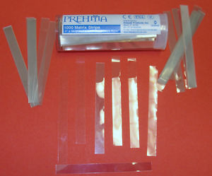
Indication: for small and large class111 and class 1v tooth coloured restoration.
Easy to use
Inexpensive.

Slide 124
Transparent plastic crown form matrix
Commercially available transparent plastic crown forms
Available in various sizes and contours for anterior tooth.
A suitable crown form can be selected for prepared tooth and trimmed to fit 1mm past the prepared margins
The contact area in the crown form is thinned with an abrasive disk so that once matrix is removed the restoration contacts the adjacent tooth.
The bulk of composite resin is loaded into crown form.
Then it is positioned over the tooth and light curing is done.
After curing the crown form can be slit with a bur and removed.

Slide 125
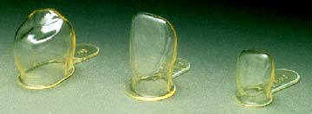
Indications:for large class1v cavities.
For oblique fractures of anterior tooth.
advantage: easy to use
Good contours can be established
Disadvantage
Time consuming
expensive

Slide 126
.Window matrix
Modification of tofflemire matrix.
Used for classV amalgam restoration.
The contra angled tofflemire retainer is applied on the lingual side of the tooth.
A window is cut in the band slightly smaller than the outline of the cavity.
Wedges are placed interproximally to stabilize band.
Following this amalgam can be condensed through window and contoured using carvers.

Slide 127
Tin foil matrix
used in classv restoration for conventional glass ionomer cements.
Tin foil may be preshaped and cut according to the gingival third of buccal and lingual surface of tooth tooth to be restored.
The band is adjusted so that it extends 1 to 2 mm circumferentially beyond the cavity margins.
This can be adapted on the cavity by means of a tweezer after placing glass ionomer cement.
Once the restoration sets the tin foil matrix can be peeled away.

Slide 128
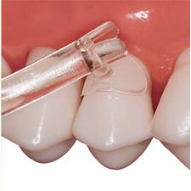
Preformed tranpsarent cervical matrix
These are transparent plastic matrices that are available in various contours or use in anterior and posterior tooth.
Indication: classV restoration with composite resin or glass ionomer restorations.
Provides good contour for restoration.

Slide 129
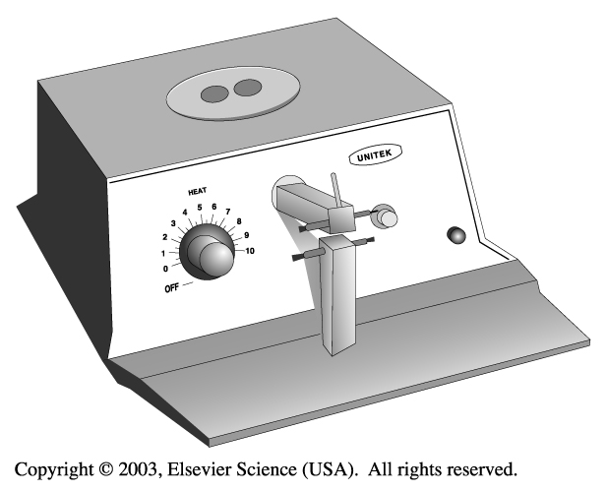
Additional Matrix Systems for Primary Teeth
A spot-welded band is a form-fitted band placed around a prepared tooth, then removed and placed in a smaller form of a welder that fuses the metal together to make a custom band.

Slide 130
CONCLUSION
The clinician should have an adequate knowledge of the anatomical and functional aspects of contacts and contours so as to reproduce them with ideal restorative materials. Extensive knowledge about the matricing serves as a guide to reproduce near to normal contacts between teeth which in turn help to maintain the oral cavity in sound health.Selection of the matrix should be based on its ease of use and efficiency to provide optimum contacts and contours.

