Slide 1

DR PROMILA VERMA
PROFESSOR
Faculty of Dental Sciences,KGMU
Lucknow, India.

Slide 2
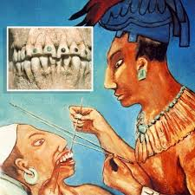
“ Most inventions are a series of improvements to an idea or concept and evolve over time"

Slide 3
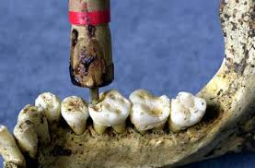
Cavities in teeth have been filled since earliest times with a variety of materials, including stone chips, turpentine resin (an organic plant substance), gum, and metals.

Slide 4
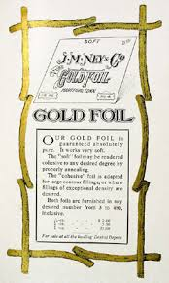
Giovanni d'Arcoli recommended gold-leaf (gold beaten into very thin sheets) fillings in 1484.
The renowned French physician Ambroise Paré (1510-1590) used lead or cork to fill teeth.

Slide 5
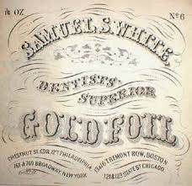
Gold leaf as a filling became popular in the United States in the early nineteenth century. Marcus Bull of Hartford, Connecticut, began producing beaten gold for dental use in 1812.

Slide 6
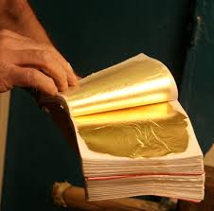
In 1853 sponge gold was introduced in the United States and England to replace gold leaf.
This was followed by the cohesive, or adhesive, gold introduced by American dentist Robert A. Arthur in 1855.

Slide 7

GOLD (Au)
Gold, the noblest of metals, has been used by man for more than 5000 years
Gold has derived its name from the old english Anglo-Saxon word ‘Geolo’ meaning YELLOW.
The symbol origin is from the latin word ‘Aurum’ meaning “Glowing Dawn”

Slide 8

DFG was practiced for about 100 years regularly and successfully.
With advent of materials like composites and other tooth coloured materials, its use started declining since 1980’s.

Slide 9
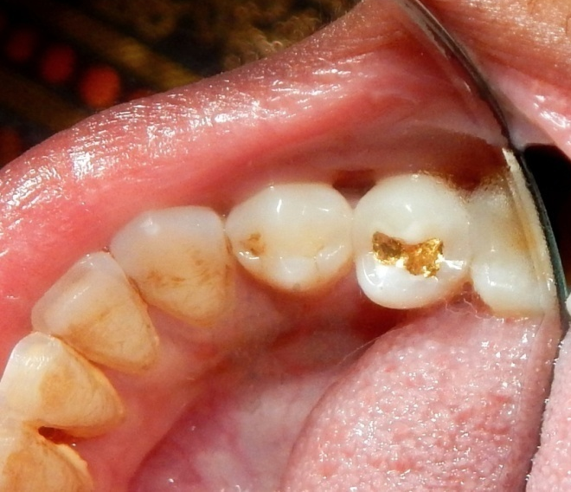
At the turn of century this remarkable restoration was nearing extinction.
It is upto a select few enthusiasts and perfectionists to make an effort to start its revival.

Slide 10
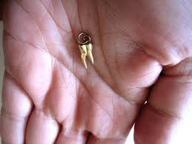
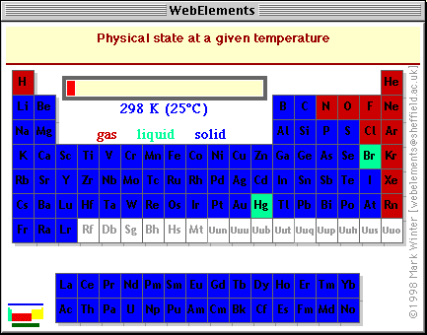
One of the first metals used by man, it is recognized as the most noble of metals
From the earliest historic records down through the ages, has played a prominent part in the development of our present knowledge of metallurgy.
Period 6 Group 11

Slide 11
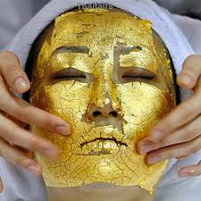
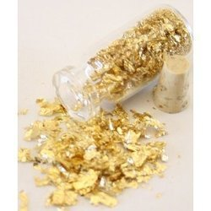
Several collodial forms of gold have been introduced for its therapeutic value in skin rejuvenation, malignant diseases, rheumatoid arthritis etc.

Slide 12
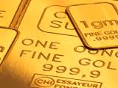
PURITY of GOLD
The karat system (k) specifies the gold content of an alloy based on parts of gold per 24 parts of the alloy.
Thus 24 karat indicates pure gold.
Fineness is the unit that describes the gold content in noble metal alloys by the number of parts of gold in each 1000 parts of alloy.
Pure gold has fineness of 1000 .

Slide 13
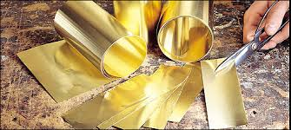
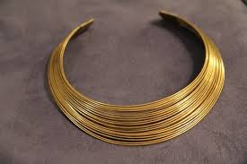
MALLEABILITY
DUCTILITY
In annealed state it can be hammered cold into a transluscent wafer of 0.000013 cm thick.
One ounce of gold can be beaten into a sheet covering over 9 sq mts and 0.000018 cm thick.
One ounce can be drawn into 80 km(50 mile) of thin gold wire 15 micron diameter) to make electrical contacts

Slide 14
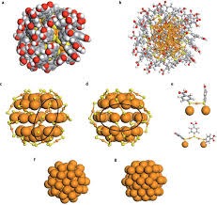
COHESIVENESS
WELDABILITY
Pure gold is cohesive in nature. By this property it can be welded by just putting pressure. Cohesiveness depends upon purity and surface annealing.
In cold state it can be welded in cold state whereas most other metals must be heated for welding to take place.

Slide 15
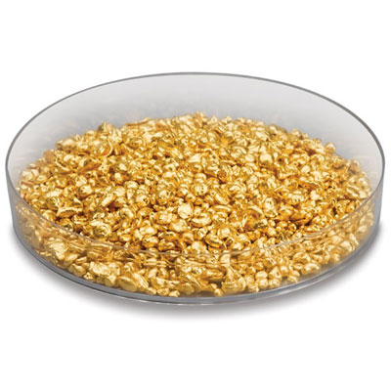
TYPES OF DFG: FOIL
Sheets: Manufactured by beating pure gold into thin sheets. The gold foil is cut into 4 × 4 inch (10 × 10 cm) sheets and sold in books of sheets, separated by pages of thin paper.
Pellets:rolled from 132-inch, 143-inch, 164-inch, or 1128-inch sections cut from a No. 4 sheet of foil.

Slide 16

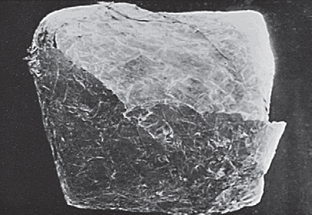
POWDERED GOLD
Powdered gold is made by a combination of chemical precipitation and atomization, with an average particle size of 15 mm
The atomized particles are mixed together in wax, cut into pieces, and wrapped in No. 4 or No. 3 foil

Slide 17
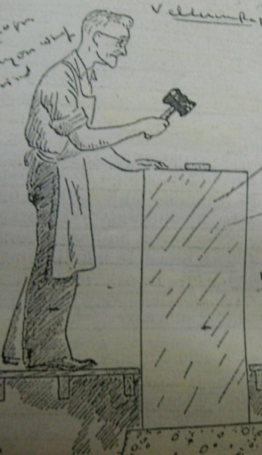
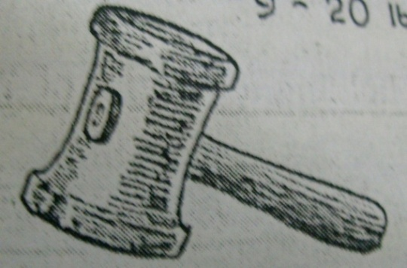
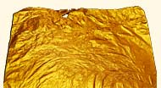
Sheets are manufactured by a process called “gold beating” or “rolling”. All light weight sheets are formed by beating and heavy weight sheets by rolling.
The gold foil is cut into 4 × 4 inch (10 × 10 cm) The sheet of foil that weighs
4 g is termed No. 4 foil;
3 g is termed No. 3 foil;
2 g is termed No. 2 foil.

Slide 18
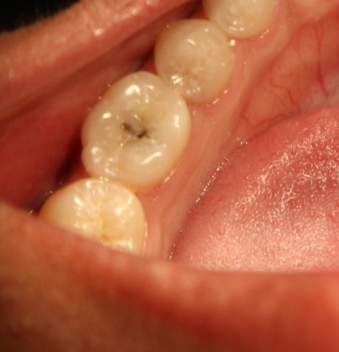
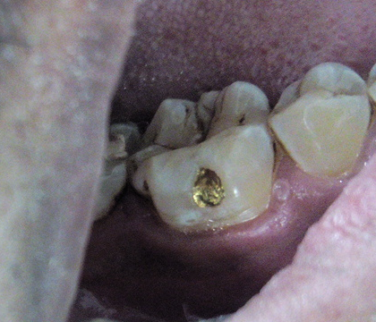
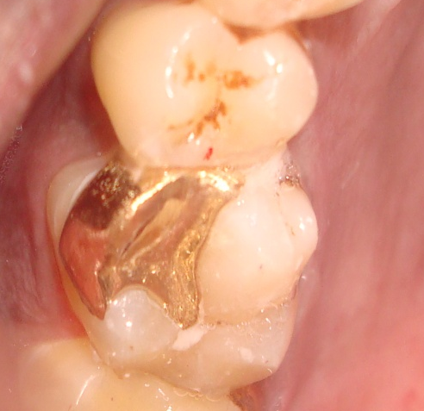
CASE SELECTION
INDICATIONS
Foil is best adapted to teeth in which decay has just begun, incipient decay specially in the pits and fissures.
Pits on the labial and buccal surfaces of teeth
For repairing margins of castings

Slide 19
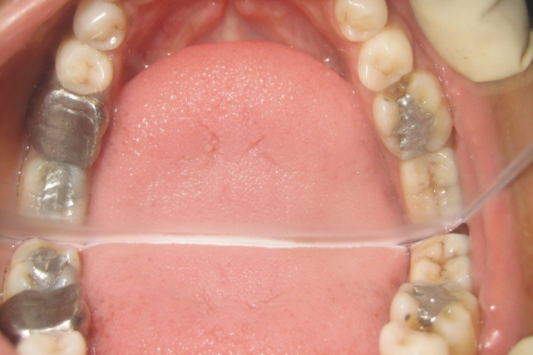
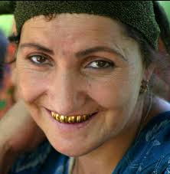
CONTRAINDICATIONS
High caries Index
Young patients
Poor periodontal conditions
Limited accessibility
Handicapped patients
Large cavities
Aesthetics.

Slide 20
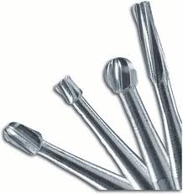
ARMAMENTARIUM FOR CAVITY PREPARATION

Slide 21
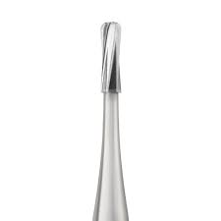
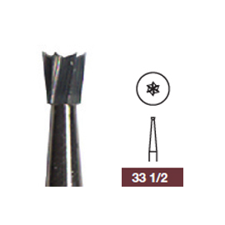
Burs
For Outline form and initial depth: Pear shaped No. 330 or 329 bur
For Retentive undercuts: No. 33 ½ inverted cone bur or 612-(90)-212-9 angle-former chisel

Slide 22
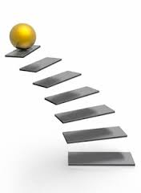
STEPS OF CAVITY PREPARATION

Slide 23
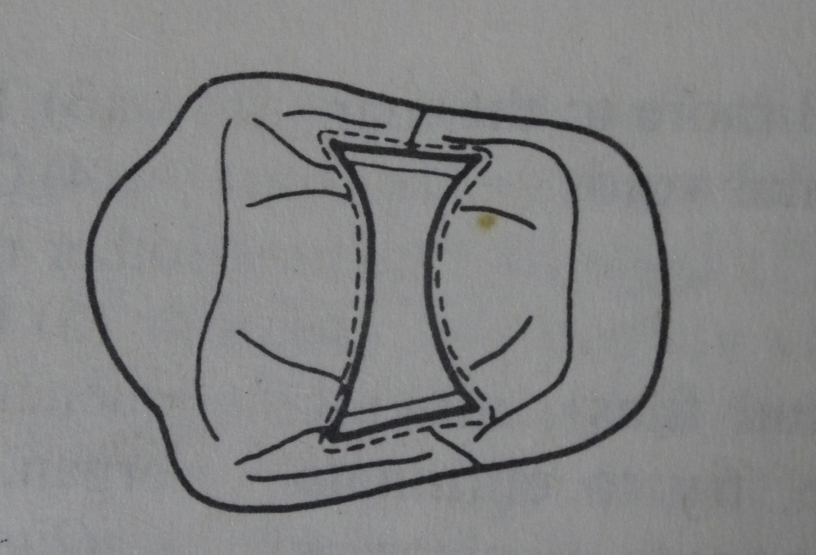
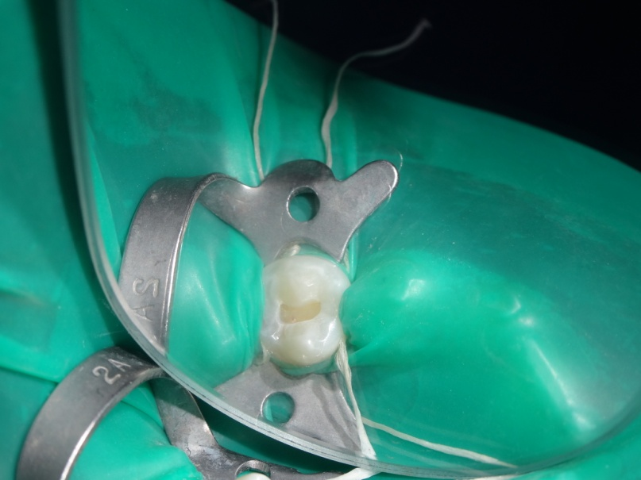
OUTLINE FORM
The external walls of the preparation are parallel to each other.
The pulpal wall is of uniform depth, parallel with the plane of the surface treated, and established at 0.5 mm into dentin.
Small undercuts to provide convenience form in beginning the compaction of gold

Slide 24
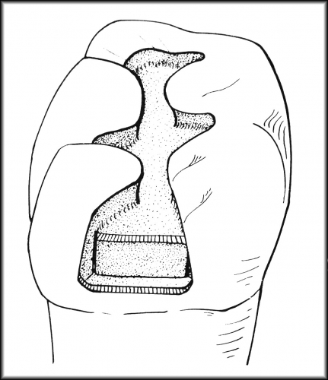
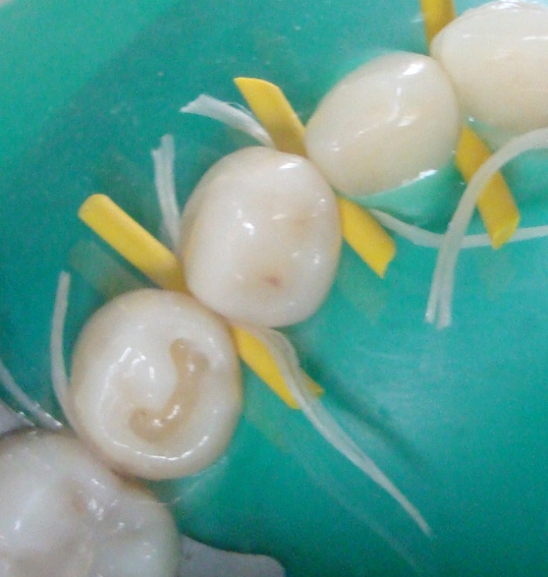
Resistance form
Flat pulpal floors perpendicular to the occlusal forces.
Walls must be smooth and flat.
Enamel walls must be supported by sound dentin.

Slide 25
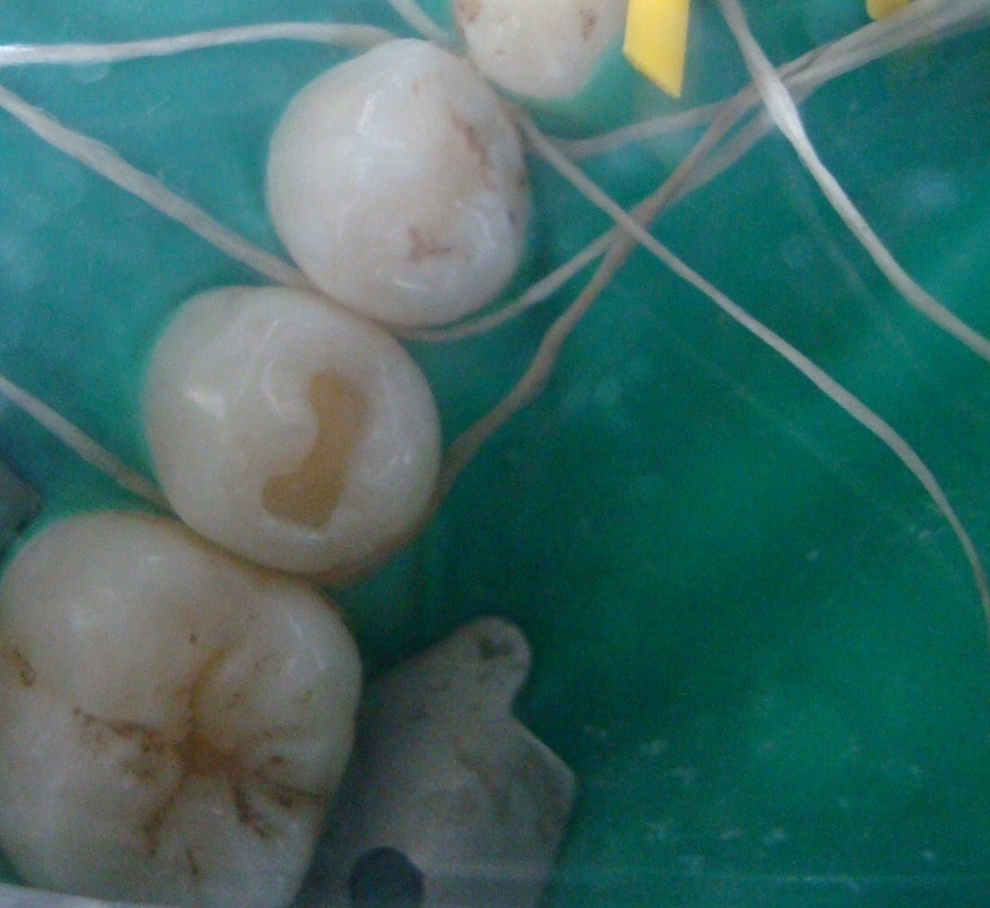
Retention form
Parallel or slight occlusal convergence of the facial & lingual walls.
Sharp internal line angles resist the movement of the restoration.

Slide 26
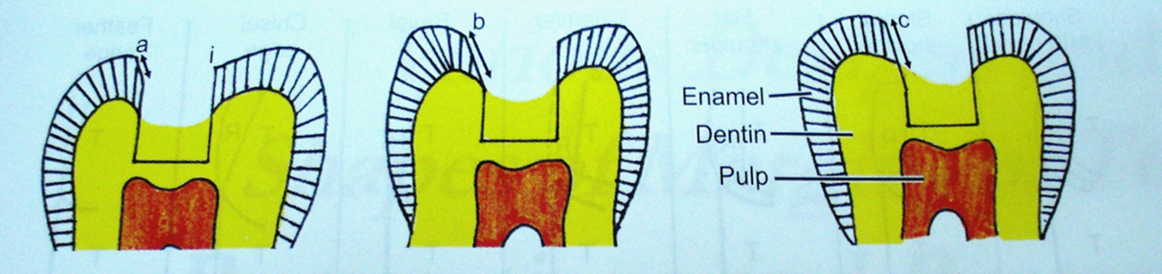
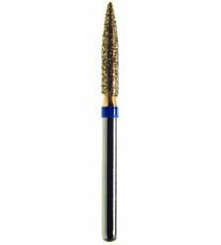
CAVOSURFACE BEVEL
A partial bevel is placed to:
create a 30- to 40-degree metal margin for ease in finishing the gold and to remove remaining rough enamel.
The bevel is not greater than 0.2 mm in width
Given with No. 8862 bur.

Slide 27

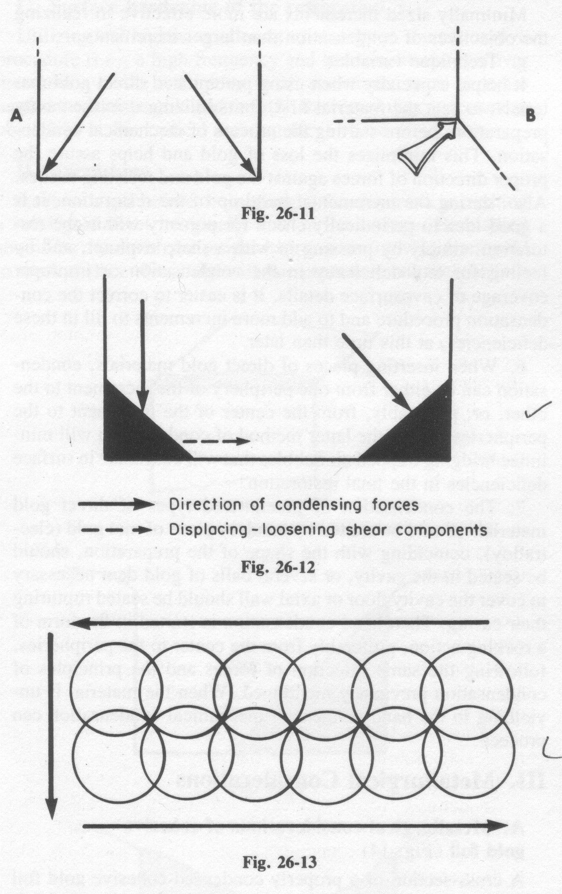
Starting Points
Sharp internal line angles and retentive points at point angles angles in dentin serve as convenient starting points for compacting of direct gold restoration.
Given with 33 1/2 inverted cone bur.

Slide 28

MANIPULATION OF GOLD FOIL

Slide 29
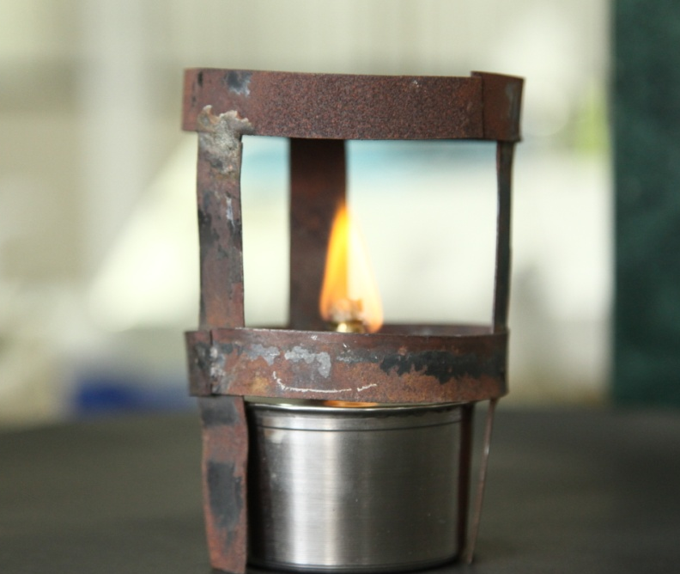
DEGASSING
For successful welding to occur during restoration, the gold must be in a cohesive state before compaction.
Because gold attracts gases that render it non-cohesive, such gases must be removed from the surface of the gold before dental compaction

Slide 30
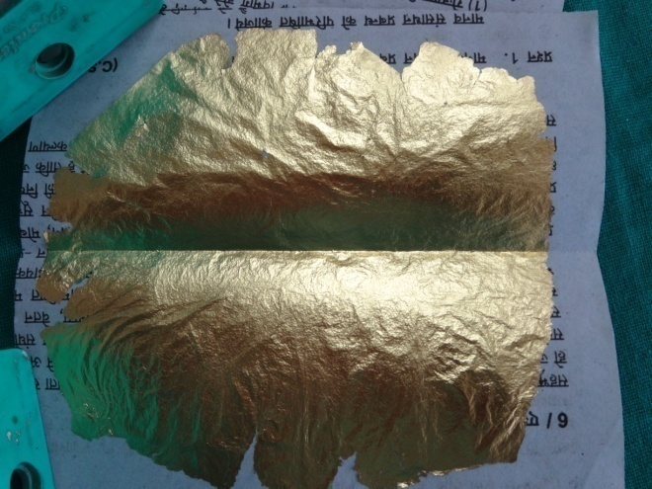
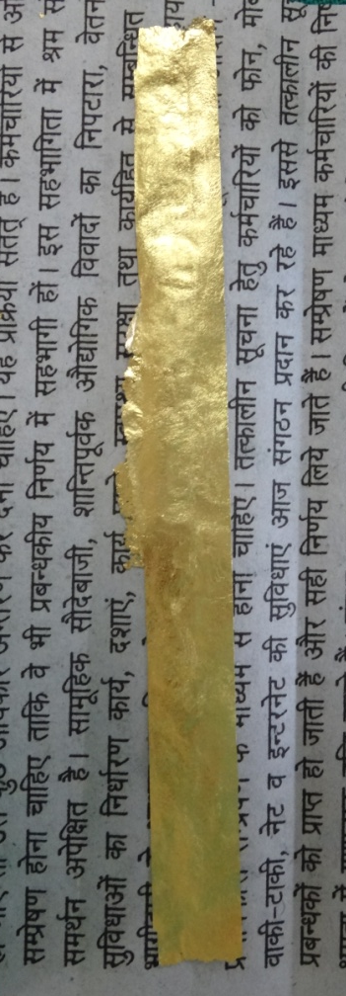
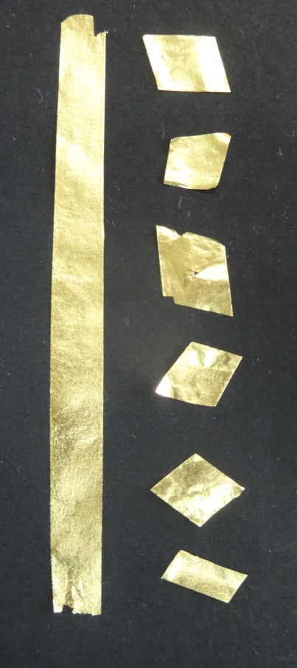

Slide 31
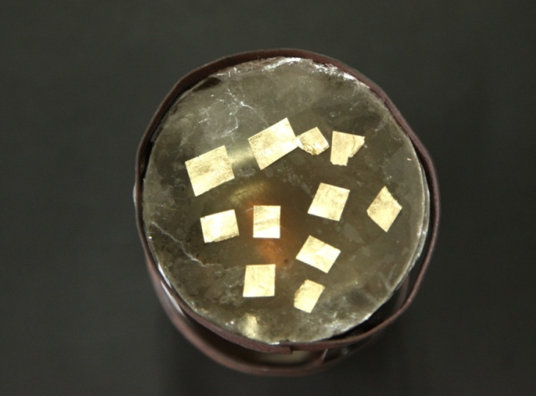
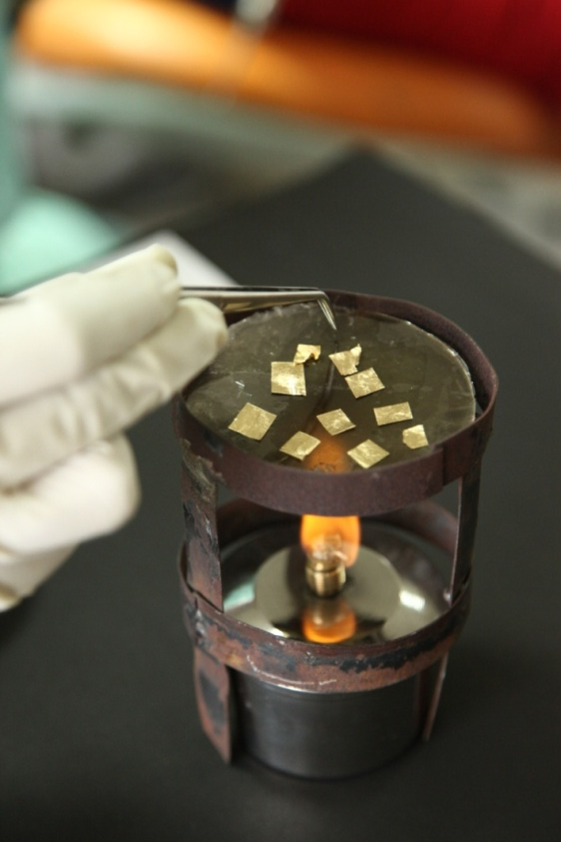
Degassing

Slide 32
DEGASSING
UNDERHEATING
OVERHEATING
Oversintering and possibly contamination from tray, instruments or flame.
Incomplete cohesion
Embrittlement
Poor compaction
Incomplete cohesion.
Pitting and flaking of the surface.

Slide 33
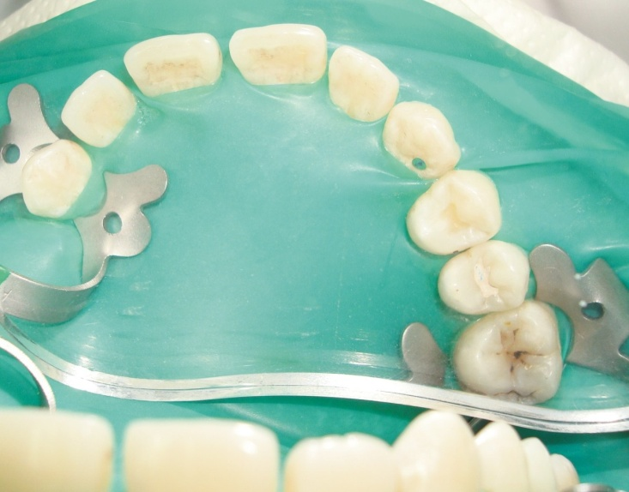
ISOLATION
The operating field should be well isolated with the help of rubber dam.

Slide 34
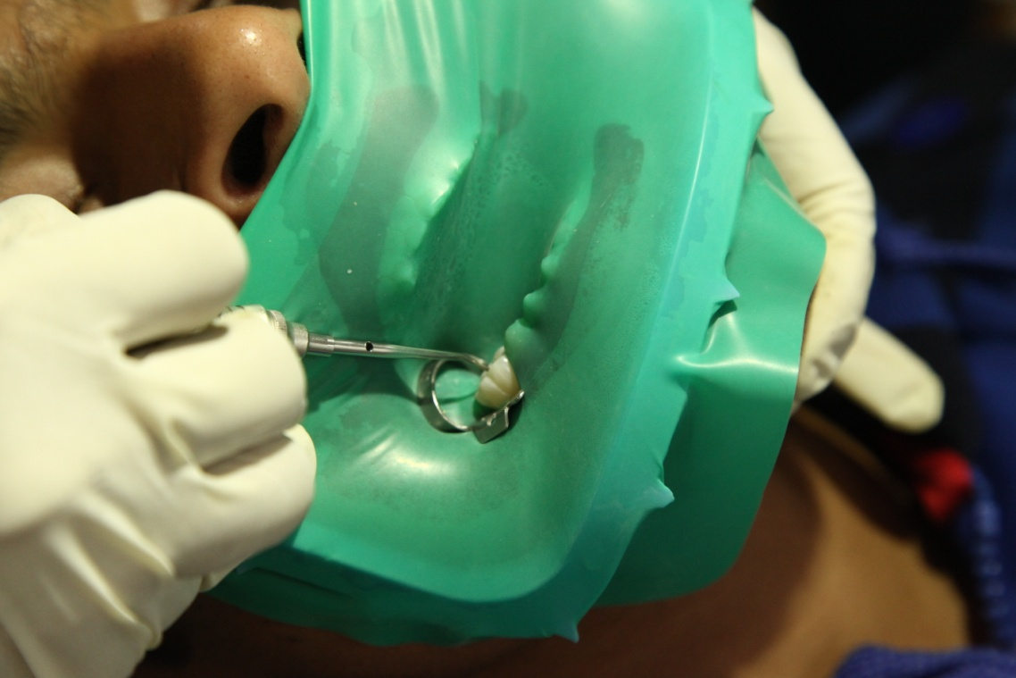
COMPACTION OF GOLD FOIL

Slide 35
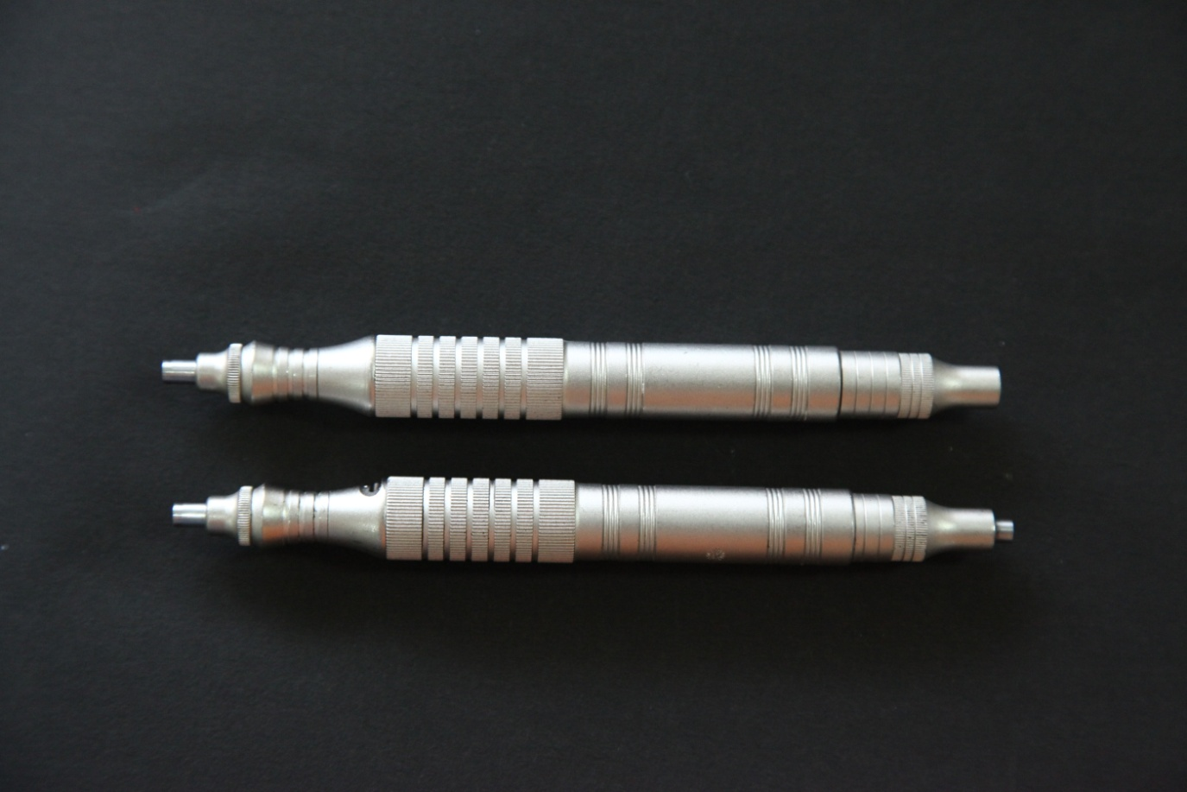
Condensors- Automatic Spring Loaded

Slide 36
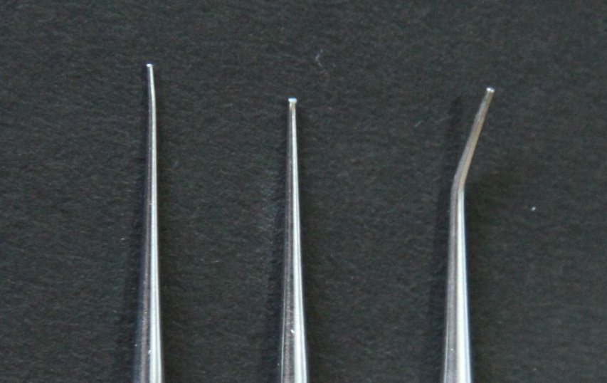
Starting the Restoration
The round condensors are used to condense foil in the starting retention points.
They come in 0.4 to 0.55 mm in diameter.
The smaller the nib face size (i.e., area), the greater the pounds per square inch delivered (given a constant malleting force)
Round nibs

Slide 37
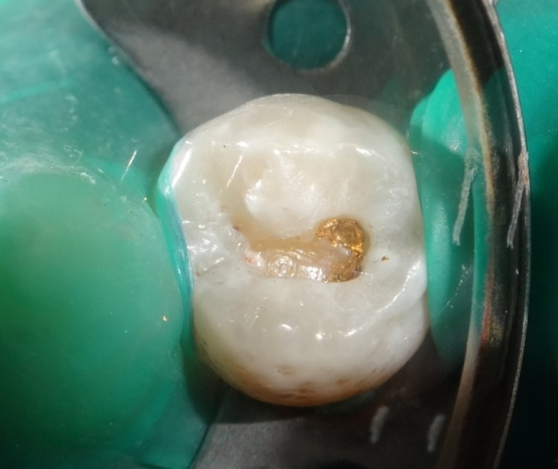
The line of direction of compaction should bisect the line angle and trisect the point angle.
First layer of foil anchored into the retention point in the mesiobuccal point angle.

Slide 38
CONDENSATION FORCE
  Exert 15lb/sq inch of force on the condenser nib less force is needed for small condenser nibs than for larger ones.
  Force of condensation must be at 45° to cavity walls and floors

Slide 39
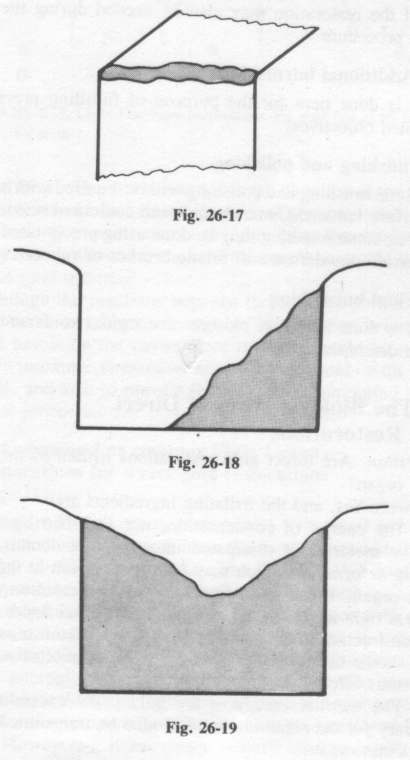

TIE FORMATION
Two opposite starting points are filled with gold to form a tie which acts as a foundation for the restoration

Slide 40
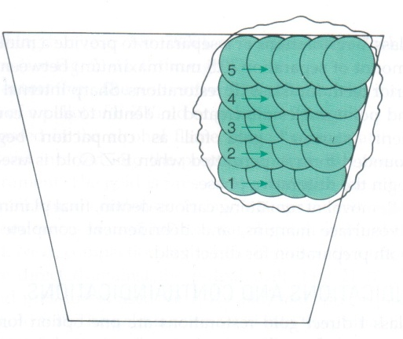
STEPPING
  Each succeeding step of the condenser overlaps (by half) the previous one as the condenser is moved toward the periphery
Some compaction also occurs by lateral movement of the gold against surrounding preparation wall.

Slide 41
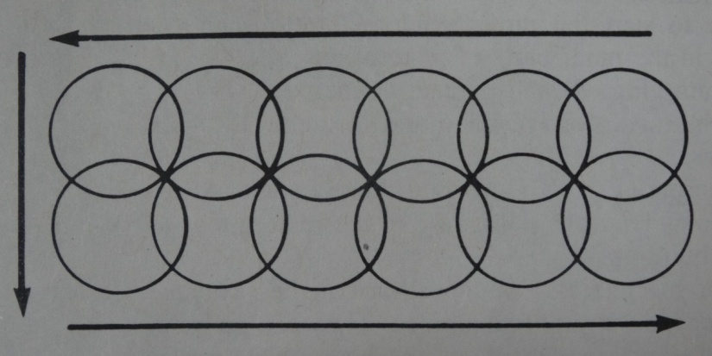
STEPPING
The most efficient compaction occurs directly under the nib face.
Carried out with a round condensor nib.

Slide 42
BANKING
This is accomplished by covering each wall from its floor or axial wall to the cavosurface margin with the direct gold material.
The parallelogram condensor is used for wedging and building gold against walls of cavities.

Slide 43
Each wall is built from its floor or axial wall to cavosurface margin.
"Banking" should be performed simultaneously on the surrounding walls of the preparation.

Slide 44
SHOULDER FORMATION
Sometimes, to complete a build-up, it is necessary to connect two opposing walls with the direct gold material.
These three steps should completely fill up the cavity preparation, but the build-up should continue until the preparation is overfilled

Slide 45


PAVING OR LAMINATING
Foot condensors are used for “after -condensation”
A controlled amount of excess is built up to allow normal contour.
Every part of cavosurface should be covered with gold.

Slide 46

BURNISHING
Done with round and Beaver tail burnisher.
Enhance surface hardening.
Adapt the material more to the margins.
Eliminates voids from the surface and margin.

Slide 47

FINISHING & POLISHING

Slide 48

FINISHING
The surface is contoured by removing excess material from margins with help of carvers or stones.
Finishing done with disks and stones with light pressure.

Slide 49

POLISHING
With help of gold polishing tips.
Silica, pumice or metallic oxide compounds are used as polishing agents.

Slide 50
Why Gold Foil??
“WE MUST ADJUST TO CHANGING TIMES AND STILL HOLD TO UNCHANGING PRINCIPLES”

Slide 51



Why gold foil?
Gold is highly noble and insoluble in oral fluids
It adapts perfectly to the cavity walls.
High crushing and edge strength.

Slide 52

It is the only permanent restoration in the truest sense.

Slide 53


Reasons for decline
Aesthetics
Expensive
Lack of skill for this procedure of operators

Slide 54

Initial investment by the patient may seem higher than the other restorative materials, the direct gold restoration is actually not very expensive.
It costs about Rs. 1500-2000 for one restoration and is one of the most cost effective treatments as it serves a lifetime.

Slide 55

Direct gold restorations can last for a lifetime if attention is paid to details of restorative technique and to proper home care.
The longevity is a result of the superb biocompatibility of gold with the oral environment and its excellent marginal integrity.

Slide 56

IN THIS MODERN AGE of dentistry, with the high speed and other up-to-date equipment, we have a tendency to forget the fine art of cavity preparation

Slide 57


Gold foil, more than any other type of proce­dure, offers an answer to this problem.
It is an exacting preparation and tests the skill of the operator.

Slide 58

Parameters in dentistry are slowly shifting towards ad-hoc and cut-paste dentistry: from metallic to plastic restoration which is not in the interest of our profession and restorative speciality.

Slide 59

As plastics and cement silicates change form during the hardening process, and lack crushing resistance and edge strength as compared with most of the non-plastics, they are not nearly so permanent in character.

Slide 60

The many failures resulting from an indiscriminate use of the acrylic resins by the profession during the last several years have gradually led to a revival of interest in the cohesive gold foil restoration.

Slide 61

The sterling qualities of gold foil should be recognised and no attempt made to displace it.
Revival of permanent restorations with use of gold, either direct or indirect is need of the hour.

Slide 62
Some of the components of composite were not tested for human use at the time of its introduction??
DO YOU KNOW ??

Slide 63
DO YOU KNOW ??
That some constituents of composite resin are POTENTIALLY CARCINOGENIC??
TEGDMA, UDMA and HEMA have been shown to cause DNA-damage and gene mutations in mammalian cells.
Benzoyl peroxide, a polymerization catalyst, has been found to promote TUMORS in vitro.
.

Slide 64
Some components like methacrylic acid and camphoroquinone have been shown to cause GENOTOXICITY.
Resin composites have been shown to release formaldehyde which is considered as a possible carcinogen

Slide 65

Composite is Cytotoxic
An in vitro evaluation of the cytotoxicity of 35 dental resin composite monomers and additives indicated moderate to severe cytotoxic effects
(Journal of Biomedical Material Research, 1998)

Slide 66

TEGDMA and the photostabiliser 2-hydro-4- methoxybenzophenone (HMBP) are cytotoxic and inhibit cell growth (Journal of Dental Research 2003)

Slide 67

Dental education program and its content should be a reflection of the anticipated requirements a dentist must possess to render high quality services to the patients he/she should serve.

Slide 68

The debate is between conserving the tooth tissue to place a plastic restoration
OR
To make a proper cavity design as per guidelines of tooth preparation and place a life long holding restoration.

Slide 69

“ If the full story of dentistry's service to humanity is ever told, gold foil must be given the major credit for this service.”
Norwood E. Lyons,
Journal, American Academy of Gold Foil Operators, Vol. XI, No. 1, April 1968

Slide 70

Direct Gold Filling- The KING of restorative materials
“If the romance of dentistry is ever written “gold foil” will be one of the leading characters……”

Slide 71
mcqs
1) The gold foil prepared by electrolytic precipitation is
a) Platinized gold foil
b)Crystalline gold foil
c) Powdered gold foil
d) Electralloy RV

Slide 72
2)The process of removing gases from the surface of gold foil is referred as
a) Annealing
b)Condensation
c) Trituration
d)Casting

Slide 73
3) When Two opposite starting points are filled with gold to form a tie which acts as a foundation for the restoration is termed as
a) tie formation
b) Banking of the wall
c) Shoulder formation
d) paving of the restoration

Slide 74
4) Name the bur used to give Retentive undercuts in gold foil cavity
a) No. 33 ½ inverted cone bur
b) No. 330 Pear shaped
c) No. 8862 bur
d) No.46 bur

Slide 75
5) pure gold is
a)24 karat
b)22 karat
c)20 karat
d)18 karat

