Slide 1
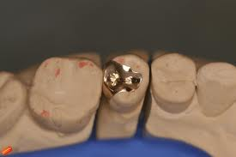
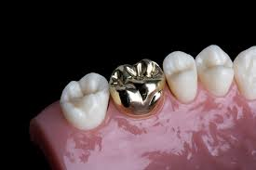
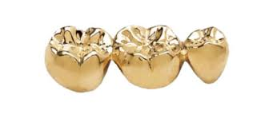
Cast restoration
DR PROMILA VERMA
DEPARTMENT OF CONSERVATIVE DENTISTRY & ENDODONTICS

Slide 2
Cast Restoration
A restoration can be defined as
“Any structure provided to replace and restore dental tissue so as to restore its form and function, such as a filling, crown or a bridge”
A tooth preparation is defined as
“Mechanical alteration of defective, injured, or diseased tooth to best receive restorative material that will reestablish a healthy state of tooth including esthetic correction along with normal form & function”

Slide 3
Cast
“Life size likeness of some desired form”.
“To produce a shape by thrusting a molten liquid or plastic material into a mold possessing a desired shape”
Casting
“Something that has been cast in the mold; an object formed by the solidification of a fluid that has been poured or injected into the mold”
Glossary of prosthodontic terms

Slide 4
Cast Restoration
Inlay
Onlay
Cast restorations with surface extension
Pinlays
Full veneer cast

Slide 6
Indication
Extensive tooth involvement
Correction of occlusion
Restoration of endodontically treated teeth
Support for and preparatory to partial or complete dentures
Retainers for fixed prosthesis
Cracked teeth
Esthetics
Dissimilar metals

Slide 7
Contraindication
Young dentition with large pulp chamber.
Developing and deciduous teeth.
High plaque caries index.
Occlusal disharmony.
Dissimilar metal.
High esthetic demands of the patients

Slide 8
Advantages
Strength of the material.
Biocompatible
Less tarnish and corrosion.
Abrasion resistance and low wear rate.
Reproduction of precise form and minute details.
Long lasting restoration.
Produces surface with maximum biologic acceptance.
Maintains proximal contact for considerable period of time.
Configuration of contact and contours can also be modified.

Slide 9
DISADVANTAGES:
Lack of close adaptability to the cavity walls because of interface of luting cement.
Microleakage.
Cost
Time consuming.
Extensive tooth involvement.
Recurrent caries.
Galvanism in case of dissimilar in metal.

Slide 10
MATERIAL FOR CAST RESTORATION
Gold based alloys.
ADA specification No. 5.
CLASSIFICATION:
Class I:
Gold & Platinum based alloys. Type I, II, III & IV.
Class II:
Low gold alloys. Gold less than 50%.

Slide 11
Class III:
Non gold palladium based alloys.
Class IV:
Nickel-chromium based alloys.
Class V:
Castable moldable ceramics.

Slide 12
CLASS I
Composition:
70-75% Gold,1-5% Platinum &/or Palladium,20-25% Silver, Copper, Zinc and /or Indium.

Slide 13
Class I type I
4 Types:
Type I:
Soft gold.
Most plastic.
Highest content of gold (75-80%).
Most ductile.
Lower hardness and proportional limit.
Indications:
Low stress bearing area.
Direct method of inlay fabrication.
Metal can be polished or finished upon the tooth.

Slide 14
Class I Type II
Medium hard.
Contains 75-80% gold.
Indications:
Indirect method of inlay fabrication.
Crowns supported by single teeth.
Finishing and polishing can be performed outside the mouth on the tooth model or die.

Slide 15
Class I Type III
Hard alloys.
Contains 65-75% gold.
Greater tensile strength and hardness.
Indications:
Single tooth restoration.
Abutment crowns for fixed prosthodontic restoration.
Three quarter and complete crowns

Slide 16
Class I Type IV
Extra hard alloy.
65-75% gold.
Least deformable with lowest content of gold.
Indications:
Removable prosthodontic appliances with clasps or precision attachment.

Slide 17
Class II
No ADA specification.
Economy gold alloy.
Gold content less than Class I.
Palladium substitutes gold.
Composition:
60% palladium.
Gold <5%.
Copper silver zinc 25-30%.

Slide 18
Class III
Non-gold palladium based alloys.
Composition:
Palladium and silver 80-90%.
Indium, copper, tin 10%.

Slide 19
Class IV
Nickel-chromium based alloys.
Composition:
Nickel-chromium with chromium content <30%.
Low percentage of molybdenum, tungsten and aluminium.
Berrylium in low percentage.
Gallium substitutes Berrylium
Silicone and iron <2%
Carbide 0.2-4%.
Titanium & cobalt.

Slide 20
Class V
Castable moldable ceramics.
Composition:
Aluminium trioxide 50%.
Magnesium oxide 15%.
0.5% wax or stearate.

Slide 21
Case Selection
Patient related factor
Medical history
Patient expectations
Dental history
Personal history
Operator related factors
Time constraints
Operator’s skill
Working with the dental technician
Oral environment related factors
Extra oral examination
Intraoral examination

Slide 22
Bevels
It is a plane / cutting of a cavity wall or floor directed away from the cavity preparation.
Advantages
Easy to burnish
Better margin fit
Better marginal adaptation
Prevention of micro leakage

Slide 23
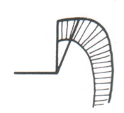
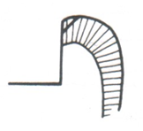
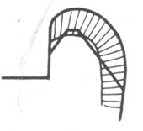
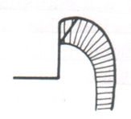
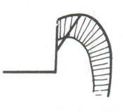
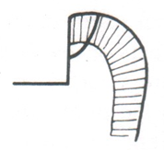
Bevels
Partial bevel.
Short bevel.
Long bevel.
Full bevel.
Counter bevel.
Hollow round bevel

Slide 24
Functions of bevels
Creates obtuse angle, marginal tooth structure and acute angle marginal cast alloy substance.
Marginal bevel: reduce the space between cast and tooth substance three or more fold at the margins.
Provide retention to the cast restoration.
Hollow ground occlusal and counter bevels are used for resistance form of the tooth restoration complex by encompassing cusps.
Gingival bevels can bring the gingival margins to the cleansable and protected area.

Slide 25
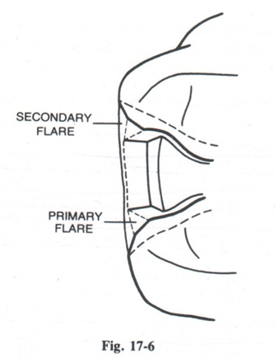
Flares
There are two types of flares:
Primary Flare
Secondary flare

Slide 26
Primary flare
Conventional and basic part of circumferential tie.
similar to Long bevel.
45° to inner dentinal wall proper.

Slide 27
Primary flare
Function:
Same as bevel.
Brings facial and lingual margins of the cavity preparation to cleansable – finishable areas.
Indications:
Any facial and lingual proximal wall of intracoronal cavity preparation.

Slide 28
Secondary flare
Flat plane superimposed peripherally to primary flare.
Some time prepared in a hollow ground form to accommodate materials with low castability.
Prepared solely in enamel for some times may involve dentin.
Have different angulation, involvement and extent depending upon their functions.

Slide 29
Function & Indication of secondary flare
Same as bevels.
In wide extended lesions buccolingually a secondary flare superimposed at correct angulation can create the needle obtuse angulation of the marginal tooth structure.
In very broad contact are or malposed contact area a secondary flare superimposed peripherally on the primary flare will bring facial and lingual margins to finishable cleansable area.
In ovoid teeth a secondary flare superimposed on primary flare eliminate the problem of marginal failure by removing undercuts with minimum sacrifice to the tooth structure.

Slide 31
Preparation path
Preparation will have a single withdrawal path
Opposite to the direction of occlusal loading
Parallel to long axis of the tooth and completed cavity will have no draft.

Slide 32
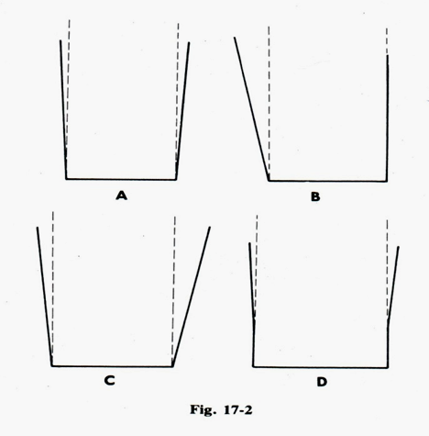
Taper
Cavity walls must diverge from the floor of the preparation externally.
2 types
Intra coronal taper
Extra coronal taper
Intra coronal taper: Extensions of opposing walls diverge towards the occlusal.
Extra coronal taper: The extensions of the opposing wall converge towards the occlusal.

Slide 33
Taper
Taper permits unobstructed removal of wax pattern and seating of subsequent casting.
Undercut if present obstruct the path of pattern removal or casting reinsertion.
On an average 2-5° is considered sufficient for retention from the path of preparation.

Slide 34
Taper
Taper can be increased or decreased according to the following factor-
-length of the preparation
-dimension & detail of surface involvement& internal anatomy in the preparation
-need for retention
-

Slide 35
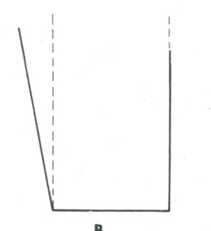
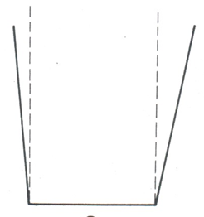
Taper
Taper can be done equally at the expense of two opposing walls or axial surface.
Taper can be done at the expense of one side only, if opposing side is absolutely parallel to insertion path.
Taper should never be made with one side having more taper than the other.

Slide 36
Design Of Cavity & Tooth Preparation
INLAY CAST RESTORATION
General shape
Occlusion portion- ‘dove tailed’
Proximal portion –boxed in shape

Slide 37
DESIGN OF THE INLAY CAVITY
LOCATION OF MARGINS
1) OCCLUSION PORTION
-margins are located on inclined planes of corresponding cusp, triangular ridges or marginal ridges.
- Bucco-lingual width at the isthmus should not exceed 1/3 the inter-cuspal distance .
2) PROXIMAL PORTION
-facial and lingual margins are each in corresponding embrasures
-

Slide 38
Internal Anatomy of Inlay Cavity
OCCLUSION PORTION
1) wall proper-constituting about pulpal two third of facial or lingual walls
Formed completely of dentin
Walls taper from each other on average of 2⁰⁻ 5⁰ or parallel to each other .
Occlusal bevel-long bevel.
Angulation of the bevel should decrease with increased steepness of the cusp.
Pulpal floor –should be flat if not at least peripheral portion should be flat.
Pulpal floor should meet all surrounding walls in a definite line angle except its junction with axial wall .

Slide 39
Proximal portion
Axial wall should either be flat or rounded in bucco-lingual direction, and either vertically or slightly divergent(5-10⁰) towards the pulpal floor in gingivo-occlusal direction.
Axial wall should meet the pulpal floor in an extremely rounded junction
Facial and lingual walls are comprised of two planes-
- axial half
- proximal half

Slide 40
Gingival Floor
Proximally should be flat in bucco-lingual direction
The junction between occlusal bevel and the secondary or primary flare proximally should be very rounded .

Slide 41
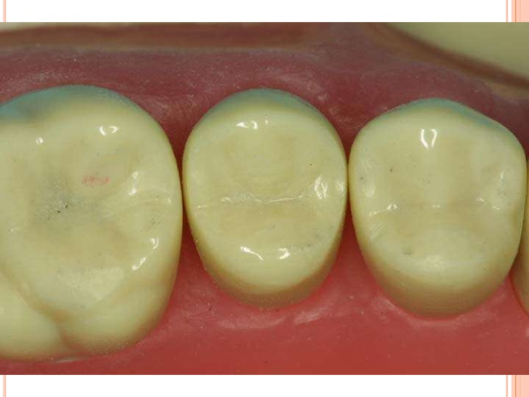
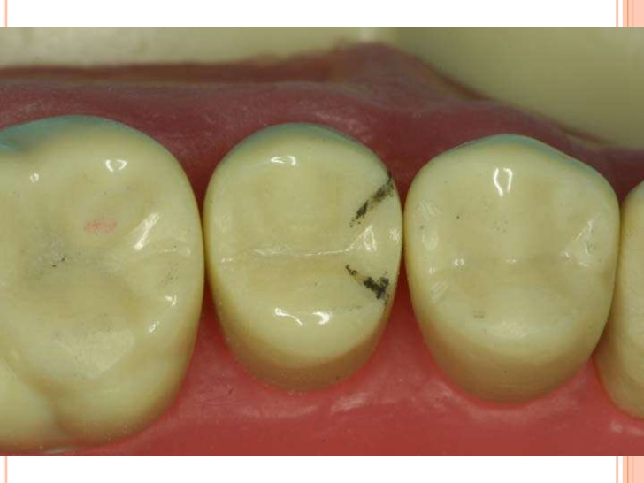

Slide 42
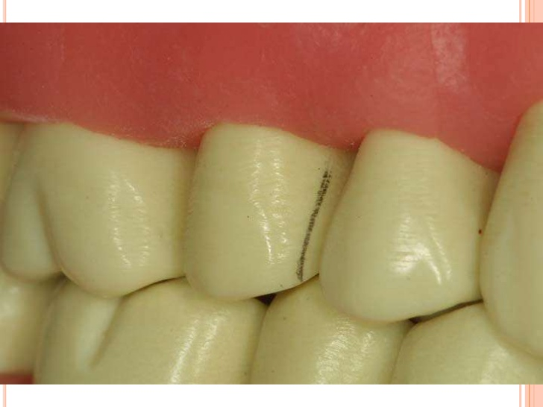
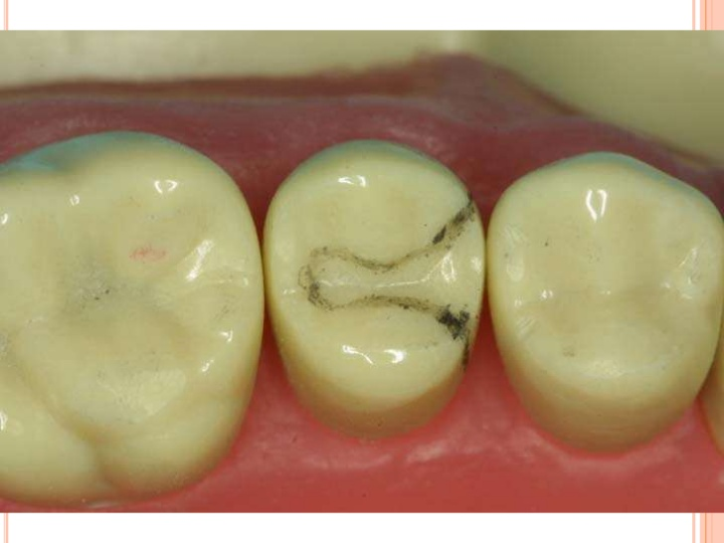

Slide 43
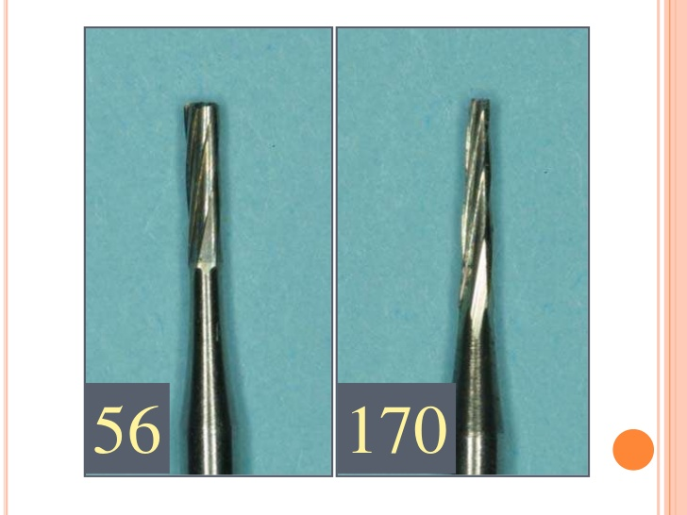

Slide 44
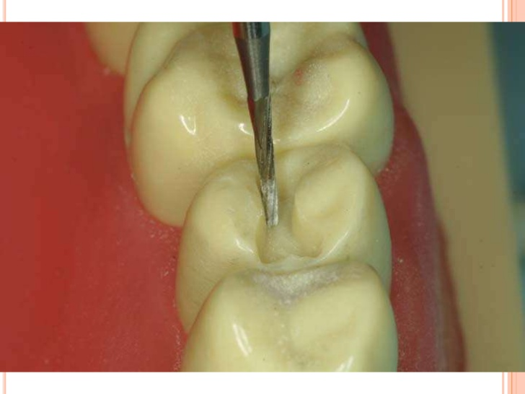

Slide 45
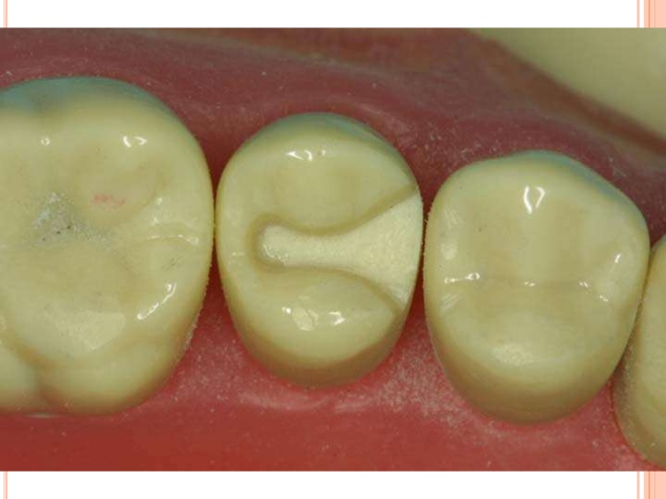

Slide 46
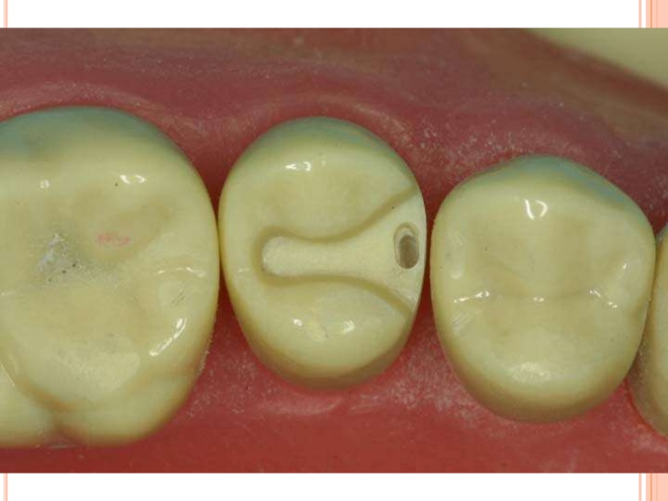
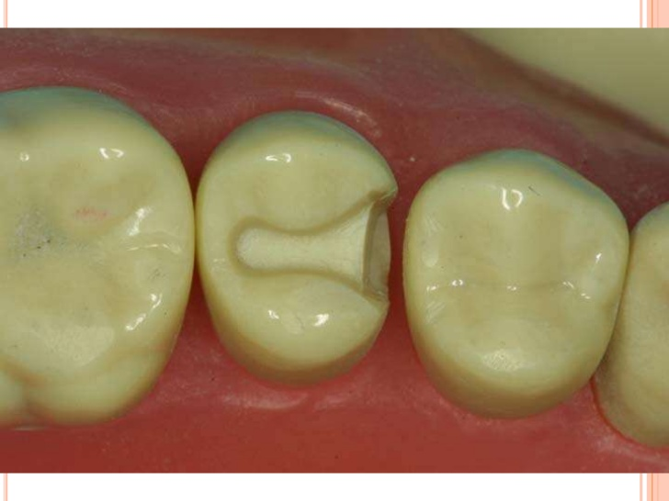
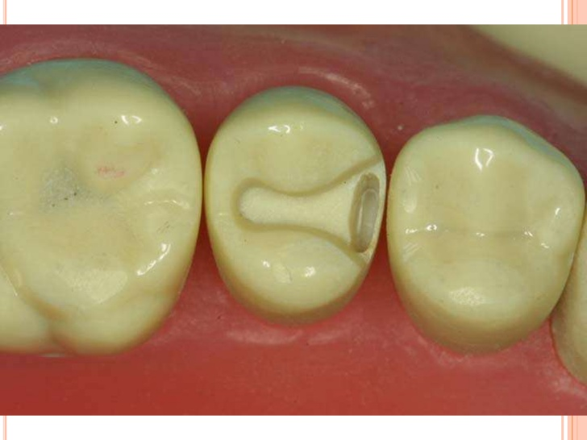

Slide 47
MCQs
1)The thin extensions of the facial or lingual proximals margins of cast metal onlay that extends from the secondary flare to a termination just past the transitional line angle of the tooth.
a)Skirt Preparation
b)Collar preparation
c) Circumferential tie
d) Bevel

Slide 48
2) Long bevel includes
a) partial enamel
b) full enamel
c) full enamel and partial dentin
d)full enamel and dentin

Slide 49
3) Class III alloys are
a)Non gold palladium based alloys.
b) Nickel-chromium based alloys.
c) Castable moldable ceramics.
d) Low gold alloys. Gold less than 50%.

Slide 50
4) Taper permits
unobstructed removal of wax pattern and seating of subsequent casting
Retention of the casting
Prevention from fracture .
Finishing of the restoration

Slide 51
5) Pulpal floor should meet all surrounding walls in a definite line angle except its junction with
a) Axial wall .
b)Gingival floor
c) Proximal wall
d) Cavosurface margin

