Slide 1
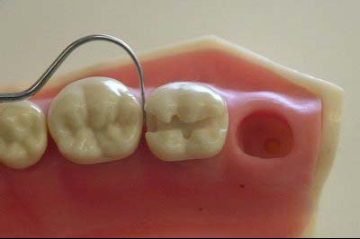
CLASS II AMALGAM RESTORATIONS

Slide 2
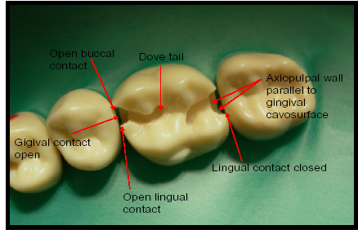
A Class II preparation

Slide 3
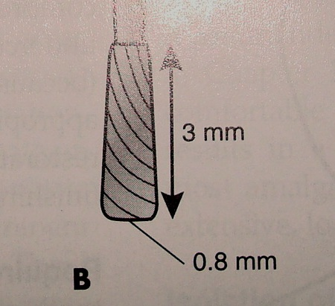
No. 245 Bur

Slide 4
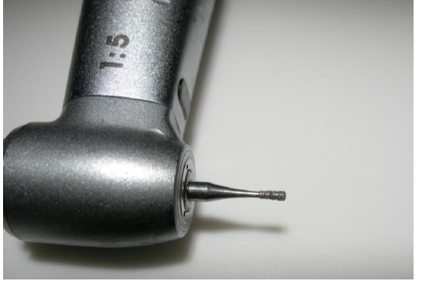
Pear shaped bur No. 330

Slide 5
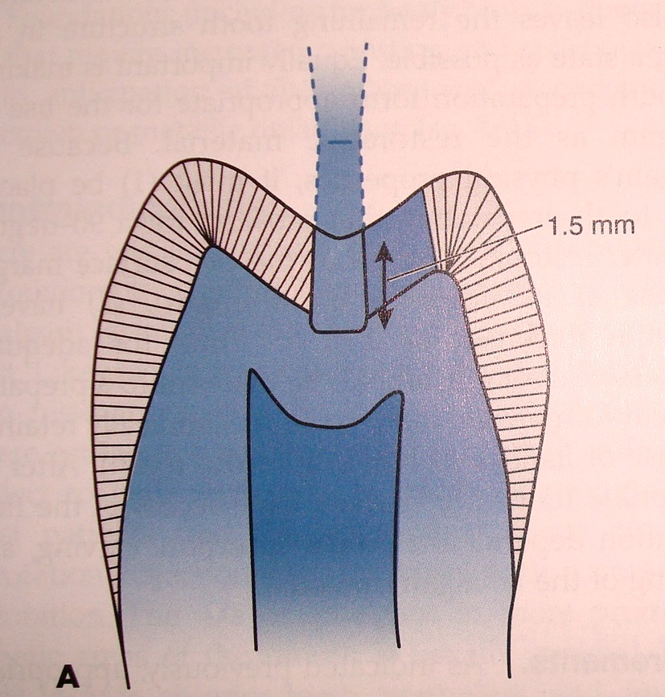
INITIAL DEPTH
Initial depth is 1.5 mm from the central pit or 0.2-0.5 mm into dentin or 2mm from the prepared buccal and lingual walls.

Slide 6
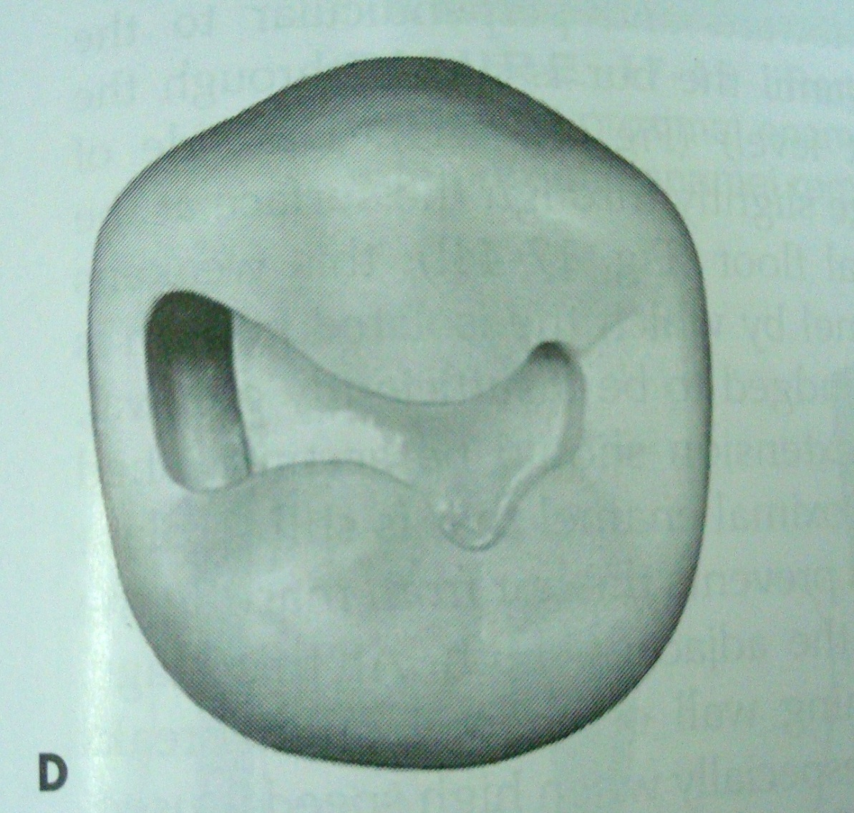
OUTLINE FORM AND PROXIMAL DITCH.
Outline form in the occlusal portion is similar to a Class I cavity.
0.8 mm from marginal ridge,a proximal ditch is made to gain a proximal step.

Slide 7
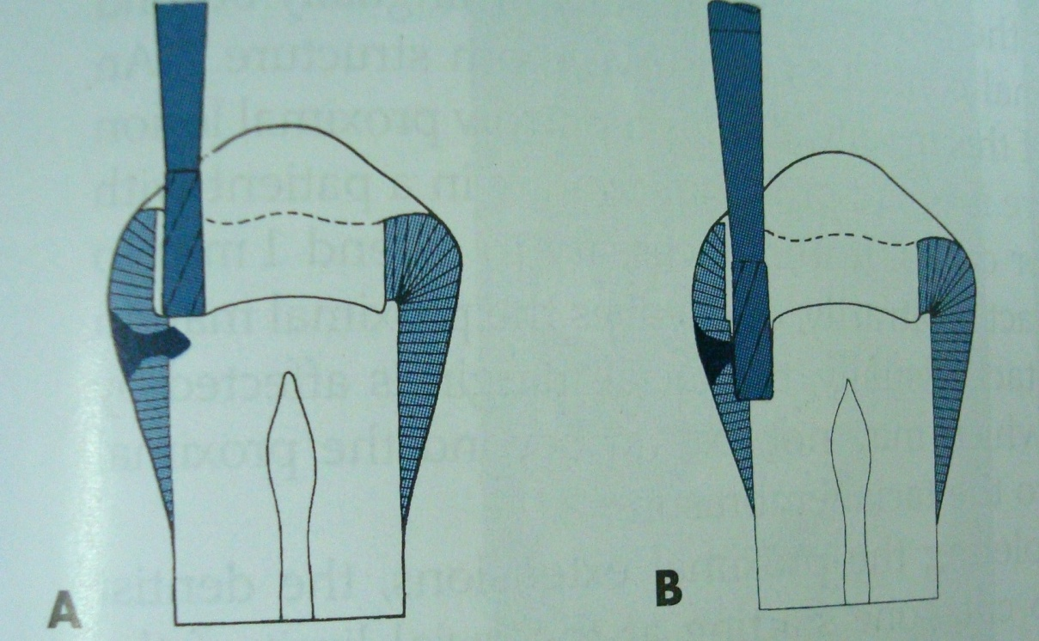
PROXIMAL DITCH
Bur position to start the proximal ditch.
B Proximal ditch etended gingivally to the desired level of gingival wall(ie. floor)

Slide 8
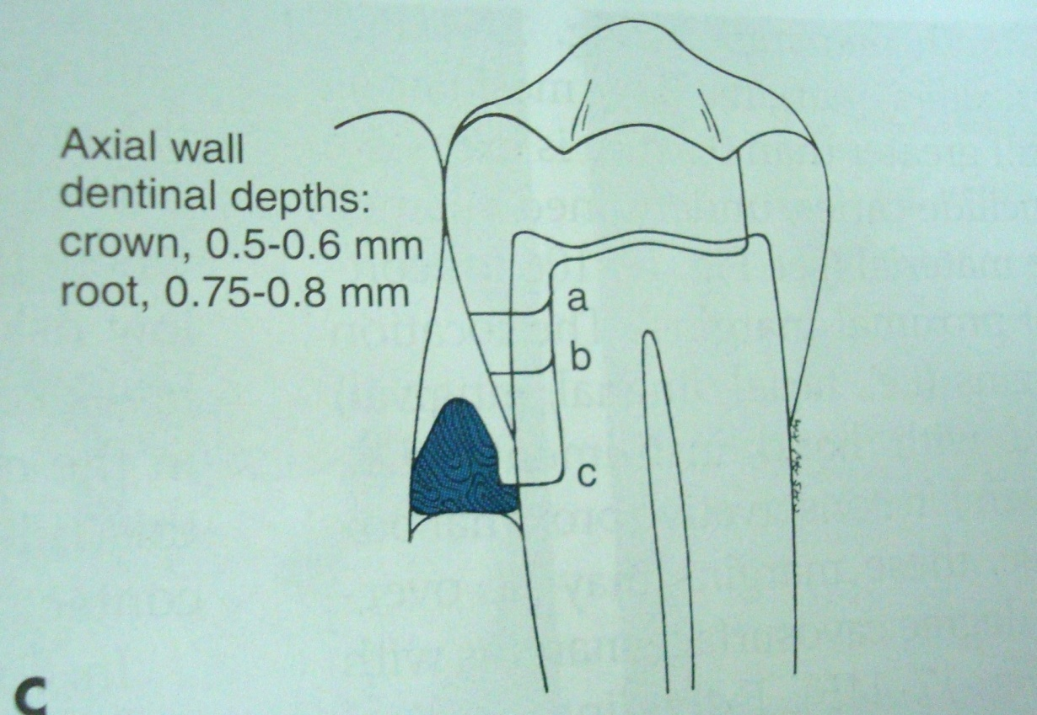
PULPAL DEPTH
Variance in pulpal depth-a. At minimal gingival extension.
b. At moderate extension.
c. At extension that places gingival margin at cementum.

Slide 9
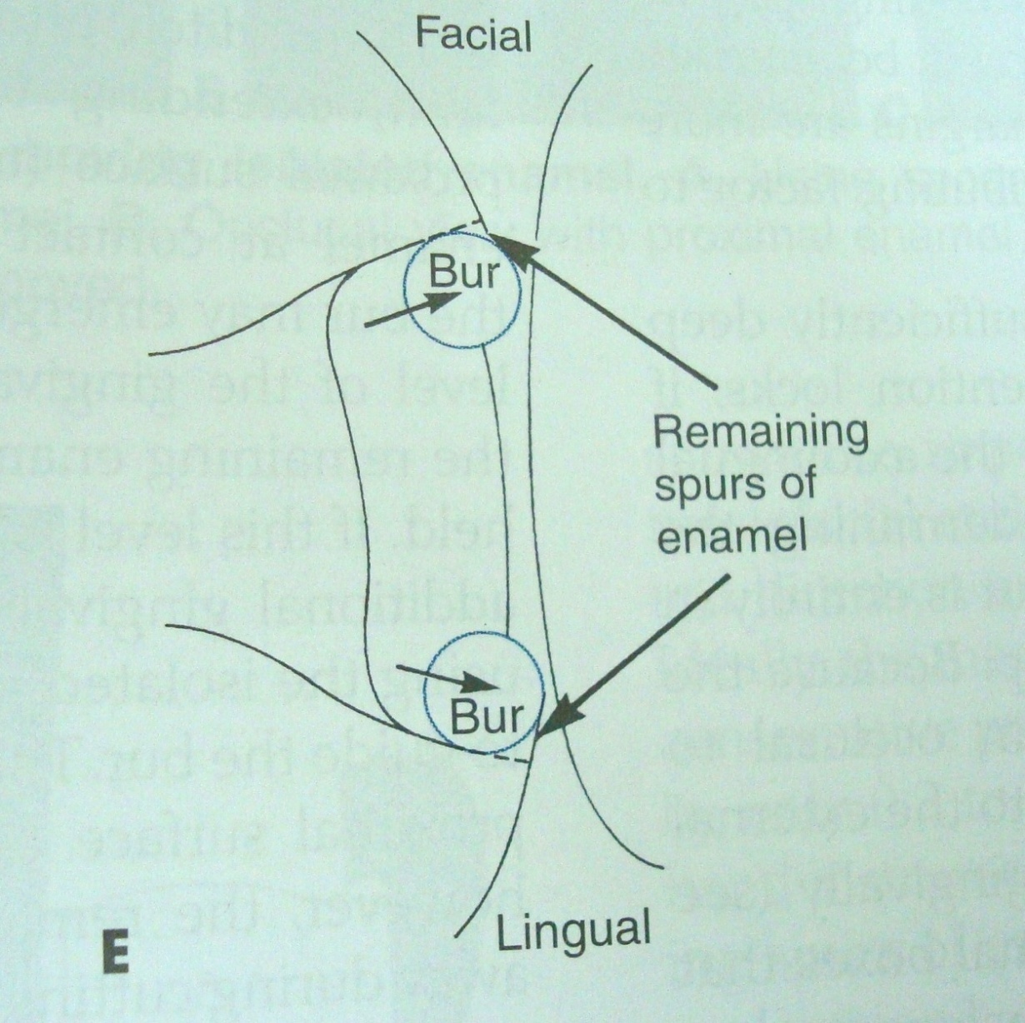
ISOLATION OF PROXIMAL ENAMEL
Position of the proximal walls ie. facial,lingual and gingival should not be over extended,as some extension will be done by hand instruments also.

Slide 10
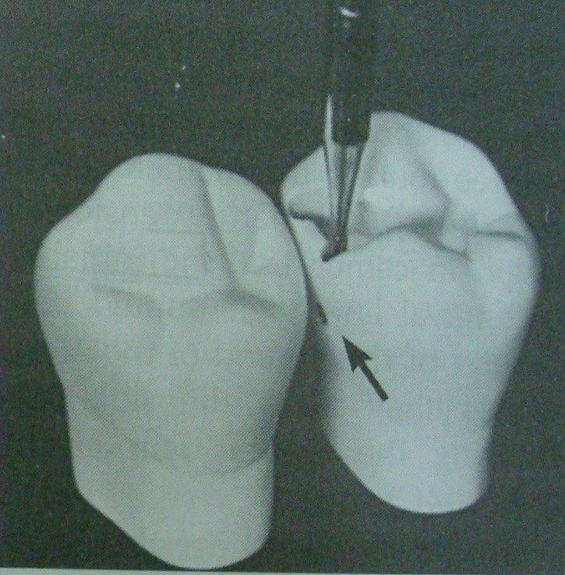
ISOLATION OF PROXIMAL ENAMEL
Bur is moved towards and perpndicular to proximal surface to isolate the proximal enamel.
Side of the bur may emerge slightly through the proximal surface at the level of gingival floor.

Slide 11
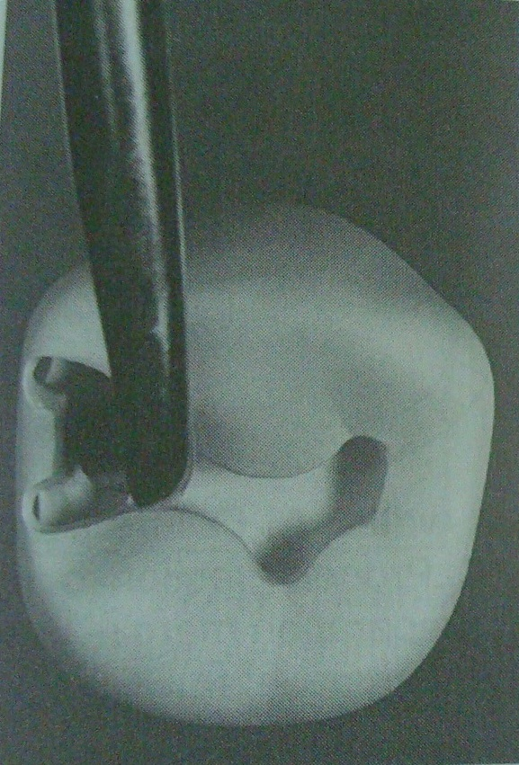
Removing isolated enamel with a spoon excavator to fracture out weakened proximal enamel.

Slide 12
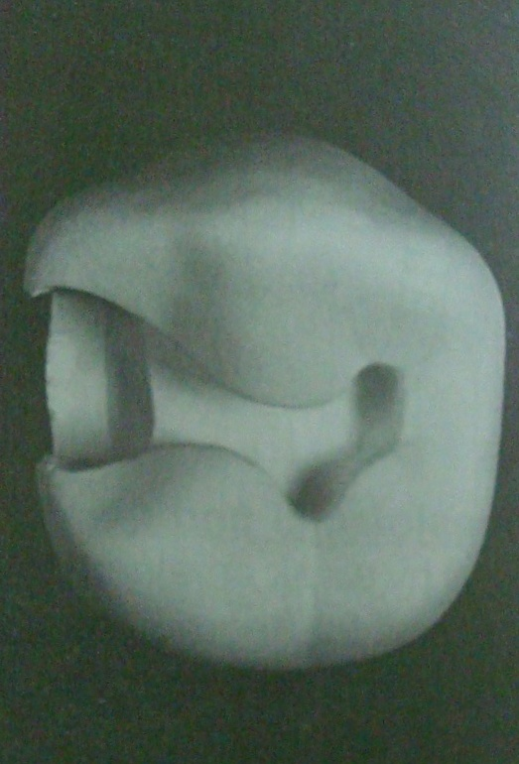
Occlusal view with proximal enamel removed.

Slide 13
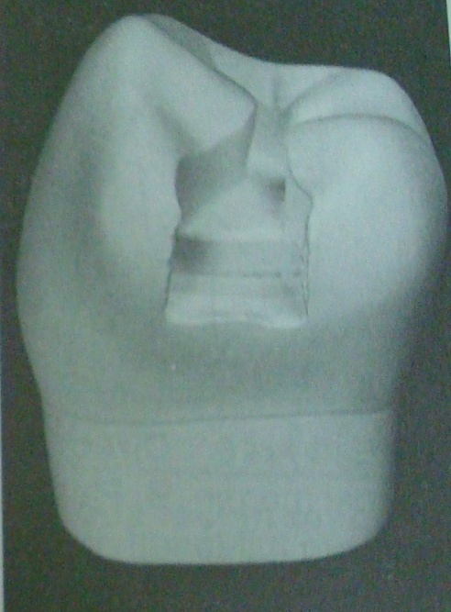
Proximal view with proximal enamel removed.

Slide 14
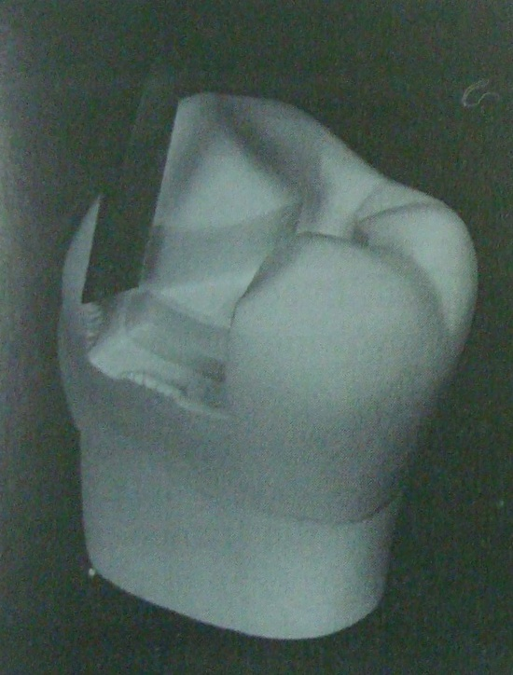
Removing remaining undermined proximal enamel with enamel hatchet on facial proximal wall.

Slide 15
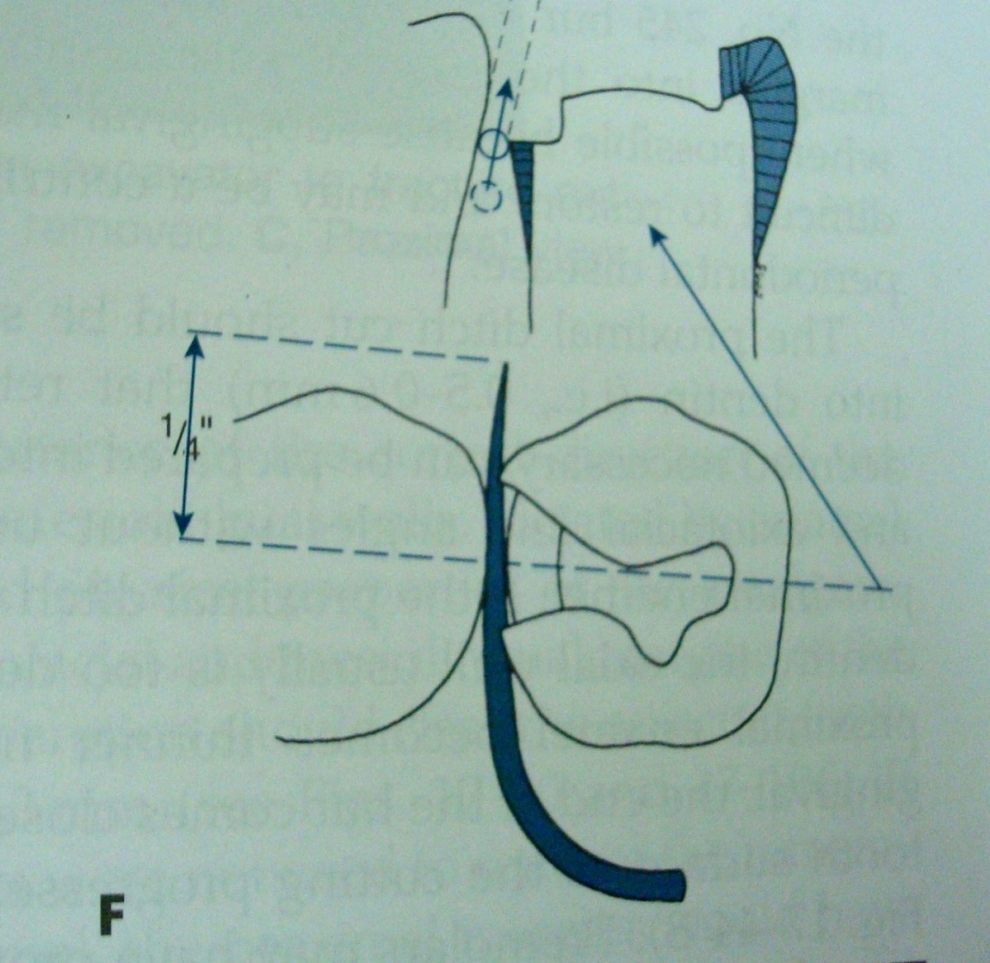
CLEAREANCE
When a small lesion is prepared,gingival margin should clear adjacent tooth by 0.5 mm.This is measured by passing tine of No. 23 explorer which is about 0.5 mm at ¼ inch from the tip.

Slide 16
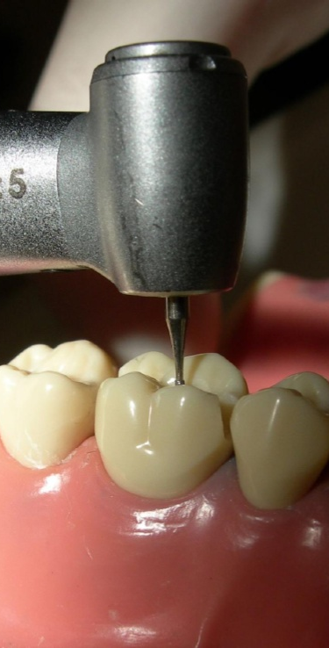
Bur is parallel to the long axis of the tooth.

Slide 17
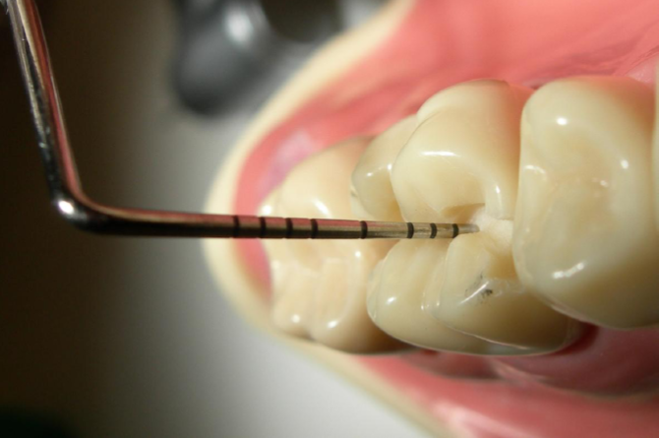
CHECKLIST
Checking for even depth on the occlusal part of the preparation.

Slide 18
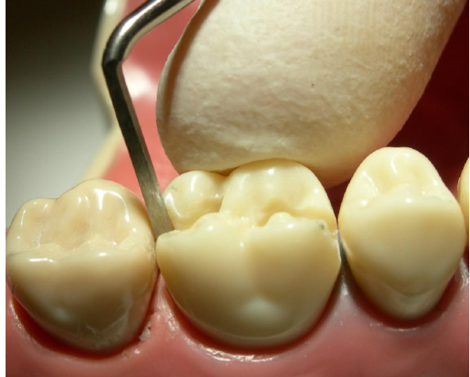
Using a off angle hatchet to smooth out the buccal wall of the proximal portion.

Slide 19
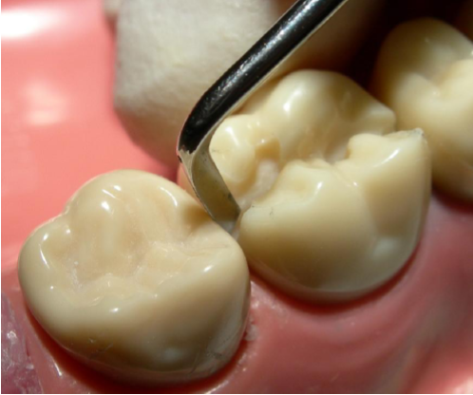
Using Off angle hatchet for smoothening buccal wall of proximal box.

Slide 20
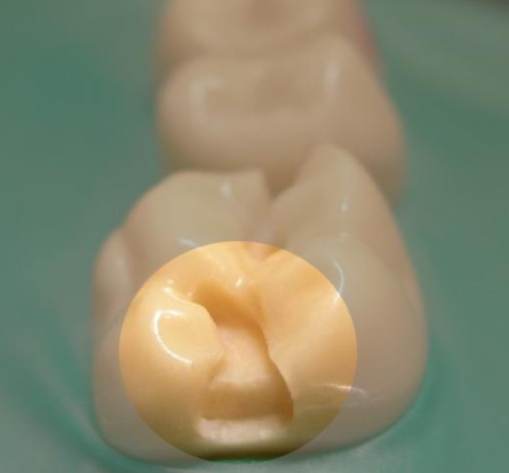
Finished proximal box(distal) of the preparation.

Slide 21
CHECKLIST AFTER CLASS II PREPARATION
1. The Buccal and lingual contacts are just broken,enough to let the tip of the explorer pass through.

Slide 22
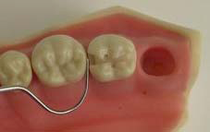
CHECKLIST
2. The lingual clearance could be a little less.

Slide 23
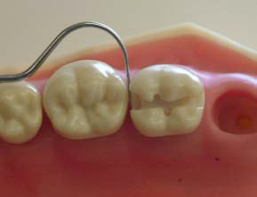
CHECKLIST
3. The Gingival contact just broken,just enough to reach and finsh these areas when placing the restoration.

Slide 24
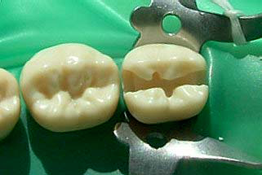
CHECKLIST
4. All the buccal and lingual walls of the preparation should be convergent.

Slide 25
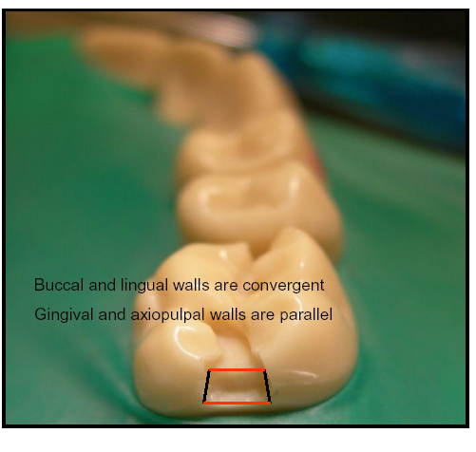
CHECKLIST
Note the convergence of buccal and lingual walls and parallelism of gingival and axiopulpal walls

Slide 26
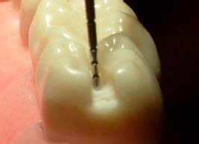
CHECKLIST
5. Note the occlusal convergence of the distal box,the axiopulpal wall still needs to be smoothened.

Slide 27
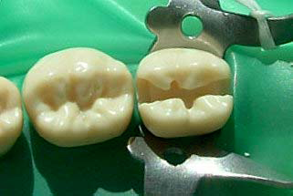
CHECKLIST
6. Are all the cavosurface margins smooth? No, in this case the linguo-proximal wall cavosurfaces both in the mesial and distal box area have to be smoothened.

Slide 28
CHECKLIST
7. The occlusal preparation follows the central groove, with the preparation width of not more than 1/4th the occlusal table.

Slide 29
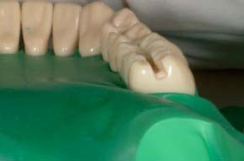
CHECKLIST
7. The axio-pulpal and other line angles should be rounded,note the rounded proximo-gingival line angles and parallelism of occlusal table,pulpal floor and gingival floor.

Slide 30
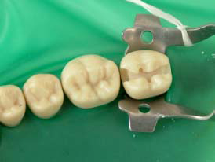
CHECKLIST
8. The reverse cureve incorporated?(to make all walls approx. 90 degrees to cavosurface. The reverse curve here is incorpoated in mesio-occluso-buccal cavosurface.

Slide 31
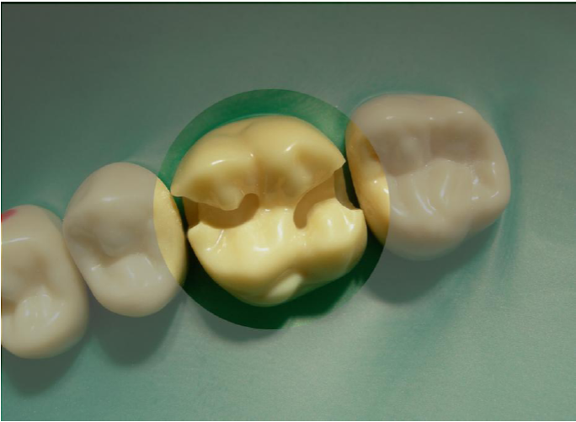
CHECKLIST
Finished cavity preparation incorporating all the features open gingival,lingual,buccal contacts,reverse curve,convergent walls,even depth,smooth surfaces and no sharp angles.

Slide 32
Q.1 Initial depth for amalgam preparation is
A. half the length of no. 245 bur at central fissure
B. 1/3rd length of no. 245 bur at central fissure
C. 2/3rd length of no. 245 bur at central fissure
D. full length of no. 245 bur at central fissure

Slide 33
Q.2 Clearance at gingival seat from adjacent tooth should be
A. 0.5 mm
B. 0.8 mm
C. 1 mm
D. 1.5 mm

Slide 34
Q.3 Pulpal wall in class II preparation is
A. gingival seat
B. axial wall
C. buccal wall
D. lingual wall

Slide 35
Q.4 Which is an external line angle
A. axio-pulpal line angle
b. axiogngival line angle
c. facio-axial line angle
D. axio-lingual line angle

Slide 36
Q.5 Dove tail provides
a. Retention form
B. resistance form
C. convenience form
D. outline form

