Slide 1
eHospital -ADT module
www.ehospital.gov.in (Main server)
www.ehospital.nic.in (Practice server)
Contact : 9415582875
8004179678

Slide 2
Admission |Discharge |Transfer
Every patient register in KGMU has a
UHID (unique health identification no), which is a
11 digit no and remain the same for life time.

Slide 4
IPD Admission
Existing Patient
This is the interface to admit a patient in IPD.
Click on ‘Existing Patient’ (WithIn Admission/Discharge/Transfer >>IPD Admission)

Slide 5
On entering a valid UHID No. >> Click on `Show Patient' Details button. It will fetch the patient's basic information (Demographic Details)

Slide 6
Admission
For admission of a patient you need only following details
Department name
Unit no
Ward name
Consultant name
UHID of patient (most important)
Other details system automatically collects for you

Slide 8
IPD registration ticket
IPD NO- it will different
on every admission of patient

Slide 9
Discharge

Slide 10
Discharge : it is a two step process
Notify Discharge (main task)
Mainly resident will do that task.
Verify Discharge (single click task)
Mainly consultant purpose for single click verify

Slide 11
Notify Discharge :- Types
All types of discharge have same fields and layout
Choose only discharge Type
CAUTION:
Last discharge type which is
“Issue Temporary Death Certificate”
Has same process but an additional Process also
that is Death certificate form generation.

Slide 13
Notify Discharge Discharge is based on Ward or UHID or Admission ID of the patient
Select a patient and click on Notify Discharge

Slide 14
Notify Discharge

Slide 15
MAIN PARTS

Slide 16
Here you can choose
consulting doctor name

Slide 17
Notify Discharge After submitting “Saved successfully as draft discharge” message will reflect

Slide 18
Verify Discharge
You can see who will prepare discharge

Slide 19
Verify Discharge
Doctor
Dr Akshay Anand
Entered By
Test ji Resident
Select verifying doctor and click on discharge and print certificate
Verifying Doctor

Slide 20
Discharge Certificate

Slide 21
Transfer

Slide 22
Transfer
Bed Allocation → first choose ward → allocate bed to patient
(floor admission also available)
Transfer Within Department:
Doctors can do Directly departmental ward to ward transfer
(Within their own department)

Slide 23
Transfer from One Dept to Another
Process remains same as before on paper:
Raise paper reference /for transfer request to other dept
Other dept accepts the case and writes OK on the Reference Slip
Patient physically moved to other department
Attendant goes to Central Transfer Desk
At Trauma center counter no 3 (Cash Counter)
Near room No 6 Main building (Near PRO office)
Please Note Central Transfer Only possible AFTER Receiving Dept has accepted

Slide 24
Death Certificate

Slide 25
Issue Temporary Death Certificate
Choose this option and
Make discharge also
verify it then…

Slide 28
Issue Temporary Death Certificate
Choose Death case entry under Death section

Slide 29
After Patient select following details will reflect, fill them carefully
Manner of death | Expire DATE | Expire TIME

Slide 30
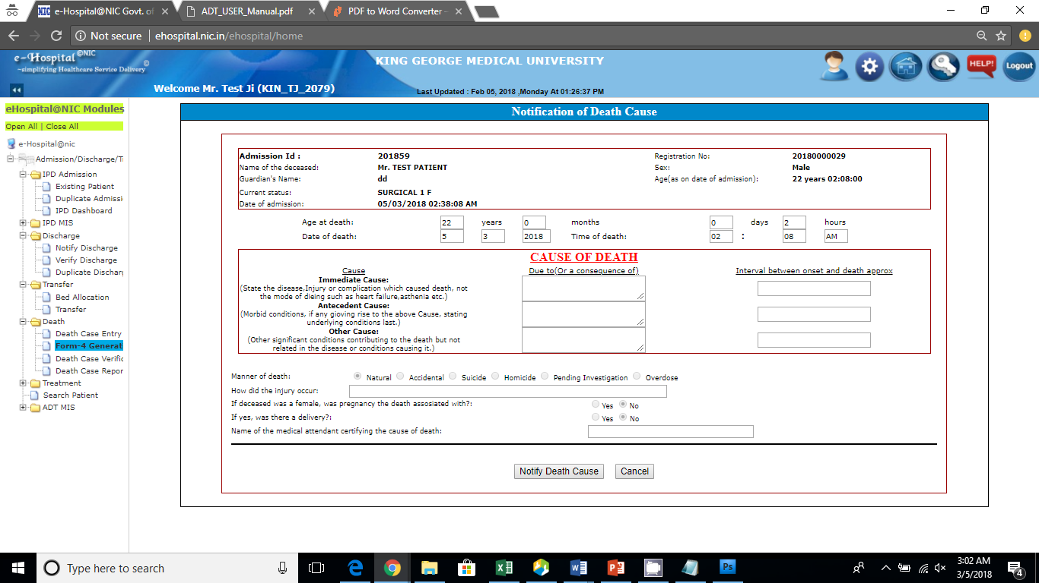
Form 4 Generation of registered Death case:

Slide 31
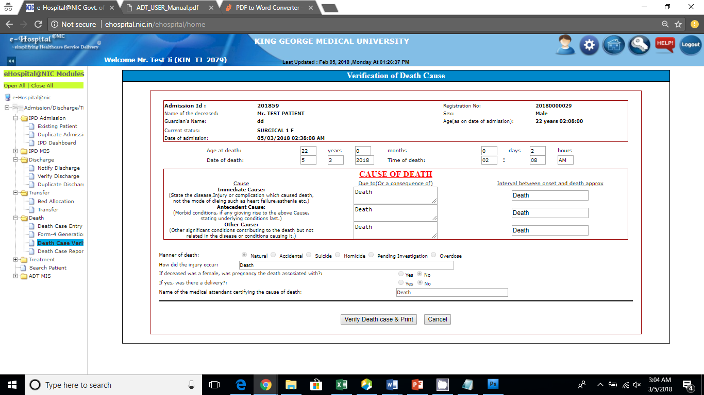
Death Case Verification

Slide 32
Death Case Report

Slide 33
Order Entry

Slide 35
Treatment: To provide observation checkup to the patient while admitted in the hospital in a particular ward/department
Service (Test order) Entry
A. OPD Service entry: Prescribe test to OPD Patient.
B. IPD Service entry : Prescribe test to IPD Patient.

Slide 36
IPD Service entry : Select category (pathology, radiology etc.)

Slide 37
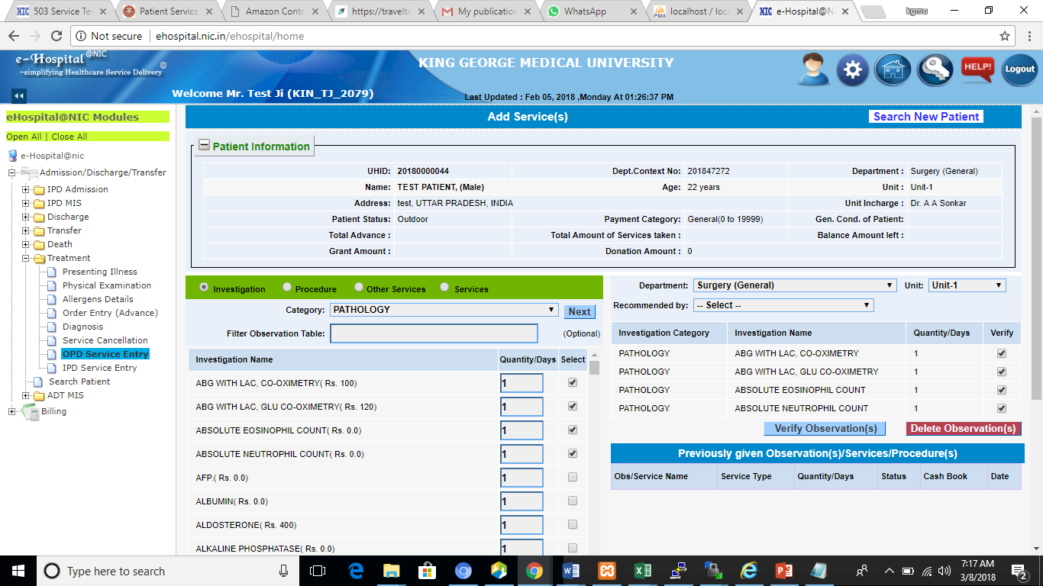
Select Test then Choose Doctor then Verify

Slide 38
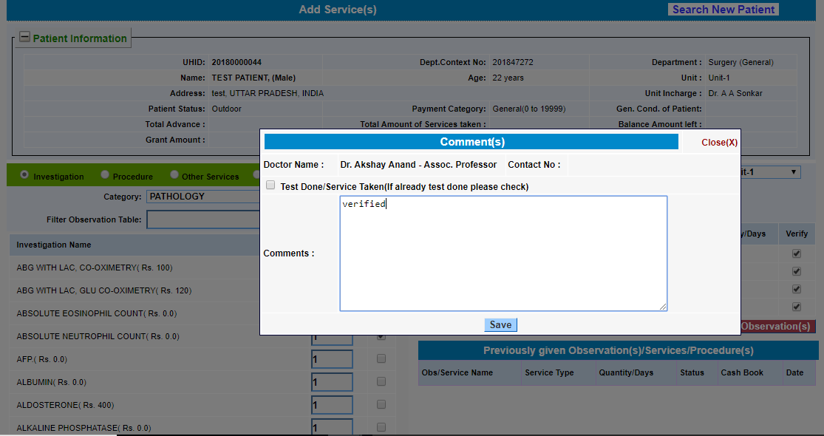

Slide 39
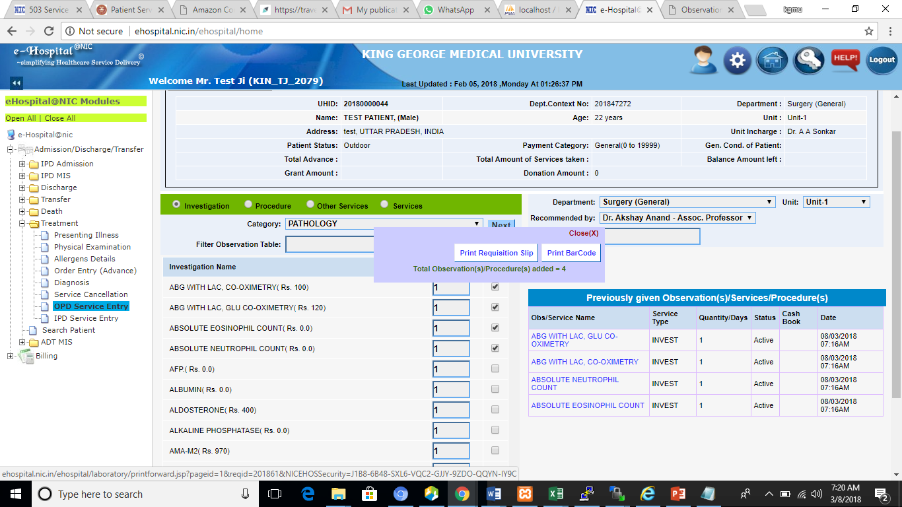
Test order Successful

Slide 40
Requisition SLIP

Slide 41
OPD Service entry
Process is same as shown in IPD Service entry except patient
You order only OPD patient in this section.

Slide 42
FAQ ?
Q. Can we admit more patient beyond our bed strength ?
Yes you can as there is a process of floor admission also and you can treat a patient without providing bed
Q. Can resident do both notify and verify discharge ?
eHospital is role based software so it is department decision to provide role to resident
Q. If software crashes then what we do ?
It is a national level application and runs at 150+ hospitals including AIIMS Delhi so maximum downtime is 10 – 15 min
Can we update discharge after verify discharge ?
No you cannot so please make all changes before verify discharge
For more FAQs you can visit
http://ehospital.nic.in/ehospitalcloud/CloudHome/faq.jsp

