Slide 1
Lecture series Gastrointestinal tract
Professor Shraddha Singh,
Department of Physiology,
KGMU, Lucknow

Slide 2
Pancreas (Essential exocrine gland)
Gland with both exocrine and endocrine functions
Location: retro-peritoneum, 2nd lumbar vertebral level
15-25 cm long
60-100 g
Extends in an oblique, transverse position
Parts of pancreas: head, neck, body and tail

Slide 3
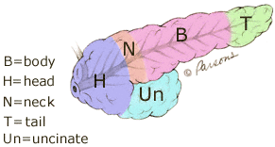
Physiological anatomy of Pancreas

Slide 4
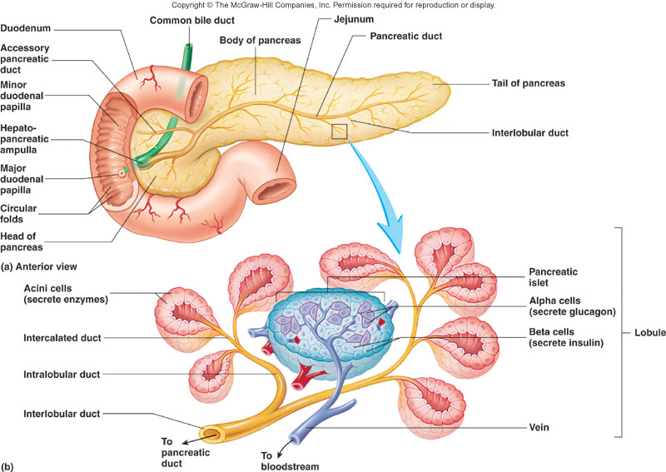

Slide 5
Exocrine pancreatic secretions
The pancreas acts as an exocrine gland by producing pancreatic juice which empties into the small intestine at hepato pancreatic ampulla
The pancreas also acts as an endocrine gland to produce insulin & glucagon.

Slide 6
Basic functions of pancreatic secretions
It plays an important role:
in digestion of lipids proteins and carbohydrates,
in metabolism since it produces insulin and other hormones.
in neutralizing the pH to become suitable for the action of the pancreatic digestive enzymes.

Slide 7
Composition of normal human pancreatic juice
Cations: Na ⁺ , K ⁺ , Ca ²⁺ , Mg ²⁺
pH approximately 8.0
Anions: HCO 3 ⁻ , Cl ⁻ , SO ₄ ²⁻ , HPO ₄ ²⁻
Digestive enzymes (95% of protein in juice)
Exocrine cells –produce 1200 to 1500 ml pancreatic juice /day

Slide 8
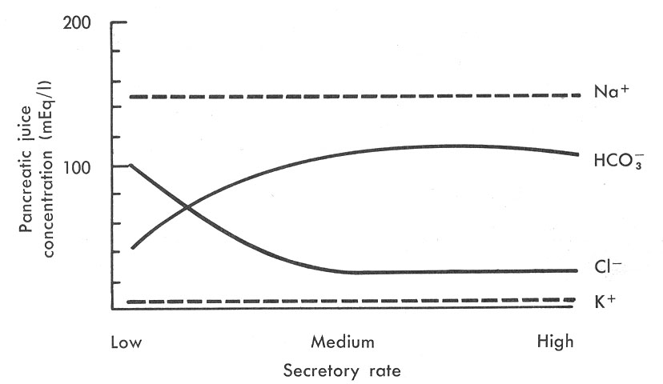
Secretion of water and electrolytes
• Na, K – the same as in plasma
• Bicarbonate concentration – up to 5 times higher than in plasma

Slide 9
Bicarbonate Ion Production in Pancreas
CO₂ diffuses to the ductule cells from blood
CO₂ combines with H₂O in presence of CA to form H₂CO₃
H₂CO₃ dissociate into HCO₃⁻ and H⁺ .
The HCO₃⁻ is actively transported into the lumen.

Slide 10
Fate of hydrogen ion
The H⁺ formed are exchanged for Na⁺ ions by active transport through blood , which will diffuse or actively be transported to the lumen

Slide 11
Transport of water from cell to duct
The movement of HCO₃⁻ and Na⁺ ions to the lumen causes an osmotic gradient causes water to move from blood to ductule cells of the pancreas producing eventually the HCO₃⁻ solution

Slide 12
Pancreatic enzymes

Slide 13
Secretion of Pancreatic Juice
Secretion of pancreatic juice is stimulated by:
Secretin:
Occurs in response to duodenal pH < 4.5.
Stimulates production of HC0₃⁻ by pancreas.
Stimulates the liver to secrete HC0₃⁻ into the bile.

Slide 14
CHOLECYTOKININ(CCK) (CCK IS POLYPEPTIDE ,33 AMINOACIDS)
Occur in response to fat &protein content of chyme in duodenum & upper jejunum from I cells
Stimulate production of pancreatic enzymes
Enhance secretin secretion
Relaxation of the sphincter of oddi
Contraction of GB to release bile

Slide 15
Mechanism of enzymes activation
Proteolytic enzymes – secreted as inactive precursors
chymotrypsinogen
procarboxypeptidase
enterokinase
trypsinogen
trypsin
chymotrypsin
carboxypeptidase

Slide 16
Protein
trypsin
chymotrypsin
Peptides
Carboxypeptidase
Amino acids

Slide 17
starches
glycogen
Pancreatic alpha amylase
Disaccharides and trisaccharides

Slide 18
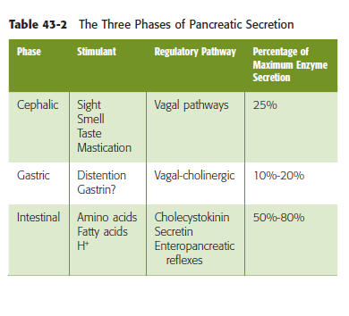
Regulation of pancreatic secretion

Slide 19
Cephalic and gastric phase of pancreatic secretions

Slide 20
Regulation of pancreatic secretion in intestinal phase

Slide 21
Regulation of pancreatic secretion in intestinal phase

Slide 22
Summary of the pancreatic regulation
NEURAL CONTROL
ENDOCRINE CONTROL
acid chyme in duodenum
psychic stimuli
stretch of stomach
enteroendocrine cells stimulated
increased parasympathetic impulses via vagus nerve
increased secretin
increased cholecystokinin
increased pancreatic secretion
increased secretion of bicarbonate ions
increased secretion of enzymes

Slide 23
Applied
Acute pancreatitis (inflammation in pancreas)
Major causes
- Gall stone
- Alcohol Ingestion
Minor causes
Over secretion of Ach
Hyper- triglyceridemia
Ingestion of pesticides
Scorpion toxins

Slide 24
Pancreatitis
Inflammation of pancreas
It can be acute or chronic
Cause-Alcohol (most common)
- Gall stone
Blockage of duct cause accumulation of panceatic enzyme trypsinogen which activate into trypsin
Carboxypolypeptidase,chymotrysin also get activated
These proteolytic enzyme digest large portion of pancreas and destroy it.

Slide 25
References
Lippincott’s Illustrated Reviews: Physiology (2013)
Medical Physiology, Updated second edition (walter F. Boron, MD, phd)
Berne & levy, physiology, sixth edition, updated edition
Ganong’s Review of Medical Physiology, 26 t h e d i t i o n

