Slide 1
Lecture series Gastrointestinal tract
Professor Shraddha Singh,
Department of Physiology,
KGMU, Lucknow

Slide 2
Learning objectives
Introduction of Liver
To describe the major components of bile
To understand the biliary tract
To describe some regulators of bile secretion
Functioning of the gall bladder & the basis of gallstone disease.

Slide 3
Functional Units of Liver
. Lobules which are made up of hepatocytes.
Hepatocytes make up 70-80% of the liver’s mass
Surrounded by
-Interlobular veins (branches of hepatic vein that empty into the vena cava)
-Interlobular arterial branches (proper hepatic artery)
-Bile ductus- series of ducts form the common
-hepatic duct
- Bile canaliculi
- Canals of Hering
-Interlobular bile ducts
-Intrahepatic bile ducts
- Left and right hepatic ducts

Slide 4
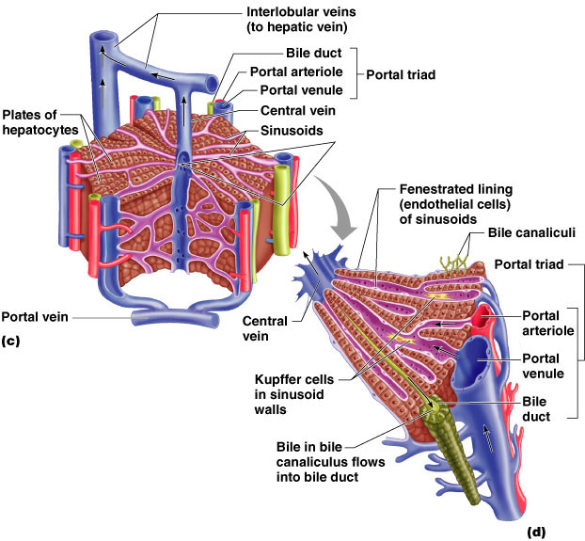

Slide 5
Functions of the Liver
Metabolic
Storage
Excretory/Secretory
Protective
Circulatory
Coagulation

Slide 6
What is bile ?
Bile (termed hepatic bile ) is produced and secreted by the tiny vacuoles in hepatocytes
From the hepatocyte bile secreted into bile canaliculi,
Then traverses a series of bile ducts, finally in to the common hepatic duct(CHD)

Slide 7
Bile from hepatocytes
Common Hepatic Duct make a junction with cystic duct to form common bile duct(CBD)
From this junction, bile can move through either the CBD into the duodenum or the cystic duct to the gallbladder

Slide 8
Composition of Bile
Bile is made up of bile acids, bile pigments and other substances dissolved in alkaline electrolyte solution.
Bile salts are synthesised by hepatocytes and bile pigments are picked up from blood sinusoids.
Daily secretion: 500 -1000 ml.
Colour: Yellow
Taste: Bitter

Slide 10
Hepatic and Biliary Bile Composition

Slide 11
Bile acids

Slide 12
Bile Acid Synthesis
Bile acids are produced by hepatocytes as end products of cholesterol metabolism.
Cholesterol is selectively metabolized by a series of enzymes that result in the formation of bile acid
Chenodeoxycholic acid and cholic acid are referred to as primary bile acids because they are synthesized by the hepatocyte

Slide 13
Bile acids
cholic acid & chenodeoxycholic acid reach duodenum through bile and in the small intestine and colon
they are converted into secondary bile acids- deoxycholic acid and lithocholic acid by bacterial action.

Slide 14
Bile Acid Synthesis
The rate-limiting step is
catalyzed by:
Cholesterol 7-α-hydroxylase
Down-regulated by end products (bile acids) “Enzyme repression”
Up-regulated by cholesterol “Enzyme induction”

Slide 15
Bile Acid Synthesis

Slide 16
Bile Salts formation
Addition of glycine or taurine result in the presence of fully ionized groups at pH 7.0:
-COOH of glycine & -SO₃ of taurine (hence, its name as bile salts e.g., Sodium or potassium glycocholate)

Slide 17
Functions of bile acid
Emulsification and digestion of fats.
Stimulate formation of bile by hepatocytes= choleretic action
Stimulate release of bile from gall bladder= cholegauge action
Absorption of fats Increased absorption of lipids into enterocytes (include vitamin A, D, E, K)
Form route for removal of cholesterol and bilirubin

Slide 18
Bile Pigments

Slide 19
Formation of bilirubin
• Life span of RBC is 120 days
• RBCs are phagocytosed and/or lysed
Normally, lysis occurs extravascularly in the reticuloendothelial system subsequent to RBC phagocytosis
Lysis can also occur intravascularly (in blood stream)

Slide 20
Pathway for RBC Destruction
Hemoglobin

Slide 21
Bilirubin
Bilirubin is transported to liver along with plasma proteins(= unconjugated ).
Protein get separated and bilirubin gets conjugated with glucuronic acid(= conjugated ).

Slide 22
Fate of Bilirubin in small intestine

Slide 23
Most of bilinogen enters liver through enterohepatic circulation and is re-excreted through bile.
About 5% of urobilinogen is excreted by kidney through urine.
Some unabsorbed part is excreted through feces as stercobilinogen. This gives yellow color to urine and feces.

Slide 24
FUNCTIONS OF THE GALLBLADDER
In normal individuals, bile flows into the gallbladder when the sphincter of Oddi is closed (ie, the period in between meals).
In the gallbladder, the bile is concentrated by absorption of water
Sustained release of bile as per requirements of food

Slide 26
Regulation of gall bladder secretions
When food enters the mouth, the resistance of the sphincter of Oddi decreases under both neural and hormonal infl uences
Fatty acids and amino acids in the duodenum release CCK, which causes gallbladder contraction
Th e production of bile is increased by stimulation of the vagus nerves and by the hormone secretin, which increases the water and HCO 3 – content of bile.

Slide 27
Gallstones-cholelithiasis
Gall stones are the common cause of biliary tract obstruction in adults .
Risk factors:
Age
Sex
Diet
Reduced biliary transit

Slide 28
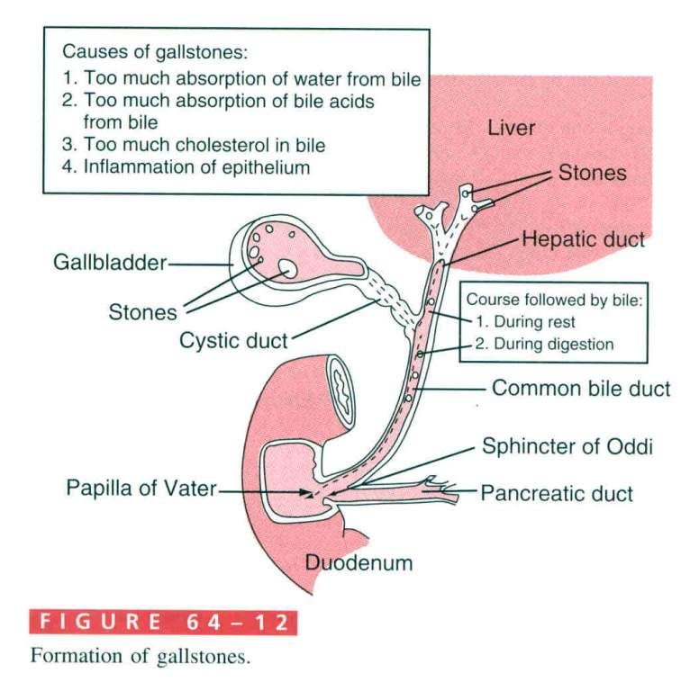
Notes:
Factors which impair gallbladder contractility will also increase the likelihood of stone development. Although progesterone decreases gallbladder contractility, stone formation in pregnant women rarely occurs. It seems reasonable to propose that lifetime exposure to progesterone in normal women may explain the increase in stone formation compared to men.
It is very clear that blockade of the common bile duct will affect the entrance not only of bile but pancreatic secretions too into the duodenum. This can have disasterous results in the pancreas. Trypsin inhibitor is normally able to prevent conversion of active trypsin. However after long periods of stasis, the effect of the inhibitor is lost and autodigestion begins. Also, trapping bacterial growth can occur once stasis occurs either in the bile or pancreatic ducts. Infection greatly complicates the clinical picture.

Slide 29
References
Lippincott’s Illustrated Reviews: Physiology (2013)
Medical Physiology, Updated second edition (walter F. Boron, MD, phd)
Berne & levy, physiology, sixth edition, updated edition
Ganong’s Review of Medical Physiology, 26 t h e d i t i o n

