Slide 2
Lecture series Gastrointestinal tract
Professor Shraddha Singh,
Department of Physiology,
KGMU, Lucknow

Slide 3
Digestion and absorption of fats

Slide 4
Learning objectives
To convince that how the lipids are important!
To describe the major types of lipids
To understand the role of bile in digestion of lipids
To describe emulsification of lipids by bile salts
To explain how fatty acids are absorbed
To understand micells formation and chylomicrons

Slide 5
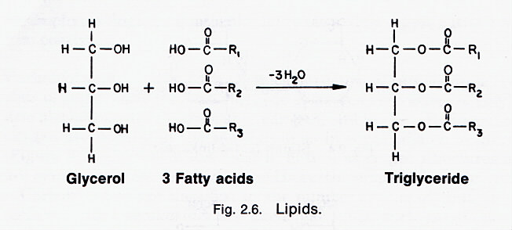
What are lipids
Lipid = a compound that is insoluble in water, but soluble in an organic solvent (e.g., ether, benzene, acetone, chloroform)

Slide 6
Saturated vs. Unsaturated Fatty Acids
saturated: the SFA’s of a lipid have no double bonds between carbons in chain
polyunsaturated: more than one double bond in the chain
most common polyunsaturated fats contain the polyunsaturated fatty acids (PUFAs) oleic, linoleic and linolenic acid
unsaturated fats have lower melting points

Slide 7
Fatty Acids Commonly Found in Lipids

Slide 8
Structure of lipids
They are composed of carbon, hydrogen, and a smaller amount of oxygen.
Some lipids also contain small but functionally important amounts of nitrogen and phosphorus

Slide 9
Properties of Lipids
Thus, lipids have been classified according to their physicochemical interactions with water.
Lipids may be either nonpolar and completely insoluble in water (e.g.cholesteryl esters and carotene)
polar and amphiphilic,that is, having both polar (hydrophilic) and nonpolar (hydrophobic) groups.

Slide 10
Types of fats we use
More than 95% are triglycerides, the other are
Cholesterol,
Cholesteryl esters,
Phospholipids, and
Unesterified fatty acids.

Slide 11
Sources of Lipids
Animal Sources
Dairy products- butter, ghee
Meat and Fish, Pork, eggs
Vegetable Sources
Cooking oils- Sun flower oil, Mustard oil, Ground nut oil Fats from other vegetable sources
Additional lipid is supplied in the form of phospholipids and cholesterol, mostly arising from the liver in biliary secretions

Slide 12
Triglyceride degradation
Triglycerides are degraded by lipases to form free fatty acids and glycerol

Slide 13
Digestion of fat in Mouth
Hydrolysis of triacylglycerol is initiated by lingual lipases, which attack the sn-3 ester bond forming 1,2-diacylglycerols and free fatty acids
Lingual lipase: Secreted by dorsal surface of tongue
Active at low pH (pH 2.0 – 7-5)
optimum pH 4.0-4.5
Ideal substrate-Short chain TGS.

Slide 14
Digestion of fat in Stomach
Gastric Lipase- secreted in small quantities
More effective at alkaline p H (Average p H 7.8)
Requires the presence of Ca⁺⁺
Not effective for long chain fatty acids, most effective for short and medium chain fatty acids

Slide 15
Significance of Lingual and Gastric Lipases
Free fatty acids produced by lipases initiates secretion of CCK
Play an important role in lipid digestion in neonates since milk is the main source of energy
Lingual and gastric lipases can degrade triglycerides in patients with pancreatic disorders despite a near or complete absence of pancreatic lipase

Slide 16
Digestion of fat in duodenum
Free fatty acids produced by gastric lipases initiates secretion of CCK
Stimulates contraction of the Gall bladder
Relaxes sphincter of Oddi.
Release of bile in to duodenum
Bile salts starts emulcification of fats

Slide 17
Emulsification and digestion
Bile salt are responsible for lowering the surface tension allowing to formation of emulsion,
The critical process of emulsification takes place in the duodenum.
This emulsification provide more site for lipases to act

Slide 18
Digestion in small intestine
Major site of fat digestion is small intestine
Effective digestion due to the presence of Pancreatic lipase (that is activated by bile acids)
cholesterol esterase catalyzes the hydrolysis of cholesterol esters, esters of fat-soluble vitamins, and phospholipids, as well as triglycerides.
Bile salts act as effective emulsifying agents for fats
Secretion of pancreatic juice is stimulated By secretion of Secretin, Cholecystokinin

Slide 19
Role of Bile Salts
Bile salts help in combination of lipase with two molecules of a small protein called as Colipase.
This combination enhances the lipase activity.

Slide 20
Triacyl glycerol degradation by pancreatic lipase
Pancreatic lipase is specific for the hydrolysis of primary ester linkages(Fatty acids present at position 1 and 3)
It can not hydrolyze the ester linkages of position -2
Digestion of Triglycerides proceeds by removal of a terminal fatty acid to produce an α,β diglyceride

Slide 21
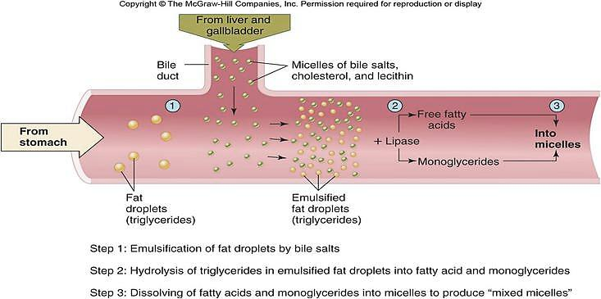
Emulsification and Digestion of Triglycerides

Slide 22
Absorption of Lipids
Glycerol, short and medium chain fatty acids (Chain length less than 14 carbons) are directly absorbed from the intestinal lumen .
Their uptake is regulated via the activity of specific membrane transporters, a microvillus membrane fatty acid–binding protein (MVM-FABP) provides for the uptake of long-chain fatty acids across the brush border.
Long chain fatty acids, free cholesterol and β- acyl glycerol together with bile salts form mixed micelles.

Slide 23
Micelles
Bile salts are amphipathic , one surface of the molecule is hydrophilic because the polar peptide bond and the carboxyl and hydroxyl groups are on that surface, whereas the other surface is hydrophobic.
Therefore, the bile acids tend to form cylindrical disks called micelles.

Slide 24
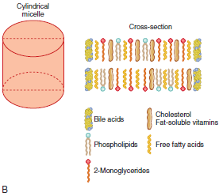
Micelles formation
When the concentration of bile acids in the intestine is high, as it is after contraction of the gallbladder, lipids and bile salts interact spontaneously to form micelles

Slide 25
Micelles
Micelles are disk shaped clusters of amphipathic lipids that coalesce with their hydrophobic groups on the inside and their hydrophilic groups on the outside of clusters
Mixed micelles are soluble in the aqueous environment of the intestinal lumen
Thus, the micelles move down their concentration gradient through the brush border of the mucosal cells.

Slide 26
Fate of fatty acids
The fate of the fatty acids in enterocytes depends on their size.
Fatty acids containing less than 10–12 carbon atoms are water-soluble enough that they pass through the enterocyte unmodified and are actively transported into the portal blood.
The fatty acids containing more than 10–12 carbon atoms are re-esterified to triglycerides in the enterocytes.
The triglycerides and cholesterol esters are then coated with a layer of protein,cholesterol, and phospholipid to form chylomicrons

Slide 27
Fate of lipids inside enterocytes
These leave the cell and enter the lymphatics, by exocytosis
because they are too large to pass through the junctions between capillary endothelial cells

Slide 28
Chylomicrons
Once again , inside the enterocyte, monoglycerides and fatty acids are re-synthesized into TG.
Chylomicrons are lipoproteins, special particles that are designed for the transport of lipids in the circulation.
Chylomicrons are released by exocytosis at the basolateral surface of the enterocytes. Because they are particles, they are too large to enter typical capillaries.
Chylomicrons then flow into the circulation via lymphatic vessels.

Slide 29
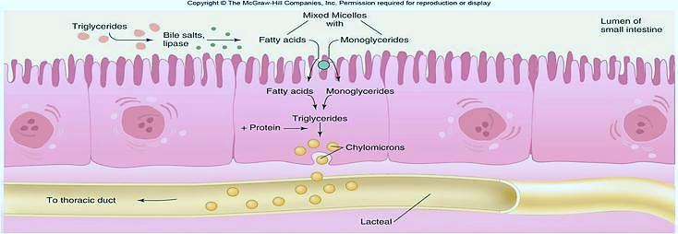
Formation and Transportation of Chylomicrons

Slide 30
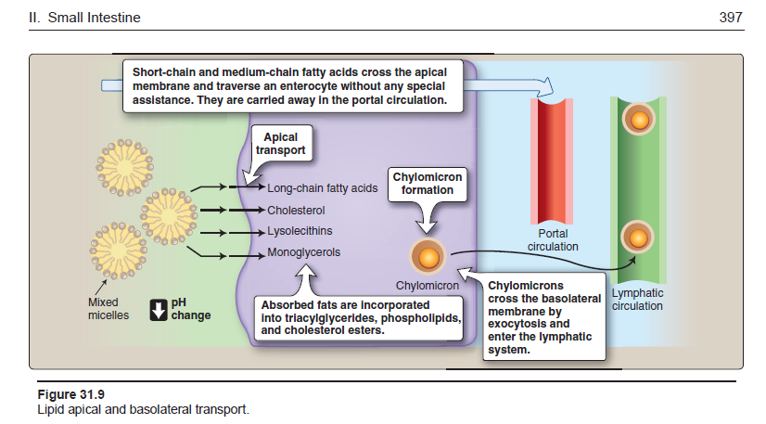

Slide 31
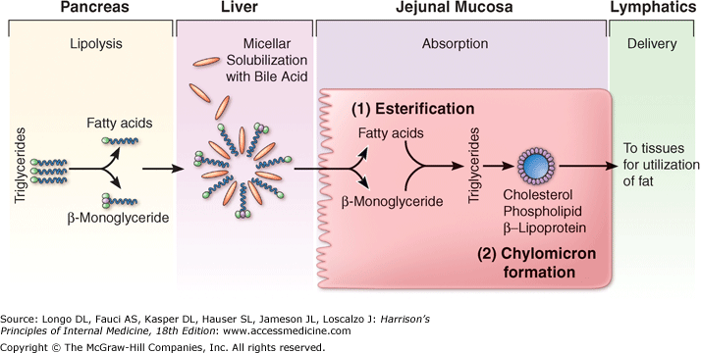
Summary of lipid digestion and Absorption

Slide 32
References
Lippincott’s Illustrated Reviews: Physiology (2013)
Medical Physiology, Updated second edition (walter F. Boron, MD, phd)
Berne & levy, physiology, sixth edition, updated edition
Ganong’s Review of Medical Physiology, 26 t h e d i t i o n

