Slide 1
Approach to a case of BOH & Still births
Dr Anjoo Agarwal
Prof Ob/Gyn
KGMU
28.05.2020

Slide 2
What is BOH
Any event in the obstetric history of a pregnant woman which affects the outcome of the present pregnancy adversely
Includes
Recurrent abortions
Previous still birth

Slide 3
Definition of Fetal Death - WHO
Fetal death means death prior to complete expulsion or extraction from the mother of a product of human conception irrespective of the duration of pregnancy and which is not an induced termination of pregnancy. The death is indicated by the fact that after such expulsion or extraction, the fetus does not breathe or show any other evidence of life such as beating of the heart, pulsation of the umbilical cord, or definite movement of voluntary muscles. Heartbeats are to be distinguished from transient cardiac contractions; respirations are to be distinguished from fleeting respiratory efforts or gasps

Slide 4
Causes of Still Birth
Causes of antepartum still birth i.e. fetal death due to antenatal problems
Obstetrical causes
Abruption
Multifetal pregnancies
PPROM
Placental abnormalities eg infarction, maternal vascular disorders
Fetal abnormalities includes FGR, major structural malformations & genetic disorders, Rh incompatibility, non immune hydrops
Infections involving fetus & placenta eg parvo virus, syphilis
Hypertensive disorders – preeclampsia & chronic hypertension
Medical disorders eg diabetes, APLA
Cord problems eg thrombosis, prolapse
Undetermined

Slide 5
Causes of intrapartum still birth i.e. fetal death due to problems during labour
Abnormal presentation
Obstructed labor & rupture uterus
Prolonged labor
APH
Cord prolapse
Fetal distress – home delivery

Slide 6
Demographic & Personal Factors Affecting chances of Still Birth
Obesity
Maternal age
Smoking
Educational status
Race

Slide 7
Issues in Management
Woman presenting with IUFD in antenatal period
Diagnosis of fetal death
Breaking the news
Investigations
Planning delivery
Counseling for autopsy
Postpartum care
Planning next pregnancy
Woman presenting with past H/O IUFD
Investigations & present pregnancy

Slide 8
Woman presenting with IUFD in antenatal period

Slide 9
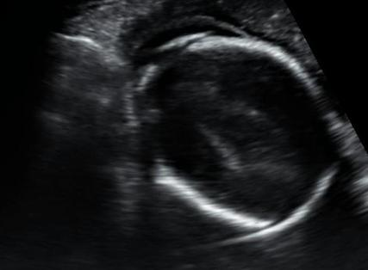
Diagnosis of IUFD
Loss of fetal movements
Absent fetal heart sounds
Confirmation by USG – absent cardiac activity
Other signs –Spalding sign (7 days)
Ball sign (hyperflexion of spine)
Robert sign (12 hrs gas in aorta)

Slide 10
Grades of maceration
Grade | Feature | Time since IUD
0 | Parboiled reddened skin | < 8 hrs
1 | Skin peeling | > 8 hrs
2 | Extensive peeling Red serous effusions in chest & abd d/t Hb staining | 2 – 7 days
3 | Liver yellow brown Turbid effusion | > 8 days
Notes:
Rbid

Slide 11
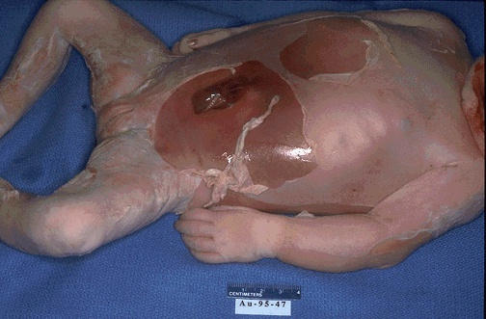
Macerated fetus

Slide 12
Breaking the news & Counseling
Empathy & sympathy
Involve husband & other family members
Discuss investigations
Discuss cause not identified in 50% cases
Discuss plan for delivery

Slide 13
Investigations
To assess maternal wellbeing
To assess cause of death
To assess possibility of recurrence
To prevent further complications

Slide 14
Investigations to assess maternal wellbeing
Risk of DIC with old IUFD
10% at 4wks & 30% later
BT/CT
S Fibrinogen
Platelet count
Repeat tests twice weekly in women who choose expectant management

Slide 15
Investigations to ascertain cause
Test | Reasoning
ABO/Rh & Kleihauer test | Rh incompatibility
GDM test | Rule out diabetes
VDRL/RPR | Rule out syphilis
TSH | Rule out thyroid disease
Preeclampsia profile | If BP raised
Liver function tests including bile salts | Obstetric cholestasis

Slide 16
Maternal bacteriology: ● blood cultures ● midstream urine ● vaginal swabs ● cervical swabs | To rule out infection sp listeriosis, chlamydia Indicated if mother has fever, purulent liquor or H/O prolonged leaking
Maternal serology for parvovirus, CMV, Toxoplasma | Toxoplasma in routine Parvovirus sp if nonimmune hydrops CMV if intracranial calcification
Maternal thrombophilia screen | Indicated if FGR or placental disease If abnormal repeat at 6wks/ antiphospholipid at 12 wks
Anti Ro anti La antibodies | Occult maternal autoimmune disease
Parental karyotype | If fetus shows translocation or abnormality or recurrent losses

Slide 17
Fetal and placental: ● fetal blood Cord or cardiac blood (if possible) ● fetal swabs in lithium heparin ● placental swabs | More useful for ruling out fetal infections than maternal tests
Fetal and placental tissues for karyotype ● deep fetal skin ● fetal cartilage ● placenta | Fetal aneuploidy & single gene disorders Written consent of parents mandatory
Postmortem examination: ● external including weight and length measurement ● autopsy ● microscopy ● X-ray ● placenta and cord | Parental consent required for autopsy If in remote center photograph & X ray help in making diagnosis later

Slide 18
Counseling for autopsy
Parents should be offered full postmortem examination to help explain the cause of an IUFD.
Parents should be advised that postmortem examination provides more information than other (less invasive) tests and this can sometimes be crucial to the management of future pregnancy
Written consent is mandatory

Slide 19
Planning delivery
Delivery must be planned immediately if preeclampsia / abruption / placenta previa/ sepsis / PROM
In all other conditions may wait
Vaginal delivery is preferred

Slide 20
Postpartum care
Lactation suppression is required & dopamine agonists are the drug of choice
Bromocriptine & cabergoline are both equally efficacious
Estrogens are not recommended
Psychological support is needed as often there is delayed reaction to the stress

Slide 21
Planning next pregnancy
Women having still birth are at 5 times greater risk of still birth in next pregnancy compared to women delivering healthy baby
Preconception visit must be advised
Ideal interconceptional period not defined
Weight loss if woman is obese
Control of blood sugar & BP

Slide 22
Woman with H/O still birth

Slide 23
Woman with H/O still birth
Preconceptional counseling
Early registration
Detailed history
Folic acid supplementation
Review of records
If previously not investigated then relevant investigations
If cause identified then appropriate intervention

Slide 24
Preconceptional or Initial Prenatal Visit
Detailed medical and obstetrical history
Review evaluation of prior stillbirth
Determination of recurrence risk
Discuss recurrence of comorbid obstetric complications
Smoking cessation
Preconceptional weight loss in obese women
Genetic counseling if family genetic condition exists
Diabetes screen
Thrombophilia screen: antiphospholipid antibodies (only if history indicates)
Support and reassurance

Slide 25
First Trimester
Dating sonography
First-trimester screen: pregnancy-associated plasma protein A, human chorionic gonadotropin, and nuchal translucency
Support and reassurance

Slide 26
Second Trimester
Fetal sonographic anatomical survey at 18–20 weeks’ gestation
Maternal serum screening (quadruple) or single-marker alpha fetoprotein if first trimester screening elected
Possible uterine artery Doppler studies at 22–24 weeks’ gestation
Support and reassurance

Slide 27
Third Trimester
Sonographic screening for fetal-growth restriction, starting at 28 weeks
Kick counts starting at 28 weeks
Antepartum fetal surveillance starting at 32 weeks or 1–2 weeks earlier than prior stillbirth
Support and reassurance

Slide 28
Delivery
Elective induction at 39 weeks as risk of still birth increases with each week 1: 2000 at 37wks to 1: 200 at 43wks
Risk reduction more in older women
Delivery before 39 weeks only with documented fetal lung maturity by amniocentesis
Caesarean delivery only when induction is contraindicated

Slide 29
Take home message
Proper evaluation by history, examination & investigations
Good psychological support
Good counseling
Preconceptional care and early ANC
Timely delivery

Slide 30
MCQ 1
Which of the following is not a cause of antepartum stillbirth
A ) prolonged pregnancy
B ) diabetes
C ) hypertension
D ) breech presentation

Slide 31
MCQ 2
Which of the following is not a cause of intrapartum stillbirth
A ) cord prolapse
B ) chronic kidney disease in mother
C ) transverse lie
D ) rupture uterus

Slide 32
MCQ 3
Which is the commonest cause of IUFD
A ) FGR
B ) thyroid disorders
C ) diabetes
D ) abruption

