Slide 1
ALCOHOL RELATED DISORDERS
Dr. Amit Arya MD.
Additional Professor
DEPARTMENT OF PSYCHIATRY
K.G.M.U.,LUCKNOW

Slide 2
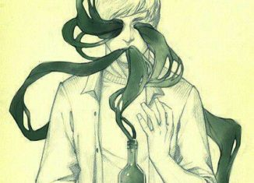
HISTORY
Alcohol is one of the most commonly used chemical substances for intoxication by humans in history. Its consumptions is more than 12000 years.
Word 'alcohol' originates from the Arabian term 'al-kuhul', meaning “BODY-EATING SPIRIT”. In alchemy, alcohol is used to extract the soul essence of an entity.
In INDIA alcoholic beverages appeared in between 3000 BC - 2000 BC.

Slide 3
EPIDEMIOLOGY
Alcohol use disorders show an increasing trend in developing countries like India as evident in NFHS4 and they are becoming major public health problem.. Alarming figure may come in NDUS-2018.
Average age of initiation has reduced from 28 years during the 80s to 20 years in recent years.
Increase in female alcohol use
Signature pattern of alcohol intake - take alcohol regularly (mostly solitarily) and heavily to the point of intoxication.

Slide 4
Alcohol content of different beverages
Expressed as `UNIT’. 1unit=8grams of alcohol.
BEVERAGE | ALCOHOL CONTENT(%) | UNITS OF ALCOHOL
Ordinary Beer | 3% | 2 per pint
Strong Beer | 5.5% | 4 per pint
Extra strong Beer | 7% | 5 per pint
Table wine | 8-10% | 7 per bottle
Fortified wines (sherry, pot, vermouth) | 13-16% | 15 per bottle
Spirits(whisky, gin, brandy, vodka) | 32% | 30 per bottle

Slide 5
PHARMACOKINETICS
1) Absorption- 10% from stomach,
90%-small intestine(proximal).
2) Peak blood conc.- In 30-90 minutes.
3) Metabolism- 90% in liver
(by ADH and ALDH enzymes)
-10% ex unchanged by kidney
and lungs
Body can metabolise ¾ ounce(1 ounce=28.35 gms) of 40%spirits in 1 hour.

Slide 6
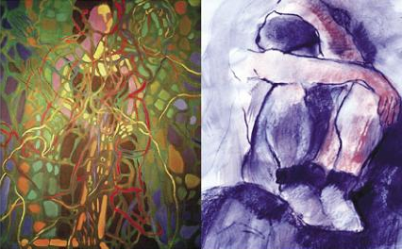
Why Do People Take Drugs?
To feel good
To have novel:
feelings
sensations
experiences
AND
to share them
To feel better
To lessen:
anxiety
worries
fears
depression
hopelessness
Notes:
Conduct mind mapping: Why do people take drugs? While noting the responses be careful to group responses into feeling good (i.e. positive) types and feeling better (i.e. negative types), as depicted on the slide.
However does everyone who takes drugs turns into an addict?

Slide 7
Vulnerability
Why do some people become
addicted while others do not?
Notes:
What makes some people more vulnerable to drug addiction? Many people try drugs without getting addicted, while others do become addicted⎯some quickly and easily.

Slide 8
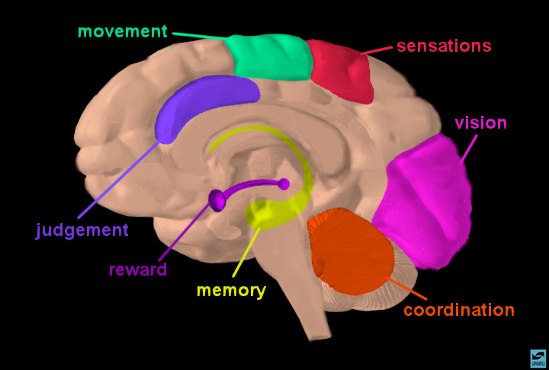

www.drugabuse.gov
Notes:
Brain Regions and Their Functions
Just like our house has different rooms devoted to different functions, certain parts of the brain govern specific functions. For instance, vision, motion, balance etc. One such function is Reward. Explain reward by giving a simple example.

Slide 9
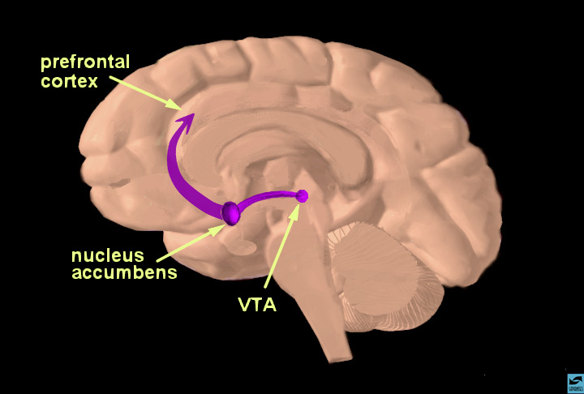
www.drugabuse.gov
Notes:
The Reward Pathway: Just an illustrative slide for transition. Facilitator should avoid spending much time on this slide. The question is, why do some people have a ‘defective’ reward system which makes them vulnerable to drug dependence?

Slide 10
EFFECT ON BRAIN
Dopamine increase in limbic system- pleasure(alcohol acutely increase dopamine levels in brain)
Serotonin- related to amount of intake
GABA-A receptors
NMDA receptors
Alcohol is a brain depressant.
In small amounts it relieves anxiety.
it may also give a sense of strength and result in boisterous behaviour
It heightens the mood prior to intake, be it sadness or happiness.
Impairs judgement and performance

Slide 11
Alcohol enhances the effect of GABA on GABA-A neuroreceptors, resulting in decreased overall brain excitability.
Chronic exposure to alcohol results in a compensatory decrease of GABA-A neuroreceptor response to GABA, evidenced by increasing tolerance of the effects of alcohol.
Notes:
Alcohol enhances the effect of GABA on GABA-A neuroreceptors, resulting in decreased overall brain excitability. Chronic exposure to alcohol results in a compensatory decrease of GABA-A neuroreceptor response to GABA, evidenced by increasing tolerance of the effects of alcohol

Slide 12
Alcohol inhibits NMDA neuroreceptors, and chronic alcohol exposure results in up-regulation of these receptors.
Notes:
Alcohol inhibits NMDA neuroreceptors, and chronic alcohol exposure results in up-regulation of these receptors.

Slide 13
Notes:
?????

Slide 14
Abrupt cessation of alcohol exposure results in brain hyperexcitability, because receptors previously inhibited by alcohol are no longer inhibited.
Notes:
Abrupt cessation of alcohol exposure results in brain hyperexcitability, because receptors previously inhibited by alcohol are no longer inhibited.

Slide 15
Drugs as reinforcers
likely that you
will continue..
Positive reinforcement
..makes you
feel good… (euphoria)
Taking drugs…
NOT
Taking drugs…
..makes you
feel miserable… (withdrawal)
..to avoid which you
will continue..
Negative reinforcement
Notes:
Use this slide to explain the vicious cycle of drug use → euphoria → repeated drug use → Withdrawal →repeated drug use

Slide 16
INTERNATIONAL CLASSIFICATION OF DISEASE -10
F10--F19 Mental and behavioural disorders due to psychoactive substance use
F10. -Alcohol
F10.0 Intoxication
F10.1 Harmful use
F10.2 Dependence syndrome
F10.3 Withdrawal state
F10.4 Withdrawal state with delirium
F10.5 Psychotic disorders
F10.6 Amnestic syndrome
F10.7 Residual and late onset psychotic disorder
F10.8 Other mental and behavioral disorders

Slide 17
The usual drug-use ‘career’
Dependence /
Addiction
Regular
use
Occasional / Irregular
use
Experimentation
Notes:
Similar to drug initiation, a number of factors both internal and external govern the progression of substance use from occasional use to regular and then dependent use. Any individual who experiments with a particular substance does not always become a regular or dependent user of the same. Many individuals may not use the substance again while some may only use it occasionally or in moderation.

Slide 18
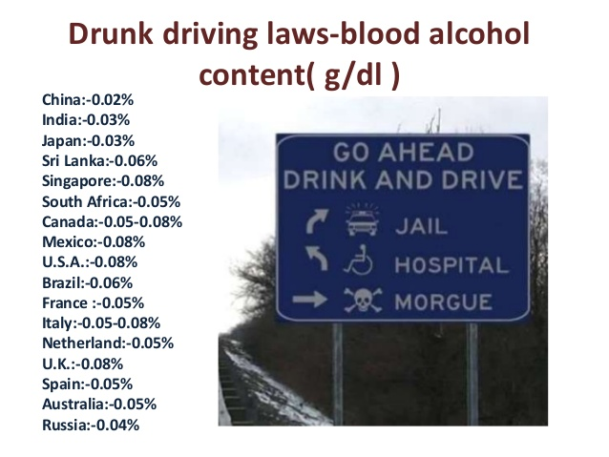
F10.0 ACUTE INTOXICATION
A transient syndrome
-due to recent substance ingestion
-that produces clinically significant psychological and physical impairment.
Changes are reversible upon elimination of substance from the body.
Legal definition of intoxication in USA is alcohol conc. 80-100 mg/dl of blood.
The blood alcohol content (BAC) legal limit in INDIA is 0.03% or 30 mg/dl

Slide 19
LEVEL
20-30 mg/dl
30-80 mg/dl
80-200 mg/dl
200-300 mg/dl
>300 mg/dl
LIKELY IMPAIRMENT
Slowed motor performance,decreased thinking ability.
Increase in motor & cognitive problems.
Increase in incoordination and judgement errors. Lability of mood, Cognitive deterioration
Marked slurring of speech, Nystagmus, Blackouts.
Impairment in vital signs, possibly Death!.

Slide 20
F10.1 ALCOHOL HARMFUL USE
A pattern of psychoactive substance use
-that is causing damage to health
-the damage may be physical or mental.
Diagnostic guidelines
Actual damage to physical or mental health.
Acute intoxication itself is not a sufficient evidence of the damage to health.
Harmful use should NOT be diagnosed if dependence syndrome, a psychotic disorder (F10.5), or another specific form of alcohol-related disorder is present.
Notes:
Dsm-iv emphasises more on negative social consequences of subs abuse; while icd-10 on physical and psychological consequences.
Term misuse also carries the same meaning.

Slide 21
F10.2 DEPENDENCE SYNDROME
A cluster of physiological, behavioural, and cognitive phenomena.
-in which the use of a substance takes on a much higher priority for an individual than other behaviours that once had greater value.

Slide 22
Diagnostic guidelines for dependence syndrome-
Three or more of the following is necessary to diagnosis in previous year.
a) Strong desire.
b) Loss of control of consumption.
c) Evidence of tolerance.
d) Signs of withdrawal on attempted abstinence
e)Progressive neglect of alternative pleasures or interests.
f)Continued drug use despite negative consequences.

Slide 23
Subtypes of Alcohol Dependence
Type A alcohol dependence
Late onset
Few childhood risk factors
Mild dependence (with few alcohol related problems and little psychopathology)
Type B alcohol dependence
Early onset
Many childhood risk factors
Severe dependence( with a strong family history and much psychopathology)

Slide 24
Some more subtypes….
Gamma alcohol dependence
Represents alcohol Dep. In those who are active in Alcoholic Anonyms.
These persons are unable to stop drinking once they start, but if drinking is terminated (due to ill health or lack of money), they can abstain quite well.
Delta alcohol dependence
Include those who must drink a certain amount each day, but are unaware of a lack of control

Slide 25
F10.3 ALCOHOL WITHDRAWAL
“A group of symptoms and signs which occur on cessation or reduction of use of a psychoactive substance, that has been taken repeatedly, usually for a prolonged period and/ or in high doses.”
It can be-
Uncomplicated- ocurring in 6-48 hrs and abates after 2-5 days.
Complicated - with seizures, delirum.
Notes:
Alcohol enhances the effect of GABA on GABA-A neuroreceptors, resulting in decreased overall brain excitability. Chronic exposure to alcohol results in a compensatory decrease of GABA-A neuroreceptor response to GABA, evidenced by increasing tolerance of the effects of alcohol.
Alcohol inhibits NMDA neuroreceptors, and chronic alcohol exposure results in up-regulation of these receptors.
Abrupt cessation of alcohol exposure results in brain hyperexcitability, because receptors previously inhibited by alcohol are no longer inhibited.
An important concept in both alcohol craving and alcohol withdrawal is the "kindling" phenomenon; the term refers to long-term changes that occur in neurons after repeated detoxifications.
Recurrent detoxifications are postulated to increase obsessive thoughts or alcohol craving

Slide 26
Diagnosis of alcohol withdrawal
A) Cessation of (or reduction in) alcohol use.
B) Two (or more) of the following, developing within several hours to a few days after Criterion A:
(1) Autonomic hyperactivity
(2) Increased hand tremor
(3) Insomnia
(4) Nausea or vomiting
Notes:
KINDLINGAn important concept in both alcohol craving and alcohol withdrawal is the "kindling" phenomenon; the term refers to long-term changes that occur in neurons after repeated detoxifications.
Recurrent detoxifications are postulated to increase obsessive thoughts or alcohol craving
In many alcoholics, the severity of withdrawal symptoms increases after repeated withdrawal
epi sodes . Thi s exacerbat ion may be at t r ibutable to a kindl ing proces s . Kindl ing i s a
phenomenon in which a weak electrical or chemical stimulus, which initially causes no overt
behavioral responses, results in the appearance of behavioral effects, such as seizures, when
it is administered repeatedly. Both clinical and experimental evidence support the existence
of a kindling mechanism during alcohol withdrawal. Withdrawal symptoms, such as seizures,
result from neurochemical imbalances in the brain of alcoholics who suddenly reduce or
cease alcohol consumption. These imbalances may be exacerbated after repeated withdrawal
experiences. The existence of kindling during withdrawal suggests that even patients
experiencing mild withdrawal should be treated aggressively to prevent the increase in
severity of subsequent withdrawal episodes. Kindling also may contribute to a patient’s
relapse risk and to alcohol-related brain damage and cognitive impairment

Slide 27
Diagnosis of alcohol withdrawal(contd.)
(5) Transient hallucinations or illusions
(6) Psychomotor agitation
(7) Anxiety
(8) Grand mal seizures
C) Social & occupational functioning impairment.
D) Not due to a general medical condition or mental disorder.

Slide 28
S/S ALCOHOL WITHDRAWAL SYNDROME
Time | withdrawal symptoms
6 to 12 hours | Insomnia, tremulousness, mild anxiety, gastrointestinal upset, headache, diaphoresis, palpitations, anorexia
12 to 24 hours | Alcoholic hallucinosis: visual, auditory, or tactile hallucinations
24 to 48 hours | Withdrawal seizures: generalized tonic-clonic seizures
48 to 72 hours | Alcohol withdrawal delirium (delirium tremens): hallucinations (predominately visual), disorientation, tachycardia, hypertension, low-grade fever, agitation, diaphoresis

Slide 29
ALCOHOL WITHDRAWAL SEIZURES
5-15% cases of alcohol withdrawal
Within 24-48hrs but may up to 7days
Tonic-clonic in nature
Usually one or two episodes
30% of pts develop delirium

Slide 30
F10.4 DELIRIUM TREMENS
Medical Emergency
< 5% of Alcohol Withdrawal syndrome
Usually begins in 48-96hrs.
Last for 1-5 days
May be associated with seizure(F10.41)
In untreated cases mortality is up to 20%.
Notes:
Autonomic dis include sweating,fever, tachycardia, high bp, dilated pupils.
CASE-
A 73-year-old professor emeritus at a university was believed to be in good health when he entered the hospital for an elective hernia repair. Perhaps reflecting his status in the community, the relatively brief history contained no detailed notes of his drinking pattern and made no mention of his γ-glutamyltransferase value of 55 U/L along with the MCV of 93.5 µm³. Eight hours postsurgery, the nursing staff noted a sharp increase in the pulse rate to 110, an increase in blood pressure to 150/100, prominent diaphoresis, and a tremor to both hands, after which the patient demonstrated a brief but intense grand mal convulsion. He awoke extremely agitated and disoriented to time, place, and person. A reevaluation of the history and an interview with the wife documented alcohol dependence with a consumption of approximately six standard drinks per night. Over the following 4 days, the patient's autonomic nervous system dysfunction decreased as his cognitive impairment disappeared. His condition is classified as alcohol withdrawal delirium in DSM-IV-TR.

Slide 31
F10.4 DELIRIUM TREMENS(contd.)
Triad of symptoms includes-
- Clouding of consciousness,
- Hallucinations and Illusions,
- Marked tremors.
Autonomic hyperactivity, dehydration, electrolyte imbalance.
Delusions may be present
May lead to circulatory collapse, coma & death

Slide 32
F10.5 PSYCHOTIC DISORDERS
Occur during or immediately after alcohol use and are characterized by-
.Vivid hallucinations (mainly auditory)
.Delusions or ideas of reference(morbid jealousy)
.Psychomotor disturbances (excitement or stupor)
.Abnormal affect.
Sensorium is usually clear but some clouding of consciousness may be present.
The disorder typically resolves in 1-6 months.

Slide 33
Diagnostic guidelines..
A psychotic disorder occurring during or immediately after drug use (usually within 48 hours)
- provided that it is not a manifestation of withdrawal state with delirium and
- should NOT be of late onset.
Late-onset psychotic disorders (with onset more than 2 weeks after substance use) should be coded as F10.75.

Slide 34
F10.6 AMNESTIC SYNDROMES
Diagnostic guidelines-
Impairment of RECENT memory(learning of new material) ; Disturbance of time sense.
Preserved immediate recall;
Preserved consciousness; and absence of generalised cognitive impairment.
Evidence of chronic (high-dose) use of alcohol.
Includes:- Wernicke’s encephalopathy (ophthalmoplegia, ataxia, and confusion.) & Korsakoff’s syndrome. (memory impairment, confabulation, confusion and personality changes)

Slide 35
ASSESSMENT OF ALCOHOL RELATED DISORDERS

Slide 36
NEED FOR ASSESSMENT:
Meta analysis of studies indicate overall substance use prevalence of 6.9/1000.
Despite high prevalence it remains under diagnosed.
Early intervention and management is of paramount importance to reduce associated significant morbidity and mortality.

Slide 37
NEED FOR ASSESSMENT(contd.):
In Indian population it is helpful in numerous ways including:
  a) Screening of patients who may present only with physical problems but do not reveal substance use by themselves.
  b) Establishing a diagnosis
  c) Planning treatment
  d) Referral to a specialist for further treatment
  e) Assessment also serves to establish rapport and motivate client towards seeking treatment/ reduce harmful use/ abstinence.

Slide 38
HOW TO ASSESS:
ASSESSMENT
CLINICAL
OTHERS
LABORATORY
ASSESSMENT WITH INSTRUMENT

Slide 39
CLINICAL ASSESSMENT
1. Detailed history
-systematic inquiry into current and past substance use
-assess whether person fulfills criteria of dependence(by ICD-10)
-Past abstinence attempts with history of past treatment response
- current motivation for quitting substance should be assessed as per accordance with Prochaska and Diclemente stages

Slide 40
PHYSICAL EXAMINATION
Certain specific features which may aid in the diagnosis are:
ALCOHOL WITHDRAWAL-Anxiety, tremors, nausea, vomiting, agitation , paroxysmal sweats, tactile disturbances, visual disturbances, auditory disturbances, clouding of consciousness, headache.

Slide 41
MENTAL STATUS EXAMINATION-
1. General appearance and behaviour-Level of consciousness and orientation – Provides clue regarding withdrawal/intoxication ,General demeanour, Eye to eye contact, Abnormal movements ex tremors can be seen in substance withdrawal.
2. Psychomotor activity-Can be affected in substance related delirium (ex hypoactive or hyperactive) or substance related mood disorder etc.
3. Speech-Spontaneity, tone, tempo and volume of speech,relevance, coherence, reaction time and prosody.

Slide 42
MENTAL STATUS EXAMINATION(contd.)
4. Thought-
-In form and stream Assess for circumstantiality, tangentiality, thought block, incoherence, verbigeration, word salad,neologism and perseveration
-ContentReferential/Persecutory/Grandiose/Hypochondrical ideation/delusions,depressive cognitions,death wishes and suicidal ideation.
-Possession Assess for thought alienation, obsession and

Slide 43
MENTAL STATUS EXAMINATION(contd.)
5. Mood-Subjective and objective component, range, reactivity, congruence to thought process and appropriateness to environment
6. Perception-
Sensory distortions - under substance intoxication
Sensory deceptions - can occur under both substance intoxication and withdrawal.
7. Cognitive function assessment-Includes assessment of orientation, attention and concentration, memory, judgment and abstraction.

Slide 44
ASSESS MOTIVATION
As per Prochaska and DiClemente's classification the stages of motivation are:
precontemplation
contemplation
preparation
action
relapse

Slide 45
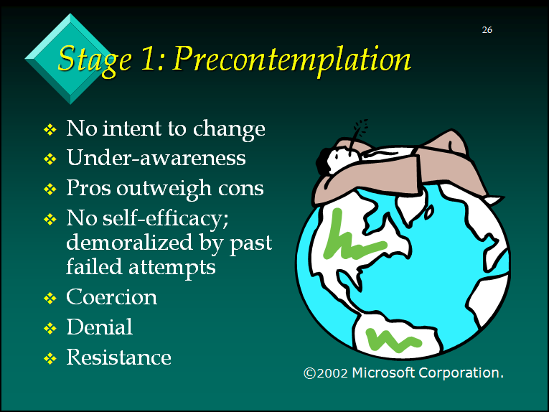

Slide 46
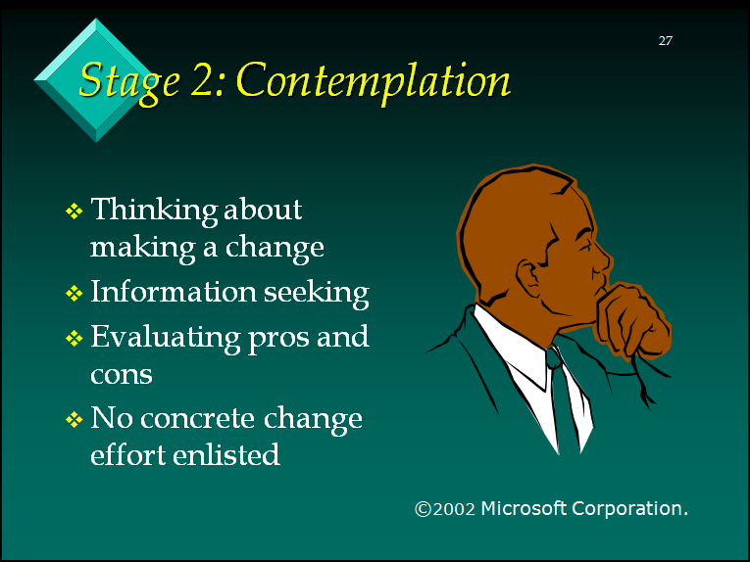

Slide 47
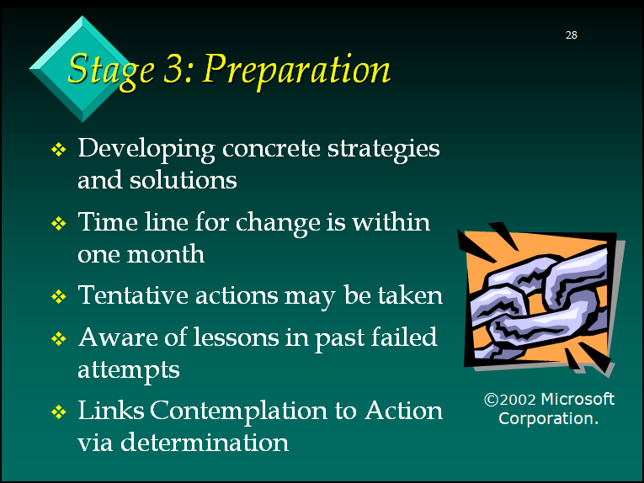

Slide 48
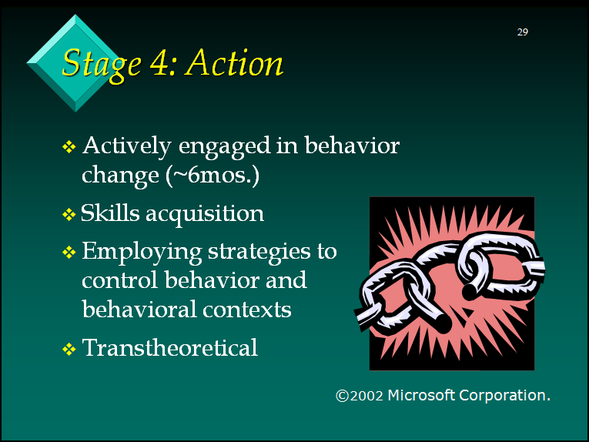

Slide 49
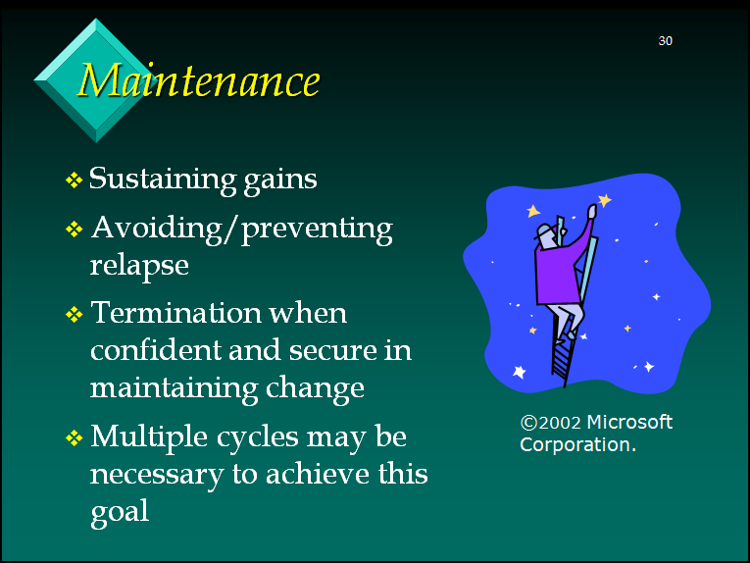

Slide 50
OTHER WAYS TO ASSESS MOTIVATION
Sl. No | Condition | Signs and symptoms
1. | POOR | Failure to perceive any problems with substance use Denying any substance-related functional impairment Refusing professional help
2. | SUPERFICIAL | Admits that there are substance problem but ascribes it to external or rationalizing internal problem
3. | FAIR/GOOD | Having an insight about the basic nature of the problem as 'dependence' and/or appreciating the extent and severity of substance related complications and ability to link them with substance as the causative factor, and/or feeling the need of treatment for the dependence itself.

Slide 51
LABORATORY ASSESSMENT
Breath alcohol concentration-Easy, non invasive method for quantifying alcohol concentration using breath analyser in end expiratory air.
Liver function test-commonly affected during heavy drinking and is a pertinent factor determining treatment options.
Mean Corpuscular Volume (MCV)-one of the indirect biomarker of alcohol use like liver function test and detects the effects of alcohol on organ system or body biochemistry.

Slide 52
ASSESSMENT OF ALCOHOL ABUSE
Sl. No. | QUESTIONNAIRE | Brief description
1. | AUDIT (Alcohol Use Disorders Identification Test) | Comprehensive 10 item brief screening instrument. Provides information on alcohol hazardous, harmful use, abuse and dependence.
2. | MAST (Michigan Alcoholism Screening Test) | 24 item screening instrument designed to identify and access alcohol abuse and dependence. Shortened 13 item and 10 item versions are available
3. | CAGE | 4 item screening instrument. Particularly useful in geriatric population and can be easily used in primary health settings
4. | SADQ – C (Severity of Alcohol Dependence Questionnaire) | 20 item scale designed to measure severity of alcohol dependence. Has five subscales

Slide 53
STAGES OF ASSESSMENT
Assessment is not a one time phenomenon. This is carried out at various stages.
Thus, the stages of assessment include
  a) Preintervention: where the purpose of assessment is to define the problem, formulate treatment, select an appropriate treatment from various modalities and motivate clients for treatment.
  b) Intervention: here assessment is done to monitor progress
  c) Post intervention: assess maintenance and abstinence status .

Slide 54
MANAGEMENT

Slide 55
GOALS OF MANAGEMENT
LONG TERM GOALS
1. Relapse Prevention
2. Maintain Abstinence
3.Occupational rehabilitation
4. Social reintegration
5. Improve Quality of Life
SHORT TERM GOALS
1. Manage Intoxication
2. Manage withdrawal
3. Motivation Enhancement
4. Treat acute medical sequel
5. Crisis Intervention

Slide 56
LEVELS OF MANAGEMENT
LEVEL 1
ACUTE INTOXICATION
OVERDOSE
LEVEL 2
BRIEF THERAPY
SHORT TERM PHARMACOTHERAPY
LEVEL 3
COMPLEX PSYCHOSOCIAL THERAPY
LONG TERM PHARMACAOTHERAPY
WITHDRAWAL
MONITORED FOLLOW UP

Slide 57
MANAGEMENT OF INTOXICATION
GOAL-To relieve patient's discomfort, and prevent the occurrence of more serious symptoms.
ASSESSMENT-Clinical Assessment which includes general assessment along with physical status, mental status, substance use history and associated consequences

Slide 58
MANAGEMENT OF INTOXICATION(contd.)
If breath analysers are available the BAC can be measured
Acute effects - generally subside with time and do not warrant any specific treatment
Pharmacological treatment – when presented with respiratory depression and recent use of other substance/s General measures like reassurance, and maintain in a safe and monitored environment to decrease external stimulation and to provide orientation as necessary
Maintain adequate hydration and nutrition
Monitor withdrawal state – past history of complicated withdrawal, and prolonged heavy drinking

Slide 59
MANAGEMENT OF WITHDRAWAL
SIMPLE WITHDRAWAL:
Starts after 6-48 hours after cessation or reduction in alcohol use
Symptoms suggestive of GI distress , anxiety, irritability, elevated blood pressure, tachycardia and autonomic hyperactivity
Symptoms intensify in initial period and diminish over 24-48 hours
Symptoms would be normally abating over duration of 5-7 days.

Slide 60
MANAGEMENT OF WITHDRAWAL(contd.)
COMPLICATED WITHDRAWAL
WITHDRAWAL SEIZURES (RUM FITS)
Starts within 12-72 hrs of cessation of prolonged ingestion of alcohol
mostly generalized tonic clonic seizure
majority (60%) have multiple seizure but only 3% progress to status epilepticus
Around 30-40% progress to DELIRIUM TREMENS

Slide 61
MANAGEMENT OF COMPLICATED WITHDRAWAL
ALCOHOL WITHDRAWAL SEIZURES
Benzodiazepines reduce withdrawal severity and the incidence of seizures and delirum
Both short acting (Lorazepam) and Long acting Benzodiazepines (Diazepam). Long acting Benzodiazepines are effective when compared to short acting Benzodiazepines
Carbamazepine (insufficient evidence)

Slide 62
MANAGEMENT OF DELIRIUM TREMENS
GENERAL MEASURES
In patient care for all patients
Maintain water and electrolyte balance
Correct metabolic disturbance, nutritional supplement
Close supervision
SPECIFIC MEASURES
Benzodiazepines(high dosage) are more effective than neuroleptics in reducing mortality in alcohol withdrawal delirium
-Lorazepam 2mg or Diazepam 10mg IV/IM.
-Repeated doses till symptoms clear,Doses should be tapered in 5-7days

Slide 63
TREATMENT GOALS FOR WITHDRAWAL STATE
To relieve patient's discomfort, prevent the occurrence of more serious symptoms, and forestall cumulative effects that might worsen future withdrawal.
To utilise the withdrawal treatment opportunity to engage patients in long-term management.

Slide 64
MANAGEMENT OF DEPENDENCE
Step 1) Detection of alcohol dependence
Step 2)Intervention
Step 3) Detoxification
(Or withdrawal from alcohol)
Step 4) Relapse prevention
(or maintenence of abstinence)
& Rehabilitation.

Slide 65
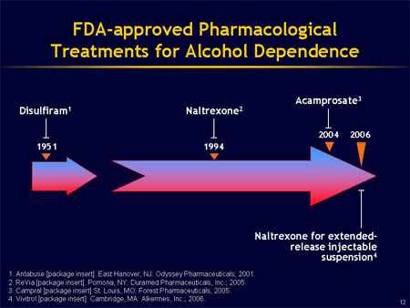
FDA APPROVED MEDICATIONS FOR THE TREATMENT OF ALCOHOL DEPENDENCE
Notes:
Currently, there are three oral medications and one injectable medication that are FDA approved for the treatment of alcohol dependence: disulfiram, naltrexone, and acamprosate are administered orally, and naltrexone for extended-release injectable suspension is administered intramuscularly. Disulfiram, which has been in use the longest of these agents, is an aversive medication that works by making the drinking of alcohol an unpleasant experience. Acamprosate, oral naltrexone, and extended-release naltrexone, in contrast, work on neurotransmitter systems involved in alcohol intake.

Slide 66
DETERRENTS
Role of Deterrents
  Produces unpleasant reaction with alcohol
  DISULFIRAM
    Inhibits enzyme aldehyde dehydrogenase
    Side effects – Drowsiness, GI irritation
    To be avoided in Pregnancy (Absolute C.I), Hepatic dysfunction, Peripheral neuropathy and Psychosis
    Dosing – 250mg/day (Usual dose), some patients may require – 500 – 750 mg/day
    Informed consent is required before treatment initiation
    Supervised treatment is better
    Good choice in motivated patients
    Duration of use – 1 year

Slide 67
ANTICRAVING AGENTS
Role of NALTREXONE
    US FDA approved for use in Alcohol dependence
    Opioid receptor (Mu) antagonist
    Reduces craving, reduces relapse, enhances abstinence
    Dosing – 50 mg/day
    Side effects- GI upset, Dizziness
    Can be combined with Acamprosate safely
    To be avoided in – Sev. Hepatic Dysfunction, Concomitant Opioid Intake
    Duration of use – 6 months

Slide 68
  ACAMPROSATE
    US FDA approved for treatment of Alcohol dependence
    Reduces craving, reduces number of drinks, enhances abstinence
    Dosing – 333mg 4 – 6 tabs /day in divided doses (<50kg – 2tabs BD, > 50 kg – 2tabs TDS)
    Hepatic & Cardiac impairment – No dose adjustment required
    Renal impairment - 333mg TDS (Mod. Impairment), Contraindicated – Sev. Impairment
    Side effects – G I upset, anxiety, depression (common); Suicidal ideation, Wt. gain, sedation (Rare)
    T _{½} : 20 – 33 hours
    Can be combined with Naltrexone (Combination may be more effective than monotherapy)
    Duration of use – 6 months

Slide 69
OTHER ANTICRAVING AGENTS
  SSRIs
    Reduces craving as found in some studies
    Fluoxetine, Sertraline & Escitalopram are most commonly studied
    Minimal efficacy of SSRIs in treating the core symptoms of Alc. Dependence
    Some evidences regarding its efficacy in treating co-morbid mood and anxiety symptoms
    Combination of SSRI + Naltrexone showed equivocal results

Slide 70
OTHER AGENTS IN USE:
Topiramate
Baclofen
Ondansetron
Nalmefene
Notes:
Ondansetron = Odep 4 mg tab, Inj.
Nalmefene =

Slide 71
How long should medications be maintained?
The risk for relapse to alcohol dependence is very high in the first 6 to 12 months after initiating abstinence and gradually diminishes over several years.
Therefore, a minimum initial period of 3 months of pharmacotherapy is recommended.
Although an optimal treatment duration hasn’t been established, it is reasonable to continue treatment for a year or longer if the patient responds to medication during this time when the risk of relapse is highest.
After patients discontinue medications, they may need to be followed more closely and have pharmacotherapy reinstated if relapse occurs.

Slide 72
PSYCHOTHERAPY
Structured specific therapies have better outcome compared to less defined supportive counselling
No particular psychotherapy has been found consistently to be better than others
GOALS:
Enhance efficacy of Pharmacotherapy
Achieving sustained drug free status
Change in life style
Improve quality of life

Slide 73
TYPES OF PSYCHOTHERAPY
MOTIVATION ENHANCEMENT THERAPY
BRIEF INTERVENTIONS
COGNITIVE BEHAVIOUR THERAPY
RELAPSE PREVENTION COUNSELLING
BEHAVIOURAL THERAPIES
GROUP THERAPIES
FAMILY THERAPY
SELF HELP GROUP APPROACH AND 12 STEP ORIENTED PROGRAMME

Slide 74
COMBINED PHARMACOLOGICAL AND NON PHARMACOLOGICAL APPROACH HAS BETTER EFFECTIVENESS
Several well conducted studies have consistently shown that utility of pharmacological therapies can be enhanced when combined with psychosocial interventions

Slide 75
SPECIAL POPULATION
PREGNANCY AND LACTATION
Adverse effect on mother, baby and course of pregnancy
Fetal alcohol spectrum disorder
Typical facies, growth and mental retardation
MANAGEMENT
Stop alcohol use
Treat medical and psychological co-morbidities
Monitor pregnancy closely
Non-pharmacological treatments should be treatment of choice
When needed drugs can be used after discussing about pros and cons and taking an
informed decisions and close monitoring of the pregnancy

Slide 76
YOUNG AGE GROUPS
Associated disorder: Conduct disorder, ADHD, Major Depression, Anxiety/ Bipolar disorder
MANAGEMENT
Young people with problems of alcohol use have shown that school based interventions, family based interventions and multipronged interventions have found to effective in medium and long term
Young children should also be assessed for psychiatric comorbidity and managed accordingly

Slide 77
CONCLUSION
Alcohol use disorders are a major health problem and its management calls for a concerted effort.
Assessment forms the cornerstone in diagnosis and management of substance use disorder.
Treatment for substance use disorder can be done in a variety of settings with a variety of clinical modalities.
A combination of pharmacological and non-pharmacological (psychosocial) interventions yields most favourable treatment outcome.
The treatment process is enhanced when clinicians match clinical interventions with patients’ motivation for change and other factors.

Slide 78

THANK YOU

