Slide 1
TIBIA
Dr. Untika Singh
Junior Resident
Department of Anatomy King George’s Medical University, UP, Lucknow

Slide 2
DISCLAIMER:
The presentation includes images which are taken from Google images or books.
They are being used in the presentation only for educational purpose.
The author of the presentation claims no personal ownership over images taken from books or Google images.

Slide 3
Learning Objectives
By the end of this teaching session on tibia, all the students must be able to correctly:-
Identify tibia.
Demonstrate the different parts, borders and surfaces of tibia.
Determine the side of the tibia
Hold the tibia in its anatomical position.
Demonstrate attachment of joint capsule ,ligaments and muscles on the tibia.
Demonstrate relations of muscles tendons ,arteries, nerves and veins on the tibia .
Describe ossification of the tibia.

Slide 4
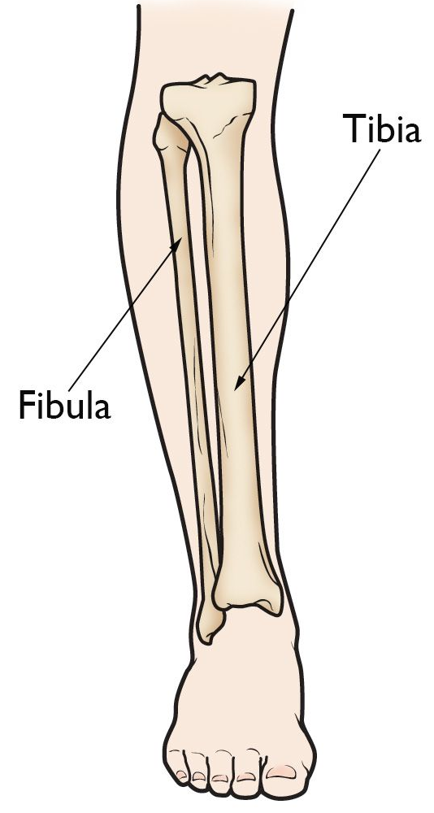
TIBIA
The tibia lies medially in the leg.
Is longer then fibula.
Is weight-bearing bone
Homologus-radius bone of upper limb.

Slide 5
FEATURES
A. Upper end contains-
Medial condyle
Lateral condyle
Intercondyler area
A tuberosity
1.Medial condyle-oval in shape and articulate with medial condyle of femur.
Central- concave surface: direct contact with femoral condyle
Peripheral-falt surface : separated from femoral condyle by meniscus.
posterior surface: have a groove.

Slide 6
Superior View

Slide 7
2.Lateral condyle-circular in shape and articulate with lateral condyle of femur.
Central- concave surface: direct contact with femoral condyle.
Peripheral-falt surface : separated from femoral condyle by meniscus.
Posteroinferiorly-have fibular facet.
Anterior aspect-have Gerdy’s tubercle.

Slide 9
3.Intercondyler area-narrowest in middle. This part elevated to form intercondyler eminence.
Superior View

Slide 10
4.Tuberosity of tibia-
Location: anterior aspect of upper end
Divided –upper smooth and lower rough area and epiphyseal line passes through its junction.

Slide 11
SHAFT
Borders and its shape
Extend of Borders
1.Anterior border:
Sharp, “S”shaped, subcutaneous
form the shin.
2.Medial border: is rounded
3.Interosseous/lateral border
Above -tibial tuberosity. Below- anterior border of medial malleolus.
Above- Medial condyle
Below posterior border of medial malleolus below.
Above- A little below and in-front of fibular facet.
Below-anterior border of fibular notch.

Slide 12
SURFACES
1.Lateral surface: lies between anterior and interosseous borders.
upper3/4th-concave,directed laterally.
lower1/4th-directed forward.
2.Medial surface: lies between anterior and medial borders and is subcutaneous.
3.Posterior surface: lies between medial and interosseous borders and upper part crossed by Soleal line.
Above soleal line-triangular area.
Below soleal line –elongated area;divided by vertical ridge into medial and lateral area

Slide 13
Lower end
1. anterior surface-have upper smooth part and lower rough, grooved part
2. medial surface-subcutaneous.
3.lateral surface-have triangular fibular notch
(articulate with fibula to form inferior tibiofibular joint).
4.Inferior surface-articulate with superior trochlear surface of talus (ankle joint).
5.Posterior surface.
Medial malleolus- short, strong process and sub-cutaneus.

Slide 14
Side determination:-
large expanded (condyler sufaces) upper end faces upward
Medial malleolus- on medial side
Anterior border(sharp,s shaped)-faces anteriorly.
Anatomical position:- Tibia is held vertically.

Slide 15
ATTACHMENTS
Surfaces & Borders of TIBIA | Muscles and Ligaments Attachments
Medial condyle | Capsular ligament of knee, medial patellar retinaculum semimembranosus.
Lateral condyle | Iliotibial tract, capsular ligament, tendon of popliteus.
Intercondyler area | Anterior horn of medial meniscus, anterior cruciate ligament, anterior horn of lateral meniscus, Posterior horn of medial meniscus, posterior horn of lateral meniscus posterior cruciate ligament,

Slide 17
Surfaces,borders of tibia | Muscles and ligaments
Tibial tuberosity | Ligamentum patellae:upper smooth part Subcutaneous :lower rough part.
Lateral surface | Tibialis anterior
Medial surface | Sartorious, Gracilis, Semitendinosus, tibial collateral ligament
Soleal line | Soleus muscle and fascia,fascia covering the popliteus

Slide 20
Surfaces and borders of tibia | Muscles and ligaments
Posterior surface | Popliteus, Flexor digitorum longus , Tibialis posterior
Anterior border | Deep fascia of leg, Superior extensor retinaculum
Fibular notch | Rough upper part-interrosseous ligament
Lower end | Capsular ligament of the ankle joint, Deltoid ligament

Slide 23
Relations of tibia
Lower part of Anterior surface of shaft and anterior surface of lower end(medial to lateral) crossed by: tibialis anterior, extensor hallucis longus ,anterior tibial artery, deep peroneal nerve, extensor digitorum longus and peroneus tertius.
Lower part of posterior surface of shaft and posterior surface of lower end(medial to lateral) crossed by: tibialis posterior, flexor digitorum longus ,posterior tibial artery, tibial nerve, and flexor hallucis longus.
Lower 1/3rd of medial surface of the shaft is crossed by:
great sephenous vein

Slide 24
OSSIFICATION
One primary and two secondary centers.
Primary centre ( in shaft) – 7th week of intrauterine life
1st Secondary centre (upper end)–apper apper at end of nine month(just before birth) fuses with shaft at 16-18 yrs.
2nd secondary centre (lower end)-apper at1st yrs of life it form medial malleolus by 7th yrsand fuses with shaft at 15-17 yrs.

Slide 25
Thank u…….

